Slide 1
Everyday note(build)
China Software Center

Slide 2
Contents
Sprizter BLE framework
Sprizter Serialization Codec
Sprizter Serialization Transport&PHY Layer
Sequence
Custom Profile
>> inroduction
http://www.tinylab.org/using-qemu-simulation-inserts-the-type-system-to-produce-the-whole-process/
>>http://www.linuxidc.com/Linux/2015-07/119764.htm

Slide 3
2017-02-28
1. will be a relief
2. assert
3 copy that
4. kilo-alpha
5. bravo
6. our window is closing, if we do it, do it now.

Slide 4
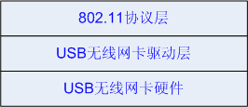
continued
Linux wifi diver

Slide 5
qemu compile
>>http://askubuntu.com/questions/424329/error-trying-to-compile-qemu-from-source
From the error:
ERROR: DTC (libfdt) not present. Your options:
(1) Preferred: Install the DTC (libfdt) devel package
(2) Fetch the DTC submodule, using:
git submodule update --init dtc
See item (2): use git submodule update --init dtc
Try get the qemu source code from the git:
# git clone git://git.qemu.org/qemu.git
# cd qemu
# git submodule init
# git submodule update --recursive
# git submodule status --recursive
65cc4d2748a2c2e6f27f1cf39e07a5dbabd80ebf dtc (v1.4.0)
87eea99e443b389c978cf37efc52788bf03a0ee0 pixman (pixman-0.32.6)
b4c93802a5b2c72f096649c497ec9ff5708e4456 roms/SLOF (qemu-slof-20141202-63-gb4c9380)
4e03af8ec2d497e725566a91fd5c19dd604c18a6 roms/ipxe (v1.0.0-2016-g4e03af8)
3caee1794ac3f742315823d8447d21f33ce019e9 roms/openbios (3caee17)
c559da7c8eec5e45ef1f67978827af6f0b9546f5 roms/openhackware (heads/master)
c87a92639b28ac42bc8f6c67443543b405dc479b roms/qemu-palcode (heads/master)
33fbe13a3e2a01e0ba1087a8feed801a0451db21 roms/seabios (rel-1.8.2)
23d474943dcd55d0550a3d20b3d30e9040a4f15b roms/sgabios (heads/master)
2072e7262965bb48d7fffb1e283101e6ed8b21a8 roms/u-boot (v2014.07-rc1-79-g2072e72)
19ea12c230ded95928ecaef0db47a82231c2e485 roms/vgabios (heads/master)
And after it you can call ./configure.
(qemu : https://github.com/qemu/qemu.git
Also compiled qemu with 3 steps.
./configure
make
sudo make install

Slide 6
Busybox arm qemu
http://www.cnblogs.com/asulove/p/6043975.html
卸载驱动出现：rmmod: can't change directory to '/lib/modules': No such file or directory
mkdir -p lib/modules/4.10.0-rc7+
cat etc/init.d/rcS
#!/bin/sh
mount -t proc none /proc
mount -t sysfs none /sys
/sbin/mdev -s
>> http://zhiyisun.github.io/2015/04/09/build-busybox-for-ARM-Qemu.html
Download busybox
git clone git://busybox.net/busybox.git
Configure busybox
make menuconfig
Change below settings:
Busybox Setting -> Build Options -> Build BusyBox as a static binary
Busybox Setting -> Build Options -> Cross Compiler Prefix // arm-linux-gnueabi-
Build busybox
make; make install
Create necessary directory in rootfs
cd _install
mkdir -p proc sys dev etc etc/init.d
cat << EOF > etc/init.d/rcS
#!/bin/sh
mount -t proc none /proc
mount -t sysfs none /sys
/sbin/mdev -s
EOF
chmod +x etc/init.d/rcS
find . | cpio -o --format=newc > ../../busybox.img
Run Qemu
qemu-system-arm -M vexpress-a9 -kernel zImage -initrd busybox.img -serial stdio -append "root=/dev/ram rdinit=/sbin/init console=ttyAMA0" -curses

Slide 7
Busybox arm qemu – ldd3 driver insmod
# To build modules outside of the kernel tree, we run "make"
# in the kernel source tree; the Makefile these then includes this
# Makefile once again.
# This conditional selects whether we are being included from the
# kernel Makefile or not.
ifeq ($(KERNELRELEASE),)
# Assume the source tree is where the running kernel was built
# You should set KERNELDIR in the environment if it's elsewhere
#KERNELDIR ?= /lib/modules/$(shell uname -r)/build
#KERNELDIR ?= /home/c_jiec/workspace/date_v118_pure_csrmesh201/qsdk/build_dir/target-mips_34kc_uClibc-1.0.14/linux-ar71xx_generic/linux-3.18.29
KERNELDIR ?= /home/c_jiec/tmp/linux_kernel_develop/stack_overflow/linux
# The current directory is passed to sub-makes as argument
PWD := $(shell pwd)
modules:
echo "kerneldir: $(KERNELDIR)"
echo "pwd: $(PWD)"
echo "kernelrelease: $(KERNELRELEASE)"
#$(MAKE) -C $(KERNELDIR) M=$(PWD) modules
$(MAKE) -C $(KERNELDIR) M=$(PWD) ARCH=arm CROSS_COMPILE=arm-linux-gnueabi- modules
modules_install:
$(MAKE) -C $(KERNELDIR) M=$(PWD) modules_install
clean:
rm -rf *.o *~ core .depend .*.cmd *.ko *.mod.c .tmp_versions
.PHONY: modules modules_install clean
else
# called from kernel build system: just declare what our modules are
#obj-m := hello.o hellop.o seq.o jit.o jiq.o sleepy.o complete.o \
# silly.o faulty.o kdatasize.o kdataalign.o
obj-m := hello.o complete.o
# echo "else kernelrelease: $(KERNELRELEASE)"
endif
/ # ls
bin dev lib proc sbin usr
cayenne etc linuxrc root sys
/ # ls cayenne/
hello.ko

Slide 8
qemu load image
./qemu/arm-softmmu/qemu-system-arm -M versatilepb -kernel ./linux/arch/arm/boot/zImage -nographic
audio: Could not init `oss' audio driver
Uncompressing Linux... done, booting the kernel.
Error: unrecognized/unsupported machine ID (r1 = 0x00000183).
Available machine support:
ID (hex) NAME
ffffffff Generic DT based system
ffffffff ARM-Versatile (Device Tree Support)
Please check your kernel config and/or bootloader.
../qemu/arm-softmmu/qemu-system-arm -M versatilepb -kernel ./arch/arm/boot/zImage -nographic -dtb arch/arm/boot/dts/versatile-pb.dtb -initrd ../rootfs.img.gz -append "root=/dev/ram0 initrd=/bin/sh"
Real:
./qemu/arm-softmmu/qemu-system-arm -M versatilepb -kernel ./linux/arch/arm/boot/zImage -nographic -dtb ./linux/arch/arm/boot/dts/versatile-pb.dtb -initrd busybox.img -append "root=/dev/ram rdinit=/sbin/init console=ttyAMA0"
http://blog.csdn.net/zhaixuebuluo/article/details/52860362
root@ubuntu:/home# qemu-system-arm -M vexpress-a9 -m 512M -kernel linux-4.4/arch/arm/boot/zImage -nographic -append "console=ttyAMA0"
(process:8559): GLib-WARNING **: /build/glib2.0-8EA4QF/glib2.0-2.48.1/./glib/gmem.c:483: custom memory allocation vtable not supported

Slide 9
qemu compile
>>http://askubuntu.com/questions/424329/error-trying-to-compile-qemu-from-source
From the error:
ERROR: DTC (libfdt) not present. Your options:
(1) Preferred: Install the DTC (libfdt) devel package
(2) Fetch the DTC submodule, using:
git submodule update --init dtc
See item (2): use git submodule update --init dtc
Try get the qemu source code from the git:
# git clone git://git.qemu.org/qemu.git
# cd qemu
# git submodule init
# git submodule update --recursive
# git submodule status --recursive
65cc4d2748a2c2e6f27f1cf39e07a5dbabd80ebf dtc (v1.4.0)
87eea99e443b389c978cf37efc52788bf03a0ee0 pixman (pixman-0.32.6)
b4c93802a5b2c72f096649c497ec9ff5708e4456 roms/SLOF (qemu-slof-20141202-63-gb4c9380)
4e03af8ec2d497e725566a91fd5c19dd604c18a6 roms/ipxe (v1.0.0-2016-g4e03af8)
3caee1794ac3f742315823d8447d21f33ce019e9 roms/openbios (3caee17)
c559da7c8eec5e45ef1f67978827af6f0b9546f5 roms/openhackware (heads/master)
c87a92639b28ac42bc8f6c67443543b405dc479b roms/qemu-palcode (heads/master)
33fbe13a3e2a01e0ba1087a8feed801a0451db21 roms/seabios (rel-1.8.2)
23d474943dcd55d0550a3d20b3d30e9040a4f15b roms/sgabios (heads/master)
2072e7262965bb48d7fffb1e283101e6ed8b21a8 roms/u-boot (v2014.07-rc1-79-g2072e72)
19ea12c230ded95928ecaef0db47a82231c2e485 roms/vgabios (heads/master)
And after it you can call ./configure.
(qemu : https://github.com/qemu/qemu.git
Also compiled qemu with 3 steps.
./configure
make
sudo make install

Slide 10
qemu compile
>>http://askubuntu.com/questions/424329/error-trying-to-compile-qemu-from-source
From the error:
ERROR: DTC (libfdt) not present. Your options:
(1) Preferred: Install the DTC (libfdt) devel package
(2) Fetch the DTC submodule, using:
git submodule update --init dtc
See item (2): use git submodule update --init dtc
Try get the qemu source code from the git:
# git clone git://git.qemu.org/qemu.git
# cd qemu
# git submodule init
# git submodule update --recursive
# git submodule status --recursive
65cc4d2748a2c2e6f27f1cf39e07a5dbabd80ebf dtc (v1.4.0)
87eea99e443b389c978cf37efc52788bf03a0ee0 pixman (pixman-0.32.6)
b4c93802a5b2c72f096649c497ec9ff5708e4456 roms/SLOF (qemu-slof-20141202-63-gb4c9380)
4e03af8ec2d497e725566a91fd5c19dd604c18a6 roms/ipxe (v1.0.0-2016-g4e03af8)
3caee1794ac3f742315823d8447d21f33ce019e9 roms/openbios (3caee17)
c559da7c8eec5e45ef1f67978827af6f0b9546f5 roms/openhackware (heads/master)
c87a92639b28ac42bc8f6c67443543b405dc479b roms/qemu-palcode (heads/master)
33fbe13a3e2a01e0ba1087a8feed801a0451db21 roms/seabios (rel-1.8.2)
23d474943dcd55d0550a3d20b3d30e9040a4f15b roms/sgabios (heads/master)
2072e7262965bb48d7fffb1e283101e6ed8b21a8 roms/u-boot (v2014.07-rc1-79-g2072e72)
19ea12c230ded95928ecaef0db47a82231c2e485 roms/vgabios (heads/master)
And after it you can call ./configure.
(qemu : https://github.com/qemu/qemu.git
Also compiled qemu with 3 steps.
./configure
make
sudo make install

Slide 11
User space
uboot
Hardware
task
Architecture
ARM
Opcode
Ahb
Apb
Find
Grep
Bash
Sed
Awk
Vm
Vim
Git disttribute
Make
Gdb
Compiler
Ld
google
kernel
Device tree
scheduler
Parser for binary opcode
ram
vfs
text
cpu
Data bus
stack
fork
mmu
heap
exec
Ro data
Usb contoller
Fifo
List
Stack
Queue
Tree
Hash
ROM
elf
bss
algorithm
Date STR
PL

Slide 12
objects
object
obit
sun
heat
earth
computer
light
man
eye
Neuron brain
New cortex
Con sci ous
ear
Peni virgin
dna
time

Slide 13
body
man
iuniverse →j
eye
Neuron brain
New cortex
Con sci ous
ear
Peni virgin
dna
Pre serve
Pre servation
Sur vivid machine
protein
build
23 a chromesomes
23 b chromesomes

Slide 14
brain
language
Paper pencil
tools
UML ppt visio
Vim find grep
Vim cscope
tools
A-Z aphabet
english
A e I o u
Find law
Maths law
packet
maths
Neoton calculation
DNA AGCT
Neuron brain
New cortex
Con sci ous
Symblic universe
← number and sharp
Geo axis y z.
Physics electron
PL
Asm c
energy
consous
lisp
Cirriut
algorithm
memory
UML
athletic
dream
calculate
see
geometry
Scire : to know
Sci ence

Slide 15
Makefile
顶层 Makefile
.config
内核配置文件
arch/$(ARCH)/Makefile
具体架构的 Makefile
scripts/Makefile.*
通用的规则等。面向所有的 Kbuild Makefiles。
kbuild Makefiles
内核源代码中大约有 500 个这样的文件
Kernel build systemn
make
vmlinux
image
.config
bzImage
Makefile
modules
Kbuild
menuconfig

Slide 16
sk_buff
Alloc
Free
Put
push
bus
Open
Read/recv
Write/send
driver
layers
device
Net driver
scheduler
socket
platform
Socket buffer
bus
sk_buff
probe
ARP
IP
wait_queue
device
driver
sk_buff
dev_queue_xmit
net_device
Reg
Unreg
net_reg
netif_rx
Task queue
net_device
Interrupt
Task
Lsit, net core struct
Kernel process
thread
context
context
add
net_dev_ops
xxx
Recv:1. Interrupt
2.polling
Send
Recv
Status
ioctl
hard_start_xmit
NET_RX_SOFTIRQ
xx_interrupt
xx_rx
xxx_ops
schedule_delayed_work
dm9000_start_xmit

Slide 17
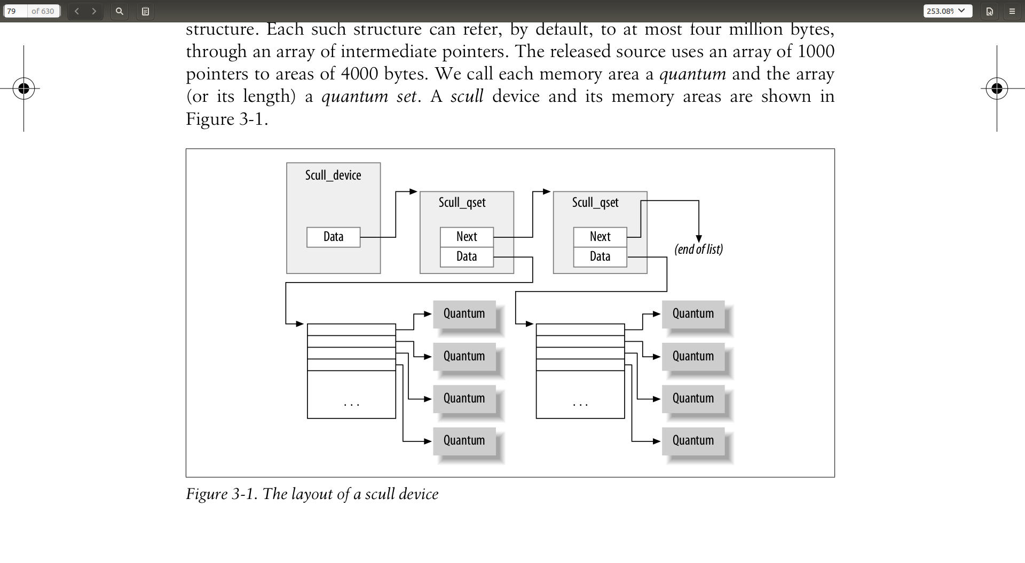

Slide 18
Instructions
Process steps capslate:
functions
Computer whole
f
RAM
data
OP+data
+-*/
Algorithm
Objects/ struct
data+functions
Layers
Don’t call me, I call you
OP+data
Binary
num
ALU
binary
&
|
^
schudler
GDB, ld, make
Add
Sub
MULti
jump
Task 0, init , kthreadd
Vim, git ppt
PUSH
SP
IP
app
POP
CALL
Eax ebx
Context switch
Sys call
ret
sk_buff
reti
Von neamman machine
instructions
Interrupt context switch
kernel
Functional
programming

Slide 19
interrupt
Synchron
exceptions
request
Async
Interrupt
hardware
Status reg
RAM
data
ALU
OP+data
Routine
do_irq
Jump
PUSH
POP
CALL
RETI
SP
IP
Eax ebx
Top half
Tasklet
Botton half
Work queue
kthread

Slide 20
Make vmlinux
Synchron
exceptions
request
Async
Interrupt
hardware
Status reg
RAM
data
ALU
OP+data
Routine
do_irq
Jump
PUSH
POP
CALL
RETI
SP
IP
Eax ebx
Top half
Tasklet
Botton half
Work queue
kthread

Slide 21
Load image
bootcmd
address
RAM
data
stack
env
heap
vmlinux
ALU
mmu
data
Ethernet
Nfs tftp
Bus
Sd
Nand falsh
text
SP
IP
uboot
Step stone
Eax ebx
kernel
fs
sdram

Slide 22
Execute image
Synchron
exceptions
request
Async
Interrupt
hardware
Status reg
RAM
data
ALU
OP+data
Routine
do_irq
Jump
PUSH
POP
CALL
RETI
SP
IP
Eax ebx
Top half
Tasklet
Botton half
Work queue
kthread

Slide 23
git
master
Git.mycompany.com
commit
commit
commit
clone
HEAD
fetch
Remote add
pull
push
origin/master
Checkout/rm
Work directory
stage
.git dir
commit
commit
commit
add
comit
Git core
merge
commit
commit
.git dir
commit
Branch
stash
tree
blob
master

Slide 24
Words
Synchron
exceptions
request
Async
Interrupt
hardware
current
Status reg
Cur->run
arbitrary
a person having complete control of something
RAM
data
arbiter
permanent
trivia
ALU
OP+data
Routine
do_irq
Jump
PUSH
POP
CALL
RETI
IP
Eax ebx
Botton half
Work queue
kthread

Slide 25
Object heritage directory and files
physics
force
computer
Computer _structure.pptx
electron
mental
entropy
dna
Eyes and ears
chemistry
cell
hands
brain
brains _structure.pptx
organ
sex
Mater energy
info_envolution.pptx
Presentation.pptx
info

Slide 26
Information presentation.pptx
screen
Console: keyborad
Letters and symbols
ALU
ALU
inputs
output
inputs
2D graphs
:penciels
Light reflections
3D videos
SP
IP
Eax ebx
Sound:mouse
Sounds:ear

Slide 27
Information presentation-- language
English lavels

Slide 28
Information presentation-- number relations
quatums

Slide 29
Information presentation-- xyz curves
Spaces forms

