Slide 1
Everyday note(build)
China Software Center

Slide 2
Contents
Sprizter BLE framework
Sprizter Serialization Codec
Sprizter Serialization Transport&PHY Layer
Sequence
Custom Profile
>> inroduction
http://www.tinylab.org/using-qemu-simulation-inserts-the-type-system-to-produce-the-whole-process/
>>http://www.linuxidc.com/Linux/2015-07/119764.htm

Slide 3
2017-02-28
1. will be a relief
2. assert
3 copy that
4. kilo-alpha
5. bravo
6. our window is closing, if we do it, do it now.

Slide 4
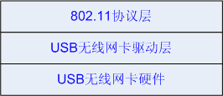
continued
Linux wifi diver

Slide 5
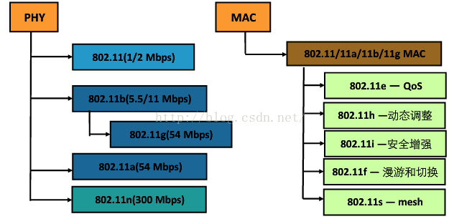
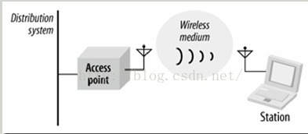
Wifi – basic knowledge
http://blog.csdn.net/zqixiao_09/article/details/51103615

Slide 6
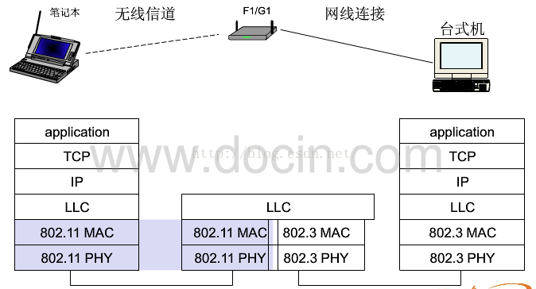
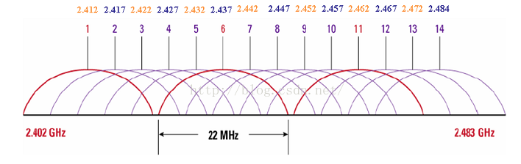
continued

Slide 7
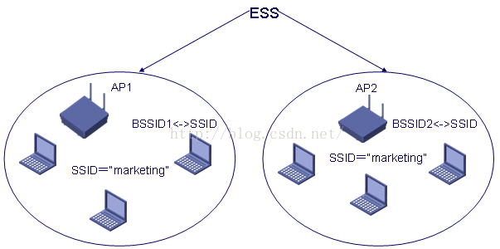
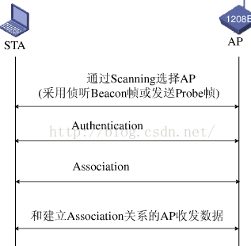
continued

Slide 8
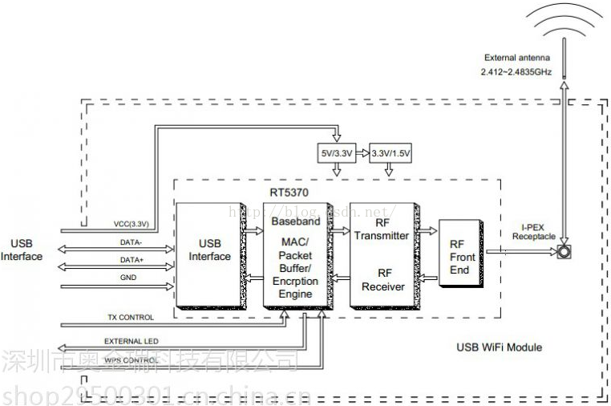
2. wifi - module

Slide 9
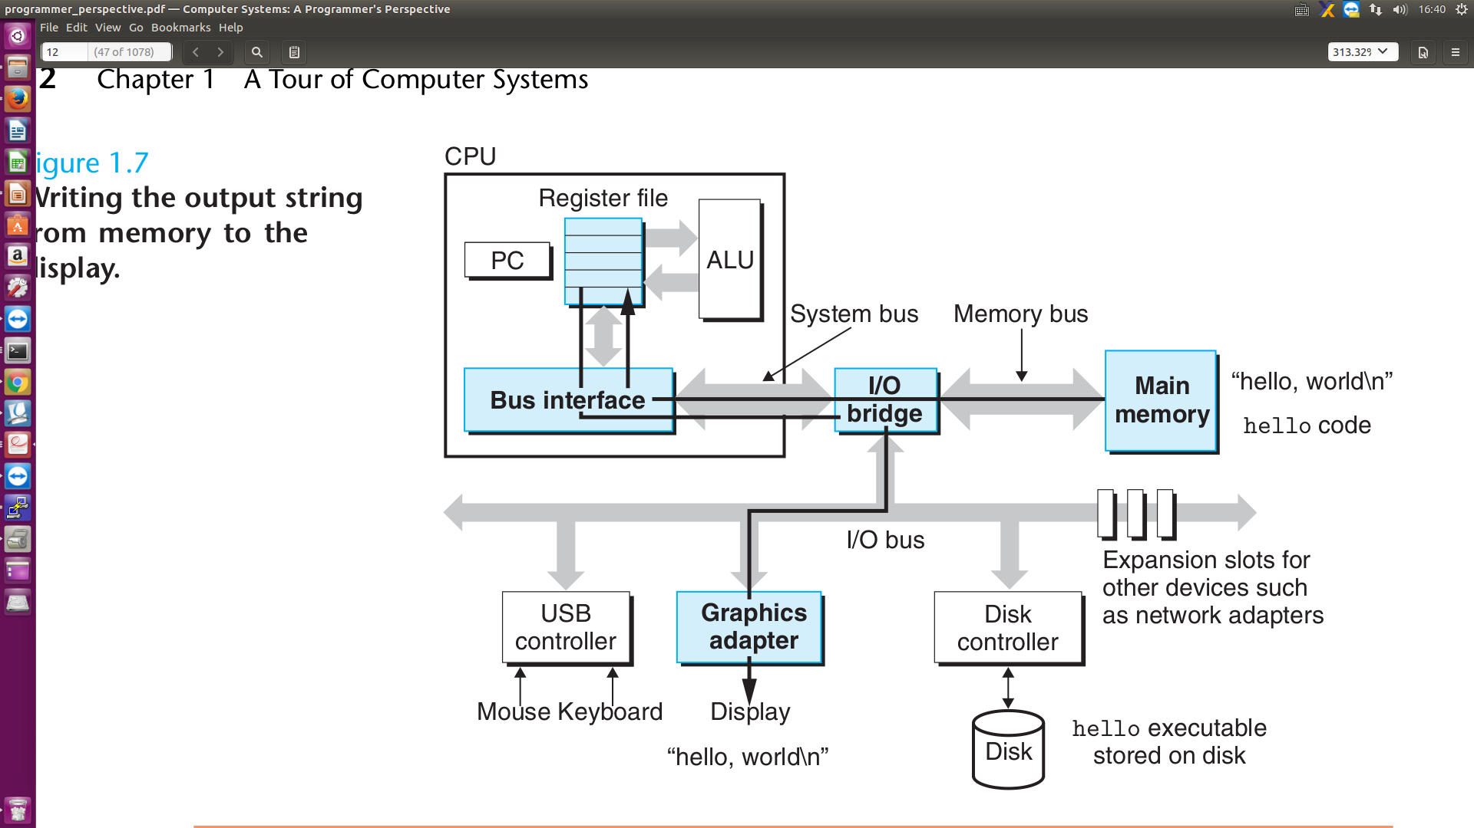
03_02 –2017 usb bus

Slide 10
03_02 –2017 kernel and userspace

Slide 11
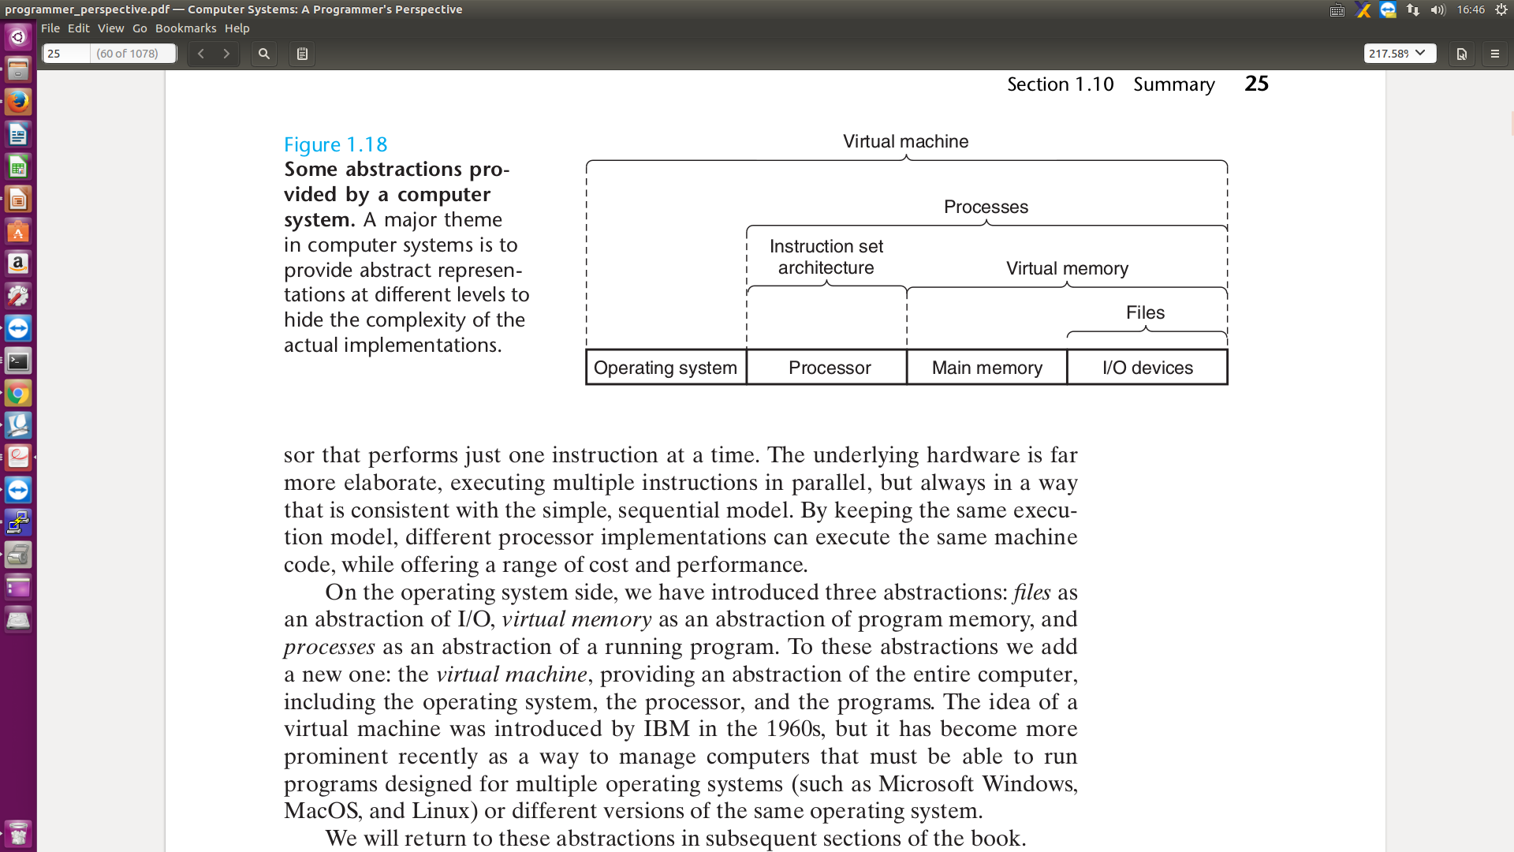
Virtual

Slide 12
User space
uboot
Hardware
task
Architecture
ARM
Opcode
Ahb
Apb
Find
Grep
Bash
Sed
Awk
Vm
Vim
Git disttribute
Make
Gdb
Compiler
Ld
google
kernel
Device tree
scheduler
Parser for binary opcode
ram
vfs
text
cpu
Data bus
stack
fork
mmu
heap
exec
Ro data
Usb contoller
Fifo
List
Stack
Queue
Tree
Hash
ROM
elf
bss
algorithm
Date STR
PL

Slide 13
objects
object
obit
sun
heat
earth
computer
light
man
eye
Neuron brain
New cortex
Con sci ous
ear
Peni virgin
dna
time

Slide 14
body
man
iuniverse →j
eye
Neuron brain
New cortex
Con sci ous
ear
Peni virgin
dna
Pre serve
Pre servation
Sur vivid machine
protein
build
23 a chromesomes
23 b chromesomes

Slide 15
brain
language
Paper pencil
tools
UML ppt visio
Vim find grep
Vim cscope
tools
A-Z aphabet
english
A e I o u
Find law
Maths law
packet
maths
Neoton calculation
DNA AGCT
Neuron brain
New cortex
Con sci ous
Symblic universe
← number and sharp
Geo axis y z.
Physics electron
PL
Asm c
energy
consous
lisp
Cirriut
algorithm
memory
UML
athletic
dream
calculate
see
geometry
Scire : to know
Sci ence

Slide 16
Makefile
顶层 Makefile
.config
内核配置文件
arch/$(ARCH)/Makefile
具体架构的 Makefile
scripts/Makefile.*
通用的规则等。面向所有的 Kbuild Makefiles。
kbuild Makefiles
内核源代码中大约有 500 个这样的文件
Kernel build systemn
make
vmlinux
image
.config
bzImage
Makefile
modules
Kbuild
menuconfig

Slide 17
sk_buff
Alloc
Free
Put
push
bus
Open
Read/recv
Write/send
driver
layers
device
Net driver
scheduler
socket
platform
Socket buffer
bus
sk_buff
probe
ARP
IP
wait_queue
device
driver
sk_buff
dev_queue_xmit
net_device
Reg
Unreg
net_reg
netif_rx
Task queue
net_device
Interrupt
Task
Lsit, net core struct
Kernel process
thread
context
context
add
net_dev_ops
xxx
Recv:1. Interrupt
2.polling
Send
Recv
Status
ioctl
hard_start_xmit
NET_RX_SOFTIRQ
xx_interrupt
xx_rx
xxx_ops
schedule_delayed_work
dm9000_start_xmit

Slide 18
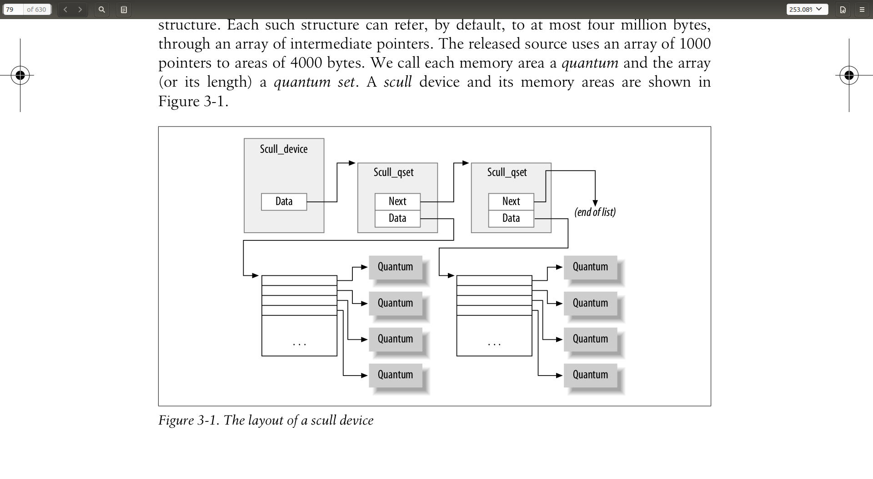

Slide 19
Instructions
Process steps capslate:
functions
Computer whole
f
RAM
data
OP+data
+-*/
Algorithm
Objects/ struct
data+functions
Layers
Don’t call me, I call you
OP+data
Binary
num
ALU
binary
&
|
^
schudler
GDB, ld, make
Add
Sub
MULti
jump
Task 0, init , kthreadd
Vim, git ppt
PUSH
SP
IP
app
POP
CALL
Eax ebx
Context switch
Sys call
ret
sk_buff
reti
Von neamman machine
instructions
Interrupt context switch
kernel
Functional
programming

Slide 20
interrupt
Synchron
exceptions
request
Async
Interrupt
hardware
Status reg
RAM
data
ALU
OP+data
Routine
do_irq
Jump
PUSH
POP
CALL
RETI
SP
IP
Eax ebx
Top half
Tasklet
Botton half
Work queue
kthread

Slide 21
Make vmlinux
Synchron
exceptions
request
Async
Interrupt
hardware
Status reg
RAM
data
ALU
OP+data
Routine
do_irq
Jump
PUSH
POP
CALL
RETI
SP
IP
Eax ebx
Top half
Tasklet
Botton half
Work queue
kthread

Slide 22
Load image
bootcmd
address
RAM
data
stack
env
heap
vmlinux
ALU
mmu
data
Ethernet
Nfs tftp
Bus
Sd
Nand falsh
text
SP
IP
uboot
Step stone
Eax ebx
kernel
fs
sdram

Slide 23
Execute image
Synchron
exceptions
request
Async
Interrupt
hardware
Status reg
RAM
data
ALU
OP+data
Routine
do_irq
Jump
PUSH
POP
CALL
RETI
SP
IP
Eax ebx
Top half
Tasklet
Botton half
Work queue
kthread

Slide 24
git
master
Git.mycompany.com
commit
commit
commit
clone
HEAD
fetch
Remote add
pull
push
origin/master
Checkout/rm
Work directory
stage
.git dir
commit
commit
commit
add
comit
Git core
merge
commit
commit
.git dir
commit
Branch
stash
tree
blob
master

Slide 25
Words
Synchron
exceptions
request
Async
Interrupt
hardware
current
Status reg
Cur->run
arbitrary
a person having complete control of something
RAM
data
arbiter
permanent
trivia
ALU
OP+data
Routine
do_irq
Jump
PUSH
POP
CALL
RETI
IP
Eax ebx
Botton half
Work queue
kthread

Slide 26
Object heritage directory and files
physics
force
computer
Computer _structure.pptx
electron
mental
entropy
dna
Eyes and ears
chemistry
cell
hands
brain
brains _structure.pptx
organ
sex
Mater energy
info_envolution.pptx
Presentation.pptx
info

Slide 27
Information presentation.pptx
screen
Console: keyborad
Letters and symbols
ALU
ALU
inputs
output
inputs
2D graphs
:penciels
Light reflections
3D videos
SP
IP
Eax ebx
Sound:mouse
Sounds:ear

Slide 28
Information presentation-- language
English lavels

Slide 29
Information presentation-- number relations
quatums

Slide 30
Information presentation-- xyz curves
Spaces forms

