Slide 1
Spritzer BLE design & architecture (draft)
China Software Center

Slide 2
Contents
Sprizter BLE framework
Sprizter Serialization Codec
Sprizter Serialization Transport&PHY Layer
Sequence
Custom Profile

Slide 3
Packet Encoding Format
Packet Type
Packet
Vender Provided
Codec packet Format
1 byte
0x00: Command
0x01: Command Response
0x02: DTM Command
0x03: DTM Command Response
Variable length
Example: SoftDevice API: BLE_GapSetAddress
Packet Type:
0x00
Packet
1 byte
10bytes
Operation code
Address cycle mode
Field present
Address
1 byte
1 byte
1 byte
7 bytes
Type
Address
1 byte
6 bytes

Slide 4
Commands and responses
sync call
Spritzer
Nordic Codec
Nordic SoftDevice
return
Command
execution
Command /
DTM command
Function call
Wait
Vender Provided
Commands &
Responses
SoftDevice response
Command Response /
DTM command response

Slide 5
Custom Profile
Legend
Vendor provided
(Sample) Application
Sample Data Profile
CSC implement
Stub
Sample Data Service
BLE stub
Led Characteristic
Generated
Attribute DB
GATT
based
Profile
Spritzer
Custom
Profile
Button Characteristic
Spritzer SDK
GATT
based
Profile
UART
driver
UART
driver
Bluetooth
Core Stack
UART
Hardware
Hardware
Spritzer Custom Profile: Sample Data Profile

Slide 6
Sample Data Service Structure
led Characteristic
Value
Type
Properties
Permission
led
Uint8
Read
Write
Read
Write
SDS Service
button Characteristic
Value
Type
Properties
Permission
button
Uint8
Read
Notify
Read

Slide 7
Sample Data Service Structure --UUID
Sample Data Service
BASE UUID
0xFFEE0000-0011-2233-4455-66778899AABB
UUID alias
Service: 0x0000
Led characteristic: 0x0001
button characteristic: 0x0002
Description | UUID | Properties
SDS service | 0xFFEE0000-0011-2233-4455-66778899AABB
led characteristic | 0xFFEE0001-0011-2233-4455-66778899AABB | Read,Write
button characteristic | 0xFFEE0002-0011-2233-4455-66778899AABB | Read,Notify

Slide 8
Read characteristic sequence
Spritzer
Module
Application
GPIO driver
Wrapper
Nordic
Central
Nordic
nRF51
Attribute
Table
Central role
device
Read Procedure
sync call
Application
Don’t need to handle read characteristic directly
Without Authorization
async call
return
serialization
PHY channel

Slide 9
Notify sequence
Spritzer
Module
Application
GPIO driver
Wrapper
Nordic
Central
Nordic
nRF51
BUTTON_CHANGE
Central role
device
BLE_GattsHandleValueNfyInd (…)
sync call
serialization
async call
return
serialization
Notify Procedure
PHY channel

Slide 10
GATT client database discovery
Spritzer
Module
Application
Wrapper
SoftDevice API
SoftDevice
Peripheral
Nordic
nRF51
BLE_GattcStartDbDiscovery(…)
Softdevice API
serialization
sd_ble_gattc_primary_services_discover(…)
[LOOP]
Peripheral role
device
sync call
SERVICE_RSP
async call
sd_ble_gattc_characteristics_discover (…)
Softdevice API
serialization
return
serialization
CHARACTERISITC_RSP
Adv packet on PHY channel
sd_ble_gattc_descriptors_discover(…)
Softdevice API
serialization
DESCRIPTOR_RSP
BLE_GATTC_EVENT_DBDISCOVERY

Slide 11
Msg queue
Share mem
semaphore
Write characteristic sequence
Spritzer
Module
AT&T
Application
GPIO driver
Wrapper
Central
Linux IPC
Unix ipc
Syetem V IPC
BLE_CommonSetBleEvtCallback(…)
Nordic
nRF51
Write Procedure
Central role
device
BSD
sync call
serialization
Socket IPC
async call
BLE_GATTS_EVENT_WRITE
return
Posix IPC
serialization
sigaction
BLE_WriteLed(…)
PHY channel
PIPE
Named pipe
FIFO
signal
IPCS cmd
userspace
Kernel sp

Slide 12
Iuniverse begin
Liberary

Slide 13
Msg queue
Share mem
semaphore
AT&T
Linux IPC
Unix ipc
Syetem V IPC
BSD
Socket IPC
Posix IPC
sigaction
PIPE
Named pipe
FIFO
signal
IPCS cmd

Slide 14
Bluetooth LE single Mode
Bluetooth
BR/EDR
Bluetooth
Dual Mode
IPCS cmd
General
Attribute
Profile
Serial Port
Profile
IPCS cmd
Serial Port
Profile
General
Attribute
Profile
Rfcomm
Protocols
Attribute
Protocol
Rfcomm
Protocols
Attribute
Protocol
L2CAP
L2CAP
L2CAP
Link
Manager
Link
Manager
Link
layer
Link
layer
Basic Rate
RF
Low energy
RF
Basic Rate +Low energy
RF
sigaction
PIPE
Named pipe
FIFO
signal

Slide 15
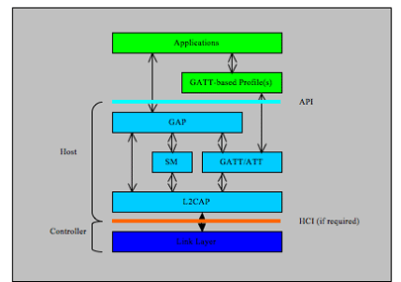
Bluetooth LE single Mode
General
Attribute
Profile
Attribute
Protocol
L2CAP
Link
layer
Low energy
RF
sigaction
PIPE
Named pipe
FIFO
signal

Slide 16
User space
uboot
Hardware
task
Architecture
ARM
Opcode
Ahb
Apb
Find
Grep
Bash
Sed
Awk
Vm
Vim
Git disttribute
Make
Gdb
Compiler
Ld
google
kernel
Device tree
scheduler
Parser for binary opcode
ram
vfs
text
cpu
Data bus
stack
fork
mmu
heap
exec
Ro data
Usb contoller
Fifo
List
Stack
Queue
Tree
Hash
ROM
elf
bss
algorithm
Date STR
PL

Slide 17
Driver module
bus
app
driver
vfs
device
File
Inode
Dentry
bus
Char
Register
Add
Start
fops
device
driver

Slide 18
Receive buffer
object
language
Paper pencil
tools
computer
AI
tools
UML ppt visio
Vim find grep
Vim cscope
A-Z aphabet
english
A e I o u
grammar
man
create
discovery
Find law
packet
eye
Maths law
Symblic universe
Maths pattern
ear
Neuron brain
New cortex
Con sci ous
← number and sharp
Geo axis y z.
Peni virgin
Physics electron
iuniverse →j
PL
Asm c
Cirriut
lisp
dna
algorithm
UML
geometry
DNA AGCT
Imagination
Forget curve line
obit
brain
sun
heat
Maxwell
light
embryonic
Physics electron
Elec
Magenta formula
Scire : to know
Sci ence
protein
Pre serve
Pre servation
Sur vivid machine
build
23 a chromesomes
23 b chromesomes

Slide 19
Objects dir
/nature
chemistry
cell
Atom
Time
Space
Gravity
Ralativity
Light
force
bus
computer
Hardware
softeware
Os
Algrithm
Data St
PL
body
myself
exec
neuron
brain
english
Manths xyfz

Slide 20
object
language
Paper pencil
obit
computer
tools
UML ppt visio
Vim find grep
Vim cscope
Neoton calculation
sun
heat
Serialized large packet sent from Host
light
Receive buffer
← number and sharp
Geo axis y z.
Cirriut
PL
maths
Find law
Physics electron
Maths law
geometry
man
Symblic universe
eye
law
A fire upon deep
ear
Neuron brain
The grand design
What is life ? Quota schdingor
Peni virgin
iuniverse →j
dna
Enst kaser renlun

Slide 21
raw
search
Note draw
Find law
Paper pencil
web
ppt
Host I/F
(SPI)
Could fix
improve
book
Sensors eys ears
brain
Git historycal
Save log data
Save log data
eye
Flash
github
Distribute store
Spritzer Standalone system
Spritzer Standalone system

Slide 22
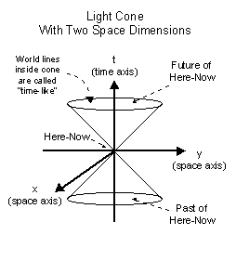
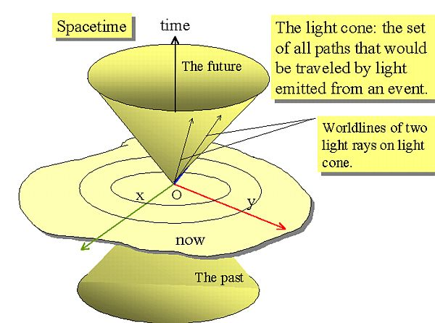
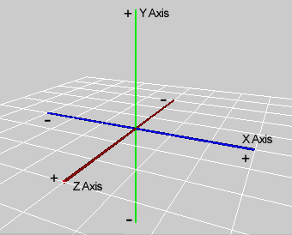
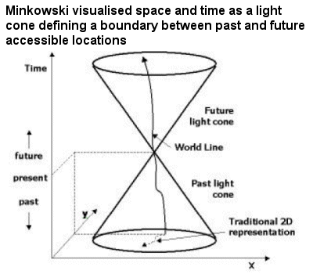
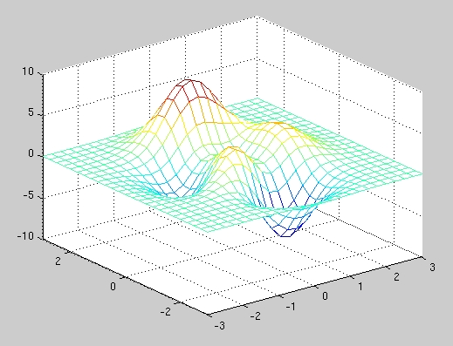
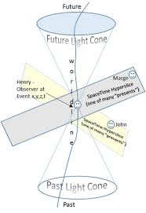
WORD
prefix
root
suffix
F ,func, force
x
F ,func, force
Y
Z
Sentence
paragraph
artical
1, See:
2, Voice read:

