Slide 1

Setting up for the course Python 3.4+
Installing:
Windows
Download and execute .exe file
https://www.python.org/downloads/
Linux
sudo apt-get install python3
Mac
Download and install
https://www.python.org/downloads/
Clone / download
https://github.com/spartam/basic_python_course

Slide 2
Python
Or at least your introduction to

Slide 3
Who Am I ?
Master student Computer Science: WISE
Active member of InfoGroep
Python self taught
Three years experience

Slide 4
Who are you?
Field of study
Programming experience

Slide 5

What are we going to see?
Installing and importing modules
Functions and Control flow
Data Structures
Slicing
Classes
Modules
Decorators

Slide 6
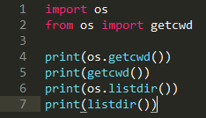
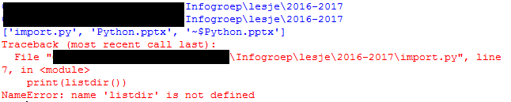
Installing and importing modules
pip (python installs packages)
Package manager for python modules
pip install <package name>
Virtual environment is recommended

Slide 7
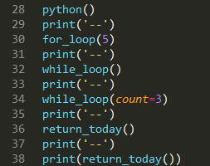
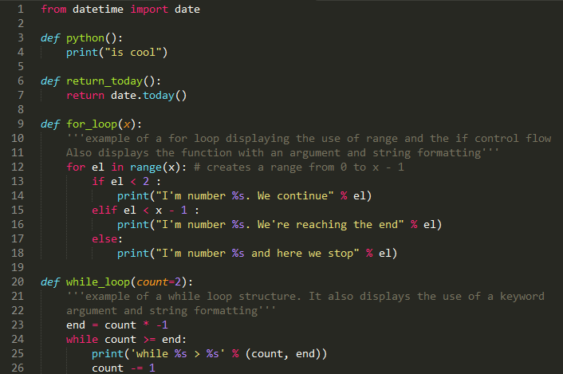
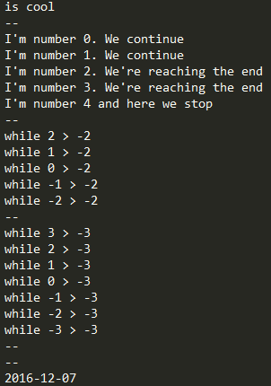
Functions and Control flow

Slide 8

Functions and Control flow
Exercises
Create factorial
Hint: range(y, x)
Create a function triplets
Given a number X loops over every number from 0 to X
Prints the number if it’s dividable by 3
Use the function “divideable_by” from the file “auxilary_functions”
DO NOT COPY THE CODE! Use import!

Slide 9
Data Structures
Dictionaries
Lists
Sets
Tuples

Slide 10


Data Structures
Dictionaries
Key – value pairs
Dict.update(dict)
Dict[key] returns or sets value
Dictionary comprehension
Dict.keys()

Slide 11

Data Structures
List
Append
List[index] returns or sets value
List comprehension
Can be used as stack
List.push
List.pop
Slicing
in operator

Slide 12

Data Structures
Sets
Only unique values
Set.add
No indexing
Pop
Iterate over every element
Mathematical operations
A – B : Every element in A which is not in B
A | B : Every element in either A or B
A & B : Every element in both A and B
A ^ B : Every element in A or B but not both
in operator

Slide 13
Data Structures
Tuples
Immutable
in operator

Slide 14


Data Structures
Comprehension

Slide 15
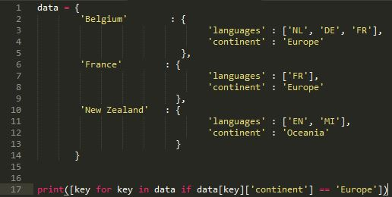
Data Structures
Comprehension exercise
Create a list containing all countries where English is an official language
Create a set containing all continents

Slide 16




Slicing
Works for
Lists
Strings
No assignment

Slide 17
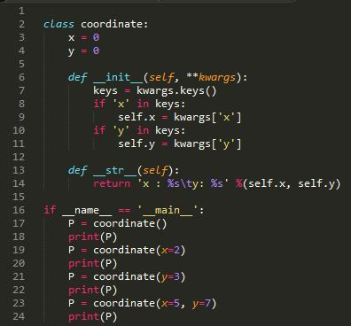

Classes
Exercise
Extend the class with __eq__

Slide 18
Modules
To import from a directory
__init__.py
From <directory> import *
__all__ = [list of files in directory]

Slide 19
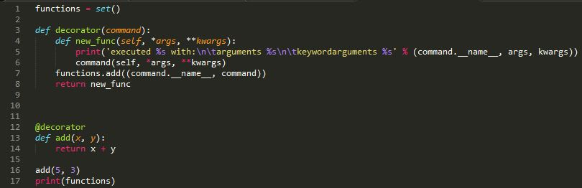

Decorators

