Slide 1
Football Manager
Arpan Venugopal

Slide 2
Highlights
Sprint Accomplishments
Set up AWS EC2 , S3 and RDS instances.
EDA, Data visualizations, data pre-processing and feature engineering
Reproducible project workflow

Slide 3
Review Progress
Data.Data Collection (2) - Data collected from kaggle.
Data.Data Exploration (4) - Preliminary EDA Analysis done
Data.Data Ingestion (1) - Data uploaded to s3 bucket. RDS used to save user inputs for the app.
Data.Feature Engineering (8) - New features created from data
Model.Baseline model (3) - Baseline Linear Regression model built for benchmark.
Model.Model Iteration & Validation (8) - Planned Not Done

Slide 4
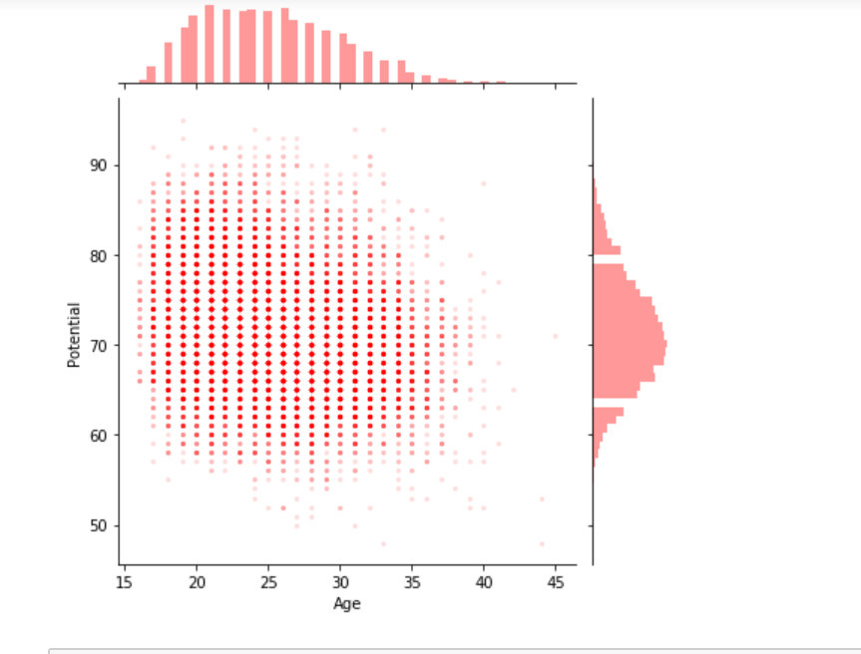
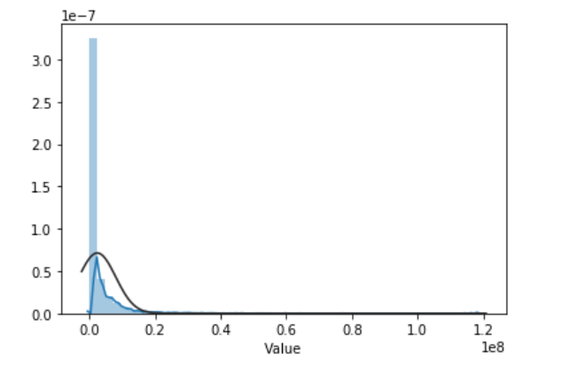
Analysis (EDA.ipynb)
Data Cleaning, Missing Value imputation done.Insights from EDA used for feature engineering and transformation of response variable

Slide 5
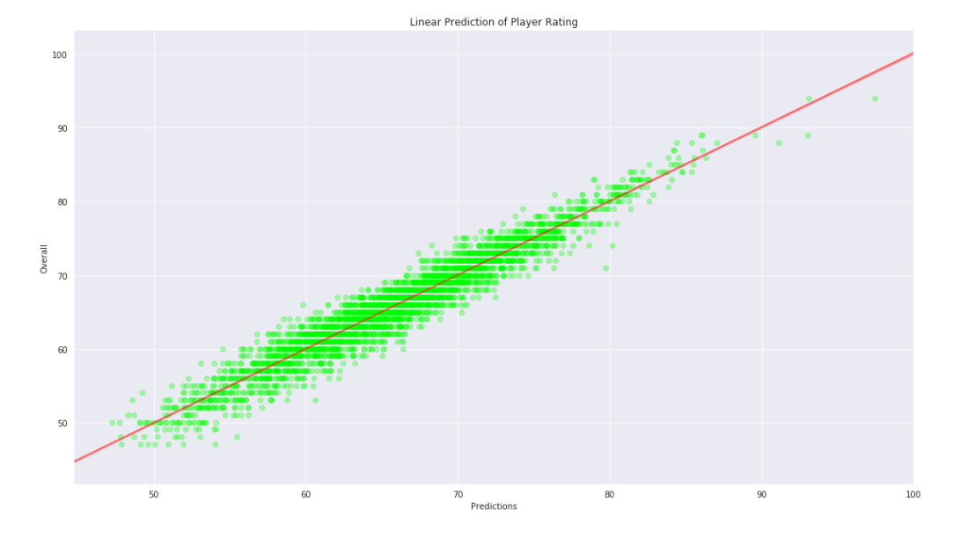
Lessons learned
In terms of model building, found that certain features are heavily correlated and there are outliers which will have to be treated to improve model performance.
Benchmark model has an R2 of 80%. Potential to improve using other regression techniques
Usage of environments for reproduciblity
Understood the usage of config files, yaml and logging

Slide 6
Recommendations
For the next sprint, stories planned in the initial charter will be pursued along with the one pending story.
1. Model.Model Iteration & Validation (8) -( Pending from Sprint 1)
2. Model.Save model (2)
3. Application.Deployment (8)
4. Application.BasicFrontEnd (4)
5. Application.Create test cases (2)
6. Application.Testing (8)

