Slide 1
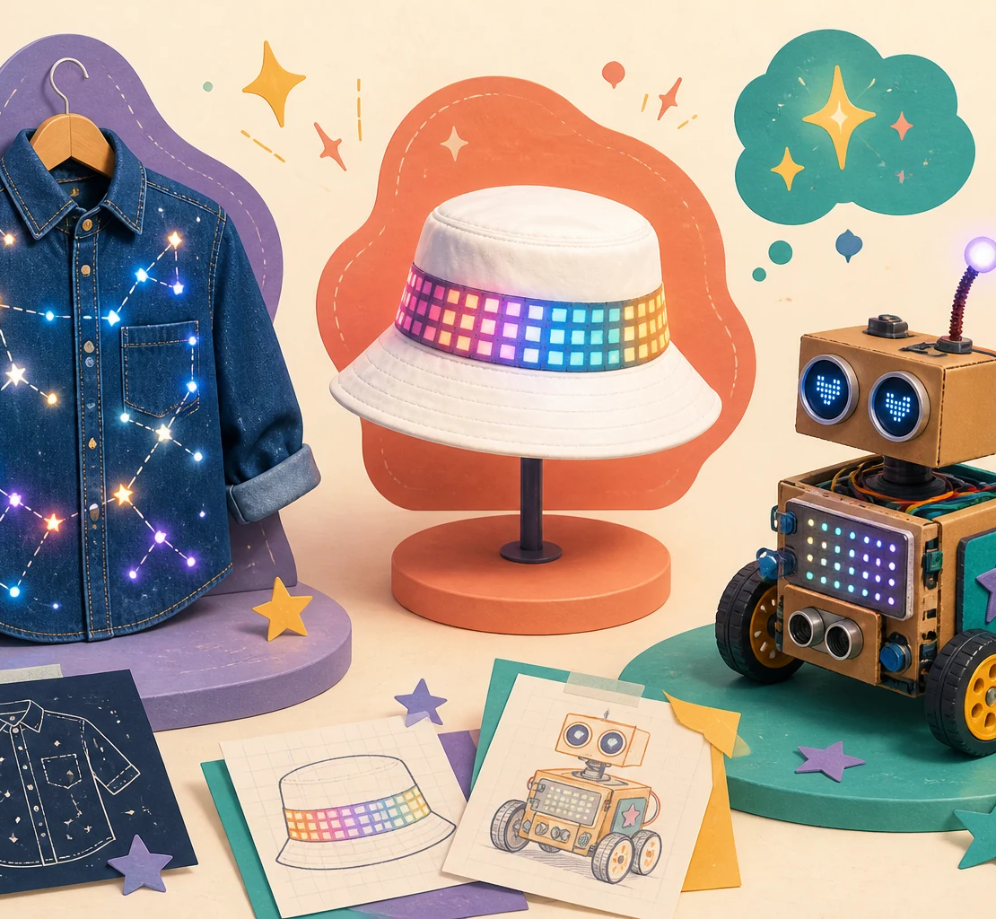
STAUFFER FEMINEERS
LIMITLESS:
DESIGNED BY HER
Imagine it.
Build it.
Become it.

Slide 2
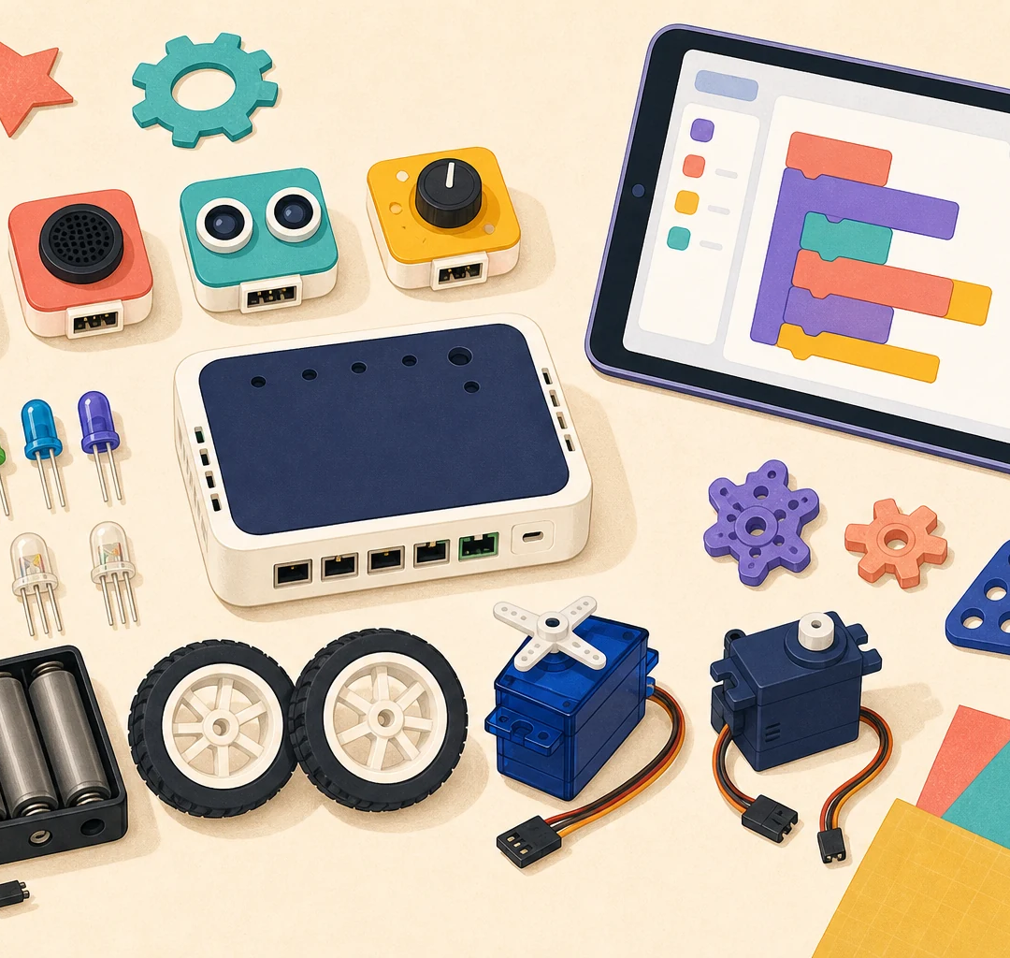
1ST YEAR • TEAM OF TWO
CREATIVE
ROBOTICS
Build an interactive invention with sensors, lights, movement, craft materials, and code.

Slide 3
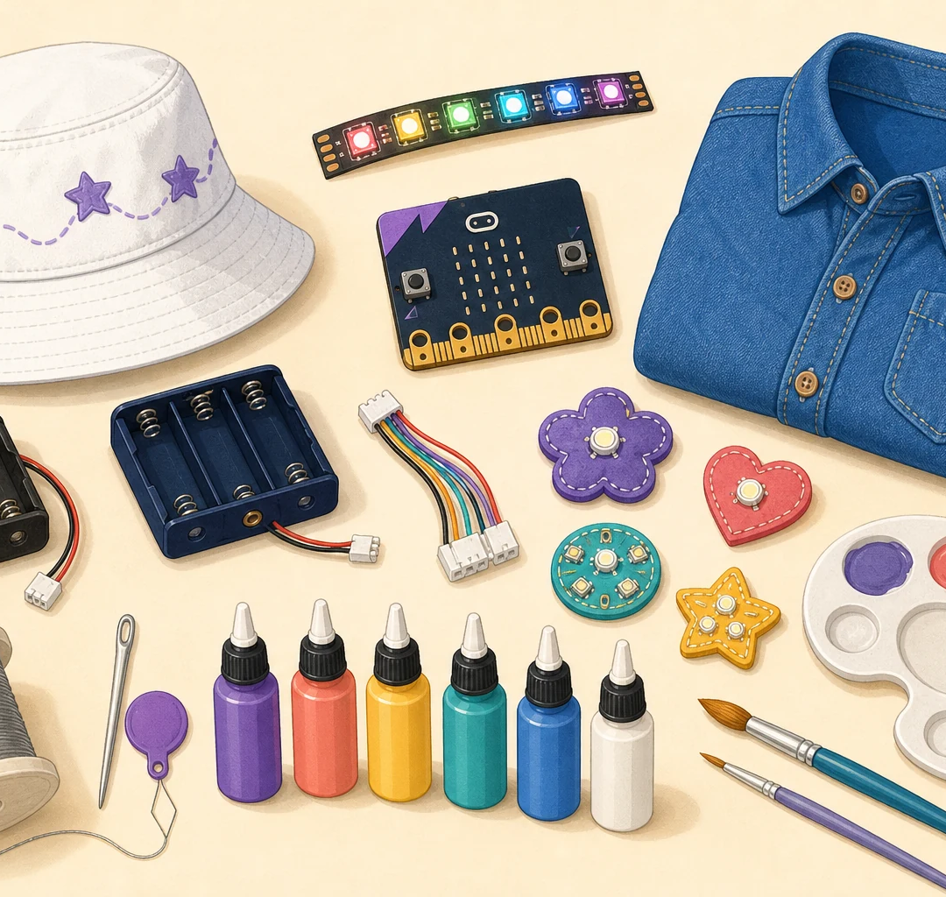
2ND YEAR • INDIVIDUAL
WEARABLE
TECHNOLOGY
Create a glowing denim shirt and programmable pixel hat with a micro:bit.
3RD YEAR: CHOOSE EITHER PATHWAY

Slide 4
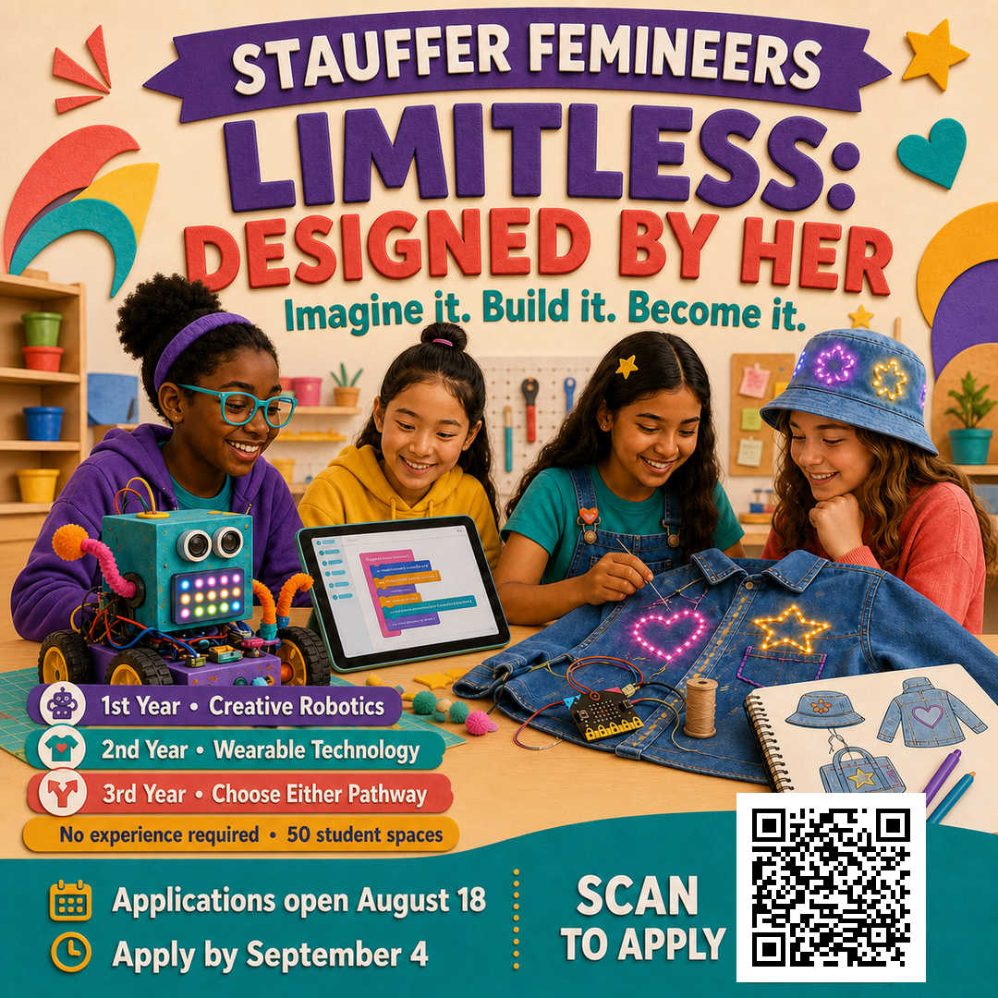
YOU BELONG
IN THE BUILD.
No experience required.
50 student spaces
Bring your curiosity.
We will help with the rest.

Slide 5
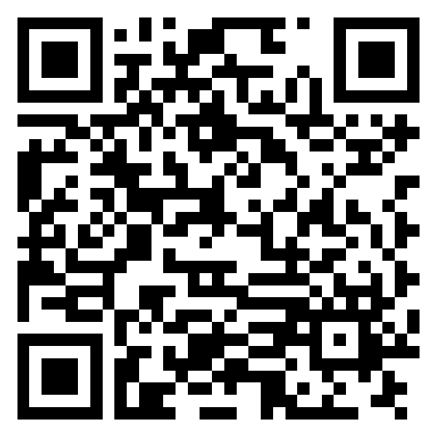
STAUFFER FEMINEERS
YOUR FUTURE
STARTS HERE.
Applications open August 18
APPLY BY SEPTEMBER 4
SCAN TO EXPLORE
AND APPLY
spartandesign.github.io/stauffer-femineers

