Slide 1
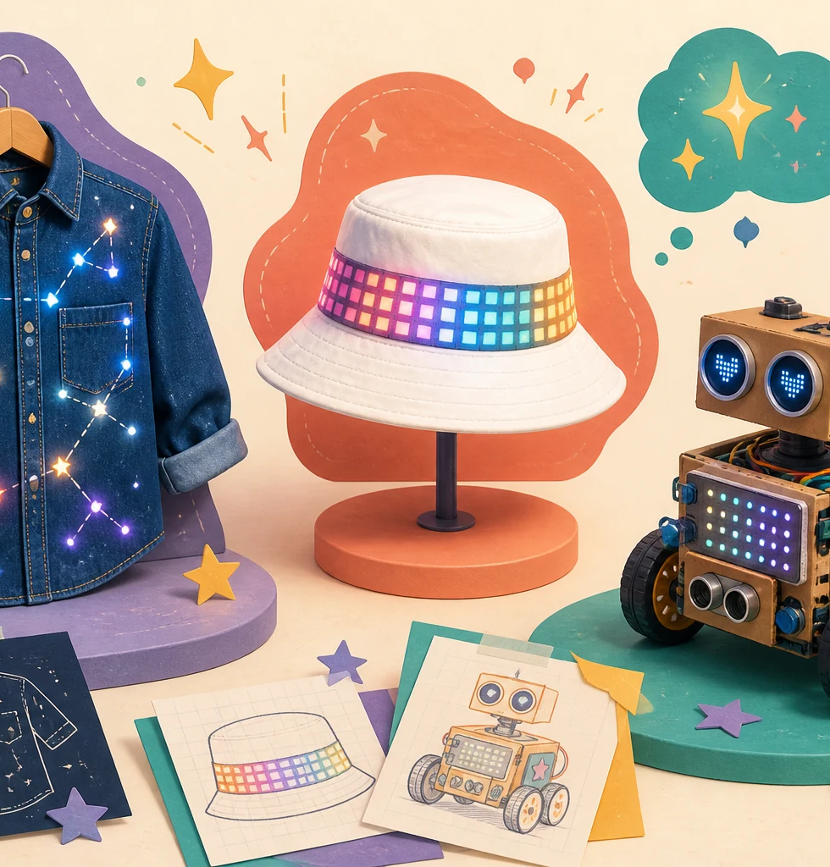
LIMITLESS • FEMINEERS
SEP 14 • 1/8
FULL WORKDAY 1
Imagine the Future
Monday, September 14, 2026 • 8:00 a.m.–2:41 p.m. • Room 14
8:00–8:40
Check in + find your pathway
• First year: Creative Robotics, team of two
• Second year: Wearable Technology, individual
• Third year: confirmed pathway choice
Everyone knows today’s pathway and finish line.
Imagine → Explore → Propose → Mentor decision
Advance at the next visible time cue
Notes:
TIMING: 8:00–8:40
MENTOR CUE: Verify every student by participation year before releasing equipment. Model the help signal, power-off rule, and the day’s Imagine → Explore → Propose → Mentor Decision arc.
PACING: Keep the slide visible for the named block; give verbal reminders at the transition times.
ACCESS: Read directions aloud, point to the finish line, and confirm understanding through a brief explanation or demonstration—not a new worksheet.
[Sources]
- C:\Users\trira\OneDrive\Documents\Femineers\mentor-lesson-plans.html#day-1
- C:\Users\trira\OneDrive\Documents\Femineers\mentor-lesson-plans.html#day1-tech-rotations
- C:\Users\trira\OneDrive\Documents\Femineers\start-here.html
- C:\Users\trira\OneDrive\Documents\Femineers\mentor-approval.html
- C:\Users\trira\OneDrive\Documents\Femineers\canvas-checkpoint-1.html
- C:\Users\trira\OneDrive\Documents\Femineers\program-roadmap.html

Slide 2
LIMITLESS • FEMINEERS
SEP 14 • 2/8
8:40–9:38
Imagine three different futures
DO THIS NOW
FINISH LINE
• Name a person, community, or need.
• Create three meaningfully different ideas.
• Change the purpose, interaction, or form—not just the colors.
• Circle the idea you most want to explore.
Three visible ideas—not one idea drawn three ways.
Start with the future user or need before the gadget.
Imagine → Explore → Propose → Mentor decision
Advance at the next visible time cue
Notes:
TIMING: 8:40–9:38
MENTOR CUE: Keep students focused on a user or need. Encourage genuine difference across the three concepts. No major construction begins today.
PACING: Keep the slide visible for the named block; give verbal reminders at the transition times.
ACCESS: Read directions aloud, point to the finish line, and confirm understanding through a brief explanation or demonstration—not a new worksheet.
[Sources]
- C:\Users\trira\OneDrive\Documents\Femineers\mentor-lesson-plans.html#day-1
- C:\Users\trira\OneDrive\Documents\Femineers\mentor-lesson-plans.html#day1-tech-rotations
- C:\Users\trira\OneDrive\Documents\Femineers\start-here.html
- C:\Users\trira\OneDrive\Documents\Femineers\mentor-approval.html
- C:\Users\trira\OneDrive\Documents\Femineers\canvas-checkpoint-1.html
- C:\Users\trira\OneDrive\Documents\Femineers\program-roadmap.html

Slide 3
LIMITLESS • FEMINEERS
SEP 14 • 3/8
9:38–9:51
Snack + find your starting station
DO THIS NOW
FINISH LINE
• At 9:48, check the posted route.
• Wearables: find W1, W2, W3, or W4.
• Robotics: go to your numbered kit table.
• Choose the first Driver and Navigator.
• Hands off until a mentor releases the station.
Everyone is in the correct safe starting position by 9:51.
Carry only your iPad/evidence card and named stamp bag.
Imagine → Explore → Propose → Mentor decision
Advance at the next visible time cue
Notes:
TIMING: 9:38–9:51
MENTOR CUE: Confirm capacity and starting tables during snack. Equipment stays at stations; Robotics kits never travel.
PACING: Keep the slide visible for the named block; give verbal reminders at the transition times.
ACCESS: Read directions aloud, point to the finish line, and confirm understanding through a brief explanation or demonstration—not a new worksheet.
[Sources]
- C:\Users\trira\OneDrive\Documents\Femineers\mentor-lesson-plans.html#day-1
- C:\Users\trira\OneDrive\Documents\Femineers\mentor-lesson-plans.html#day1-tech-rotations
- C:\Users\trira\OneDrive\Documents\Femineers\start-here.html
- C:\Users\trira\OneDrive\Documents\Femineers\mentor-approval.html
- C:\Users\trira\OneDrive\Documents\Femineers\canvas-checkpoint-1.html
- C:\Users\trira\OneDrive\Documents\Femineers\program-roadmap.html

Slide 4
LIMITLESS • FEMINEERS
SEP 14 • 4/8
Pathway technology tour
Wearables move clockwise. Robotics remains with its numbered kit and switches roles.
9:51–10:16
Round 1
Start the core task
10:16–10:19
STOP → MAKE SAFE → ACCOUNT → MOVE / SWITCH
Transition 1
10:19–10:44
Round 2
Change active role
10:44–10:47
STOP → MAKE SAFE → ACCOUNT → MOVE / SWITCH
Transition 2
10:47–11:12
Round 3
Save evidence first
11:12–11:15
STOP → MAKE SAFE → ACCOUNT → MOVE / SWITCH
Transition 3
11:15–11:40
Round 4
Complete capability check
11:40–11:45
Evidence, bagging, final count, shutdown
Mentor reports status
Missing needle, powered system, or uncounted kit = transition stops.
Imagine → Explore → Propose → Mentor decision
Advance at the next visible time cue
Notes:
TIMING: 9:51–11:45
MENTOR CUE: Run a visible timer and announce one-minute warnings. Save evidence locally; Canvas upload happens later. Station leads release Wearables movement only after the count. Robotics performs SAFE RESET, disconnects, powers off, saves, and switches Driver/Navigator.
PACING: Keep the slide visible for the named block; give verbal reminders at the transition times.
ACCESS: Read directions aloud, point to the finish line, and confirm understanding through a brief explanation or demonstration—not a new worksheet.
[Sources]
- C:\Users\trira\OneDrive\Documents\Femineers\mentor-lesson-plans.html#day-1
- C:\Users\trira\OneDrive\Documents\Femineers\mentor-lesson-plans.html#day1-tech-rotations
- C:\Users\trira\OneDrive\Documents\Femineers\start-here.html
- C:\Users\trira\OneDrive\Documents\Femineers\mentor-approval.html
- C:\Users\trira\OneDrive\Documents\Femineers\canvas-checkpoint-1.html
- C:\Users\trira\OneDrive\Documents\Femineers\program-roadmap.html

Slide 5
LIMITLESS • FEMINEERS
SEP 14 • 5/8
Four capability checks—one pathway story
WEARABLE TECHNOLOGY
CREATIVE ROBOTICS
1. Future Stamp
2. LED + conductive-thread Circuit Lab
3. micro:bit
4. NeoPixel
1. Controller + safe start/reset
2. Read one input
3. Test two outputs
4. Input → decision → two outputs → reset
Four evidence items saved; every needle returned separately.
Four evidence boxes complete; both partners named.
Imagine → Explore → Propose → Mentor decision
Advance at the next visible time cue
Notes:
TIMING: 9:51–11:45
MENTOR CUE: Keep this slide available as a pathway map between timed rotation cues. Wearables equipment remains at stations. Robotics teams use their assigned numbered kit for all four challenges.
PACING: Keep the slide visible for the named block; give verbal reminders at the transition times.
ACCESS: Read directions aloud, point to the finish line, and confirm understanding through a brief explanation or demonstration—not a new worksheet.
[Sources]
- C:\Users\trira\OneDrive\Documents\Femineers\mentor-lesson-plans.html#day-1
- C:\Users\trira\OneDrive\Documents\Femineers\mentor-lesson-plans.html#day1-tech-rotations
- C:\Users\trira\OneDrive\Documents\Femineers\start-here.html
- C:\Users\trira\OneDrive\Documents\Femineers\mentor-approval.html
- C:\Users\trira\OneDrive\Documents\Femineers\canvas-checkpoint-1.html
- C:\Users\trira\OneDrive\Documents\Femineers\program-roadmap.html

Slide 6
LIMITLESS • FEMINEERS
SEP 14 • 6/8
11:45–12:59
Share one discovery + reset for lunch
DO THIS NOW
FINISH LINE
• Show one discovery that changed your thinking.
• Confirm four pathway evidence items are saved.
• Wearables: return every needle separately.
• Robotics: SAFE RESET, disconnect, power off, count kit.
• Open the proposal guide before lunch.
All materials are accounted for before lunch begins at 12:29.
Lunch: 12:29–12:59.
Imagine → Explore → Propose → Mentor decision
Advance at the next visible time cue
Notes:
TIMING: 11:45–12:59
MENTOR CUE: Each Robotics partner explains a different system part. Do not release lunch until needles, power, station materials, and numbered kits are accounted for.
PACING: Keep the slide visible for the named block; give verbal reminders at the transition times.
ACCESS: Read directions aloud, point to the finish line, and confirm understanding through a brief explanation or demonstration—not a new worksheet.
[Sources]
- C:\Users\trira\OneDrive\Documents\Femineers\mentor-lesson-plans.html#day-1
- C:\Users\trira\OneDrive\Documents\Femineers\mentor-lesson-plans.html#day1-tech-rotations
- C:\Users\trira\OneDrive\Documents\Femineers\start-here.html
- C:\Users\trira\OneDrive\Documents\Femineers\mentor-approval.html
- C:\Users\trira\OneDrive\Documents\Femineers\canvas-checkpoint-1.html
- C:\Users\trira\OneDrive\Documents\Femineers\program-roadmap.html

Slide 7
LIMITLESS • FEMINEERS
SEP 14 • 7/8
12:59–2:05
Turn the idea into a buildable proposal
DO THIS NOW
FINISH LINE
• Show the future user + need.
• Include three ideas + selected concept.
• Label build views and technology behavior.
• Name materials, safety, and repair access.
• Write the first prototype question.
• Explain the complete plan to a peer.
Another builder can point to what it does, how it works, and what must be tested first.
Wearables: shirt + hat. Robotics: input → decision → two outputs → reset.
Imagine → Explore → Propose → Mentor decision
Advance at the next visible time cue
Notes:
TIMING: 12:59–2:05
MENTOR CUE: Coach meaning, completeness, feasibility, safety, and repair access. Do not redraw proposals. Use the peer explanation as a comprehension check, not a polish contest.
PACING: Keep the slide visible for the named block; give verbal reminders at the transition times.
ACCESS: Read directions aloud, point to the finish line, and confirm understanding through a brief explanation or demonstration—not a new worksheet.
[Sources]
- C:\Users\trira\OneDrive\Documents\Femineers\mentor-lesson-plans.html#day-1
- C:\Users\trira\OneDrive\Documents\Femineers\mentor-lesson-plans.html#day1-tech-rotations
- C:\Users\trira\OneDrive\Documents\Femineers\start-here.html
- C:\Users\trira\OneDrive\Documents\Femineers\mentor-approval.html
- C:\Users\trira\OneDrive\Documents\Femineers\canvas-checkpoint-1.html
- C:\Users\trira\OneDrive\Documents\Femineers\program-roadmap.html

Slide 8
LIMITLESS • FEMINEERS
SEP 14 • 8/8
2:05–2:41
Mentor decision + safe exit
APPROVED
APPROVED WITH NOTES
REVISE + RETURN
TECH REVIEW
Plan is understandable, feasible, and ready for October deliverables.
Move forward after the named small correction.
Complete the exact revision and return for another decision.
A safety, power, motion, or feasibility question needs the technical lead.
Save Checkpoint 1 or the exact revision plan. Clean, label, and leave one November prototype question.
Imagine → Explore → Propose → Mentor decision
Advance at the next visible time cue
Notes:
TIMING: 2:05–2:41
MENTOR CUE: Technical Review is not rejection. Record the decision and next action. Preview the October 19 Design Ready submission briefly; avoid turning dismissal into a long assignment lecture.
PACING: Keep the slide visible for the named block; give verbal reminders at the transition times.
ACCESS: Read directions aloud, point to the finish line, and confirm understanding through a brief explanation or demonstration—not a new worksheet.
[Sources]
- C:\Users\trira\OneDrive\Documents\Femineers\mentor-lesson-plans.html#day-1
- C:\Users\trira\OneDrive\Documents\Femineers\mentor-lesson-plans.html#day1-tech-rotations
- C:\Users\trira\OneDrive\Documents\Femineers\start-here.html
- C:\Users\trira\OneDrive\Documents\Femineers\mentor-approval.html
- C:\Users\trira\OneDrive\Documents\Femineers\canvas-checkpoint-1.html
- C:\Users\trira\OneDrive\Documents\Femineers\program-roadmap.html

