Slide 1
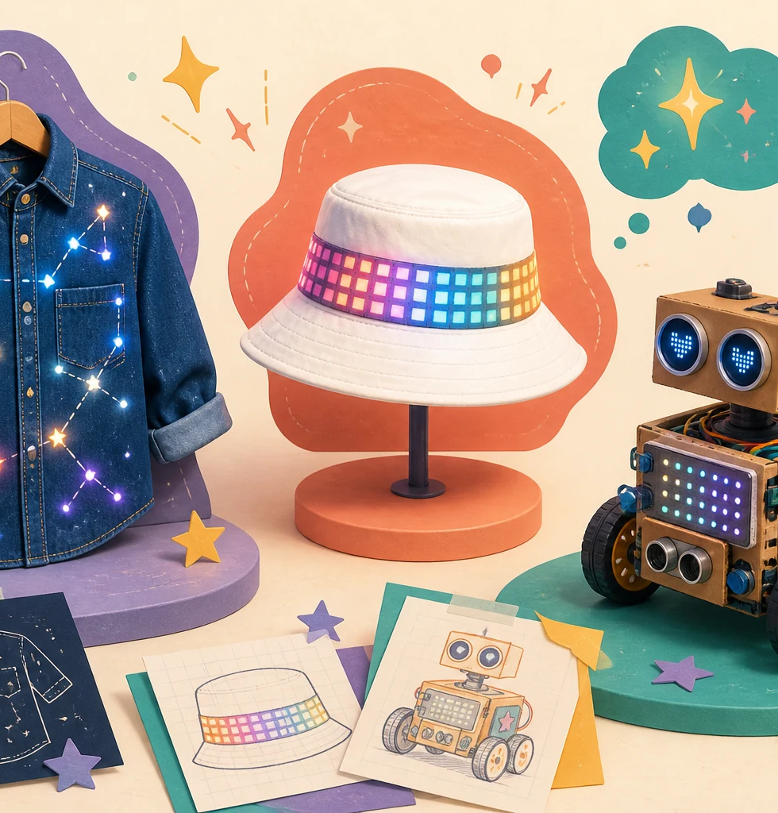
LIMITLESS • FEMINEERS
OCT 13 • 1/7
20-MINUTE DISTRICT ROTATION
Glow Up Your Badge
Tuesday, October 13, 2026 • District Femineers Kickoff • Griffiths
0:00–2:00
Personalize a badge + make it light
• Working light
• Secure power
• Safe attachment
• Shared tools returned
The circuit is standardized. The design is yours.
Standard circuit • Personal design • Safe light-up badge
Advance at the next visible time cue
Notes:
TIMING: 0:00–2:00
MENTOR CUE: Hold up the minimum successful example and one personalized example. Keep the district activity theme-neutral. Start the timer immediately.
PACING: Keep the slide visible for the named block; give verbal reminders at the transition times.
ACCESS: Read directions aloud, point to the finish line, and confirm understanding through a brief explanation or demonstration—not a new worksheet.
[Sources]
- C:\Users\trira\OneDrive\Documents\Femineers\mentor-lesson-plans.html#kickoff-badge
- C:\Users\trira\OneDrive\Documents\Femineers\mentor-lesson-plans.html#kickoff-agenda
- C:\Users\trira\OneDrive\Documents\Femineers\glow-up-your-badge.html
- C:\Users\trira\OneDrive\Documents\Femineers\program-roadmap.html

Slide 2
LIMITLESS • FEMINEERS
OCT 13 • 2/7
2:00–4:00
How the light works
DO THIS NOW
FINISH LINE
• The battery provides energy.
• The light module changes that energy into light.
• Open path = gap = off.
• Complete approved path = light on.
• Power comes last. Dark badge? Stop and raise your hand.
Everyone can point to the power source, light, and approved path.
Match the exact orientation marks shown at the station.
Standard circuit • Personal design • Safe light-up badge
Advance at the next visible time cue
Notes:
TIMING: 2:00–4:00
MENTOR CUE: Use the open demonstration and only the final kit’s actual parts. Show polarity, arrow, keyed plug, or matching marks only when required. Never demonstrate a live short.
PACING: Keep the slide visible for the named block; give verbal reminders at the transition times.
ACCESS: Read directions aloud, point to the finish line, and confirm understanding through a brief explanation or demonstration—not a new worksheet.
[Sources]
- C:\Users\trira\OneDrive\Documents\Femineers\mentor-lesson-plans.html#kickoff-badge
- C:\Users\trira\OneDrive\Documents\Femineers\mentor-lesson-plans.html#kickoff-agenda
- C:\Users\trira\OneDrive\Documents\Femineers\glow-up-your-badge.html
- C:\Users\trira\OneDrive\Documents\Femineers\program-roadmap.html

Slide 3
LIMITLESS • FEMINEERS
OCT 13 • 3/7
4:00–7:00
Check your kit + personalize
DO THIS NOW
FINISH LINE
• 4:00–5:00: compare the tray with the pictured parts list.
• Choose one approved base or insert.
• 5:00–7:00: add name, color, stickers, or quick shapes.
• At 6:00: one minute remains for decoration.
Contacts, switch, opening, orientation marks, and attachment point remain clear.
Swap an incomplete or mismatched kit immediately.
Standard circuit • Personal design • Safe light-up badge
Advance at the next visible time cue
Notes:
TIMING: 4:00–7:00
MENTOR CUE: Keep choices fast. Prevent art materials from covering functional areas. Mentor spares stay separate from student kits.
PACING: Keep the slide visible for the named block; give verbal reminders at the transition times.
ACCESS: Read directions aloud, point to the finish line, and confirm understanding through a brief explanation or demonstration—not a new worksheet.
[Sources]
- C:\Users\trira\OneDrive\Documents\Femineers\mentor-lesson-plans.html#kickoff-badge
- C:\Users\trira\OneDrive\Documents\Femineers\mentor-lesson-plans.html#kickoff-agenda
- C:\Users\trira\OneDrive\Documents\Femineers\glow-up-your-badge.html
- C:\Users\trira\OneDrive\Documents\Femineers\program-roadmap.html

Slide 4
LIMITLESS • FEMINEERS
OCT 13 • 4/7
7:00–11:00
Place + connect with power off
DO THIS NOW
FINISH LINE
• Match the real placement photo.
• Match every required orientation mark.
• Complete only the approved no-solder connection.
• Stop and ask—do not improvise another circuit.
The unpowered layout matches the approved example before testing.
One part at a time. Keep service points visible.
Standard circuit • Personal design • Safe light-up badge
Advance at the next visible time cue
Notes:
TIMING: 7:00–11:00
MENTOR CUE: Model one part at a time. Watch for reversal, crossed paths, poor contact, pinched material, loose tails, or the wrong connector.
PACING: Keep the slide visible for the named block; give verbal reminders at the transition times.
ACCESS: Read directions aloud, point to the finish line, and confirm understanding through a brief explanation or demonstration—not a new worksheet.
[Sources]
- C:\Users\trira\OneDrive\Documents\Femineers\mentor-lesson-plans.html#kickoff-badge
- C:\Users\trira\OneDrive\Documents\Femineers\mentor-lesson-plans.html#kickoff-agenda
- C:\Users\trira\OneDrive\Documents\Femineers\glow-up-your-badge.html
- C:\Users\trira\OneDrive\Documents\Femineers\program-roadmap.html

Slide 5
LIMITLESS • FEMINEERS
OCT 13 • 5/7
11:00–15:00
Power last. Test on the table.
DO THIS NOW
FINISH LINE
• 11:00–13:00: compare marks, add/switch on power, observe.
• Dark badge? Raise your hand for quick help.
• 13:00–15:00: if it works, secure and finish.
• Test again after securing.
Working light + secure power + reachable switch/battery opening.
STOP for warmth, odor, damage, loose power, or unstable flicker.
Standard circuit • Personal design • Safe light-up badge
Advance at the next visible time cue
Notes:
TIMING: 11:00–15:00
MENTOR CUE: Limit ordinary diagnosis to 30–45 seconds. Compare with the master, change one thing, then use a known-good swap instead of rebuilding for the student.
PACING: Keep the slide visible for the named block; give verbal reminders at the transition times.
ACCESS: Read directions aloud, point to the finish line, and confirm understanding through a brief explanation or demonstration—not a new worksheet.
[Sources]
- C:\Users\trira\OneDrive\Documents\Femineers\mentor-lesson-plans.html#kickoff-badge
- C:\Users\trira\OneDrive\Documents\Femineers\mentor-lesson-plans.html#kickoff-agenda
- C:\Users\trira\OneDrive\Documents\Femineers\glow-up-your-badge.html
- C:\Users\trira\OneDrive\Documents\Femineers\program-roadmap.html

Slide 6
LIMITLESS • FEMINEERS
OCT 13 • 6/7
15:00–18:00
Show your light + explain the circuit
DO THIS NOW
FINISH LINE
• 15:00–15:30: everyone runs the final table test.
• 15:30–17:00: point to battery, light, and complete path.
• Tell a partner why the light turns on.
• 17:00–18:00: complete the final mentor safety check.
A badge that does not pass the safety check is not worn.
Secure power • covered loose/sharp areas • secure attachment
Standard circuit • Personal design • Safe light-up badge
Advance at the next visible time cue
Notes:
TIMING: 15:00–18:00
MENTOR CUE: Count working, quick-help, and swap-needed badges. Check secure power, covered loose or sharp areas, complete path, and attachment.
PACING: Keep the slide visible for the named block; give verbal reminders at the transition times.
ACCESS: Read directions aloud, point to the finish line, and confirm understanding through a brief explanation or demonstration—not a new worksheet.
[Sources]
- C:\Users\trira\OneDrive\Documents\Femineers\mentor-lesson-plans.html#kickoff-badge
- C:\Users\trira\OneDrive\Documents\Femineers\mentor-lesson-plans.html#kickoff-agenda
- C:\Users\trira\OneDrive\Documents\Femineers\glow-up-your-badge.html
- C:\Users\trira\OneDrive\Documents\Femineers\program-roadmap.html

Slide 7
LIMITLESS • FEMINEERS
OCT 13 • 7/7
18:00–20:00
Wear only after approval + reset the station
DO THIS NOW
FINISH LINE
• 18:00–19:00: attach the badge after mentor approval.
• 19:00–19:40: return tools, scraps, unused parts, inspect items.
• 19:40–20:00: take your badge and move to the next station.
• Photo + reflection happen later—not during this workshop.
Every seat is clear and the next complete kit is ready.
Failed electronics go to INSPECT—never back into stock.
Standard circuit • Personal design • Safe light-up badge
Advance at the next visible time cue
Notes:
TIMING: 18:00–20:00
MENTOR CUE: Reset lead restores one complete kit per seat and confirms master/spare counts before the next group. Do not begin the Canvas submission during the rotation.
PACING: Keep the slide visible for the named block; give verbal reminders at the transition times.
ACCESS: Read directions aloud, point to the finish line, and confirm understanding through a brief explanation or demonstration—not a new worksheet.
[Sources]
- C:\Users\trira\OneDrive\Documents\Femineers\mentor-lesson-plans.html#kickoff-badge
- C:\Users\trira\OneDrive\Documents\Femineers\mentor-lesson-plans.html#kickoff-agenda
- C:\Users\trira\OneDrive\Documents\Femineers\glow-up-your-badge.html
- C:\Users\trira\OneDrive\Documents\Femineers\program-roadmap.html

