Slide 1
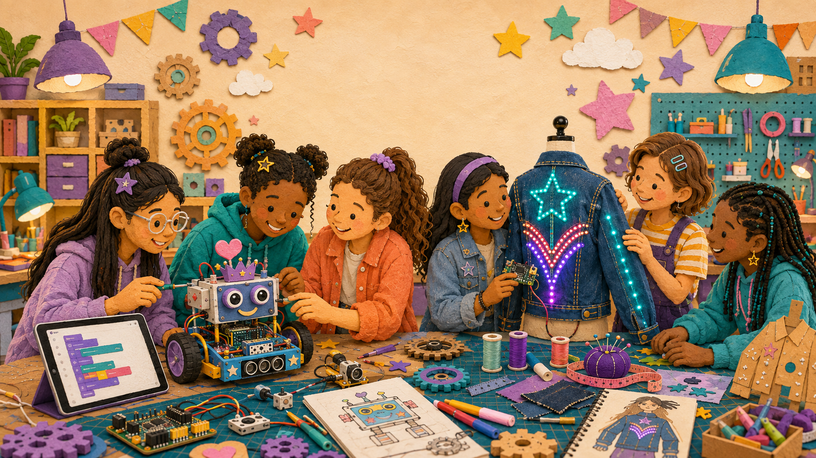
LIMITLESS • FEMINEERS
OCT 21 • 1/5
ALL-PROGRAM LUNCH CHECKPOINT
Design Ready Checkpoint
Wednesday, October 21, 2026 • 12:29–12:59 p.m. • Room 14
12:29–12:34
Eat + check in + open your evidence
• Approved proposal + labeled drawing
• Circuit/system diagram + storyboard
• Materials request + digital file + three-trial plan
Evidence is open before the one-minute shares begin.
Show evidence • Explain a decision • Name the first test
Advance at the next visible time cue
Notes:
TIMING: 12:29–12:34
MENTOR CUE: Canvas review should already be complete. Seat students in small pathway groups. This meeting demonstrates existing work; it does not create another worksheet.
PACING: Keep the slide visible for the named block; give verbal reminders at the transition times.
ACCESS: Read directions aloud, point to the finish line, and confirm understanding through a brief explanation or demonstration—not a new worksheet.
[Sources]
- C:\Users\trira\OneDrive\Documents\Femineers\lunch-checkpoints.html#october
- C:\Users\trira\OneDrive\Documents\Femineers\mentor-lesson-plans.html#day-2
- C:\Users\trira\OneDrive\Documents\Femineers\phase-2-prototype.html
- C:\Users\trira\OneDrive\Documents\Femineers\program-roadmap.html

Slide 2
LIMITLESS • FEMINEERS
OCT 21 • 2/5
12:34–12:44
Your 60-second Design Ready share
DO THIS NOW
FINISH LINE
• SHOW the evidence.
• EXPLAIN one important design decision.
• NAME the first November 16 test.
• STATE your next action.
• Robotics: both partners explain different parts.
Every project demonstrates readiness in one minute.
A visible timer protects everyone’s turn.
Show evidence • Explain a decision • Name the first test
Advance at the next visible time cue
Notes:
TIMING: 12:34–12:44
MENTOR CUE: Run a visible 60-second timer. Save detailed coaching for the conference block; do not let one presentation consume the lunch period.
PACING: Keep the slide visible for the named block; give verbal reminders at the transition times.
ACCESS: Read directions aloud, point to the finish line, and confirm understanding through a brief explanation or demonstration—not a new worksheet.
[Sources]
- C:\Users\trira\OneDrive\Documents\Femineers\lunch-checkpoints.html#october
- C:\Users\trira\OneDrive\Documents\Femineers\mentor-lesson-plans.html#day-2
- C:\Users\trira\OneDrive\Documents\Femineers\phase-2-prototype.html
- C:\Users\trira\OneDrive\Documents\Femineers\program-roadmap.html

Slide 3
LIMITLESS • FEMINEERS
OCT 21 • 3/5
12:44–12:46
Read your project status
GREEN
YELLOW
RED
Complete, understandable, and ready to build.
One specific revision before materials release.
Mentor conference required to resolve a blocker.
A status describes project readiness—not your value or ability.
Show evidence • Explain a decision • Name the first test
Advance at the next visible time cue
Notes:
TIMING: 12:44–12:46
MENTOR CUE: Give status privately or at the project table. Make every Yellow revision specific. Avoid public comparison of students or project polish.
PACING: Keep the slide visible for the named block; give verbal reminders at the transition times.
ACCESS: Read directions aloud, point to the finish line, and confirm understanding through a brief explanation or demonstration—not a new worksheet.
[Sources]
- C:\Users\trira\OneDrive\Documents\Femineers\lunch-checkpoints.html#october
- C:\Users\trira\OneDrive\Documents\Femineers\mentor-lesson-plans.html#day-2
- C:\Users\trira\OneDrive\Documents\Femineers\phase-2-prototype.html
- C:\Users\trira\OneDrive\Documents\Femineers\program-roadmap.html

Slide 4
LIMITLESS • FEMINEERS
OCT 21 • 4/5
12:46–12:54
Get the next move
DO THIS NOW
FINISH LINE
• GREEN: confirm the first test and next action.
• YELLOW: record the one named revision.
• RED: meet with a mentor and narrow the blocker.
• Leave with WHO + ACTION + evidence of READY.
One actionable next move—not a lunch-period redesign.
Mentors prioritize Red projects, then Yellow.
Show evidence • Explain a decision • Name the first test
Advance at the next visible time cue
Notes:
TIMING: 12:46–12:54
MENTOR CUE: Keep each conversation focused on one actionable change. Confirm exactly what evidence will show the correction is complete.
PACING: Keep the slide visible for the named block; give verbal reminders at the transition times.
ACCESS: Read directions aloud, point to the finish line, and confirm understanding through a brief explanation or demonstration—not a new worksheet.
[Sources]
- C:\Users\trira\OneDrive\Documents\Femineers\lunch-checkpoints.html#october
- C:\Users\trira\OneDrive\Documents\Femineers\mentor-lesson-plans.html#day-2
- C:\Users\trira\OneDrive\Documents\Femineers\phase-2-prototype.html
- C:\Users\trira\OneDrive\Documents\Femineers\program-roadmap.html

Slide 5
LIMITLESS • FEMINEERS
OCT 21 • 5/5
12:54–12:59
Record the next action + celebrate
DO THIS NOW
FINISH LINE
• Mentor status saved.
• Exact next Femineers action named.
• November first-test question ready.
• Canvas closed and table cleared.
• Choose an ingredient-labeled treat or nonfood prize when eligible.
Preparation, honest evidence, and responsibility are recognized—not polish.
A revision is support, not punishment.
Show evidence • Explain a decision • Name the first test
Advance at the next visible time cue
Notes:
TIMING: 12:54–12:59
MENTOR CUE: Preserve accommodations and make-up access. Recognition requires on-time, complete, genuine evidence, a demonstration, and a named next action.
PACING: Keep the slide visible for the named block; give verbal reminders at the transition times.
ACCESS: Read directions aloud, point to the finish line, and confirm understanding through a brief explanation or demonstration—not a new worksheet.
[Sources]
- C:\Users\trira\OneDrive\Documents\Femineers\lunch-checkpoints.html#october
- C:\Users\trira\OneDrive\Documents\Femineers\mentor-lesson-plans.html#day-2
- C:\Users\trira\OneDrive\Documents\Femineers\phase-2-prototype.html
- C:\Users\trira\OneDrive\Documents\Femineers\program-roadmap.html

