Slide 1
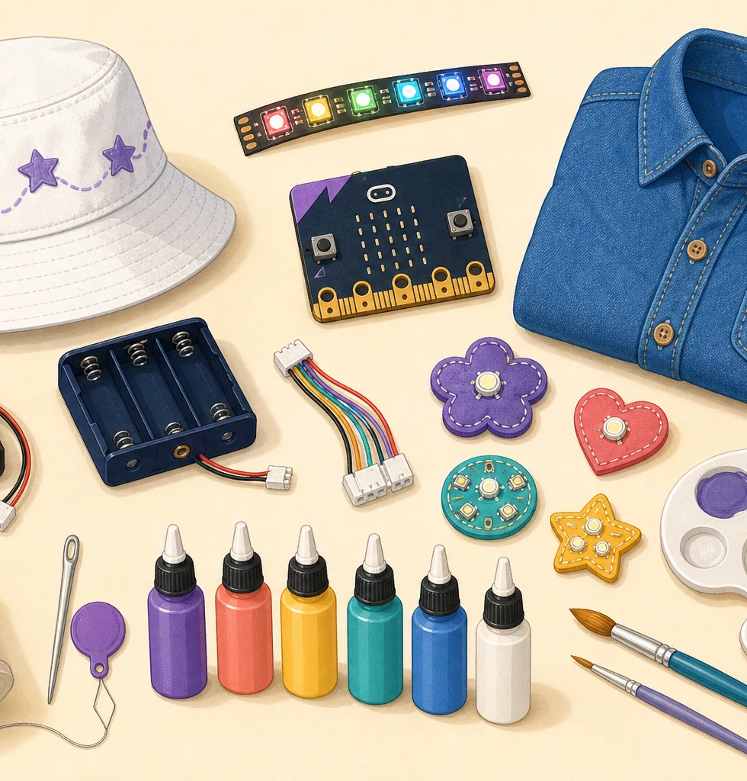
LIMITLESS • FEMINEERS
NOV 16 • 1/8
FULL WORKDAY 2
Design What’s Next
Monday, November 16, 2026 • 8:00 a.m.–2:41 p.m. • Room 14
8:00–8:20
Start with one small question
• Retrieve only your named bin.
• Open the approved Design Ready plan.
• Name one uncertainty, success, stop rule, and milestone.
A mentor approves one small test question.
Prototype first • Build from evidence • Keep systems repairable
Advance at the next visible time cue
Notes:
TIMING: 8:00–8:20
MENTOR CUE: Nothing receives power. Confirm the correct project, materials, device identity, and repairable milestone.
PACING: Keep the slide visible for the named block; give verbal reminders at the transition times.
ACCESS: Read directions aloud, point to the finish line, and confirm understanding through a brief explanation or demonstration—not a new worksheet.
[Sources]
- C:\Users\trira\OneDrive\Documents\Femineers\mentor-lesson-plans.html#nov16-agenda
- C:\Users\trira\OneDrive\Documents\Femineers\phase-3-build.html
- C:\Users\trira\OneDrive\Documents\Femineers\build-progress-evidence.html
- C:\Users\trira\OneDrive\Documents\Femineers\program-roadmap.html

Slide 2
LIMITLESS • FEMINEERS
NOV 16 • 2/8
8:20–8:40
Make the test safe + fair
DO THIS NOW
FINISH LINE
• Battery out before touching wearable paths.
• Safe reset before Robotics motion.
• Keep the test condition the same.
• Run three honest trials.
• Change only one variable.
Everyone can explain what should be observed if the test passes.
STOP for warmth, odor, damage, unsafe motion, or unknown device.
Prototype first • Build from evidence • Keep systems repairable
Advance at the next visible time cue
Notes:
TIMING: 8:20–8:40
MENTOR CUE: Use the working examples. Ask, ‘What should we observe if this passes?’ Have students explain the sequence back.
PACING: Keep the slide visible for the named block; give verbal reminders at the transition times.
ACCESS: Read directions aloud, point to the finish line, and confirm understanding through a brief explanation or demonstration—not a new worksheet.
[Sources]
- C:\Users\trira\OneDrive\Documents\Femineers\mentor-lesson-plans.html#nov16-agenda
- C:\Users\trira\OneDrive\Documents\Femineers\phase-3-build.html
- C:\Users\trira\OneDrive\Documents\Femineers\build-progress-evidence.html
- C:\Users\trira\OneDrive\Documents\Femineers\program-roadmap.html

Slide 3
LIMITLESS • FEMINEERS
NOV 16 • 3/8
Prototype sprint
Answer the uncertainty before permanent construction.
8:40
Build the smallest useful test
Prototype materials only
8:55
Run three comparable trials
Record what happened
9:18
Change one thing + repeat
Same condition
9:30
Save proof + meet the gate
CLEARED / REVISION / HOLD
No permanent construction before observable evidence and mentor clearance.
Prototype first • Build from evidence • Keep systems repairable
Advance at the next visible time cue
Notes:
TIMING: 8:40–9:38
MENTOR CUE: Release prototype materials only. Protect the same test condition across all trials. Photograph the prototype and record the status before snack.
PACING: Keep the slide visible for the named block; give verbal reminders at the transition times.
ACCESS: Read directions aloud, point to the finish line, and confirm understanding through a brief explanation or demonstration—not a new worksheet.
[Sources]
- C:\Users\trira\OneDrive\Documents\Femineers\mentor-lesson-plans.html#nov16-agenda
- C:\Users\trira\OneDrive\Documents\Femineers\phase-3-build.html
- C:\Users\trira\OneDrive\Documents\Femineers\build-progress-evidence.html
- C:\Users\trira\OneDrive\Documents\Femineers\program-roadmap.html

Slide 4
LIMITLESS • FEMINEERS
NOV 16 • 4/8
9:38–9:51
Snack + safe reset
DO THIS NOW
FINISH LINE
• All power off.
• Needles and numbered kits counted.
• Wet work stays flat and labeled.
• Leave every project in its safe pause state.
Return ready at 9:51 with actual counts complete.
No powered, sharp, wet, or loose item unattended.
Prototype first • Build from evidence • Keep systems repairable
Advance at the next visible time cue
Notes:
TIMING: 9:38–9:51
MENTOR CUE: Complete actual counts before students move. Investigate any missing needle or kit part immediately.
PACING: Keep the slide visible for the named block; give verbal reminders at the transition times.
ACCESS: Read directions aloud, point to the finish line, and confirm understanding through a brief explanation or demonstration—not a new worksheet.
[Sources]
- C:\Users\trira\OneDrive\Documents\Femineers\mentor-lesson-plans.html#nov16-agenda
- C:\Users\trira\OneDrive\Documents\Femineers\phase-3-build.html
- C:\Users\trira\OneDrive\Documents\Femineers\build-progress-evidence.html
- C:\Users\trira\OneDrive\Documents\Femineers\program-roadmap.html

Slide 5
LIMITLESS • FEMINEERS
NOV 16 • 5/8
Build only what passed the gate
Circulate by safety and engineering risk—not decoration quality.
9:51
Permanent-construction gate
Trace / inspect / clear
10:10
Build the approved milestone
Keep access visible
10:55
Power-off quality pause
Count + inspect
11:05
Continue one named step
No optional work
11:35
Save overall + close-up evidence
Name the lunch-safe action
Power, connections, sensors, mechanisms, and controllers remain accessible for repair.
Prototype first • Build from evidence • Keep systems repairable
Advance at the next visible time cue
Notes:
TIMING: 9:51–11:45
MENTOR CUE: Move hidden or questionable work to repair/inspect. Release only the next measurable construction step. Require evidence before anything moves.
PACING: Keep the slide visible for the named block; give verbal reminders at the transition times.
ACCESS: Read directions aloud, point to the finish line, and confirm understanding through a brief explanation or demonstration—not a new worksheet.
[Sources]
- C:\Users\trira\OneDrive\Documents\Femineers\mentor-lesson-plans.html#nov16-agenda
- C:\Users\trira\OneDrive\Documents\Femineers\phase-3-build.html
- C:\Users\trira\OneDrive\Documents\Femineers\build-progress-evidence.html
- C:\Users\trira\OneDrive\Documents\Femineers\program-roadmap.html

Slide 6
LIMITLESS • FEMINEERS
NOV 16 • 6/8
11:45–12:59
Save progress before lunch
DO THIS NOW
FINISH LINE
• Save an overall photo + engineering close-up.
• Write the afternoon restart action.
• Wearables: manage battery, count needles, protect wet work.
• Robotics: safe reset, disconnect, power off, count kit.
• Lunch begins at 12:29.
No powered, sharp, wet, loose, or unsupported item remains unattended.
Evidence exists before the mat is erased or project moves.
Prototype first • Build from evidence • Keep systems repairable
Advance at the next visible time cue
Notes:
TIMING: 11:45–12:59
MENTOR CUE: Verify evidence names on the reusable log. Do not release lunch until the actual pathway shutdown is complete.
PACING: Keep the slide visible for the named block; give verbal reminders at the transition times.
ACCESS: Read directions aloud, point to the finish line, and confirm understanding through a brief explanation or demonstration—not a new worksheet.
[Sources]
- C:\Users\trira\OneDrive\Documents\Femineers\mentor-lesson-plans.html#nov16-agenda
- C:\Users\trira\OneDrive\Documents\Femineers\phase-3-build.html
- C:\Users\trira\OneDrive\Documents\Femineers\build-progress-evidence.html
- C:\Users\trira\OneDrive\Documents\Femineers\program-roadmap.html

Slide 7
LIMITLESS • FEMINEERS
NOV 16 • 7/8
12:59–2:05
Finish the milestone + show real progress
DO THIS NOW
FINISH LINE
• Restart from the written action.
• Compare the plan with what was actually built.
• Continue or repair the approved milestone.
• At 1:45 save prototype result, overall photo, close-up, change, status.
• Name the first December 7 test.
Unfinished work is acceptable. Unclear evidence is not.
Capture evidence while the project is visible.
Prototype first • Build from evidence • Keep systems repairable
Advance at the next visible time cue
Notes:
TIMING: 12:59–2:05
MENTOR CUE: Require a reason for each meaningful change. Keep optional work deferred. Check evidence before the work surface is cleared.
PACING: Keep the slide visible for the named block; give verbal reminders at the transition times.
ACCESS: Read directions aloud, point to the finish line, and confirm understanding through a brief explanation or demonstration—not a new worksheet.
[Sources]
- C:\Users\trira\OneDrive\Documents\Femineers\mentor-lesson-plans.html#nov16-agenda
- C:\Users\trira\OneDrive\Documents\Femineers\phase-3-build.html
- C:\Users\trira\OneDrive\Documents\Femineers\build-progress-evidence.html
- C:\Users\trira\OneDrive\Documents\Femineers\program-roadmap.html

Slide 8
LIMITLESS • FEMINEERS
NOV 16 • 8/8
2:05–2:41
Status, restart, store
ON TRACK
TARGETED REPAIR
BLOCKED
Safe measurable progress; December action is clear.
One named repair must happen first next time.
A safety, material, code, or technical issue prevents safe progress.
Power off • Count • Label • Protect • Store. Another mentor could restart the project.
Prototype first • Build from evidence • Keep systems repairable
Advance at the next visible time cue
Notes:
TIMING: 2:05–2:41
MENTOR CUE: Use a 60–90 second conference. Reject ‘keep working’ as a next step; require a verb plus the exact part or subsystem. Record the December action before cleanup.
PACING: Keep the slide visible for the named block; give verbal reminders at the transition times.
ACCESS: Read directions aloud, point to the finish line, and confirm understanding through a brief explanation or demonstration—not a new worksheet.
[Sources]
- C:\Users\trira\OneDrive\Documents\Femineers\mentor-lesson-plans.html#nov16-agenda
- C:\Users\trira\OneDrive\Documents\Femineers\phase-3-build.html
- C:\Users\trira\OneDrive\Documents\Femineers\build-progress-evidence.html
- C:\Users\trira\OneDrive\Documents\Femineers\program-roadmap.html

