Slide 1
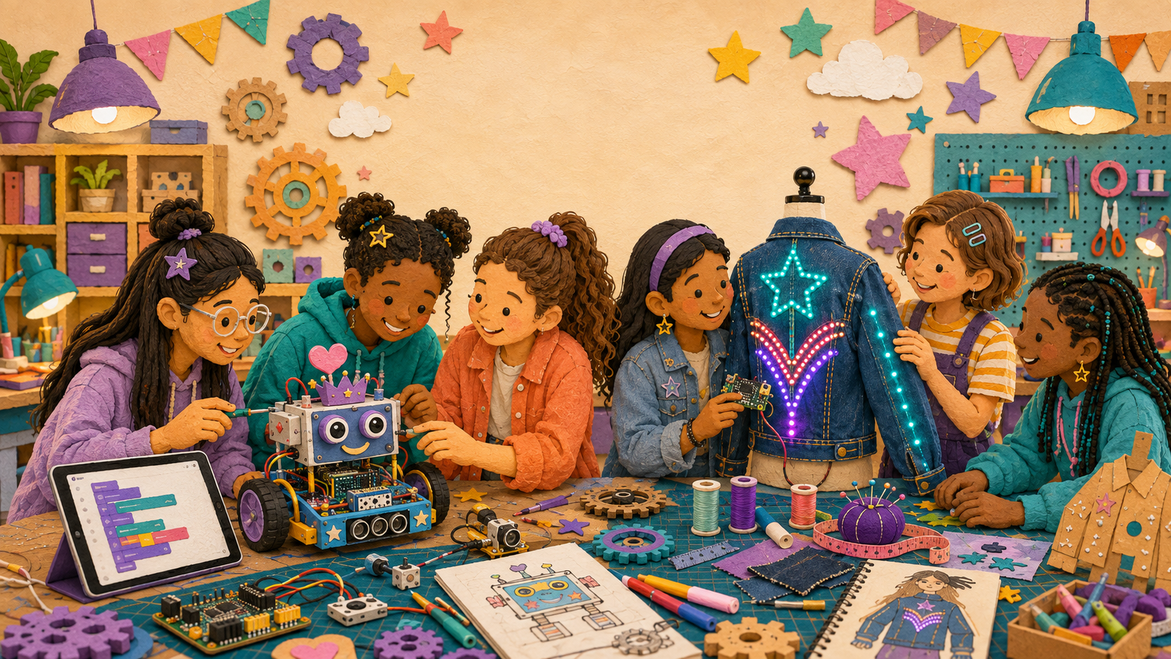
LIMITLESS • FEMINEERS
DEC 2 • 1/5
INVITATION-ONLY EVIDENCE CONFERENCE
Project Rescue
Wednesday, December 2, 2026 • 12:29–12:59 p.m. • Room 14
12:29–12:33
Open evidence—not projects
• Latest photo/video + last trustworthy test
• Code filename/screenshot when relevant
• November 16 next action + current blocker
Support—not punishment. Projects and tools stay stored.
Evidence—not memory • One narrow blocker • One safe restart
Advance at the next visible time cue
Notes:
TIMING: 12:29–12:33
MENTOR CUE: Confirm invited students and evidence access. There is no new submission, construction, or live test.
PACING: Keep the slide visible for the named block; give verbal reminders at the transition times.
ACCESS: Read directions aloud, point to the finish line, and confirm understanding through a brief explanation or demonstration—not a new worksheet.
[Sources]
- C:\Users\trira\OneDrive\Documents\Femineers\mentor-lesson-plans.html#december-2-rescue
- C:\Users\trira\OneDrive\Documents\Femineers\lunch-checkpoints.html#december-rescue
- C:\Users\trira\OneDrive\Documents\Femineers\mentor-print-center.html
- C:\Users\trira\OneDrive\Documents\Femineers\program-roadmap.html

Slide 2
LIMITLESS • FEMINEERS
DEC 2 • 2/5
12:33–12:37
Use the five-question rescue pattern
DO THIS NOW
FINISH LINE
• SHOW one working result.
• COMPARE expected with observed.
• NARROW the smallest blocker.
• RESCUE one next move.
• RELEASE with a status.
A blocker is narrower than ‘it doesn’t work.’
Working proof → expected/observed → blocker → rescue move → status
Evidence—not memory • One narrow blocker • One safe restart
Advance at the next visible time cue
Notes:
TIMING: 12:33–12:37
MENTOR CUE: Model one complete conversation in under four minutes. Name what makes the evidence trustworthy and the blocker narrow.
PACING: Keep the slide visible for the named block; give verbal reminders at the transition times.
ACCESS: Read directions aloud, point to the finish line, and confirm understanding through a brief explanation or demonstration—not a new worksheet.
[Sources]
- C:\Users\trira\OneDrive\Documents\Femineers\mentor-lesson-plans.html#december-2-rescue
- C:\Users\trira\OneDrive\Documents\Femineers\lunch-checkpoints.html#december-rescue
- C:\Users\trira\OneDrive\Documents\Femineers\mentor-print-center.html
- C:\Users\trira\OneDrive\Documents\Femineers\program-roadmap.html

Slide 3
LIMITLESS • FEMINEERS
DEC 2 • 3/5
12:37–12:51
Three-minute pathway conferences
CONTINUE
CUT SCOPE
REPAIR FIRST
TECH LEAD
Begin the named build or retest.
Defer one optional feature and protect the core.
Pass one specific repair before building.
Unknown safety, power, firmware, motion, or damage issue. No release yet.
Point to working evidence • expected • observed • one repair/simplification/staged item/first test
Evidence—not memory • One narrow blocker • One safe restart
Advance at the next visible time cue
Notes:
TIMING: 12:37–12:51
MENTOR CUE: Conduct up to four conferences per lane. Both Robotics partners contribute. Unknown safety, power, firmware, motion, or damage issues go directly to TECH LEAD.
PACING: Keep the slide visible for the named block; give verbal reminders at the transition times.
ACCESS: Read directions aloud, point to the finish line, and confirm understanding through a brief explanation or demonstration—not a new worksheet.
[Sources]
- C:\Users\trira\OneDrive\Documents\Femineers\mentor-lesson-plans.html#december-2-rescue
- C:\Users\trira\OneDrive\Documents\Femineers\lunch-checkpoints.html#december-rescue
- C:\Users\trira\OneDrive\Documents\Femineers\mentor-print-center.html
- C:\Users\trira\OneDrive\Documents\Femineers\program-roadmap.html

Slide 4
LIMITLESS • FEMINEERS
DEC 2 • 4/5
12:51–12:56
Make December 7 restartable
SAY + RECORD
FINISH LINE
• DEC. 7 START: [name/role] will [verb] [subsystem]
• using [staged item].
• Good enough means [observable result].
• STOP AND ASK if [condition].
Specific enough that another person could begin in five minutes.
Correct vague, unsafe, or overlarge plans.
Evidence—not memory • One narrow blocker • One safe restart
Advance at the next visible time cue
Notes:
TIMING: 12:51–12:56
MENTOR CUE: Record the sentence on the existing Canvas comment or project-bin label. Confirm the named item can actually be staged before December 7.
PACING: Keep the slide visible for the named block; give verbal reminders at the transition times.
ACCESS: Read directions aloud, point to the finish line, and confirm understanding through a brief explanation or demonstration—not a new worksheet.
[Sources]
- C:\Users\trira\OneDrive\Documents\Femineers\mentor-lesson-plans.html#december-2-rescue
- C:\Users\trira\OneDrive\Documents\Femineers\lunch-checkpoints.html#december-rescue
- C:\Users\trira\OneDrive\Documents\Femineers\mentor-print-center.html
- C:\Users\trira\OneDrive\Documents\Femineers\program-roadmap.html

Slide 5
LIMITLESS • FEMINEERS
DEC 2 • 5/5
12:56–12:59
Confirm + close
DO THIS NOW
FINISH LINE
• Say your status.
• Say your first safe action.
• Name what the mentor will stage.
• Name when you must stop and ask.
• Return to lunch.
Nothing is assigned for home.
Mentor records tracker status and restart line.
Evidence—not memory • One narrow blocker • One safe restart
Advance at the next visible time cue
Notes:
TIMING: 12:56–12:59
MENTOR CUE: Finish page 2 of the shared tracker. Do not create another student worksheet. Keep the meeting supportive and brief.
PACING: Keep the slide visible for the named block; give verbal reminders at the transition times.
ACCESS: Read directions aloud, point to the finish line, and confirm understanding through a brief explanation or demonstration—not a new worksheet.
[Sources]
- C:\Users\trira\OneDrive\Documents\Femineers\mentor-lesson-plans.html#december-2-rescue
- C:\Users\trira\OneDrive\Documents\Femineers\lunch-checkpoints.html#december-rescue
- C:\Users\trira\OneDrive\Documents\Femineers\mentor-print-center.html
- C:\Users\trira\OneDrive\Documents\Femineers\program-roadmap.html

