Slide 1
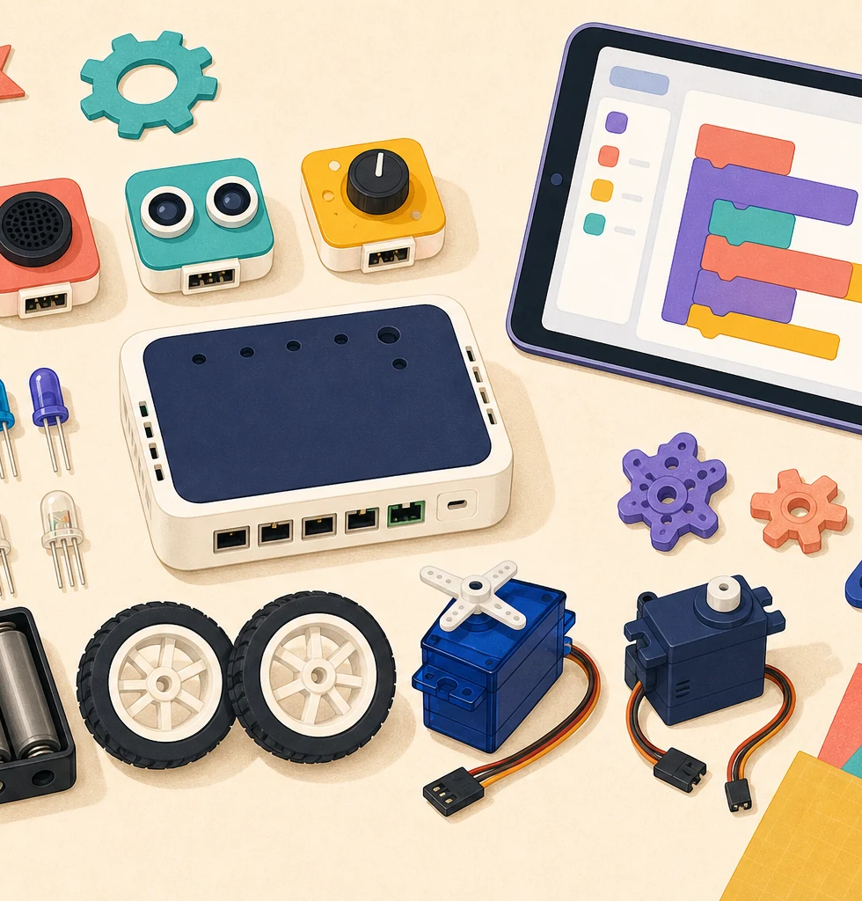
LIMITLESS • FEMINEERS
DEC 7 • 1/8
FULL WORKDAY 3
Build & Test
Monday, December 7, 2026 • 8:00 a.m.–2:41 p.m. • Room 14
8:00–8:20
Photograph before touching
• Nothing receives power.
• Check project, loose parts, kit/device, and code record.
• Name the blocker and first safe action.
Starting lane: CONTINUE • CUT SCOPE • REPAIR FIRST • TECH LEAD
Observe • Power off • Check one thing • Retest • Record
Advance at the next visible time cue
Notes:
TIMING: 8:00–8:20
MENTOR CUE: Use Project Rescue status when available; otherwise use Checkpoint 2 evidence. Record the as-found condition and inventory before any change.
PACING: Keep the slide visible for the named block; give verbal reminders at the transition times.
ACCESS: Read directions aloud, point to the finish line, and confirm understanding through a brief explanation or demonstration—not a new worksheet.
[Sources]
- C:\Users\trira\OneDrive\Documents\Femineers\mentor-lesson-plans.html#dec7-agenda
- C:\Users\trira\OneDrive\Documents\Femineers\phase-4-test.html
- C:\Users\trira\OneDrive\Documents\Femineers\mid-build-evidence.html
- C:\Users\trira\OneDrive\Documents\Femineers\lunch-checkpoints.html#december-rescue
- C:\Users\trira\OneDrive\Documents\Femineers\program-roadmap.html

Slide 2
LIMITLESS • FEMINEERS
DEC 7 • 2/8
8:20–8:40
Troubleshoot one variable at a time
DO THIS NOW
FINISH LINE
• OBSERVE the exact symptom.
• POWER OFF or make the system safe.
• CHECK one likely variable.
• RETEST the same condition.
• RECORD better, worse, unchanged, or new problem.
The test can make an honest before/after comparison.
On the reusable mat: subsystem • success • stop • constant condition
Observe • Power off • Check one thing • Retest • Record
Advance at the next visible time cue
Notes:
TIMING: 8:20–8:40
MENTOR CUE: Demonstrate the safe loose-pad fault and threshold/sensor-direction fault. Never model a powered short or servo stall.
PACING: Keep the slide visible for the named block; give verbal reminders at the transition times.
ACCESS: Read directions aloud, point to the finish line, and confirm understanding through a brief explanation or demonstration—not a new worksheet.
[Sources]
- C:\Users\trira\OneDrive\Documents\Femineers\mentor-lesson-plans.html#dec7-agenda
- C:\Users\trira\OneDrive\Documents\Femineers\phase-4-test.html
- C:\Users\trira\OneDrive\Documents\Femineers\mid-build-evidence.html
- C:\Users\trira\OneDrive\Documents\Femineers\lunch-checkpoints.html#december-rescue
- C:\Users\trira\OneDrive\Documents\Femineers\program-roadmap.html

Slide 3
LIMITLESS • FEMINEERS
DEC 7 • 3/8
Prepare one useful baseline
Build or repair only what makes the named test useful.
8:40
Complete one critical build or repair
Contain the issue
9:05
Pass power/motion inspection
Pathway gate
9:25
Run baseline—or document the hold
Expected + observed
9:35
Save the first evidence filename
Trustworthy result
One trustworthy result exists before snack.
Observe • Power off • Check one thing • Retest • Record
Advance at the next visible time cue
Notes:
TIMING: 8:40–9:38
MENTOR CUE: Do not release live testing until pathway inspection passes. If testing cannot proceed safely, document the exact hold rather than improvising.
PACING: Keep the slide visible for the named block; give verbal reminders at the transition times.
ACCESS: Read directions aloud, point to the finish line, and confirm understanding through a brief explanation or demonstration—not a new worksheet.
[Sources]
- C:\Users\trira\OneDrive\Documents\Femineers\mentor-lesson-plans.html#dec7-agenda
- C:\Users\trira\OneDrive\Documents\Femineers\phase-4-test.html
- C:\Users\trira\OneDrive\Documents\Femineers\mid-build-evidence.html
- C:\Users\trira\OneDrive\Documents\Femineers\lunch-checkpoints.html#december-rescue
- C:\Users\trira\OneDrive\Documents\Femineers\program-roadmap.html

Slide 4
LIMITLESS • FEMINEERS
DEC 7 • 4/8
9:38–9:51
Snack + safe reset
DO THIS NOW
FINISH LINE
• All systems off.
• Needles and numbered kits accounted for.
• Keep the marked repair and test condition intact.
• Return ready at 9:51.
No powered, sharp, loose, or unsupported item is unattended.
A missing item or unsafe state stops the transition.
Observe • Power off • Check one thing • Retest • Record
Advance at the next visible time cue
Notes:
TIMING: 9:38–9:51
MENTOR CUE: Verify the actual counts and safe pause before students move. Do not let a nearly finished test delay the common safety reset.
PACING: Keep the slide visible for the named block; give verbal reminders at the transition times.
ACCESS: Read directions aloud, point to the finish line, and confirm understanding through a brief explanation or demonstration—not a new worksheet.
[Sources]
- C:\Users\trira\OneDrive\Documents\Femineers\mentor-lesson-plans.html#dec7-agenda
- C:\Users\trira\OneDrive\Documents\Femineers\phase-4-test.html
- C:\Users\trira\OneDrive\Documents\Femineers\mid-build-evidence.html
- C:\Users\trira\OneDrive\Documents\Femineers\lunch-checkpoints.html#december-rescue
- C:\Users\trira\OneDrive\Documents\Femineers\program-roadmap.html

Slide 5
LIMITLESS • FEMINEERS
DEC 7 • 5/8
Repair, repeat, then decide
Keep one variable per project and preserve repair access.
9:51
Repair one named variable
Complete or escalate
10:25
Repeat the same test condition
Compare honestly
10:50
Take only the next critical step
No trapped parts
11:15
Finish one subsystem test or name blocker
Useful evidence
11:35
Save photo, result, change, filename
Begin shutdown
Result = BETTER • WORSE • UNCHANGED • NEW PROBLEM
Observe • Power off • Check one thing • Retest • Record
Advance at the next visible time cue
Notes:
TIMING: 9:51–11:45
MENTOR CUE: Wearables: no final NeoPixel strip cutting or installation. Robotics: no Hummingbird part may be trapped inside construction. Escalate repeated unexplained failures.
PACING: Keep the slide visible for the named block; give verbal reminders at the transition times.
ACCESS: Read directions aloud, point to the finish line, and confirm understanding through a brief explanation or demonstration—not a new worksheet.
[Sources]
- C:\Users\trira\OneDrive\Documents\Femineers\mentor-lesson-plans.html#dec7-agenda
- C:\Users\trira\OneDrive\Documents\Femineers\phase-4-test.html
- C:\Users\trira\OneDrive\Documents\Femineers\mid-build-evidence.html
- C:\Users\trira\OneDrive\Documents\Femineers\lunch-checkpoints.html#december-rescue
- C:\Users\trira\OneDrive\Documents\Femineers\program-roadmap.html

Slide 6
LIMITLESS • FEMINEERS
DEC 7 • 6/8
11:45–12:59
Evidence first, then lunch
DO THIS NOW
FINISH LINE
• Save photo, result, change, and filename.
• Wearables: manage battery, count needles, protect circuit/wet work.
• Robotics: safe reset, disconnect, power off, count numbered kit.
• No sharp, loose, powered, or unsupported item unattended.
• Lunch: 12:29–12:59.
The afternoon can restart from evidence—not memory.
Do not release lunch until pathway shutdown is complete.
Observe • Power off • Check one thing • Retest • Record
Advance at the next visible time cue
Notes:
TIMING: 11:45–12:59
MENTOR CUE: Check the saved evidence before the project moves. Verify actual power state, kit count, needle count, and physical support.
PACING: Keep the slide visible for the named block; give verbal reminders at the transition times.
ACCESS: Read directions aloud, point to the finish line, and confirm understanding through a brief explanation or demonstration—not a new worksheet.
[Sources]
- C:\Users\trira\OneDrive\Documents\Femineers\mentor-lesson-plans.html#dec7-agenda
- C:\Users\trira\OneDrive\Documents\Femineers\phase-4-test.html
- C:\Users\trira\OneDrive\Documents\Femineers\mid-build-evidence.html
- C:\Users\trira\OneDrive\Documents\Femineers\lunch-checkpoints.html#december-rescue
- C:\Users\trira\OneDrive\Documents\Femineers\program-roadmap.html

Slide 7
LIMITLESS • FEMINEERS
DEC 7 • 7/8
12:59–2:05
Improve, retest, explain
DO THIS NOW
FINISH LINE
• Make one evidence-based improvement.
• Repeat the original test condition.
• Record starting condition, success, first result, and one change.
• Record the retest and current blocker.
• Write the first January action with a specific verb.
A visible before/after comparison supports the claim.
A failed retest is acceptable when recorded honestly.
Observe • Power off • Check one thing • Retest • Record
Advance at the next visible time cue
Notes:
TIMING: 12:59–2:05
MENTOR CUE: Require an observable comparison. Stop students from changing several things at once or altering the test condition to create success.
PACING: Keep the slide visible for the named block; give verbal reminders at the transition times.
ACCESS: Read directions aloud, point to the finish line, and confirm understanding through a brief explanation or demonstration—not a new worksheet.
[Sources]
- C:\Users\trira\OneDrive\Documents\Femineers\mentor-lesson-plans.html#dec7-agenda
- C:\Users\trira\OneDrive\Documents\Femineers\phase-4-test.html
- C:\Users\trira\OneDrive\Documents\Femineers\mid-build-evidence.html
- C:\Users\trira\OneDrive\Documents\Femineers\lunch-checkpoints.html#december-rescue
- C:\Users\trira\OneDrive\Documents\Femineers\program-roadmap.html

Slide 8
LIMITLESS • FEMINEERS
DEC 7 • 8/8
2:05–2:41
Pass the winter-storage gate
DO THIS NOW
FINISH LINE
• Zero energy; power state verified.
• Every part contained and counted.
• Code backed up and named.
• Condition and storage location photographed.
• Structure supported; January action specific.
Another person can restart safely on January 25.
2:21 Label • photograph location • secure inspect items
Observe • Power off • Check one thing • Retest • Record
Advance at the next visible time cue
Notes:
TIMING: 2:05–2:41
MENTOR CUE: Inspect hands-on. Damaged or questionable items remain in the inspect area. Reject loose batteries, damp paint, unsupported mechanisms, or vague restart notes.
PACING: Keep the slide visible for the named block; give verbal reminders at the transition times.
ACCESS: Read directions aloud, point to the finish line, and confirm understanding through a brief explanation or demonstration—not a new worksheet.
[Sources]
- C:\Users\trira\OneDrive\Documents\Femineers\mentor-lesson-plans.html#dec7-agenda
- C:\Users\trira\OneDrive\Documents\Femineers\phase-4-test.html
- C:\Users\trira\OneDrive\Documents\Femineers\mid-build-evidence.html
- C:\Users\trira\OneDrive\Documents\Femineers\lunch-checkpoints.html#december-rescue
- C:\Users\trira\OneDrive\Documents\Femineers\program-roadmap.html

