Slide 1
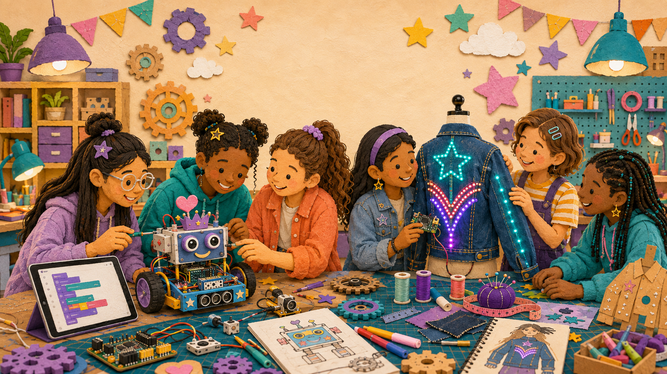
LIMITLESS • FEMINEERS
JAN 13 • 1/6
ALL-PROGRAM LUNCH CHECKPOINT
Restart Ready
Wednesday, January 13, 2027 • 12:29–12:59 p.m. • Room 14
12:29–12:34
Eat. Open. Locate.
• Current project photo
• Last trustworthy test
• Code filename
• Materials/repair list
Use existing evidence. Projects and tools stay stored.
Evidence • Starting lane • Three priorities • First five minutes
Advance at the next visible time cue
Notes:
TIMING: 12:29–12:34
MENTOR CUE: No project retrieval or construction. Keep lunch tracker page 3 on the shared clipboard and verify evidence access before demonstrations.
PACING: Keep the slide visible for the named block; give verbal reminders at the transition times.
ACCESS: Read directions aloud, point to the finish line, and confirm understanding through a brief explanation or demonstration—not a new worksheet.
[Sources]
- C:\Users\trira\OneDrive\Documents\Femineers\lunch-checkpoints.html#january
- C:\Users\trira\OneDrive\Documents\Femineers\mentor-lesson-plans.html#day-5
- C:\Users\trira\OneDrive\Documents\Femineers\phase-5-integrate.html
- C:\Users\trira\OneDrive\Documents\Femineers\mentor-print-center.html
- C:\Users\trira\OneDrive\Documents\Femineers\program-roadmap.html

Slide 2
LIMITLESS • FEMINEERS
JAN 13 • 2/6
12:34–12:44
Your 60-second restart story
DO THIS NOW
FINISH LINE
• Where did your project stop?
• What did the last test reveal?
• What will you do first on January 25?
• What exact help or material do you need?
• Robotics partners explain different parts.
Every project tells a complete restart story in one minute.
Simultaneous table demonstrations protect the clock.
Evidence • Starting lane • Three priorities • First five minutes
Advance at the next visible time cue
Notes:
TIMING: 12:34–12:44
MENTOR CUE: Keep each student/team to one minute. Listen for a real test result and a specific request rather than a general feeling about readiness.
PACING: Keep the slide visible for the named block; give verbal reminders at the transition times.
ACCESS: Read directions aloud, point to the finish line, and confirm understanding through a brief explanation or demonstration—not a new worksheet.
[Sources]
- C:\Users\trira\OneDrive\Documents\Femineers\lunch-checkpoints.html#january
- C:\Users\trira\OneDrive\Documents\Femineers\mentor-lesson-plans.html#day-5
- C:\Users\trira\OneDrive\Documents\Femineers\phase-5-integrate.html
- C:\Users\trira\OneDrive\Documents\Femineers\mentor-print-center.html
- C:\Users\trira\OneDrive\Documents\Femineers\program-roadmap.html

Slide 3
LIMITLESS • FEMINEERS
JAN 13 • 3/6
12:44–12:49
Choose the January 25 starting lane
READY TO INTEGRATE
REPAIR FIRST
MENTOR HOLD
Parts, code, and a safe first action are ready.
One named repair must pass before integration.
Unsafe, unknown, damaged, or missing stays off.
Starting lanes come from evidence—not confidence or appearance.
Evidence • Starting lane • Three priorities • First five minutes
Advance at the next visible time cue
Notes:
TIMING: 12:44–12:49
MENTOR CUE: Assign the lane from current photos, test records, code identity, and materials condition. Confirm who owns the first action.
PACING: Keep the slide visible for the named block; give verbal reminders at the transition times.
ACCESS: Read directions aloud, point to the finish line, and confirm understanding through a brief explanation or demonstration—not a new worksheet.
[Sources]
- C:\Users\trira\OneDrive\Documents\Femineers\lunch-checkpoints.html#january
- C:\Users\trira\OneDrive\Documents\Femineers\mentor-lesson-plans.html#day-5
- C:\Users\trira\OneDrive\Documents\Femineers\phase-5-integrate.html
- C:\Users\trira\OneDrive\Documents\Femineers\mentor-print-center.html
- C:\Users\trira\OneDrive\Documents\Femineers\program-roadmap.html

Slide 4
LIMITLESS • FEMINEERS
JAN 13 • 4/6
12:49–12:54
Rank three January priorities
DO THIS NOW
FINISH LINE
• 1. Restore or repair _____.
• 2. Add the next system layer _____.
• 3. Run the complete test _____.
• Begin every priority with a verb.
Three sequenced tasks—not ‘finish hat’ or ‘work on robot.’
Each priority names a part, action, and observable result.
Evidence • Starting lane • Three priorities • First five minutes
Advance at the next visible time cue
Notes:
TIMING: 12:49–12:54
MENTOR CUE: Replace vague language with a specific part, action, and finish condition. Keep the priority list realistic for one workday.
PACING: Keep the slide visible for the named block; give verbal reminders at the transition times.
ACCESS: Read directions aloud, point to the finish line, and confirm understanding through a brief explanation or demonstration—not a new worksheet.
[Sources]
- C:\Users\trira\OneDrive\Documents\Femineers\lunch-checkpoints.html#january
- C:\Users\trira\OneDrive\Documents\Femineers\mentor-lesson-plans.html#day-5
- C:\Users\trira\OneDrive\Documents\Femineers\phase-5-integrate.html
- C:\Users\trira\OneDrive\Documents\Femineers\mentor-print-center.html
- C:\Users\trira\OneDrive\Documents\Femineers\program-roadmap.html

Slide 5
LIMITLESS • FEMINEERS
JAN 13 • 5/6
12:54–12:57
Record the first five minutes
DO THIS NOW
FINISH LINE
• JAN. 25 START: I/we will _____.
• Using _____.
• Good enough means _____.
• STOP AND ASK if _____.
The required item can be staged and the stop condition is safe.
Protect power, motion, comfort, and unknown parts.
Evidence • Starting lane • Three priorities • First five minutes
Advance at the next visible time cue
Notes:
TIMING: 12:54–12:57
MENTOR CUE: Confirm the needed material or repair will be available. Correct any stop condition that is missing or too late.
PACING: Keep the slide visible for the named block; give verbal reminders at the transition times.
ACCESS: Read directions aloud, point to the finish line, and confirm understanding through a brief explanation or demonstration—not a new worksheet.
[Sources]
- C:\Users\trira\OneDrive\Documents\Femineers\lunch-checkpoints.html#january
- C:\Users\trira\OneDrive\Documents\Femineers\mentor-lesson-plans.html#day-5
- C:\Users\trira\OneDrive\Documents\Femineers\phase-5-integrate.html
- C:\Users\trira\OneDrive\Documents\Femineers\mentor-print-center.html
- C:\Users\trira\OneDrive\Documents\Femineers\program-roadmap.html

Slide 6
LIMITLESS • FEMINEERS
JAN 13 • 6/6
12:57–12:59
Ready to restart
DO THIS NOW
FINISH LINE
• Code backup verified.
• Supply or repair request named.
• Three priorities ranked.
• First safe action recorded.
• Return to lunch.
Nothing is assigned for home.
Celebrate preparation and honest evidence—not polish.
Evidence • Starting lane • Three priorities • First five minutes
Advance at the next visible time cue
Notes:
TIMING: 12:57–12:59
MENTOR CUE: Record the status on the shared tracker. Students leave with clarity, not an additional assignment.
PACING: Keep the slide visible for the named block; give verbal reminders at the transition times.
ACCESS: Read directions aloud, point to the finish line, and confirm understanding through a brief explanation or demonstration—not a new worksheet.
[Sources]
- C:\Users\trira\OneDrive\Documents\Femineers\lunch-checkpoints.html#january
- C:\Users\trira\OneDrive\Documents\Femineers\mentor-lesson-plans.html#day-5
- C:\Users\trira\OneDrive\Documents\Femineers\phase-5-integrate.html
- C:\Users\trira\OneDrive\Documents\Femineers\mentor-print-center.html
- C:\Users\trira\OneDrive\Documents\Femineers\program-roadmap.html

