Slide 1
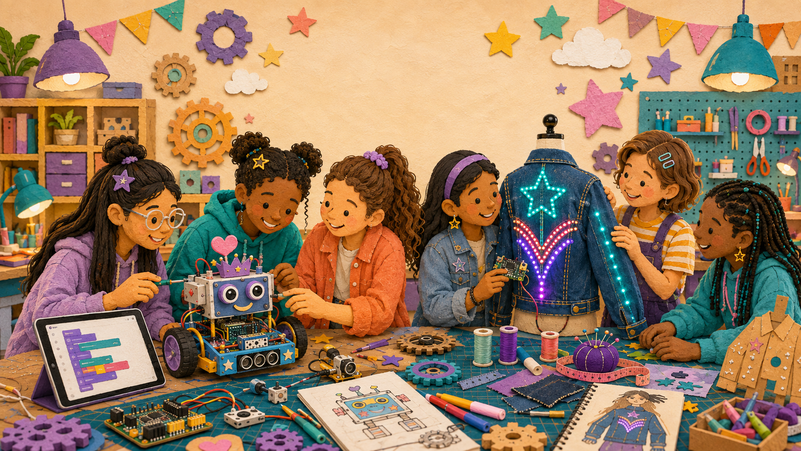
LIMITLESS • FEMINEERS
FEB 10 • 1/6
ALL-PROGRAM LUNCH CHECKPOINT
Gala Path Checkpoint
Wednesday, February 10, 2027 • 12:29–12:59 p.m. • Room 14
12:29–12:34
Open your Gala evidence
• Overall project photo + latest complete-system test
• Ranked punch list + repair/replacement request
• Draft project card + safe backup plan
Current evidence—not confidence—drives the final plan.
Current evidence • Critical task • Safe backup • Gala role
Advance at the next visible time cue
Notes:
TIMING: 12:29–12:34
MENTOR CUE: Students use current evidence only; projects stay stored. Keep lunch tracker page 4 on the shared clipboard.
PACING: Keep the slide visible for the named block; give verbal reminders at the transition times.
ACCESS: Read directions aloud, point to the finish line, and confirm understanding through a brief explanation or demonstration—not a new worksheet.
[Sources]
- C:\Users\trira\OneDrive\Documents\Femineers\lunch-checkpoints.html#february
- C:\Users\trira\OneDrive\Documents\Femineers\mentor-lesson-plans.html#day-6
- C:\Users\trira\OneDrive\Documents\Femineers\phase-6-gala-ready.html
- C:\Users\trira\OneDrive\Documents\Femineers\mentor-print-center.html
- C:\Users\trira\OneDrive\Documents\Femineers\program-roadmap.html

Slide 2
LIMITLESS • FEMINEERS
FEB 10 • 2/6
12:34–12:44
Your 60-second Gala story
DO THIS NOW
FINISH LINE
• Show the current project condition.
• Name the greatest Gala readiness risk.
• Name one critical February 22 task.
• Say the opening line of your project story.
• Robotics partners divide the explanation.
The story includes a real test result—not simply ‘it works.’
One minute per student/team protects the clock.
Current evidence • Critical task • Safe backup • Gala role
Advance at the next visible time cue
Notes:
TIMING: 12:34–12:44
MENTOR CUE: Listen for current evidence, the highest-consequence risk, and a realistic final-workday action. Redirect long project histories.
PACING: Keep the slide visible for the named block; give verbal reminders at the transition times.
ACCESS: Read directions aloud, point to the finish line, and confirm understanding through a brief explanation or demonstration—not a new worksheet.
[Sources]
- C:\Users\trira\OneDrive\Documents\Femineers\lunch-checkpoints.html#february
- C:\Users\trira\OneDrive\Documents\Femineers\mentor-lesson-plans.html#day-6
- C:\Users\trira\OneDrive\Documents\Femineers\phase-6-gala-ready.html
- C:\Users\trira\OneDrive\Documents\Femineers\mentor-print-center.html
- C:\Users\trira\OneDrive\Documents\Femineers\program-roadmap.html

Slide 3
LIMITLESS • FEMINEERS
FEB 10 • 3/6
12:44–12:48
Rank work by consequence
CRITICAL
IMPORTANT
OPTIONAL
Safety • required function • comfort/stability • reset
Clarity • documentation • repairability • rehearsal
Extra feature or decoration that can be deferred.
Identify exactly one critical February 22 action. No major new feature.
Current evidence • Critical task • Safe backup • Gala role
Advance at the next visible time cue
Notes:
TIMING: 12:44–12:48
MENTOR CUE: Appearance never outranks safety, core function, comfort/stability, reset, or repairability. Cut optional scope aggressively.
PACING: Keep the slide visible for the named block; give verbal reminders at the transition times.
ACCESS: Read directions aloud, point to the finish line, and confirm understanding through a brief explanation or demonstration—not a new worksheet.
[Sources]
- C:\Users\trira\OneDrive\Documents\Femineers\lunch-checkpoints.html#february
- C:\Users\trira\OneDrive\Documents\Femineers\mentor-lesson-plans.html#day-6
- C:\Users\trira\OneDrive\Documents\Femineers\phase-6-gala-ready.html
- C:\Users\trira\OneDrive\Documents\Femineers\mentor-print-center.html
- C:\Users\trira\OneDrive\Documents\Femineers\program-roadmap.html

Slide 4
LIMITLESS • FEMINEERS
FEB 10 • 4/6
12:48–12:52
Prepare the safe backup
DO THIS NOW
FINISH LINE
• Failure sign: _____.
• First safe action: _____.
• Feature kept off or still: _____.
• Audience alternative: card • static display • video.
A modified demonstration is a valid engineering decision.
Do not plan public improvisation around power or motion.
Current evidence • Critical task • Safe backup • Gala role
Advance at the next visible time cue
Notes:
TIMING: 12:48–12:52
MENTOR CUE: Make the backup specific and immediately safe. Avoid any plan that depends on live rewiring, forced mechanisms, or untested substitute power.
PACING: Keep the slide visible for the named block; give verbal reminders at the transition times.
ACCESS: Read directions aloud, point to the finish line, and confirm understanding through a brief explanation or demonstration—not a new worksheet.
[Sources]
- C:\Users\trira\OneDrive\Documents\Femineers\lunch-checkpoints.html#february
- C:\Users\trira\OneDrive\Documents\Femineers\mentor-lesson-plans.html#day-6
- C:\Users\trira\OneDrive\Documents\Femineers\phase-6-gala-ready.html
- C:\Users\trira\OneDrive\Documents\Femineers\mentor-print-center.html
- C:\Users\trira\OneDrive\Documents\Femineers\program-roadmap.html

Slide 5
LIMITLESS • FEMINEERS
FEB 10 • 5/6
12:52–12:54
Own your Gala role
DO THIS NOW
FINISH LINE
• Say: ‘I/we designed _____ for _____ because _____.’
• Name your speaking role.
• Name your operating/reset role.
• Name who explains the backup if needed.
Every student has a visible contribution to the public experience.
Wearables: walk/operate/explain/shutdown • Robotics: greet/present/operate/reset
Current evidence • Critical task • Safe backup • Gala role
Advance at the next visible time cue
Notes:
TIMING: 12:52–12:54
MENTOR CUE: Ensure roles match the students who will actually be present. Do not assign an untrained person to live power or motion.
PACING: Keep the slide visible for the named block; give verbal reminders at the transition times.
ACCESS: Read directions aloud, point to the finish line, and confirm understanding through a brief explanation or demonstration—not a new worksheet.
[Sources]
- C:\Users\trira\OneDrive\Documents\Femineers\lunch-checkpoints.html#february
- C:\Users\trira\OneDrive\Documents\Femineers\mentor-lesson-plans.html#day-6
- C:\Users\trira\OneDrive\Documents\Femineers\phase-6-gala-ready.html
- C:\Users\trira\OneDrive\Documents\Femineers\mentor-print-center.html
- C:\Users\trira\OneDrive\Documents\Femineers\program-roadmap.html

Slide 6
LIMITLESS • FEMINEERS
FEB 10 • 6/6
12:54–12:59
Leave with one final-workday plan
DO THIS NOW
FINISH LINE
• On February 22, first we will _____.
• Mentor preparation needed: _____.
• We will know it passes when _____.
• Record the speaking/operating responsibility.
• Return to lunch.
No new feature. No take-home assignment.
Mentors prepare repairs, replacements, prints, charging, fabrication, or simplification.
Current evidence • Critical task • Safe backup • Gala role
Advance at the next visible time cue
Notes:
TIMING: 12:54–12:59
MENTOR CUE: Record exactly what mentors must prepare before February 22 and who owns it. Confirm the critical action can be completed and retested within the morning cutoff.
PACING: Keep the slide visible for the named block; give verbal reminders at the transition times.
ACCESS: Read directions aloud, point to the finish line, and confirm understanding through a brief explanation or demonstration—not a new worksheet.
[Sources]
- C:\Users\trira\OneDrive\Documents\Femineers\lunch-checkpoints.html#february
- C:\Users\trira\OneDrive\Documents\Femineers\mentor-lesson-plans.html#day-6
- C:\Users\trira\OneDrive\Documents\Femineers\phase-6-gala-ready.html
- C:\Users\trira\OneDrive\Documents\Femineers\mentor-print-center.html
- C:\Users\trira\OneDrive\Documents\Femineers\program-roadmap.html

