Slide 1
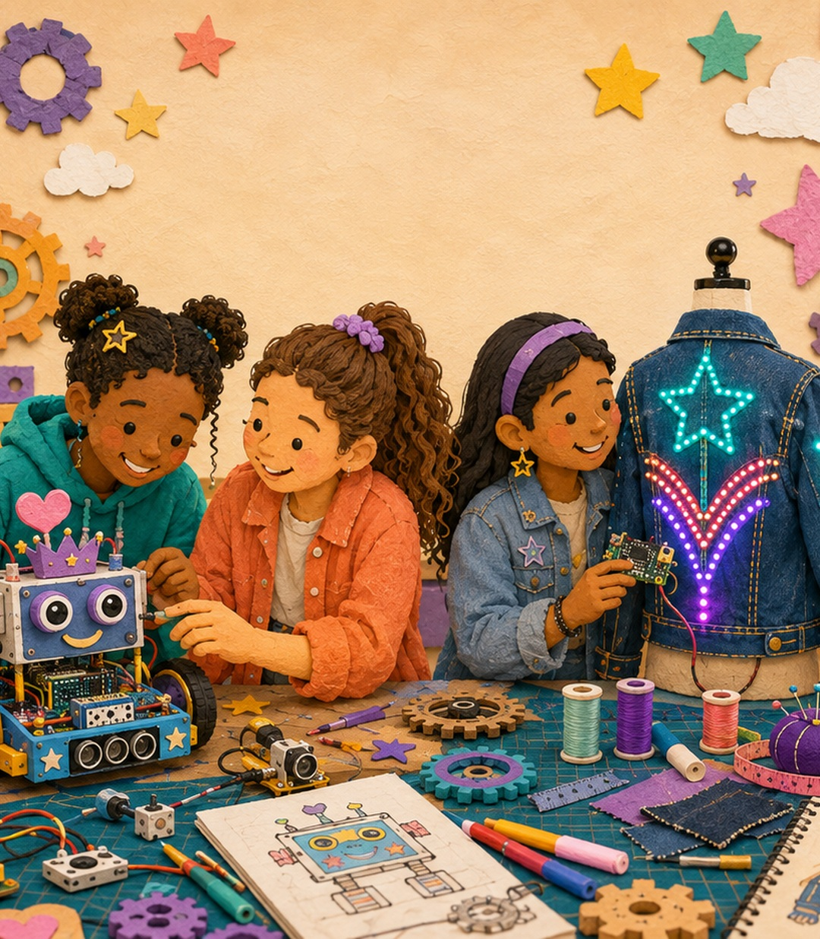
STAUFFER FEMINEERS • LUNCH INFO SESSION
What future
will you design?
Limitless: Designed by Her
Meet the mentors • Explore the program • Room 14
LIMITLESS • DESIGNED BY HER
1
Notes:
Welcome students and introduce the mentors who are present. Ask: What is one thing in your school or community that you wish worked better?
[Sources]
- Workspace source: recruitment.html
- Recruitment hub: https://spartandesign.github.io/stauffer-femineers/recruitment.html
- Workspace image: images/Canvas Course Image.png
[/Sources]

Slide 2
Femineers turns curiosity into real things
Imagine
Build
Share
Start with a future person, place, or problem that matters to you.
Turn an idea into robotics, code, craft materials, and a physical design.
Test, improve, and present what you made to families and the community.
Creative engineering • Digital design • Teamwork • Two public showcases
LIMITLESS • ROOM 14
2
Notes:
Frame Femineers as a learning community, not a club for students who already know engineering. Invite students to notice which of the three verbs sounds most exciting to them.
[Sources]
- Workspace source: recruitment.html
- Recruitment hub: https://spartandesign.github.io/stauffer-femineers/recruitment.html
- Cal Poly Pomona Femineer Program overview: https://www.cpp.edu/engineering/femineer/index.shtml
[/Sources]

Slide 3
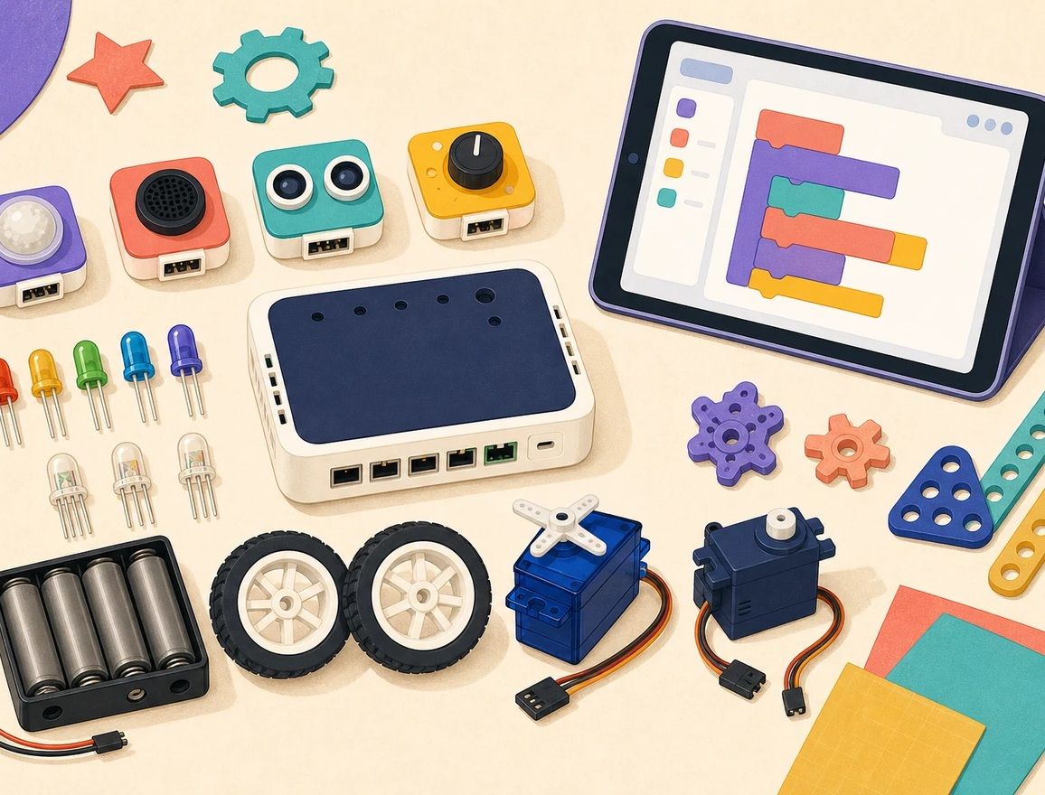
First-year Femineers build Creative Robotics
TEAMS OF TWO
Use sensors, lights, motion, sound, craft materials, and BirdBlox on an iPad to create an interactive invention for a future person or community.
No prior engineering or coding experience is required.
LIMITLESS • ROOM 14
3
Notes:
Explain that every first-year Femineer begins in Creative Robotics and works with one partner. Point out that the image is a concept illustration of the planned materials, not a wiring guide.
[Sources]
- Workspace source: creative-robotics.html
- Workspace source: recruitment.html
- Workspace image: assets/images/robotics-materials-cartoon.webp
- Recruitment hub: https://spartandesign.github.io/stauffer-femineers/recruitment.html
[/Sources]

Slide 4
No experience needed—just a willingness to try
Curiosity
Creativity
Ask why, wonder what if, and notice problems worth solving.
Make original connections and turn rough ideas into possibilities.
Collaboration
Persistence
Listen, contribute, and build with a partner who sees things differently.
Test, learn from what happened, and try again with a stronger idea.
These are the qualities mentors and teachers are looking for.
LIMITLESS • ROOM 14
4
Notes:
Emphasize that selection is not a grade check. Ask students which habit they already use and which one they want to strengthen.
[Sources]
- Workspace source: teacher-recommendation.html
- Workspace source: recruitment-toolkit.html
- Teacher recommendation form: https://forms.gle/sE54GRSr9tNdvAqL8
[/Sources]

Slide 5
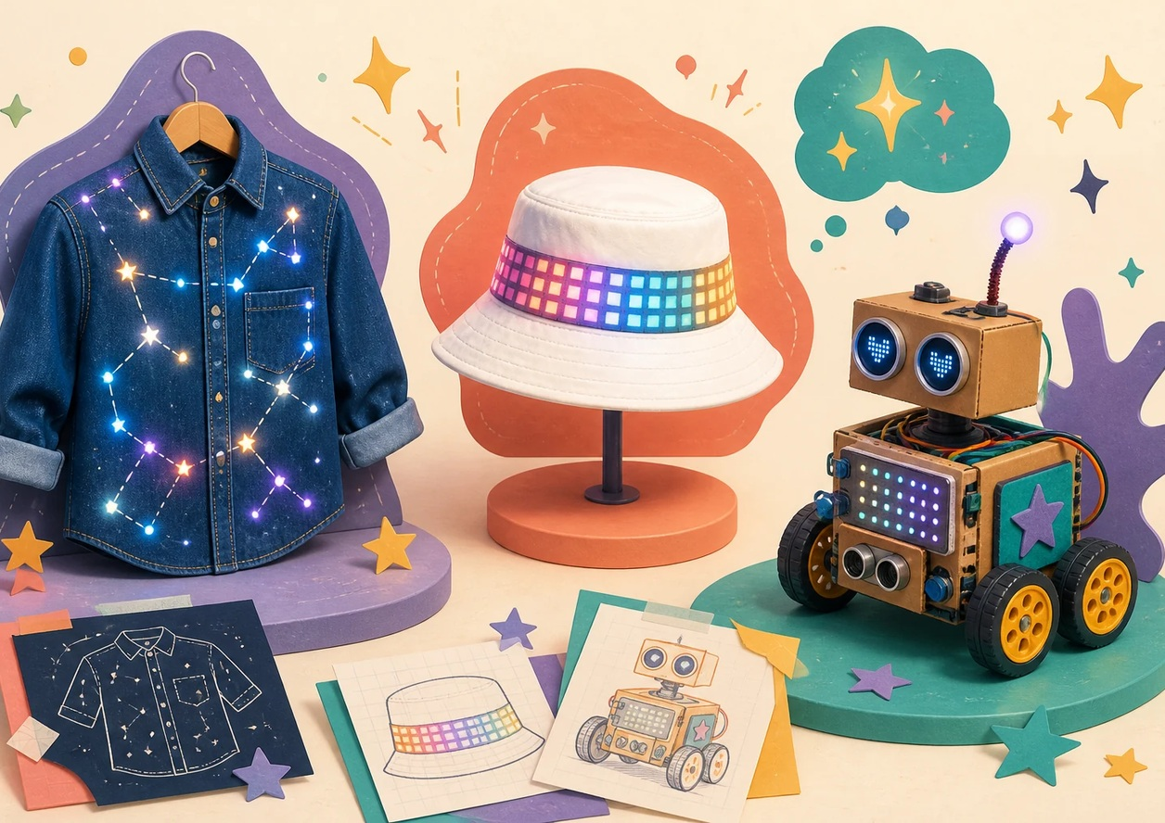
Make a future need interactive
If you could build something for your future community, what would it do?
1
Notice
A sensor detects light, sound, distance, or a dial.
2
Decide
Your BirdBlox program chooses what happens next.
3 Respond — lights, motion, or sound make the idea come alive.
LIMITLESS • ROOM 14
5
Notes:
Pause for student ideas. Take two or three answers, then connect each idea to the simple robotics loop: notice, decide, respond.
[Sources]
- Workspace source: creative-robotics.html
- Workspace image: assets/images/project-concepts-cartoon.webp
[/Sources]

Slide 6
The commitment is clear—and worth it
5
3
2
full workdays
lunch checkpoints
public showcases
Sept. 14 • Nov. 16 • Dec. 7
Jan. 25 • Feb. 22
Oct. 21 • Jan. 13 • Feb. 10
Stauffer Gala • March 1
District Gala • March 18
Room 14 is home base. Students also plan, document, test, and make up missed classwork between sessions.
LIMITLESS • ROOM 14
6
Notes:
Walk through the commitment honestly. The five workdays are full school-day pull-outs in Room 14; students are responsible for arranging and completing missed classwork. The three lunch checkpoints are separate from today's recruitment lunch.
[Sources]
- Workspace source: recruitment.html
- Workspace source: program-roadmap.html
- Workspace source: google-forms/StaufferFemineersRecruitment.gs
- Recruitment hub: https://spartandesign.github.io/stauffer-femineers/recruitment.html
[/Sources]

Slide 7
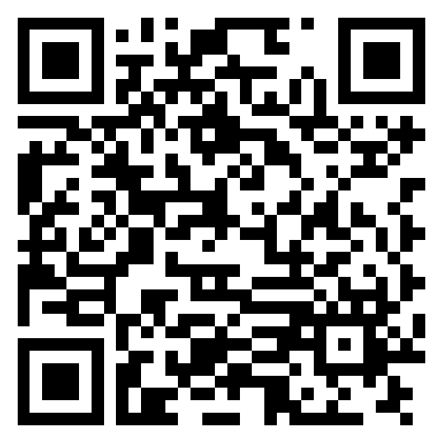
YOUR NEXT STEP
Apply by
September 4
1. Scan the recruitment page.
2. Complete the first-year application.
3. Review the commitment with your family.
50 spaces • No experience required
Open the Stauffer Femineers recruitment page
A teacher recommendation can support your application, but it does not replace it.
QUESTIONS? ASK A MENTOR
7
Notes:
Give students time to scan the code. Clarify that the QR opens the recruitment hub, where first-year students choose the student application and families review the commitment. Close with questions.
[Sources]
- Workspace source: recruitment.html
- Workspace image: assets/images/recruitment-qr.png
- Recruitment hub: https://spartandesign.github.io/stauffer-femineers/recruitment.html
- Staff recommendation form (not the student application): https://forms.gle/sE54GRSr9tNdvAqL8
[/Sources]

