Slide 1
PROBLEM STATEMENT #5 · EV BATTERY CELL IMBALANCE DETECTION
CellSense
Predictive cell imbalance detection for EV battery packs
Find the weakest cell before it costs you range.
96-cell pack · each square is one cell
TEAM BITSTORM
Cell 47: degrading, ~11 km lost
Mohammed Amees
Girish Kumara M
Cell 12: low charge, balance
Pranav N
Prajwal V
Cell 83: early drift, monitor
Notes:
CellSense, by Team BitStorm, for problem statement #5: EV battery cell imbalance detection. One line pitch: we find the weakest cell in a battery pack before it costs the driver range, and we explain why it is weak and what to do about it. The grid on the right is the motif for the deck: one square per cell in a 96-cell pack.

Slide 2



A battery pack is only as strong as its weakest cell
THE PROBLEM
An EV pack wires around 96 cells in series. The same current flows through every one of them, so the whole pack has to stop the moment any single cell reaches its limit.
One weak cell, and the whole pack stops early
Lost range
One weak cell strands the energy still left in all the others.
Faster ageing
The weakest cell is stressed hardest every cycle, so it degrades even faster.
Safety risk
Usable energy
Stranded energy
Weakest cell
Cells pushed past their limits run hot; in extreme cases this becomes a fire risk.
Usable pack capacity = capacity of the weakest cell
Illustration: 12 of 96 cells shown, levels exaggerated for clarity
Notes:
In a series pack every cell carries the same current, so the pack has to stop discharging when the weakest cell hits its cut-off. Everything still stored in the healthy cells above that line is stranded. That costs range, it makes the weak cell work hardest so it ages fastest, and pushing cells past their limits is a safety risk.

Slide 3



Today's BMS reacts only after the damage starts
THE GAP
Simulated example: how far one degrading cell sits below the pack median under load
~435 cycles
CellSense flags it
~cycle 100 (|z| ≥ 3)
Fixed alarm trips
~cycle 535
earlier warning than a fixed 100 mV alarm: about 17 months of daily driving in this example
Where today's BMS falls short
Fixed thresholds
Alarms only once a hard limit is crossed.
Blind to root cause
Cannot tell low charge from degradation.
No look-ahead
No forecast of which cell fails next.
Notes:
A conventional BMS watches fixed limits: a cell voltage window and maybe a fixed imbalance threshold. A degrading cell drifts slowly, so the alarm only trips once the cell is already far gone. In our simulated example, comparing each cell to the rest of the pack flags the drift around cycle 100; the fixed 100 mV alarm trips around cycle 535. The BMS also cannot say why a cell is low, or which cell will fail next.

Slide 4




CellSense: detect, diagnose, forecast, translate
OUR SOLUTION
WHAT IT DOES
1 · DETECT
2 · DIAGNOSE
Spot the outlier early
Balance or replace?
Compares every cell against the rest of the pack, continuously, and explains what it finds.
Rolling z-scores against the pack median, plus an Isolation Forest for subtle multi-signal outliers.
Internal resistance from ΔV/ΔI separates a cell that needs balancing from one that needs replacing.
Not just which cell is off, but why, what happens next, and what it costs the driver.
3 · FORECAST
4 · TRANSLATE
Predict the weakest link
Speak in km, not mV
Each cell's drift rate forecasts which cell will limit the pack next, and roughly when.
"Cell 47 is costing you ~11 km", with a clear balance, monitor or replace action.
Notes:
CellSense has four layers. Detect: compare every cell to the pack median with rolling z-scores and an Isolation Forest. Diagnose: estimate internal resistance from how voltage responds to current changes, which separates a low-charge cell from a degrading one. Forecast: track drift rates to predict the next limiting cell and when. Translate: express it as range lost in km with a clear action.

Slide 5




From simulated pack to driver-ready insight
HOW IT WORKS
01
02
03
04
Simulate
Extract features
Detect & predict
Act
PyBaMM + liionpack model a 96-cell pack
Realistic cell-to-cell spread
Inject faults: fade, resistance, self-discharge
Deviation from pack median
Rolling robust z-scores
ΔV/ΔI internal resistance at current steps
Isolation Forest anomaly score
Balance-vs-replace diagnosis
Drift forecast with confidence band
Live 96-cell heatmap and alerts
Range lost in km, plus next action
Fault-injection demo mode
VALIDATION
NASA PCoE battery ageing data
Oxford battery degradation dataset
100% software, no hardware needed
TECH STACK
Python
PyBaMM
liionpack
NumPy / pandas
scikit-learn
Plotly dashboard
Notes:
The whole system runs in software. PyBaMM with liionpack simulates a 96-cell pack with realistic spread in capacity and resistance, and we inject faults. A feature engine computes each cell's deviation from the pack median, rolling z-scores and resistance from voltage response to current steps. Models score anomalies, decide balance versus replace, and forecast drift. The dashboard shows it live. Public NASA and Oxford ageing data back up the degradation patterns.

Slide 6
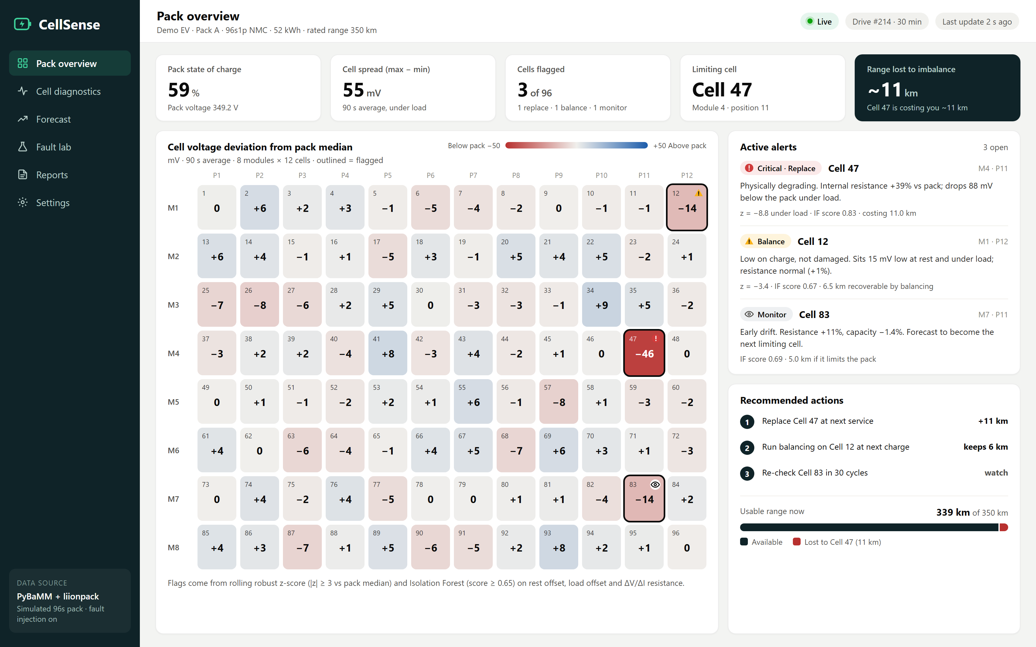
Live pack view: every cell, compared in real time
SCREEN 1 · PACK OVERVIEW
1
Live 96-cell heatmap
3
Each cell's deviation from the pack median. Outliers stand out; flagged cells are outlined.
1
2
2
Explainable alerts
Each alert states the problem, the evidence (z-score, Isolation Forest score) and the action.
3
Range lost, in km
Cell 47 is costing about 11 km. Replacing it and balancing Cell 12 wins that back.
Concept mockup rendered from a simulated 96-cell pack. Values are illustrative.
Notes:
The pack overview. The heatmap shows all 96 cells as their deviation from the pack median, so a weak cell stands out immediately. Alerts on the right explain each flag and give an action. The dark tile translates it all into range: Cell 47 is costing about 11 km.

Slide 7
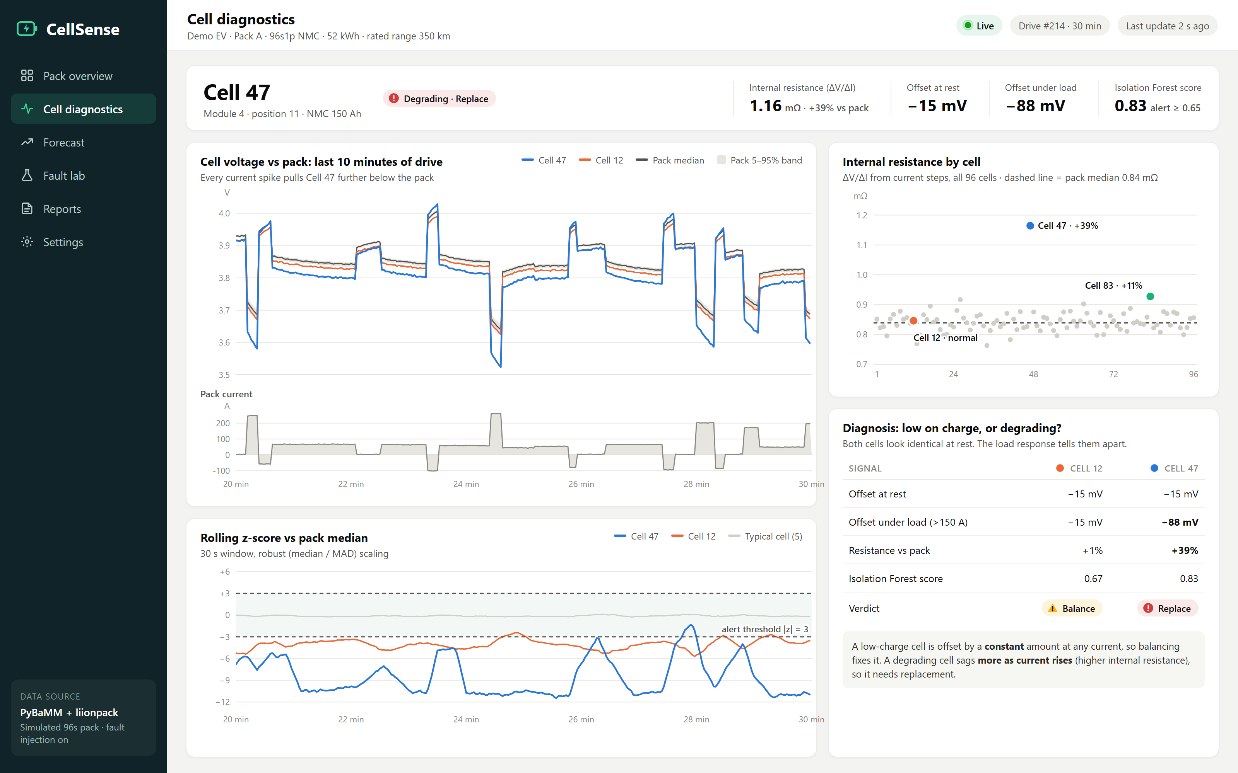
Cell diagnostics: low on charge, or degrading?
SCREEN 2 · CELL DIAGNOSTICS
1
See the sag under load
Cell 47 tracks the pack at rest but drops further below it with every current spike.
1
2
2
Resistance for every cell
ΔV/ΔI at current steps estimates internal resistance: Cell 47 is 39% above the pack.
3
3
Balance or replace?
Same offset at rest, different response under load: Cell 12 needs balancing, Cell 47 needs replacing.
Concept mockup rendered from a simulated 96-cell pack. Values are illustrative.
Notes:
This is the diagnose step. Cells 12 and 47 both sit about 15 mV low at rest, so a simple threshold would treat them the same. Under load, Cell 12 keeps the same offset while Cell 47 drops to nearly 90 mV below the pack. Its estimated internal resistance is 39% higher than the pack median. So Cell 12 just needs balancing, while Cell 47 is physically degrading and needs replacement.

Slide 8
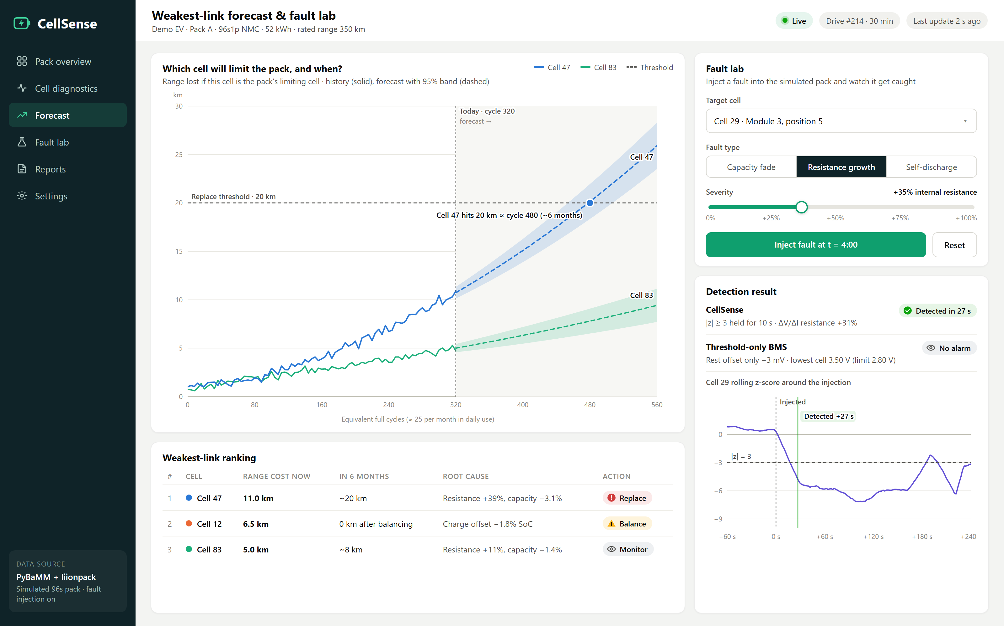
Forecast the weakest link, and inject a fault live
SCREEN 3 · FORECAST AND FAULT LAB
1
Weakest-link forecast
1
2
Drift trends project when Cell 47 crosses the replace threshold: about 6 months ahead.
2
Live fault injection
3
During the demo, judges pick a cell, a fault type and a severity; the simulator injects it live.
3
Caught in seconds
CellSense flagged the injected fault in 27 s. A threshold-only BMS raised no alarm.
Concept mockup rendered from a simulated 96-cell pack. Values are illustrative.
Notes:
Forecast: we track each cell's drift and project when it crosses a replace threshold, so service can be planned months ahead. Fault lab is our live demo moment: pick a cell, a fault type and a severity, inject it, and watch CellSense catch it within seconds while a threshold-only check stays silent.

Slide 9

From reactive alarms to predictive, explainable care
WHY IT STANDS OUT
 | Conventional BMS | CellSense
When it warns | After a fixed voltage limit is crossed | As soon as a cell drifts away from the pack
What it catches | Single-signal threshold breaches | Subtle multi-signal outliers (z-score + Isolation Forest)
Root cause | Not identified | ΔV/ΔI tells low charge from degradation
Looking ahead | None | Which cell limits the pack next, and when
What you see | Millivolts and fault codes | Range lost in km, plus a clear next action
BONUS COVERAGE
Also addresses
#1
Battery health monitoring
#10
Predictive maintenance
Outcome
Safer packs, issues caught early
More usable range per charge
Longer pack life, planned service
Notes:
Compared with a conventional BMS, CellSense warns earlier, catches subtler outliers, explains the root cause, looks ahead, and speaks in kilometres and actions instead of millivolts. Because it monitors health and predicts failures, it also covers problem statements 1 (battery health) and 10 (predictive maintenance).

Slide 10
Under the hood: four explainable calculations
TECHNICAL APPROACH
STEP
THE MATH
IN PLAIN WORDS
z = (V − pack median) ÷ (1.4826 × MAD)
How unusual is this cell compared with the rest of the pack right now? Alert when |z| ≥ 3 for 10 s, or the Isolation Forest score is ≥ 0.65.
Detect
R ≈ −ΔV ÷ ΔI at every current step
When current jumps, a high-resistance cell's voltage jumps further. Same offset at any current: balance. R ≥ 1.2 × pack median: replace.
Diagnose
deficit(cycle) = a + b·cycle + c·cycle²
Fit each cell's capacity-deficit trend, project it forward with a confidence band, and read off when it crosses the replace threshold.
Forecast
km lost ≈ (median charge − weakest charge) ÷ nominal charge × rated range
Cell 47 holds 3.1% less usable charge than the median cell, so 3.1% × 350 km ≈ 11 km of range is lost.
Translate
Notes:
These are the four calculations behind CellSense, and each one is explainable. Detect uses a robust z-score: how far a cell sits from the pack median, scaled by the median absolute deviation, plus an Isolation Forest for combinations a single score misses. Diagnose estimates internal resistance from the voltage jump at each current step. Forecast fits each cell's drift trend and projects when it crosses the replace threshold. Translate converts the charge the weakest cell is missing into kilometres of range.

Slide 11


How we build and prove it, without any hardware
SIMULATION & VALIDATION
Fault | How we inject it | Signature CellSense looks for | Action
Charge imbalance | SoC offset of 1–3% | Same offset at every current | Balance
Resistance growth | +20% to +60% resistance | Sag grows as current rises | Replace
Capacity fade | −2% to −6% capacity | Drifts lower as the pack discharges | Monitor, then replace
Self-discharge | Small leakage current | Offset grows while parked | Inspect
SIMULATED PACK
Pack
96 cells in series (96s1p), NMC
Simulator
PyBaMM + liionpack
Cell-to-cell spread
Capacity σ ≈ 0.35%, resistance σ ≈ 3.5%
Drive cycles
City, highway and mixed profiles
Validation
Ageing trends vs. NASA + Oxford data
WHAT WE WILL MEASURE
Detection delay
Precision & recall
Diagnosis accuracy
Forecast error
Seconds from fault injection to the first alert
Correct flags vs. missed faults and false alarms
Balance vs. replace calls that match the fault
Predicted vs. actual cycles to the threshold
Notes:
Everything is built in simulation. PyBaMM with liionpack models a 96-cell series pack with realistic spread between cells, driven by city, highway and mixed current profiles. We then inject four fault types at random cells and severities, each with a different signature, and measure how fast we detect them, how often we are right, whether the balance-or-replace call is correct, and how accurate the forecast is. Degradation trends are cross-checked against NASA and Oxford ageing data.

Slide 12





Why it's buildable now, and what could go wrong
FEASIBILITY & RISKS
Why it's feasible
Risks and how we handle them
Software only
Simulation is not a real pack
Open-source simulators replace lab hardware. Everything runs in Python on a laptop.
Physics-based features, with ageing trends cross-checked on NASA and Oxford data.
Lightweight models
Sensor noise causes false alarms
z-scores and an Isolation Forest score all 96 cells in milliseconds, light enough for an edge unit.
Robust median/MAD statistics, rolling windows and a 10 s persistence rule.
Uses existing signals
Temperature shifts resistance
Needs only what every BMS already measures: cell voltages and pack current.
Cells are compared with each other at the same instant, so pack-wide effects cancel.
Right skills
Range depends on driving style
Our data-engineering and BI strengths map directly to time-series pipelines and dashboards.
Shown against rated range for now; refined with real consumption data later.
Notes:
Why this is feasible: it is software only, the models are light, it uses signals every BMS already has, and it matches our skills. The main risks: simulation differs from real packs, sensor noise can cause false alarms, temperature changes resistance, and range depends on driving style. Each has a mitigation, mostly by comparing cells with each other rather than against fixed limits.

Slide 13




Who benefits, and how
IMPACT
Drivers
Fleet operators
OEMs & service
Sustainability
Warnings in km, not millivolts
Range recovered by timely balancing
Fewer surprise breakdowns
Service planned before failures
Less vehicle downtime
Pack health compared across the fleet
Replace one cell or module, not the pack
Root-cause evidence for warranty claims
Early warning on weak cell batches
Longer pack life
Fewer packs scrapped early
Better grading for second-life use
CellSense shifts battery care from reactive to predictive: safer packs, more range, longer life.
Notes:
Drivers get warnings they understand and range back through balancing. Fleets can plan service before failures. OEMs and service centres can replace a single cell or module instead of a whole pack, with root-cause evidence for warranty. And longer pack life means fewer packs scrapped and better grading for second-life use.

Slide 14
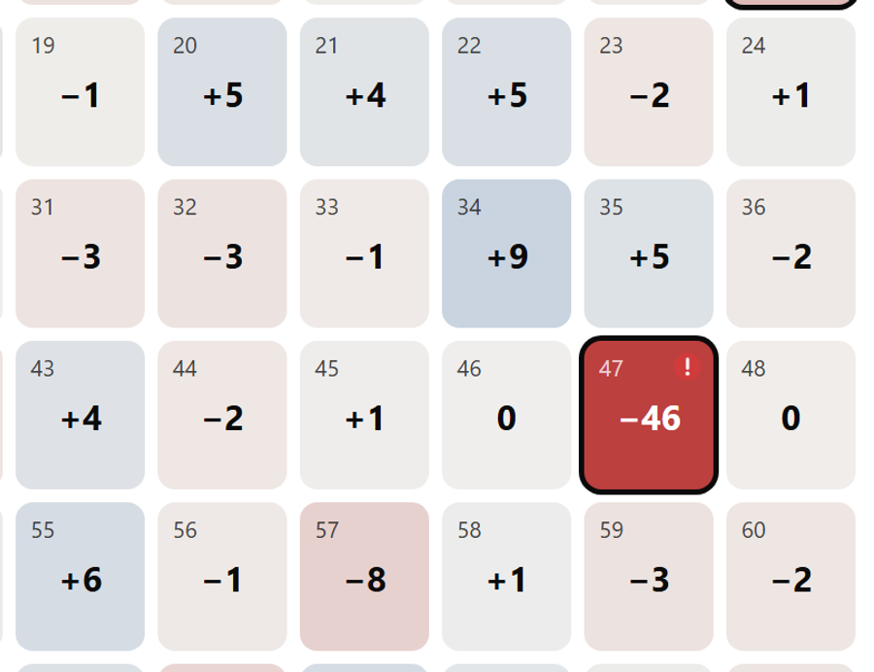
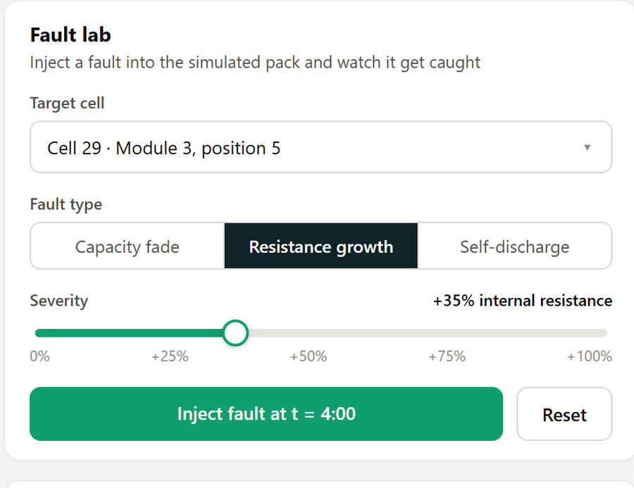
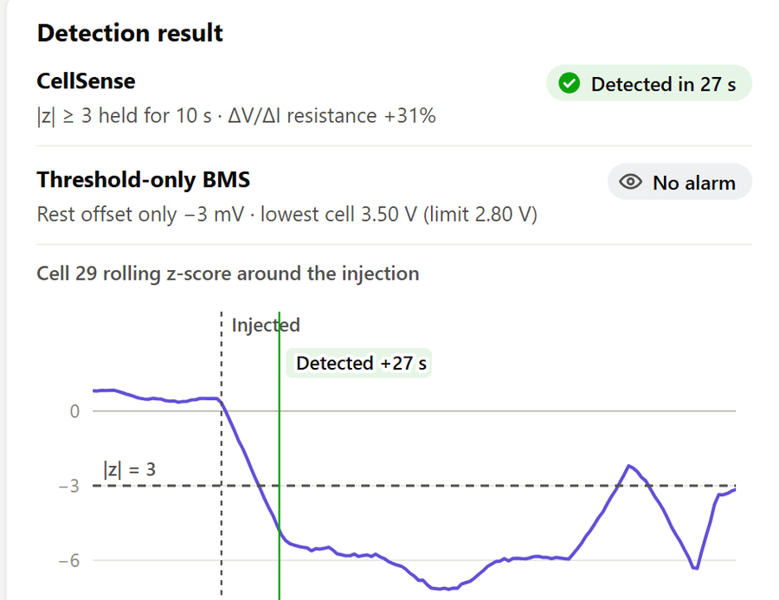
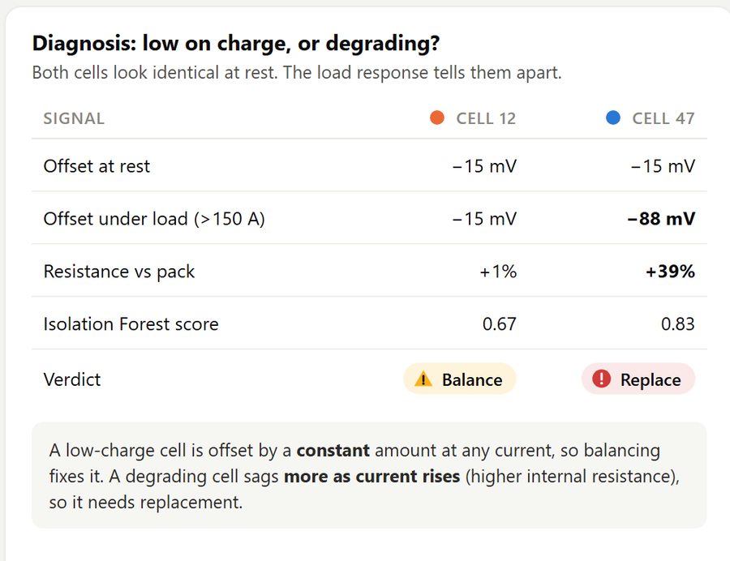
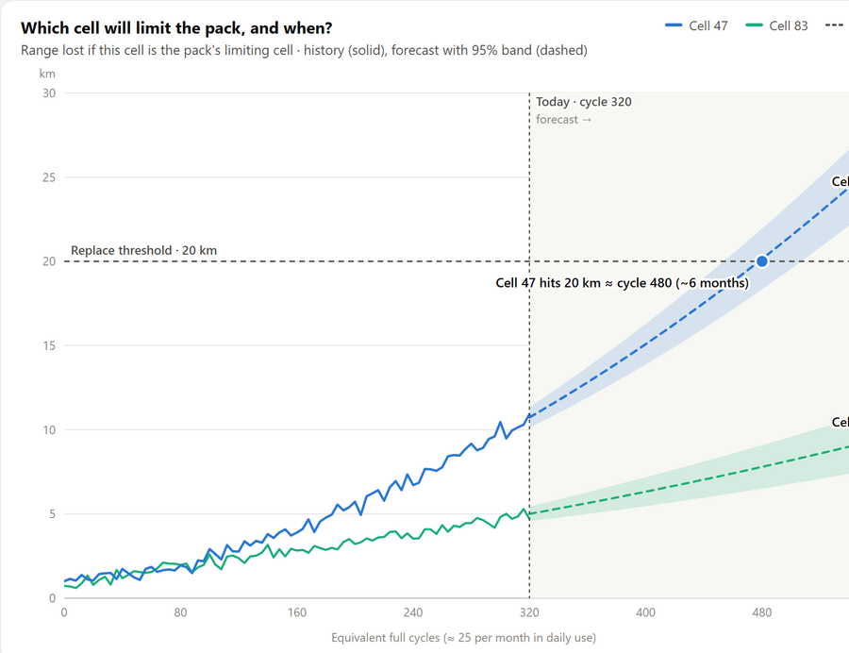

The demo: judges break a cell, we catch it
LIVE DEMO PLAN
1
Show the pack
2
Inject a fault
3
Catch it
4
Explain it
5
Show the cost
96 cells stream from the simulator; the heatmap compares every cell with the pack.
A judge picks any cell, a fault type and a severity in the Fault lab.
CellSense flags the cell within seconds; a threshold-only BMS stays silent.
ΔV/ΔI shows if it is low charge (balance) or degradation (replace).
Range lost in km, and when this cell will limit the pack.
Judges choose the cell, the fault type and the severity, so the detection is live, not scripted.
Notes:
Demo script, about three minutes. One: show the live 96-cell pack. Two: hand a judge the Fault lab and let them pick a cell, a fault type and a severity. Three: CellSense flags it within seconds while the threshold-only check stays silent. Four: open the cell and show whether it needs balancing or replacing. Five: show the range it costs and the forecast.

Slide 15
From hackathon prototype to real packs
ROADMAP
WE ARE HERE
PHASE 1 · NOW
PHASE 2 · NEXT
PHASE 3 · PILOT
PHASE 4 · SCALE
Hackathon prototype
Validate at scale
Real vehicle data
Deploy
Simulated 96-cell pack with fault injection
Detection, diagnosis and forecast
Dashboard with a live Fault lab
Benchmark on randomized fault runs
Cross-check with NASA and Oxford data
Tune thresholds, add temperature
Read BMS logs over the CAN bus
Pilot with an EV two- or three-wheeler fleet
Calibrate range lost to real consumption
Edge module beside the BMS
Fleet cloud dashboard and alerts
Second-life grading for retired packs
DONE WHEN
DONE WHEN
DONE WHEN
DONE WHEN
A judge-injected fault is caught live on stage
A benchmark report with precision, recall and delay
Alerts match what technicians find
It runs on vehicles with no laptop attached
Notes:
Phase one is what we build at the hackathon. Next, we validate at scale with randomized fault benchmarks and public ageing data. Then a pilot on real vehicle data read from the BMS over CAN, for example with an electric two- or three-wheeler fleet. Finally, deployment as an edge module beside the BMS with a fleet dashboard, and second-life grading for retired packs.

Slide 16

Tools, data and methods we build on
REFERENCES
1
Sulzer, V., Marquis, S. G., Timms, R., Robinson, M. & Chapman, S. J. (2021). Python Battery Mathematical Modelling (PyBaMM). Journal of Open Research Software.
2
Tranter, T. G. et al. (2022). liionpack: A Python package for simulating packs of batteries with PyBaMM. Journal of Open Source Software.
OPEN BY DESIGN
3
Liu, F. T., Ting, K. M. & Zhou, Z.-H. (2008). Isolation Forest. IEEE International Conference on Data Mining (ICDM).
Every tool and dataset we use is open source or publicly available.
4
Saha, B. & Goebel, K. (2007). Battery Data Set. NASA Ames Prognostics Data Repository.
PyBaMM and liionpack
scikit-learn
NASA PCoE battery data
Oxford degradation data
5
Birkl, C. (2017). Oxford Battery Degradation Dataset 1. University of Oxford.
6
Iglewicz, B. & Hoaglin, D. C. (1993). How to Detect and Handle Outliers. ASQC Quality Press.
Notes:
These are the tools, datasets and methods CellSense builds on. All of them are open source or publicly available, so anyone can reproduce our results.

Slide 17
CELLSENSE · TEAM BITSTORM
Thank you
Questions?
Find the weakest cell before it costs you range.
One weak cell found. The other 95 keep their range.
TEAM BITSTORM
Mohammed Amees
Girish Kumara M
Pranav N
Prajwal V
Notes:
Thank you. CellSense finds the weakest cell before it costs you range, explains why, and tells you what to do. Happy to take questions, or to let you break a cell in the live demo.

