Slide 1
MENTORING ROUND
PROBLEM STATEMENT #5 · EV BATTERY CELL IMBALANCE DETECTION
CellSense
Predictive cell imbalance detection for EV battery packs
Find the weakest cell before it costs you range.
96-cell pack · each square is one cell
TEAM BITSTORM
Cell 47: degrading, ~11 km lost
Mohammed Amees
Girish Kumara M
Cell 12: low charge, balance
Pranav N
Prajwal V
Cell 83: early drift, monitor
Notes:
About 30 seconds. CellSense, Team BitStorm, problem statement 5. One line: we find the weakest cell in an EV battery pack before it costs the driver range, explain why it is weak, and say what to do. We have about five minutes and would most like your feedback on the questions on our last slide.

Slide 2



One weak cell drags down the whole pack
THE PROBLEM
In a series pack every cell carries the same current, so the pack must stop when its weakest cell runs out.
Why today's BMS misses it
Fixed thresholds
The weakest cell sets the limit
Alarms only once a hard voltage limit is crossed.
Blind to root cause
Cannot tell low charge (balance) from degradation (replace).
No look-ahead
No forecast of which cell will fail next, or when.
~435 cycles
Usable energy
Stranded energy
Weakest cell
earlier warning than a fixed 100 mV alarm, in our simulated example of one degrading cell (about 17 months of daily driving)
Result: lost range, faster ageing of the weak cell, and a safety risk if it is pushed past its limits.
Notes:
About 45 seconds. In a series pack the same current flows through every cell, so the pack has to stop when the weakest one is empty, and the energy left in the others is stranded. Today's BMS uses fixed limits, so it reacts late, cannot say whether a cell needs balancing or replacing, and cannot predict which cell fails next. In our simulation, comparing each cell to the pack flags a degrading cell around 435 cycles before a fixed 100 mV alarm.

Slide 3








CellSense: detect, diagnose, forecast, translate
OUR SOLUTION
1 · DETECT
2 · DIAGNOSE
3 · FORECAST
4 · TRANSLATE
Spot the outlier early
Balance or replace?
Predict the weakest link
Speak in km, not mV
Rolling z-scores vs. the pack median, plus an Isolation Forest for subtle outliers.
ΔV/ΔI internal resistance tells a low-charge cell from a degrading one.
Drift trends show which cell will limit the pack next, and roughly when.
"Cell 47 is costing you ~11 km", plus a clear next action.
HOW IT RUNS: 100% SOFTWARE, NO HARDWARE NEEDED
Simulate
Extract
Model
Show
PyBaMM + liionpack, 96 cells, injected faults
Pack-median deviation, z-scores, ΔV/ΔI
Isolation Forest, rules, drift forecast
Live dashboard, alerts, range in km
Checked against NASA PCoE and Oxford battery-ageing data · Python, scikit-learn, Plotly
Notes:
About 60 seconds. Four layers. Detect: compare every cell to the pack median with rolling z-scores, plus an Isolation Forest. Diagnose: estimate internal resistance from voltage response to current steps, which separates balance from replace. Forecast: track drift to predict the next limiting cell. Translate: express it as kilometres of range and an action. It is all software: PyBaMM and liionpack simulate a 96-cell pack with injected faults, and we check ageing trends against NASA and Oxford data.

Slide 4
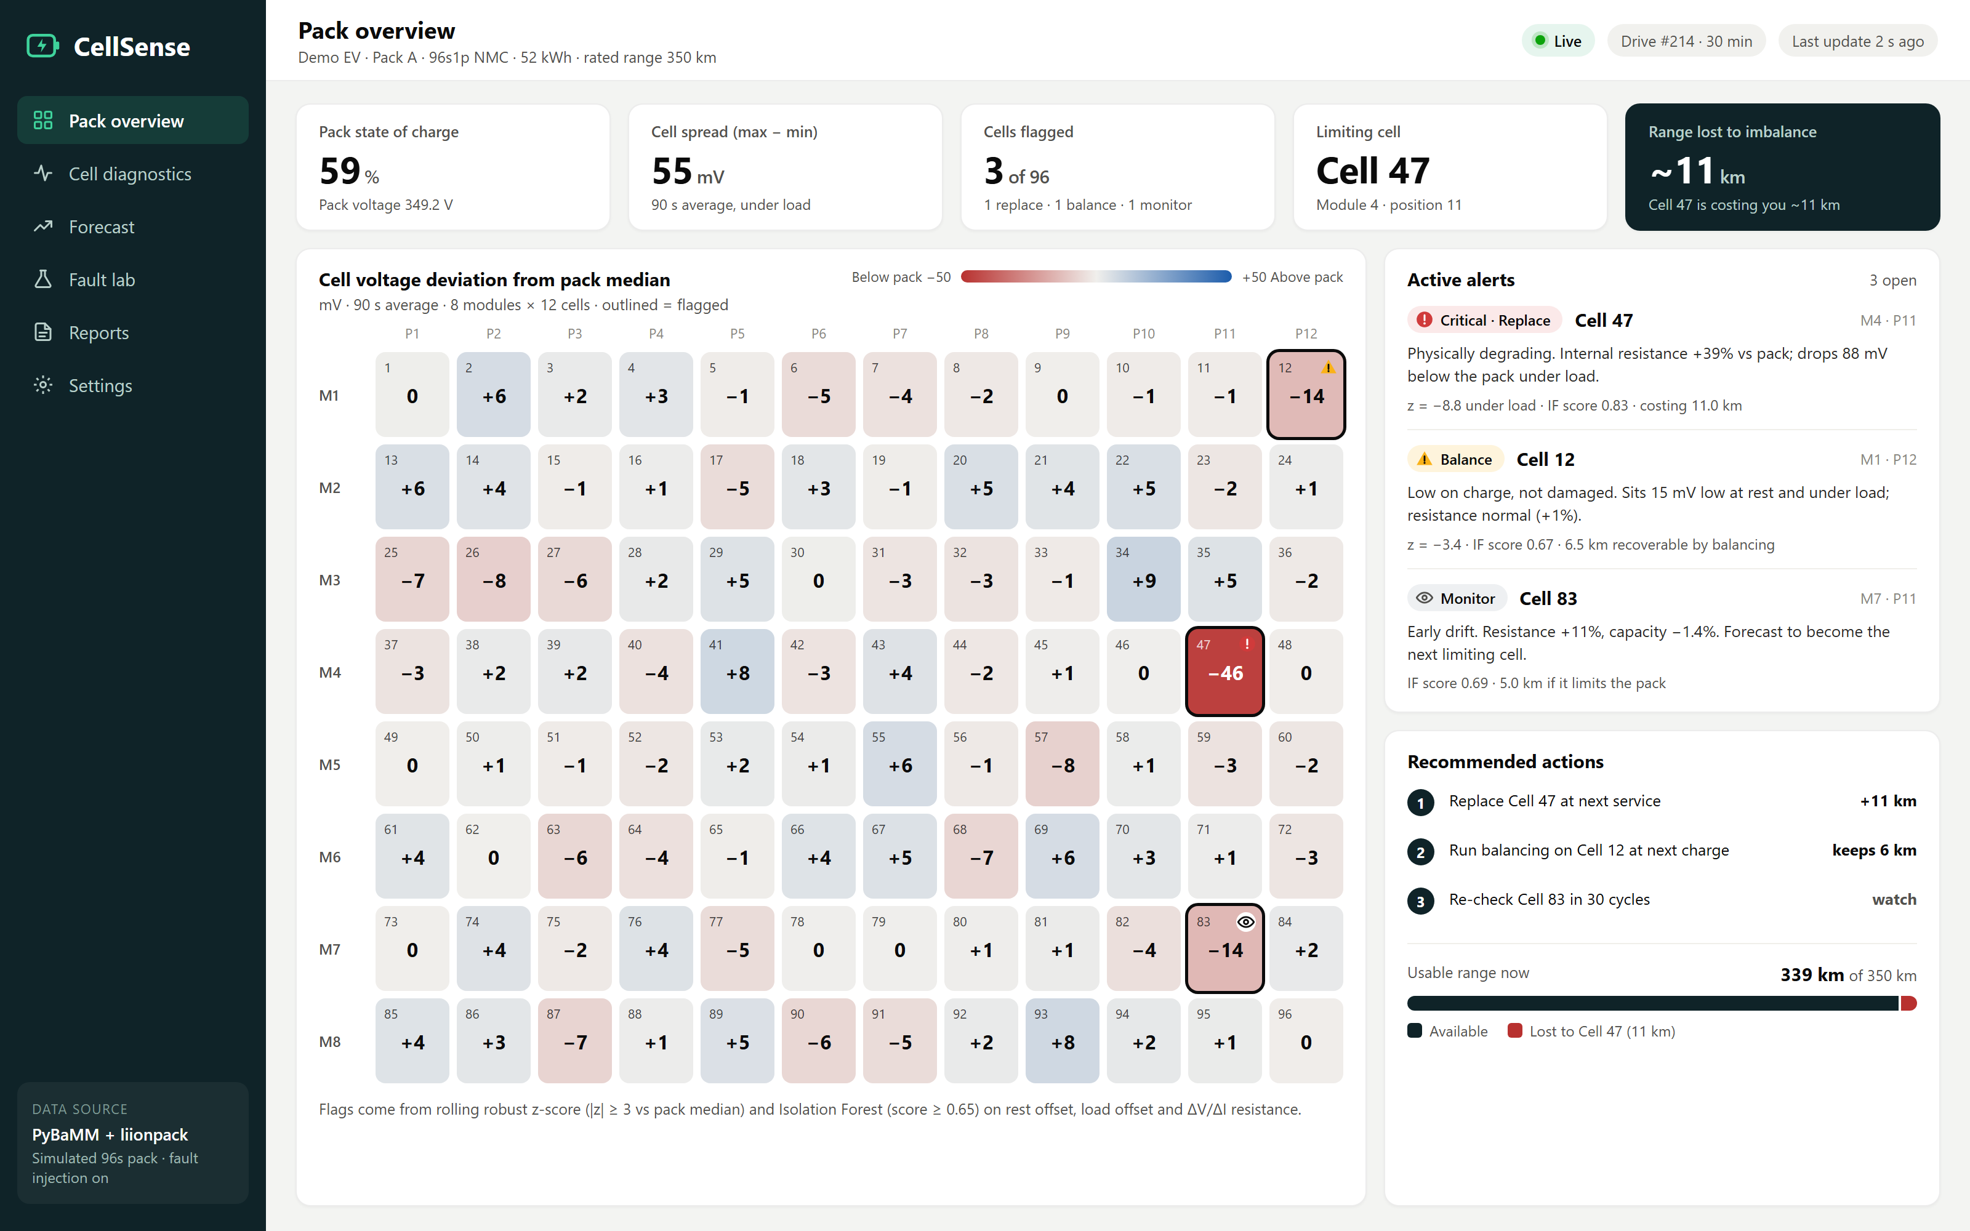
Live pack view: every cell, compared in real time
PROTOTYPE · SCREEN 1
1
Live 96-cell heatmap
3
Each cell's deviation from the pack median. Outliers stand out; flagged cells are outlined.
1
2
2
Explainable alerts
Each alert states the problem, the evidence (z-score, Isolation Forest score) and the action.
3
Range lost, in km
Cell 47 is costing about 11 km. Replacing it and balancing Cell 12 wins that back.
Concept mockup rendered from our simulated 96-cell pack. Values are illustrative.
Notes:
About 45 seconds. This is the main screen. The heatmap shows all 96 cells as their deviation from the pack median, so the weak cell stands out. Each alert says what is wrong, the evidence, and the action. The dark tile turns it into range: Cell 47 is costing about 11 km.

Slide 5
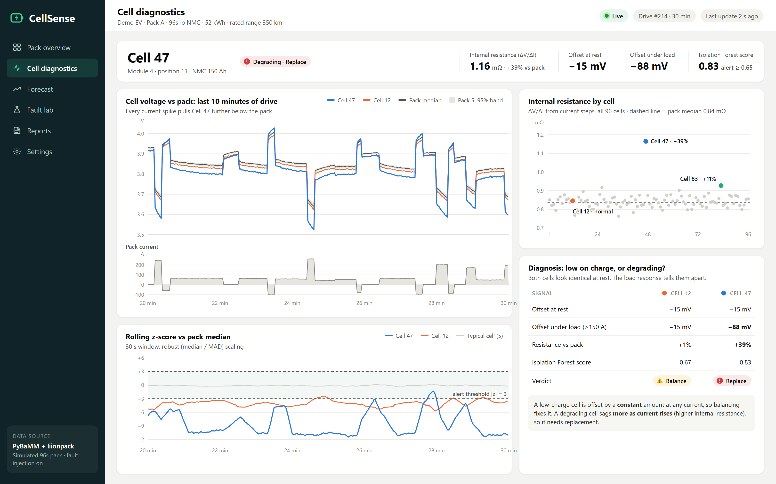
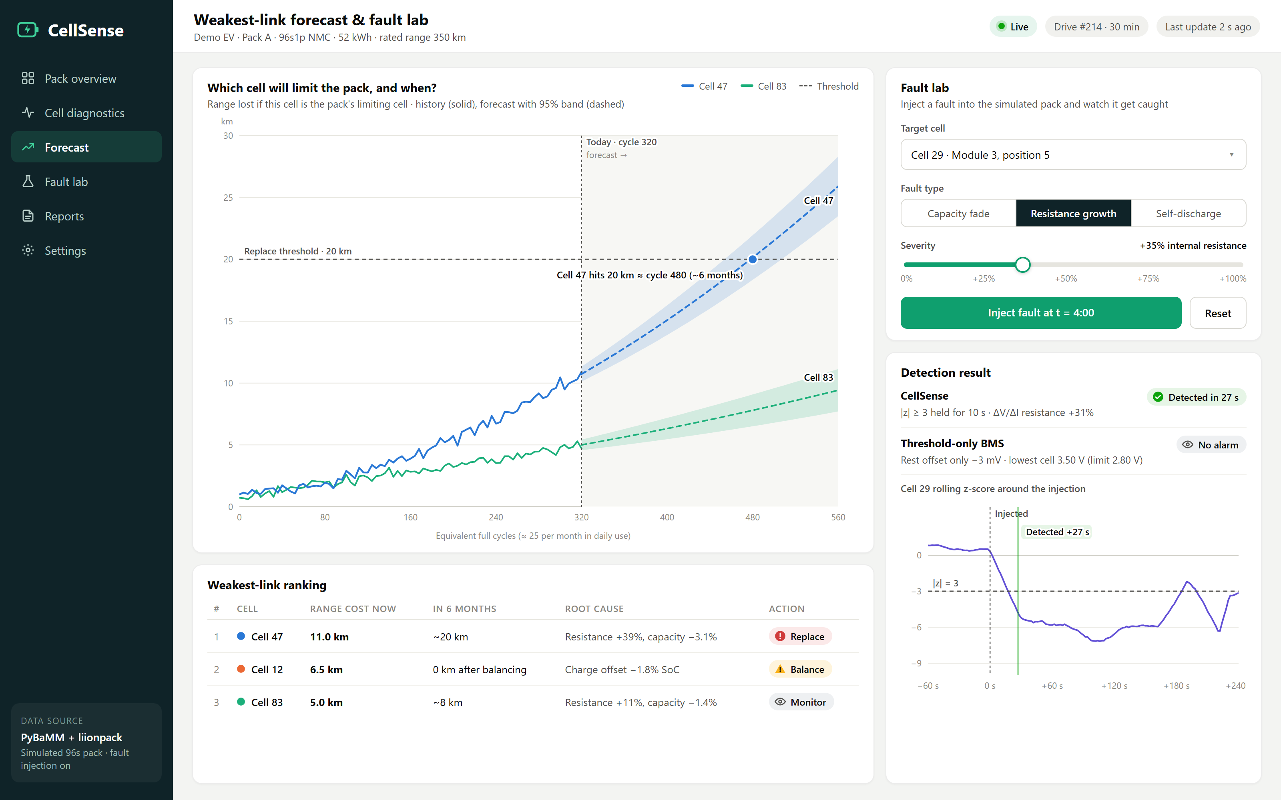
Diagnose the cause, then forecast the failure
PROTOTYPE · SCREENS 2 AND 3
2
Balance or replace?
3
Forecast + live fault lab
Cells 12 and 47 look the same at rest. Under load Cell 47 sags to −88 mV with 39% higher resistance, so it needs replacing; Cell 12 only needs balancing.
Cell 47 reaches the replace threshold in about 6 months. In the demo a judge injects a fault: CellSense flags it in 27 s, a threshold-only BMS stays silent.
Concept mockups rendered from our simulated 96-cell pack. Values are illustrative.
Notes:
About 45 seconds. Left: the diagnose step. Cells 12 and 47 both sit about 15 mV low at rest, but under load Cell 47 drops to nearly 90 mV below the pack and its resistance is 39% higher, so it is degrading; Cell 12 just needs balancing. Right: the forecast says Cell 47 hits the replace threshold in about six months, and the fault lab is our live demo: a judge breaks a cell and we catch it within seconds.

Slide 6



Where we are, and where we'd value your input
STATUS AND ASKS
Where we are
WE'D VALUE YOUR FEEDBACK ON
DONE
Problem framing, solution design, dashboard concept
1
Is a simulated pack, checked against public ageing data, convincing enough, or should we find real BMS logs?
IN PROGRESS
2
What matters most to EV teams: earlier detection, the balance-vs-replace diagnosis, or range in km?
96-cell PyBaMM + liionpack pack with fault injection
NEXT
3
Is a 96-cell series pack the right scope, or should we model a two- or three-wheeler pack?
Detection and diagnosis models, live Fault lab, validation on NASA and Oxford data
4
Are detection delay, precision/recall and forecast error the right proof for the final round?
Final-round goal: a judge injects a fault live, and CellSense catches and explains it in seconds.
Notes:
About 60 seconds, then questions. Be honest about status: what is done, what is in progress, what is next. Then ask the four questions on the right and note the answers. Most important for us: is simulation plus public data enough, and which of our features matters most to industry.

