Slide 1
From Belief to Behavior
Modeling and Tracking Moral Alignment
in Autonomous Agents
Soraya Partow
Master of Science in Computer Science
Thesis Advisor: Dr. Satyaki Nan
Georgia Southwestern State University | 2026

Slide 2
The AI Alignment Challenge
RLHF
Black-box reward models offer no transparent justification for decisions
Opaque reasoning
Constitutional AI
Hard constraints create brittleness in edge cases and novel situations
Rigid rules
Value Learning
Implicit value representations lack stability guarantees over time
Value drift

Slide 3
The VAST Framework
Value-Aligned Structured Tracking
Belief Model
JWMC Revision
EEU-CC Decision
Four Gauges
(pi, kappa, J)
Belief Update
Action Selection
Monitoring
Tripartite representation separating credence, confidence, and justification
Justification-weighted moral consistency operator preserving value stability
Ethical expected utility with cascading soft constraints for flexible reasoning
Real-time calibration, normative alignment, coherence, and reasoning quality
->
->
->

Slide 4
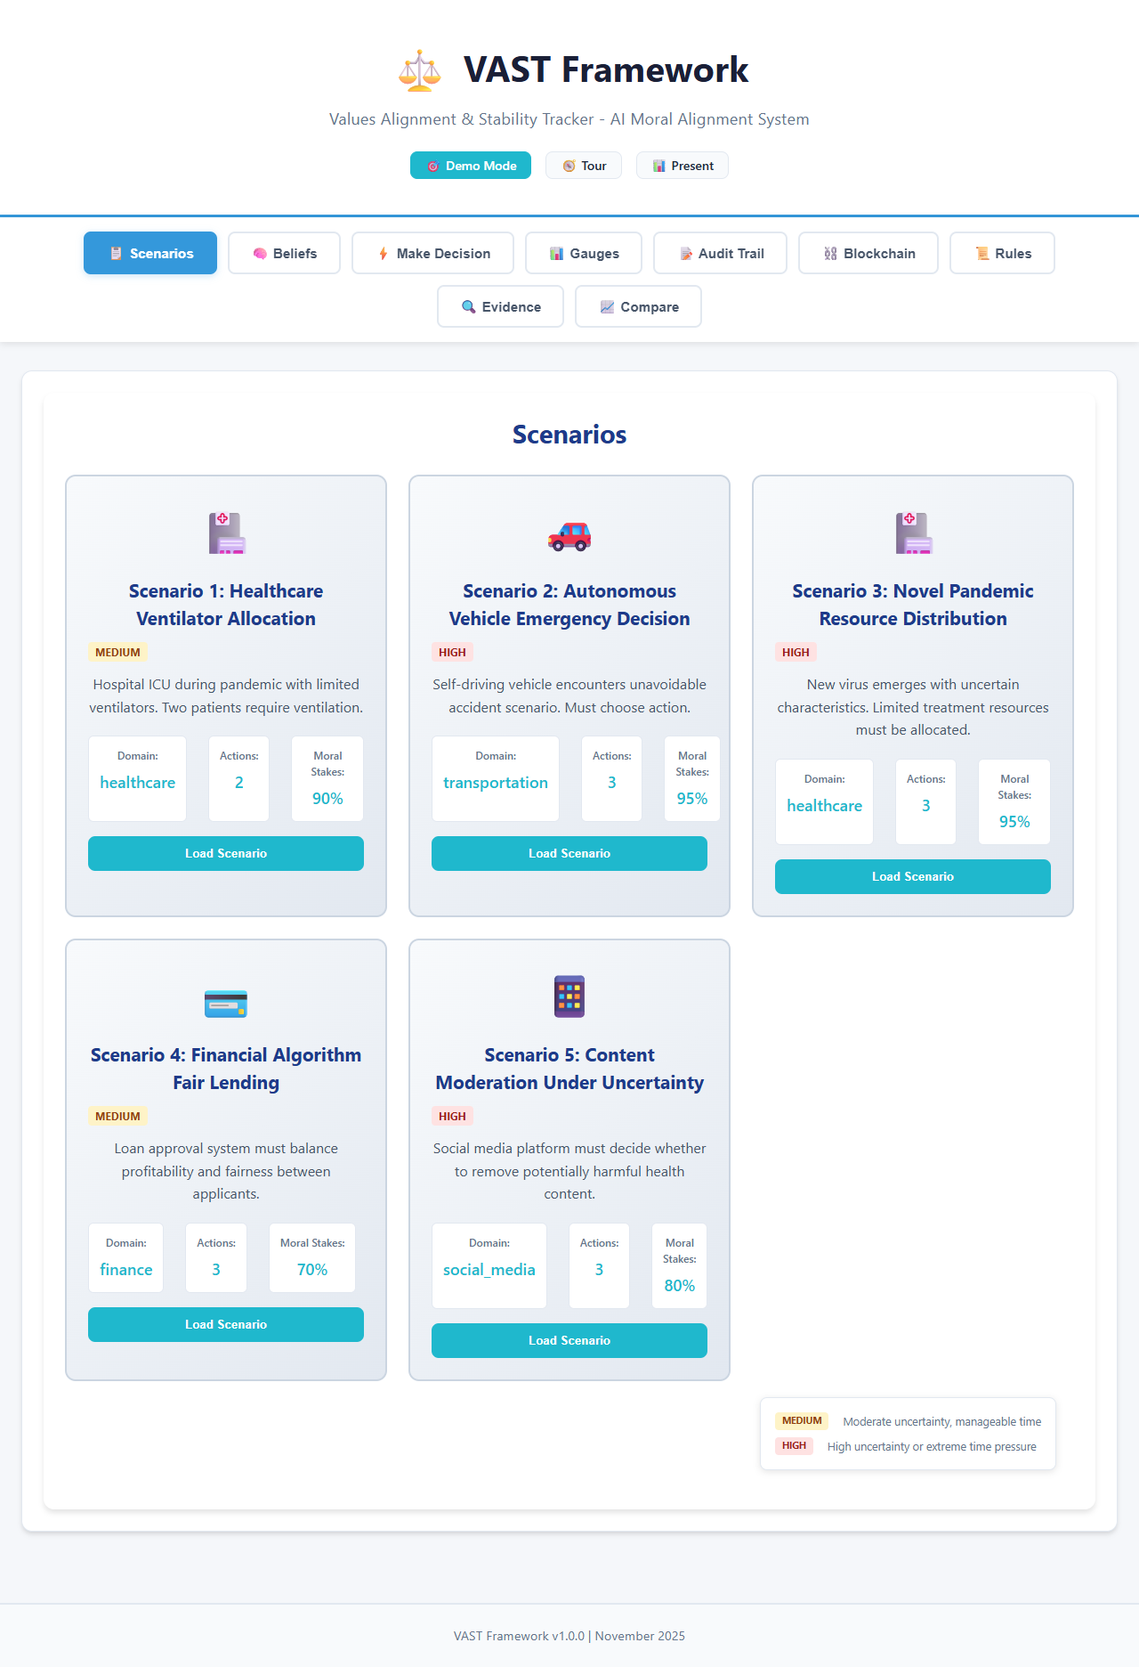
LIVE DEMO
Scenario Selection

Slide 5
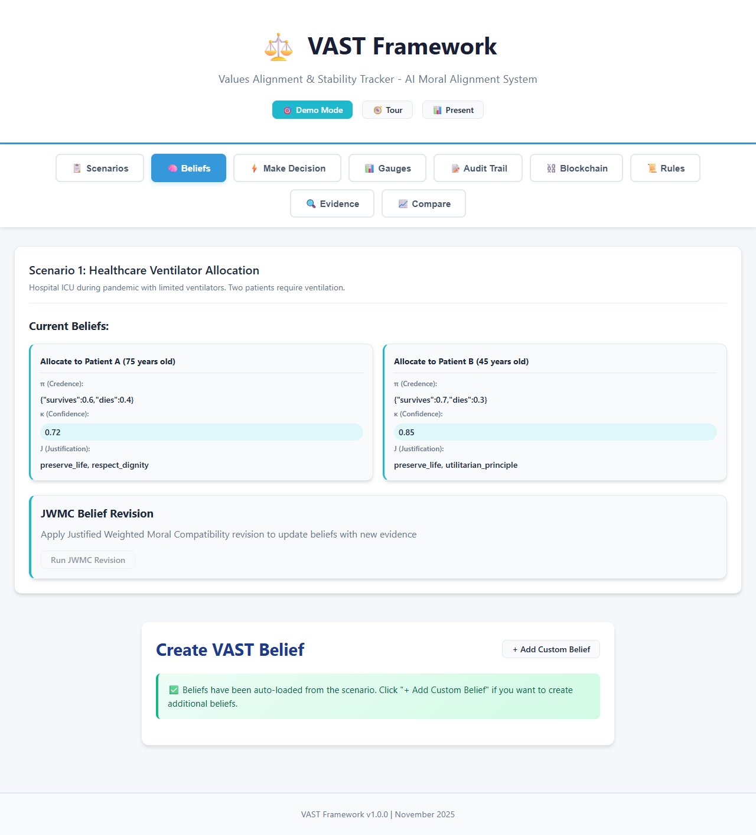
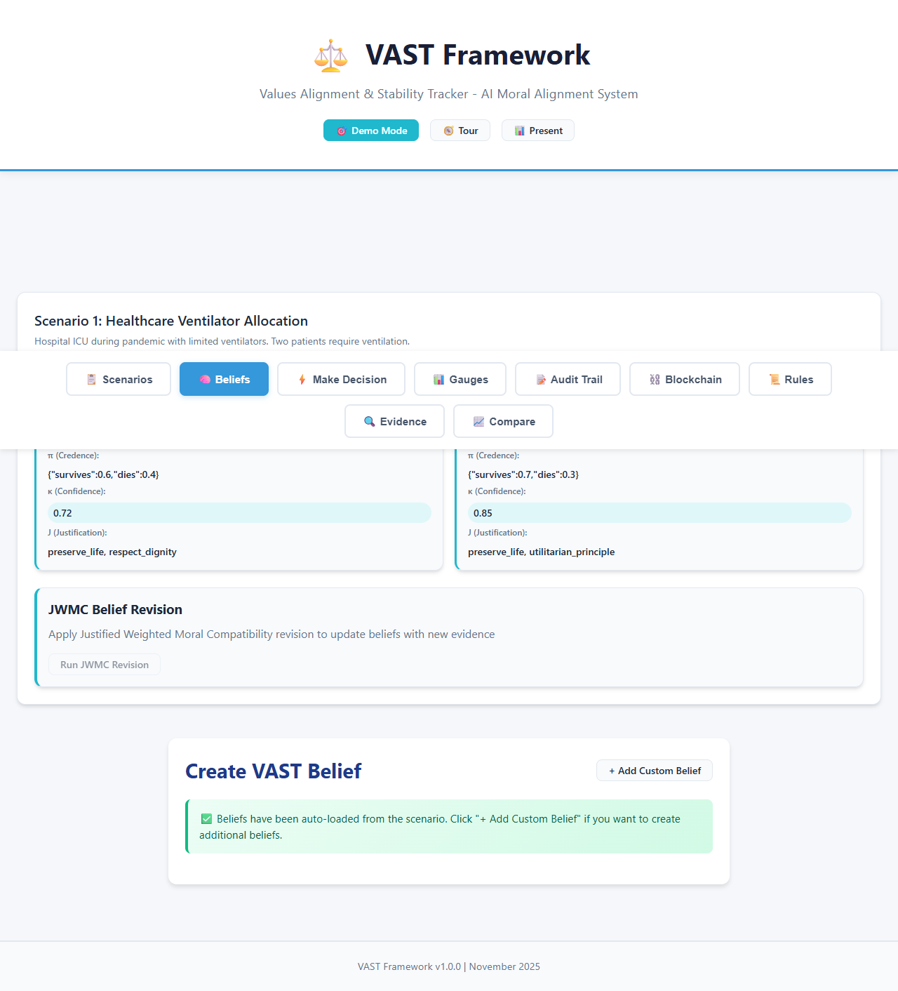
Belief Structures (pi, kappa, J)
Each action's epistemic state: credence distribution, confidence level, and moral justification

Slide 6
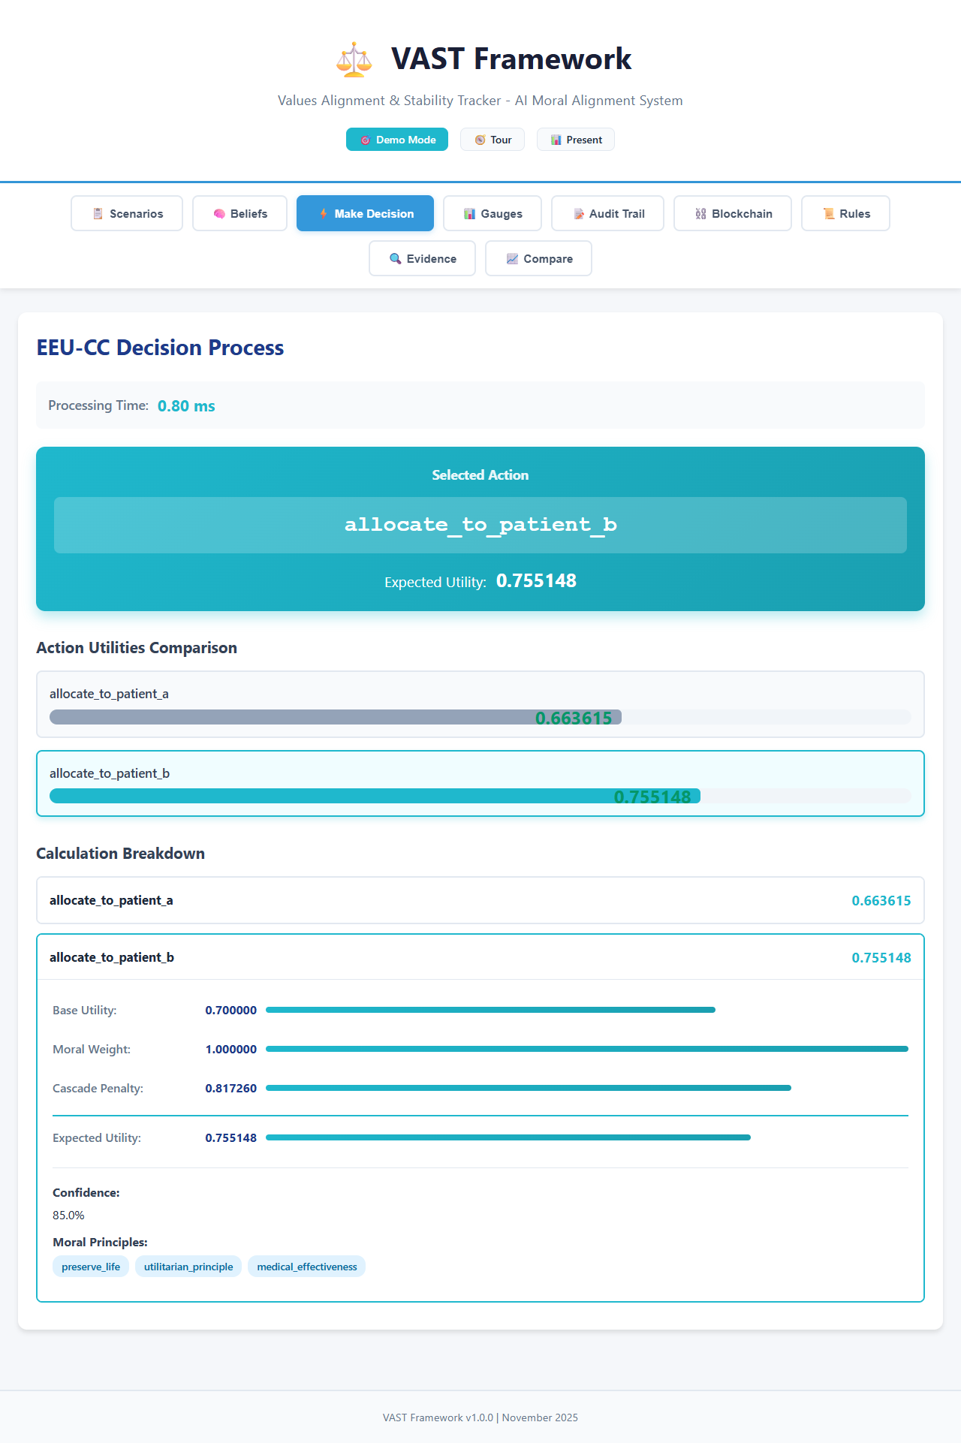
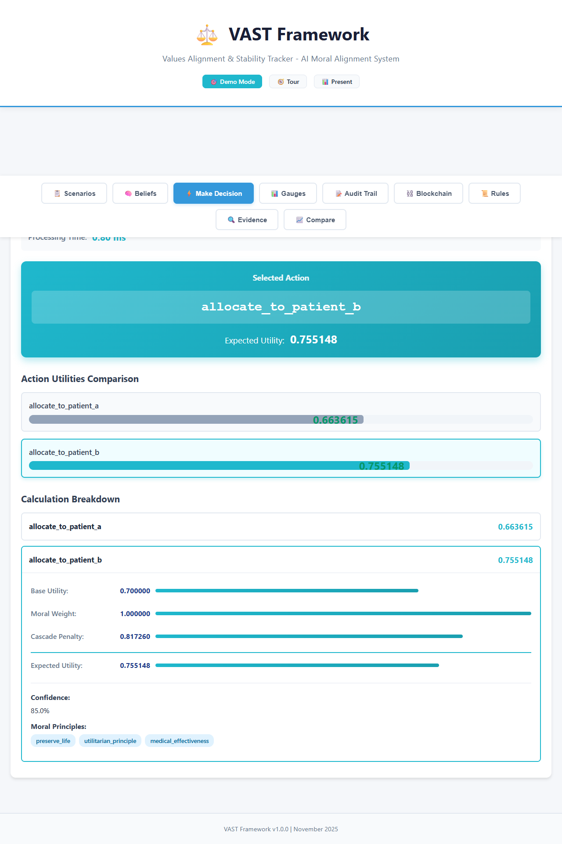
EEU-CC Decision Making
Selected Action: allocate_to_patient_b | Expected Utility: 0.755148

Slide 7
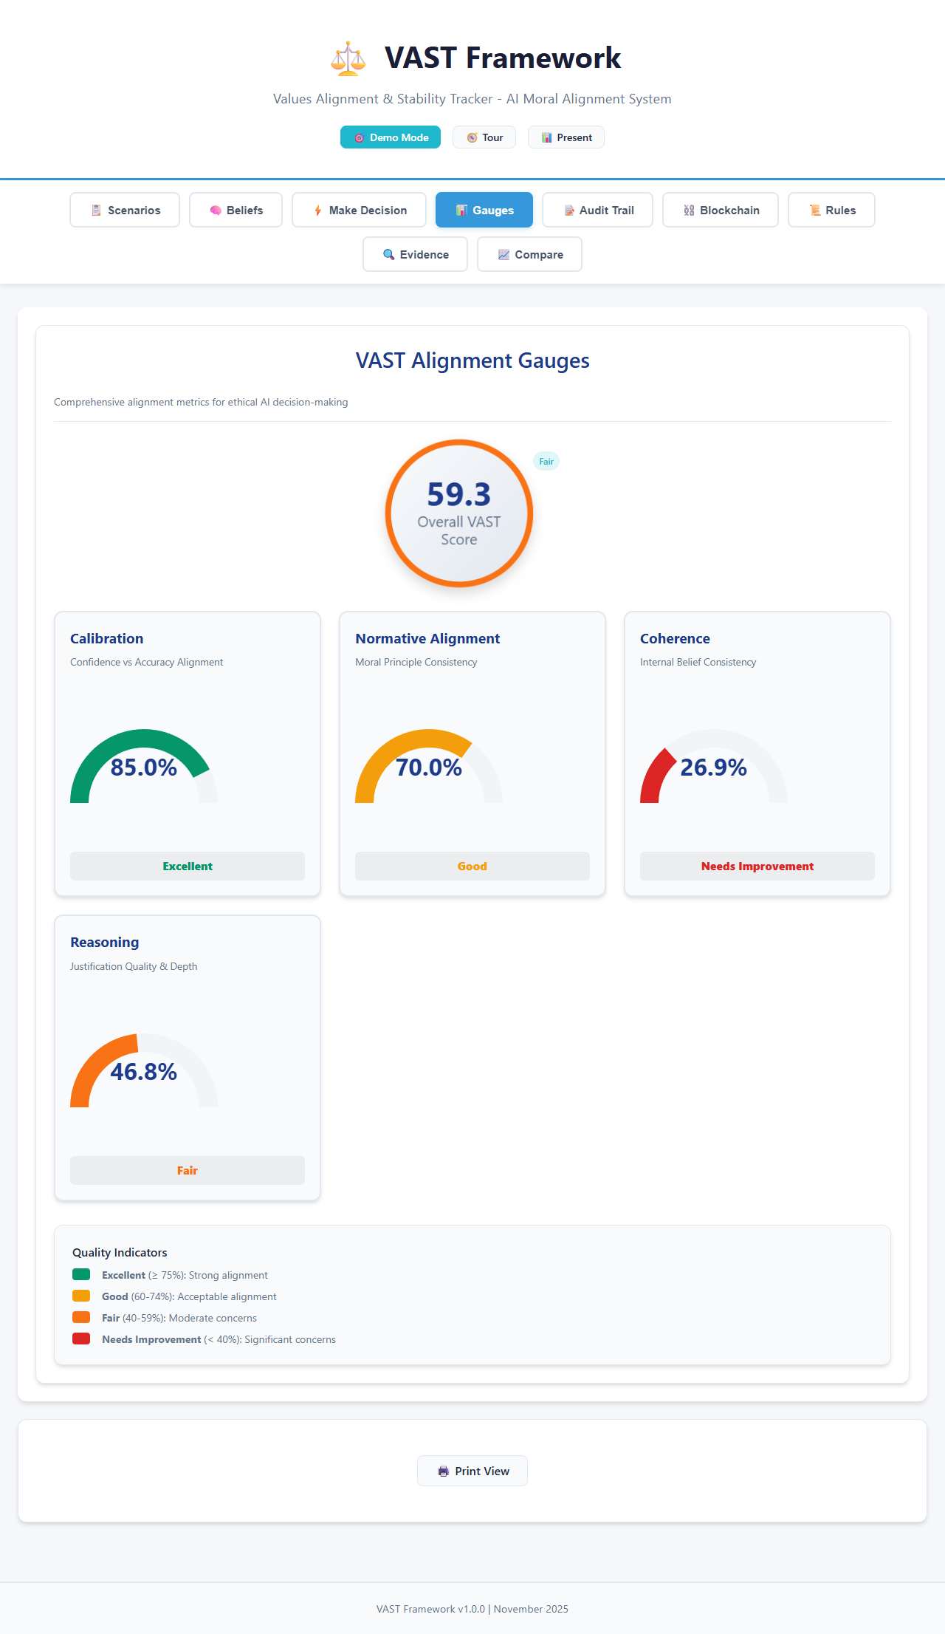
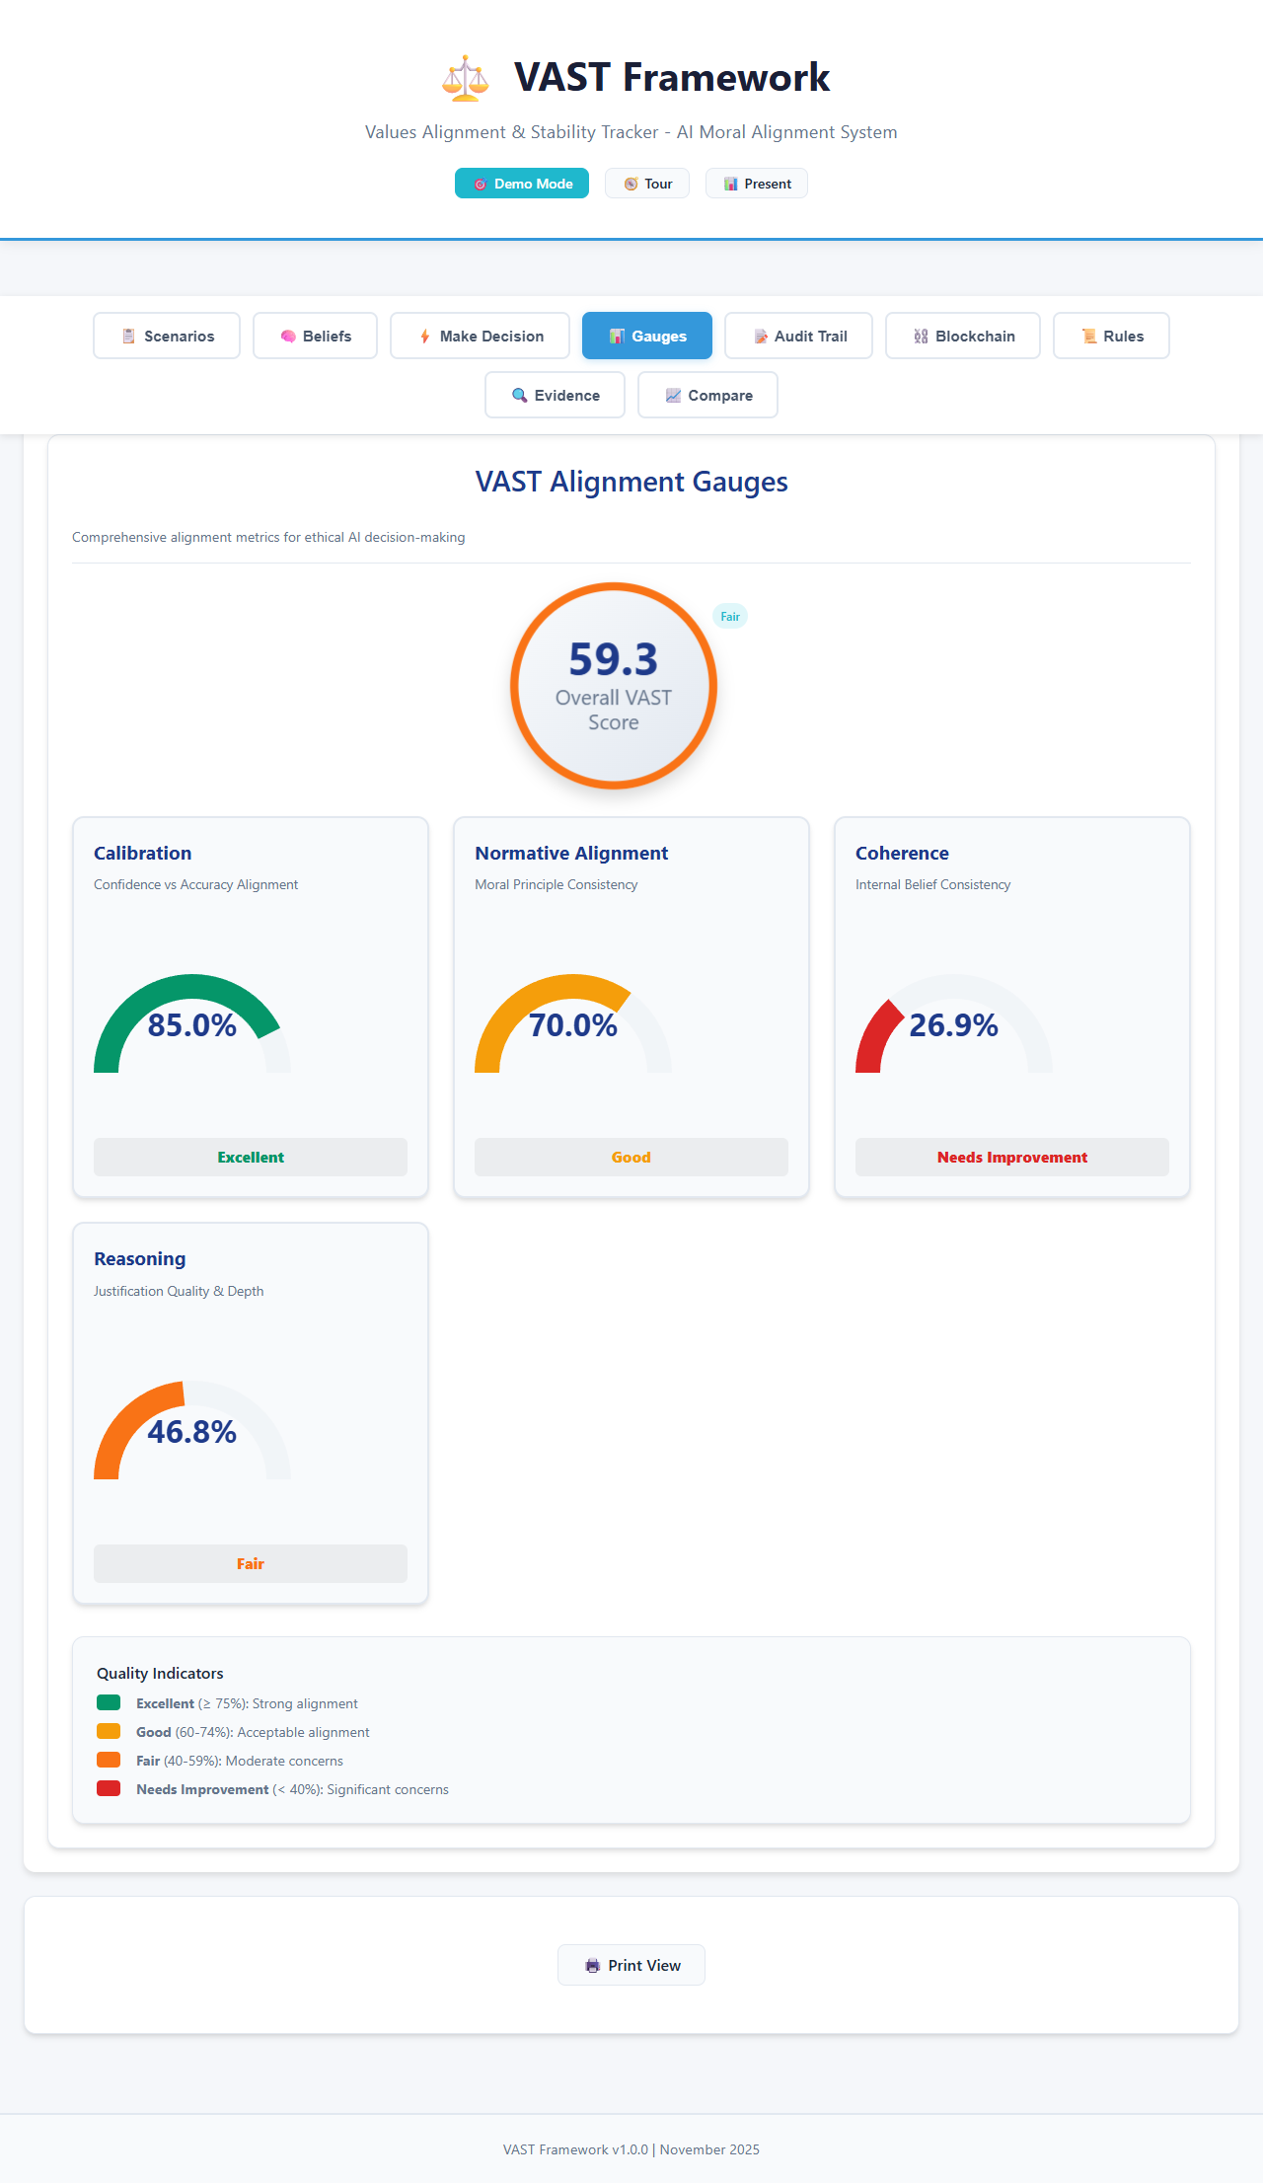
Four-Gauge Alignment Monitoring
Calibration | Normative Alignment | Coherence | Reasoning Quality

Slide 8
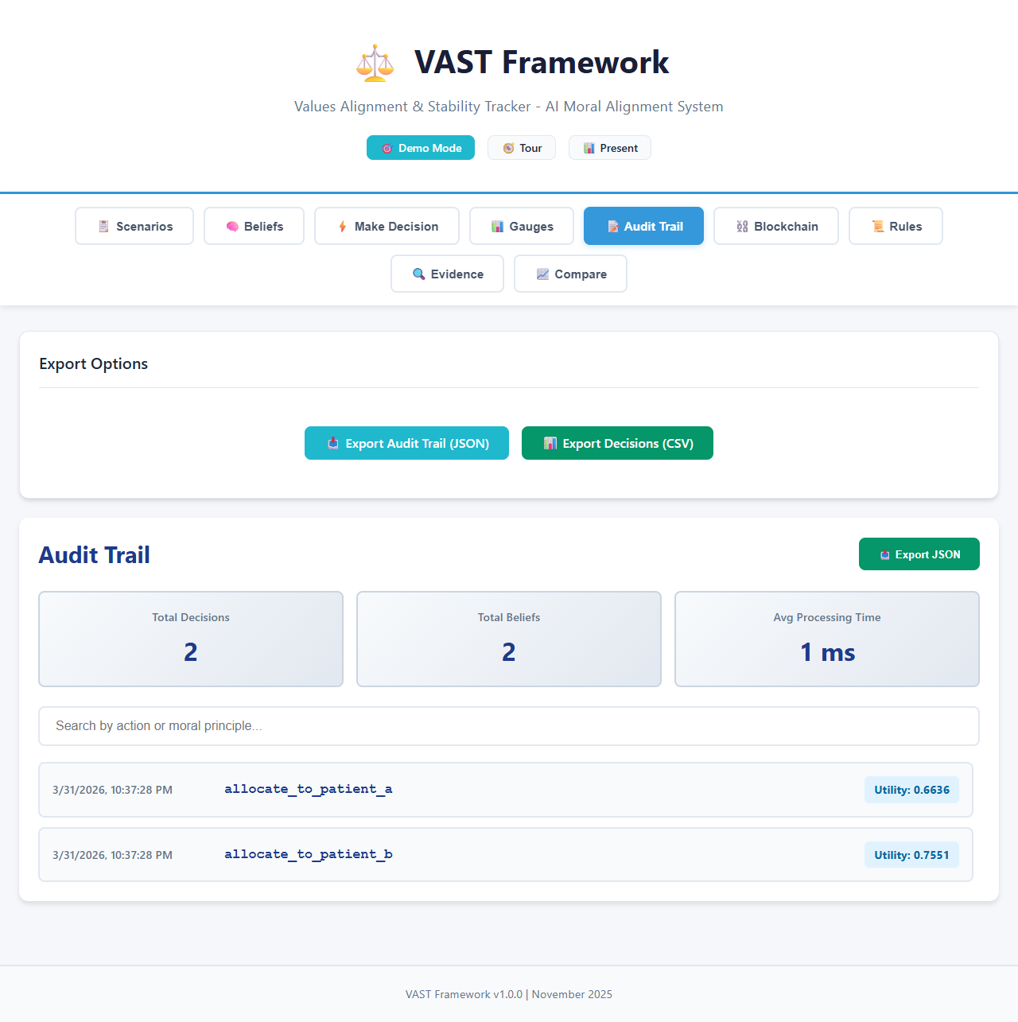
Transparent Audit Trail

Slide 9
VAST-Blockchain Extension
Hybrid Ledger Anchoring for Verifiable
Governance and Auditability of Aligned AI
Accepted Paper #2

Slide 10
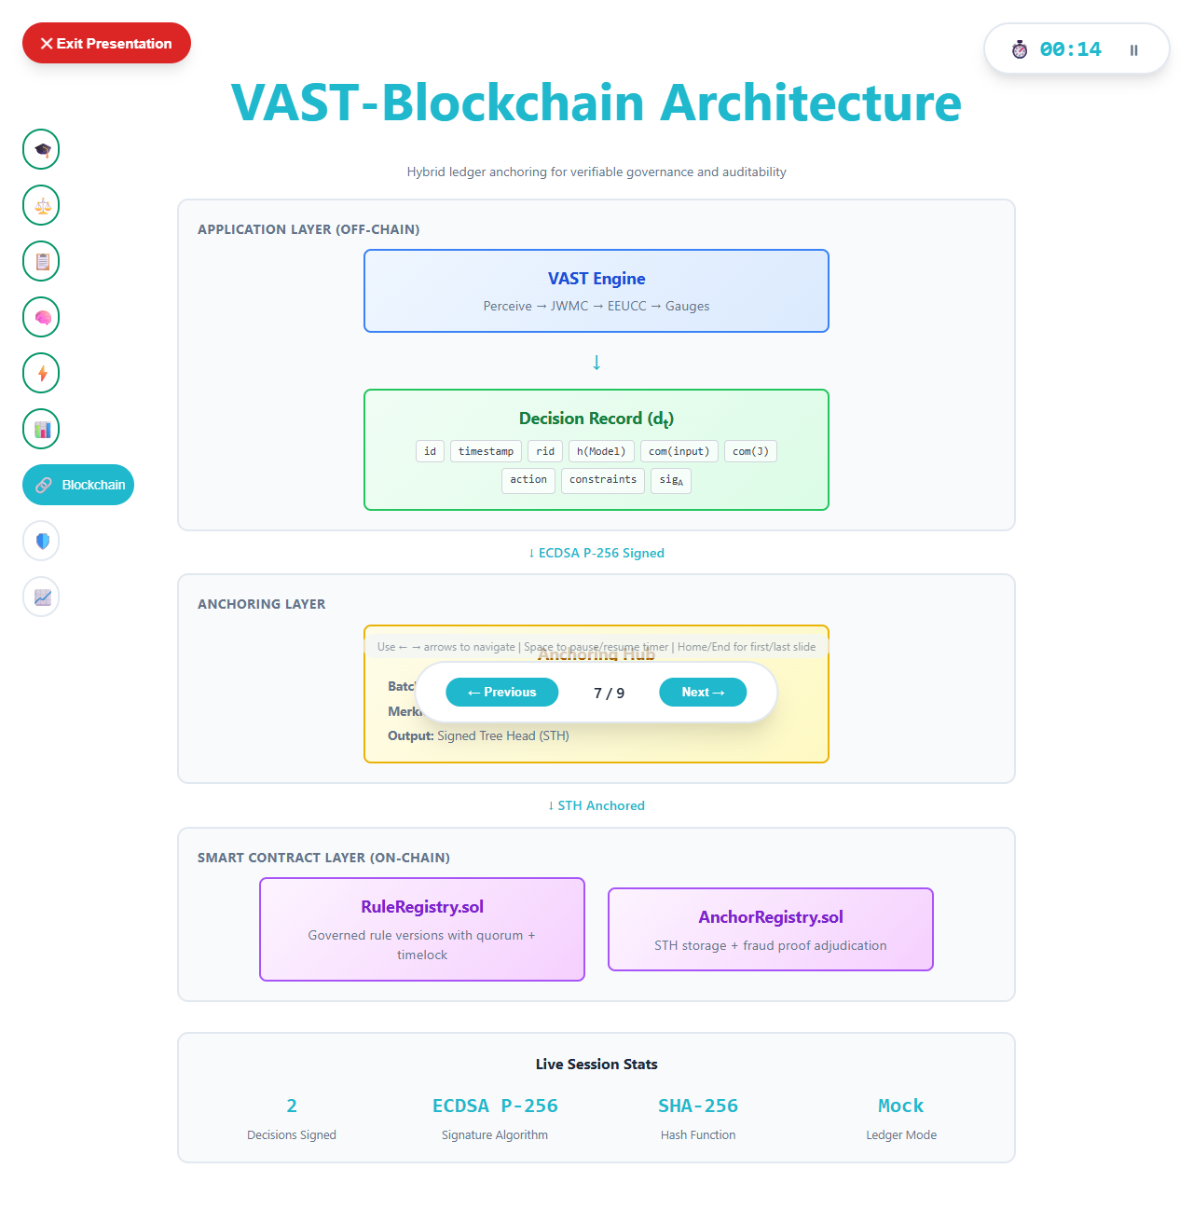
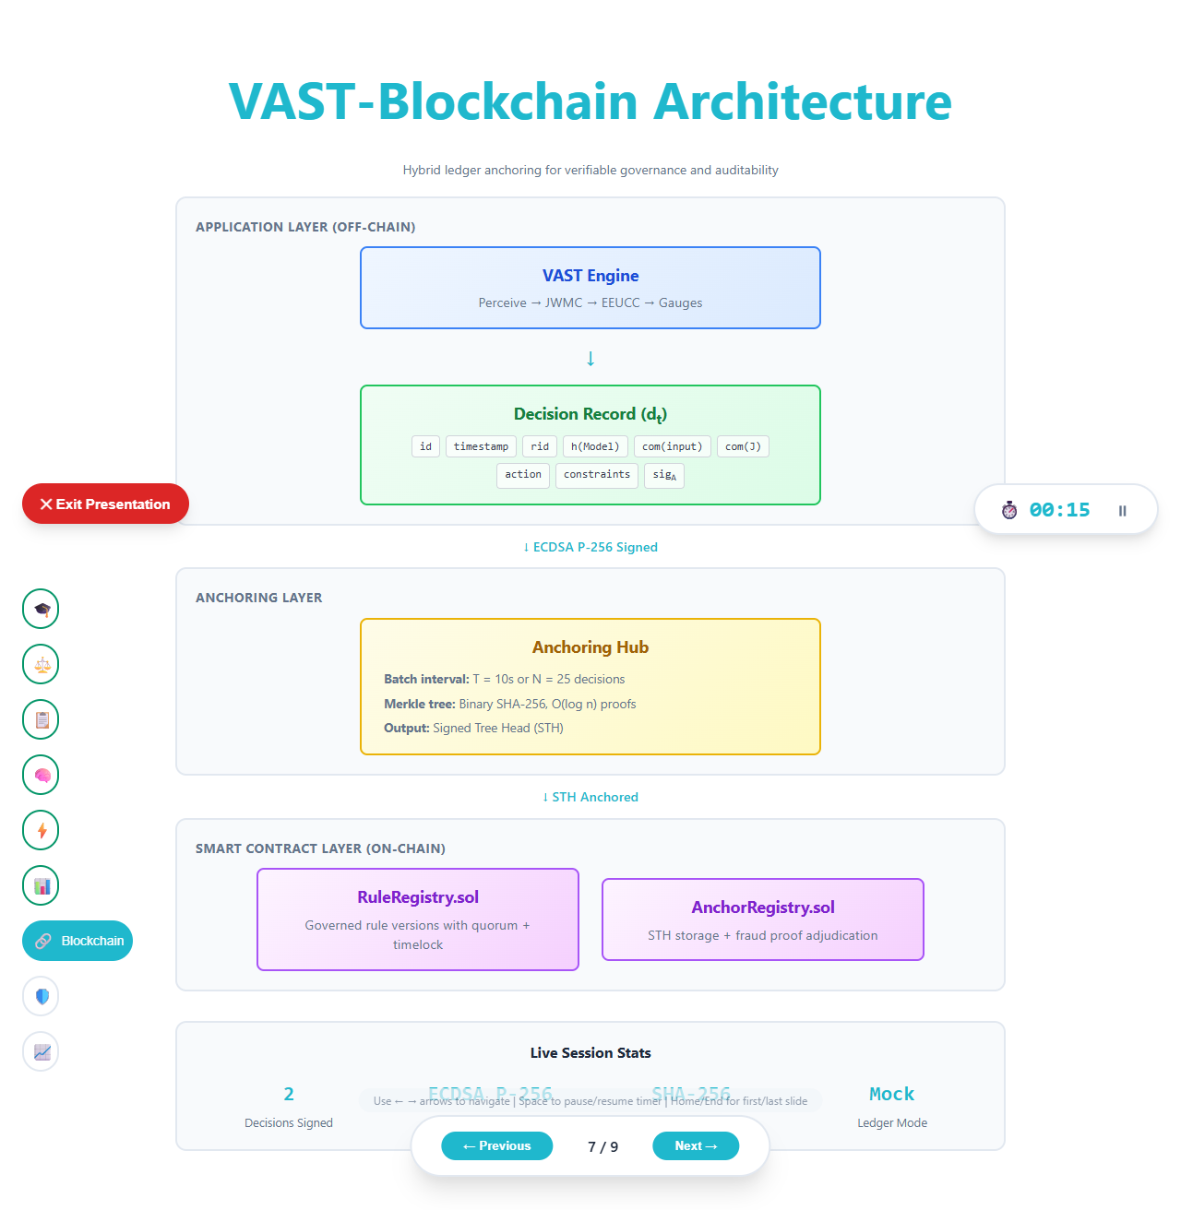
Hybrid Off-Chain / On-Chain Architecture
VAST reasoning off-chain | Rules & commitments on-chain | Audits via verifiable proofs

Slide 11
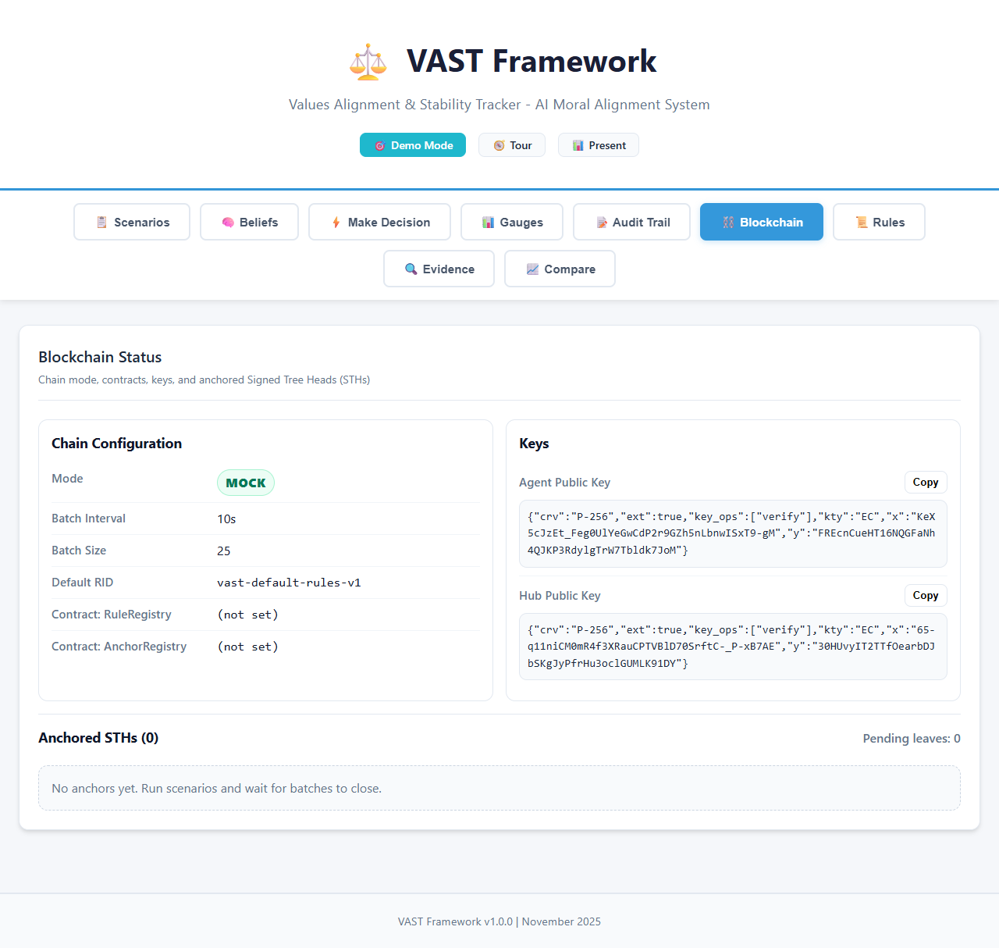
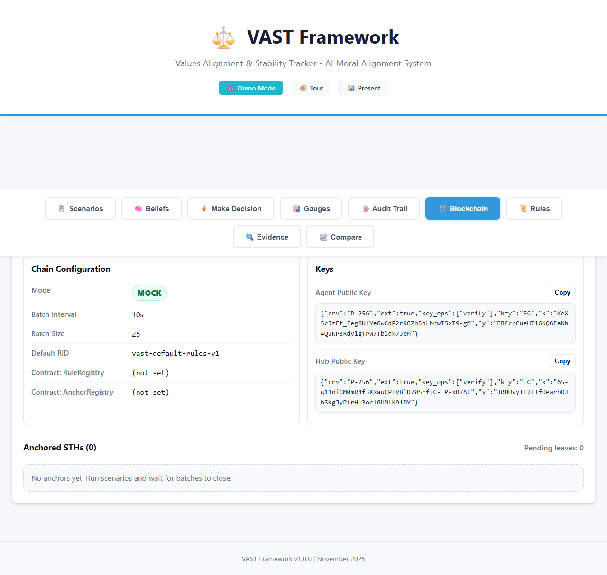
Blockchain Integration Status
ECDSA P-256 agent keys | SHA-256 Merkle trees | Signed Tree Heads (STHs)

Slide 12
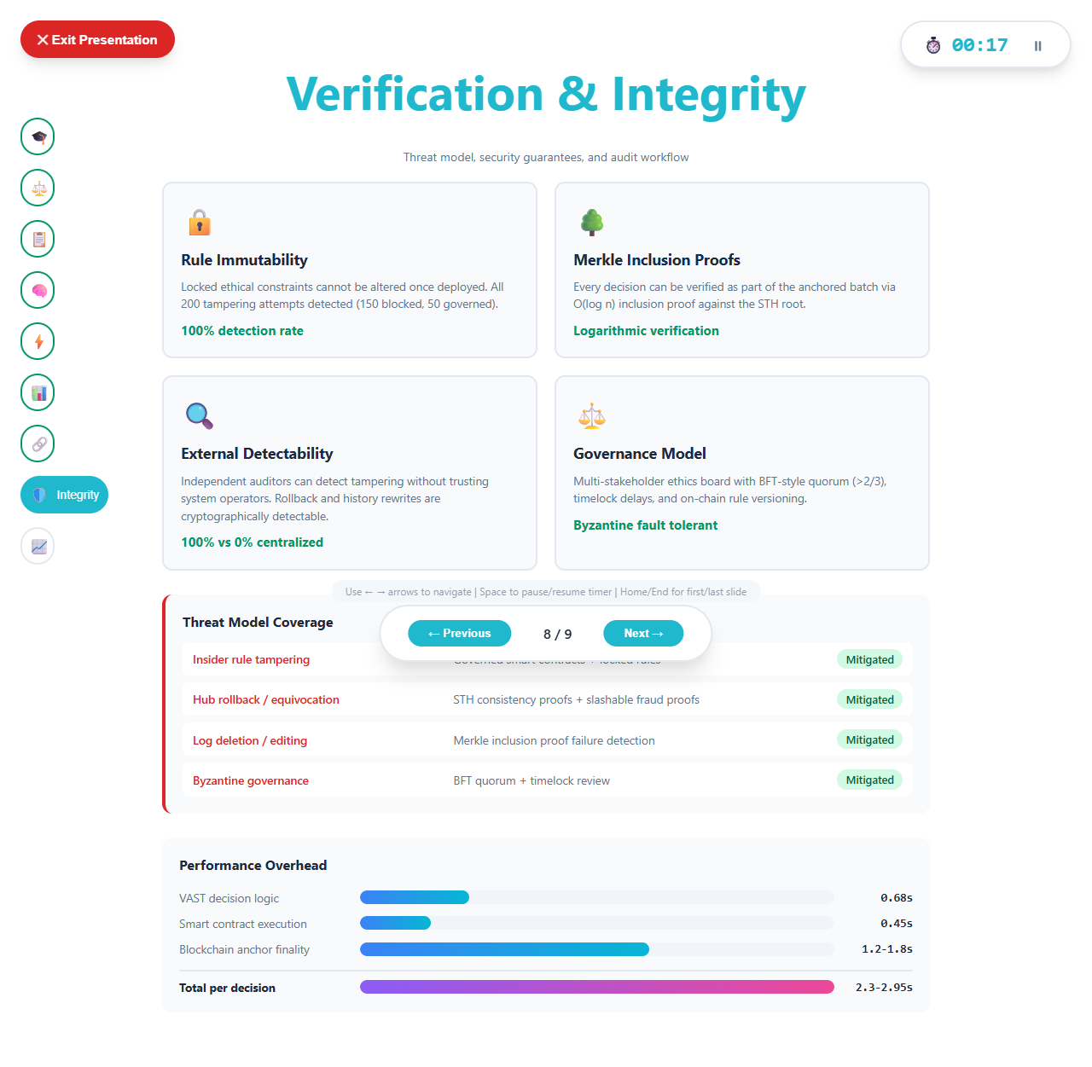
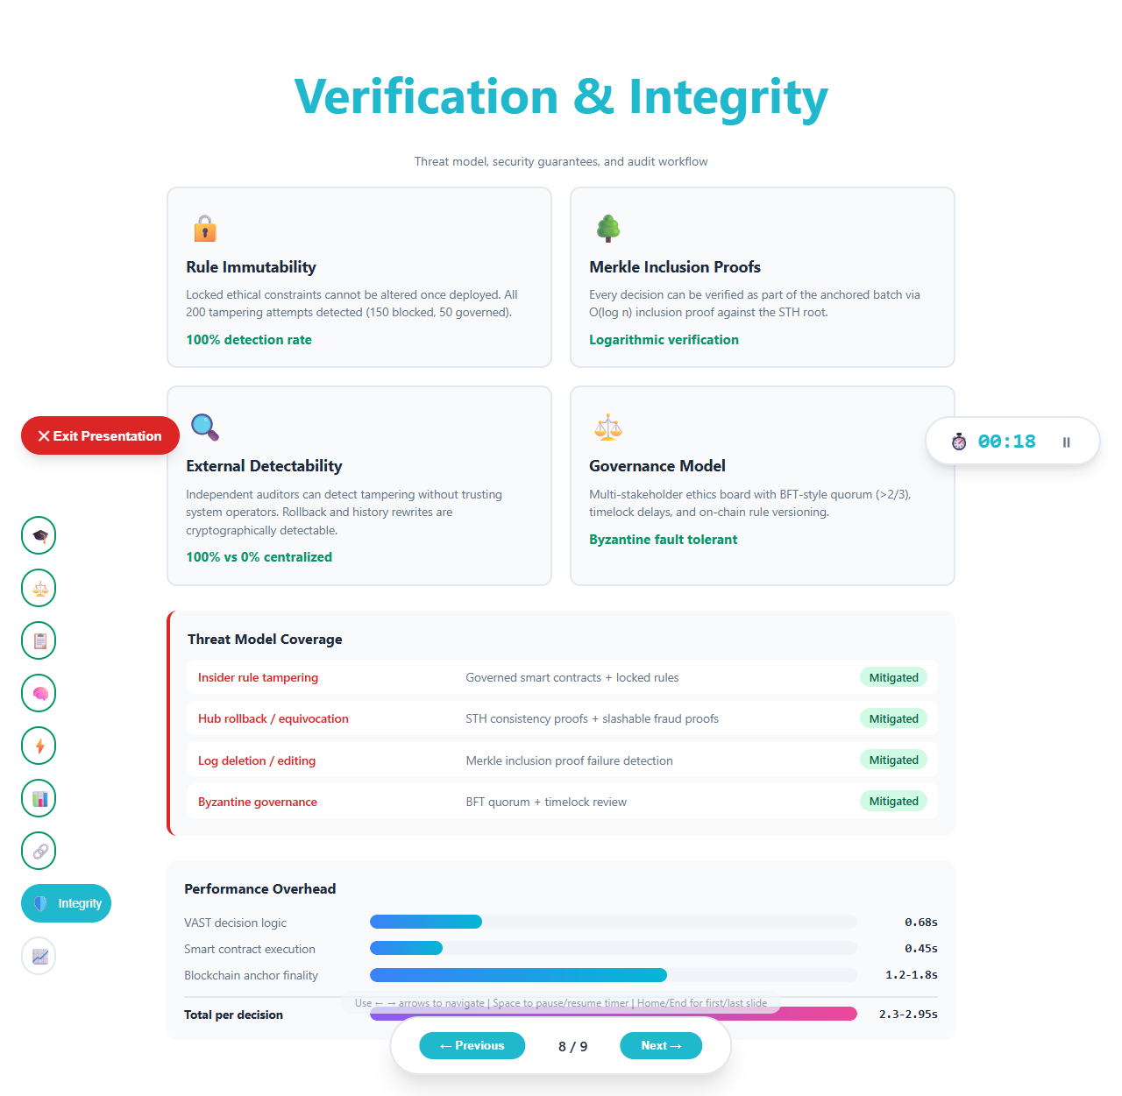
Verification & Threat Model
100% tampering detection | O(log n) verification | Byzantine fault tolerant governance

Slide 13
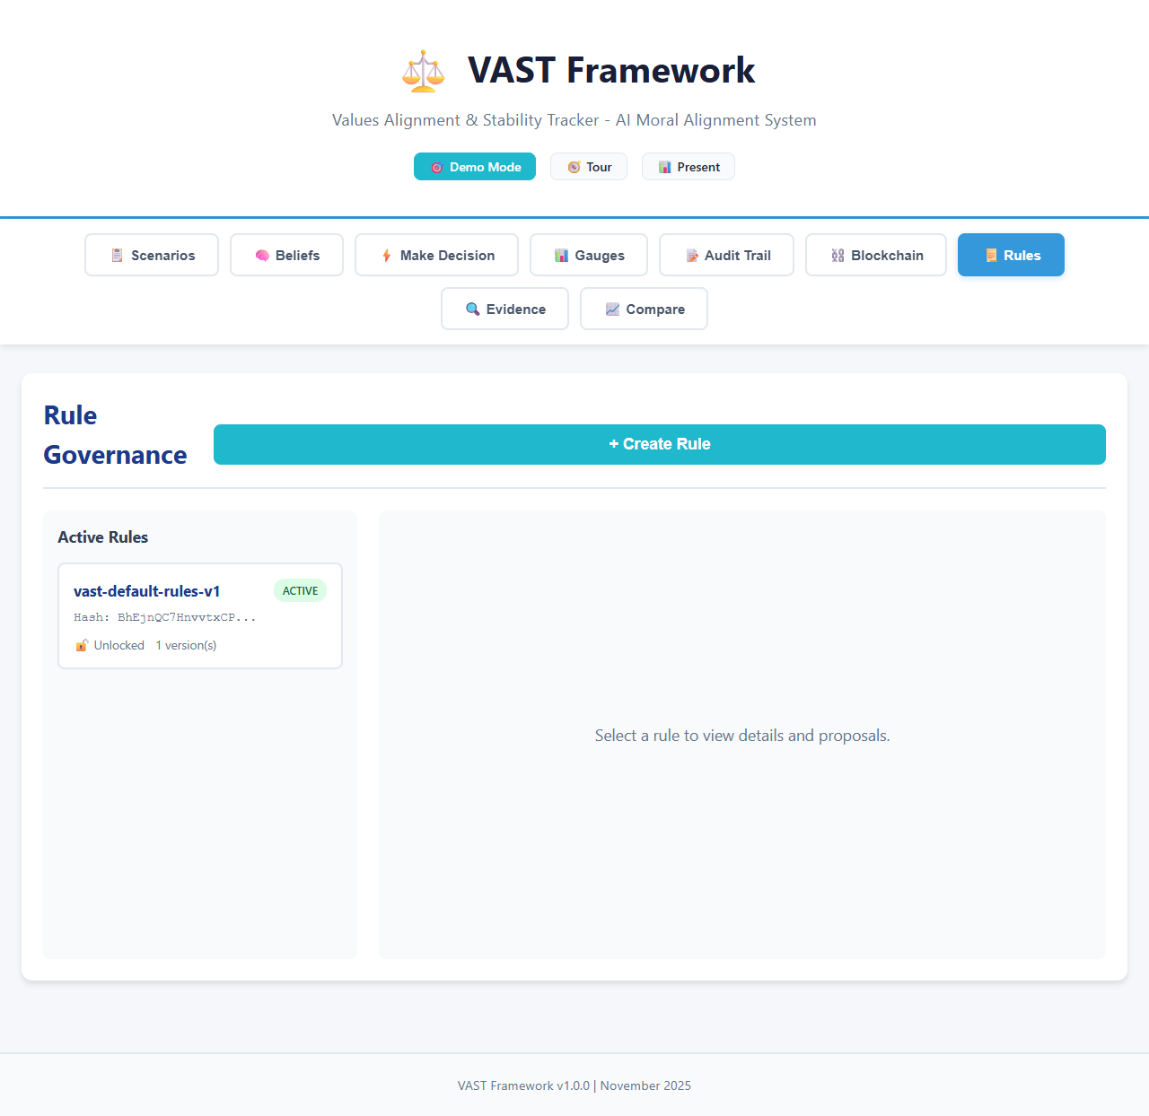
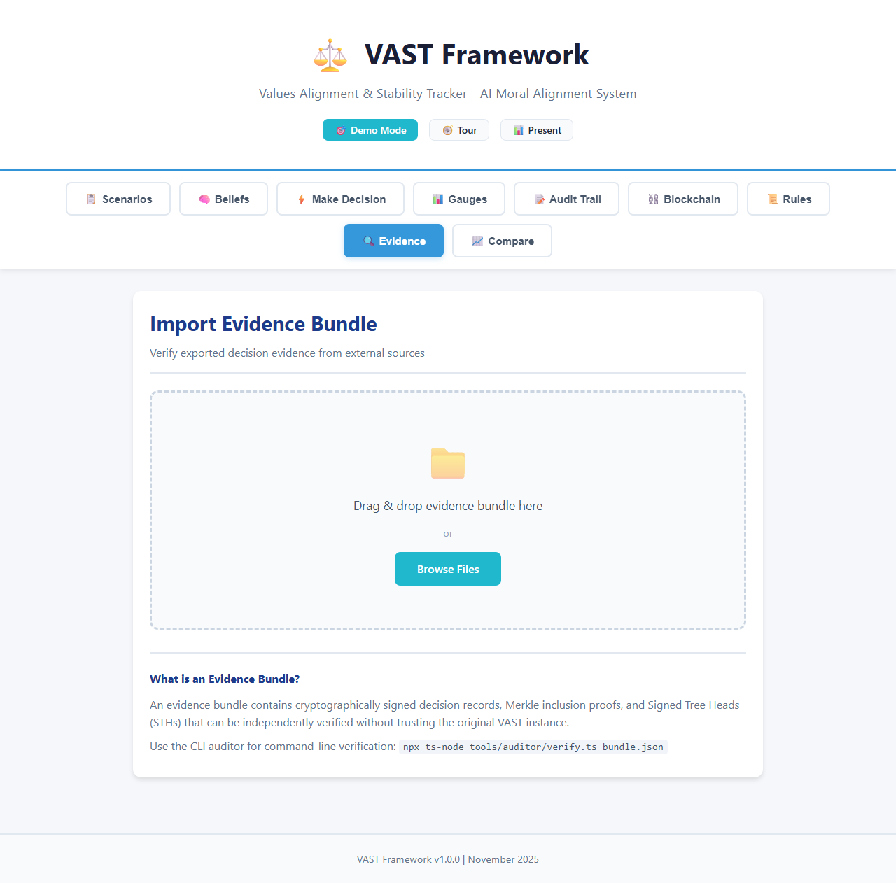
Governance Rules & Evidence Verification
On-chain rule registry with governance lifecycle | Independent evidence bundle verification

Slide 14
Evaluation Results
0.77
+29%
+23%
+21%
VAST Mean
Alignment
vs RLHF
(0.58)
vs Const. AI
(0.61)
vs Value Learn
(0.63)
VAST-Blockchain Integrity
100%
100%
2.3-2.95s
O(log n)
Tampering
Detected
External
Detectability
Total Latency
Per Decision
Verification
Complexity

Slide 15
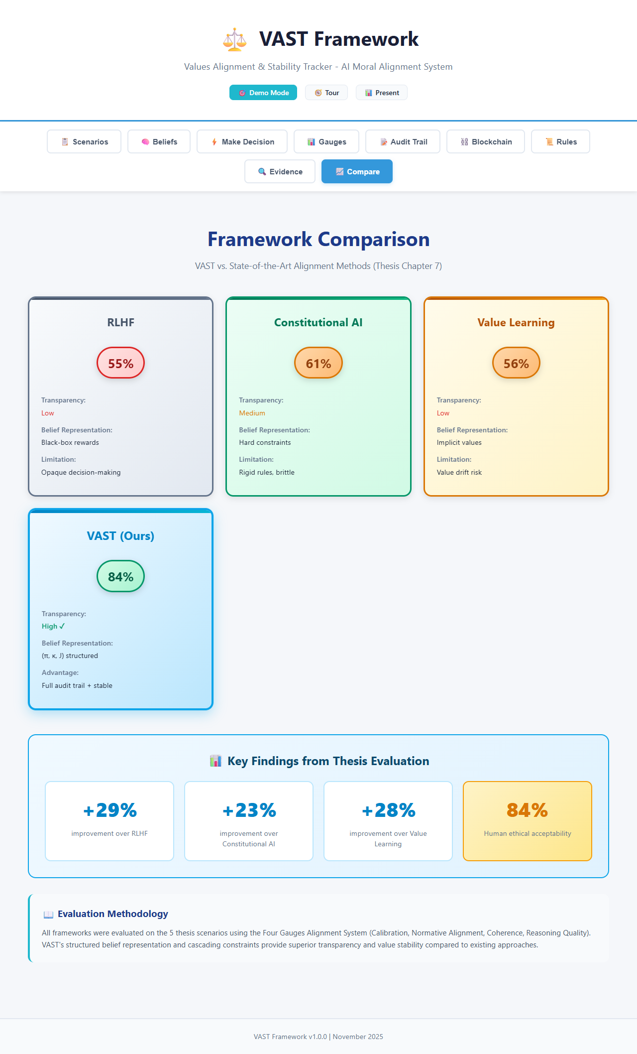
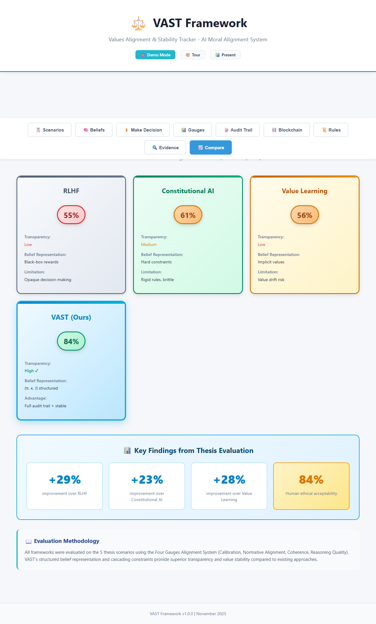
Framework Comparison
VAST achieves consistently higher alignment than RLHF, Constitutional AI, and Value Learning

Slide 16
Key Contributions
1
Tripartite Belief Model
4
Four-Gauge Monitoring
Separates credence, confidence, and justification for transparent reasoning
Real-time multidimensional alignment tracking with actionable signals
2
JWMC Operator
5
Blockchain Integrity Layer
Justification-weighted belief revision with proven value stability bounds
Hybrid anchoring with Merkle proofs, governed rules, and fraud detection
3
EEU-CC Decision Making
6
Working Implementation
Soft cascading constraints balancing competing values without brittleness
Full-stack React app with 5 scenarios, blockchain integration, and presentation mode

Slide 17
Thank You
Questions?
Soraya Partow | spartow@radar.gsw.edu
Dr. Satyaki Nan | Georgia Southwestern State University
Two accepted papers: VAST Framework & VAST-Blockchain

