Slide 1
Hierarchical Neural Story Generation
Angela Fan, Mike Lewis, Yann Dauphin
Shubhankar Patankar

Slide 2
Story-telling
Stories must be thematically consistent across the entire exposition
They must be creative
Must have a high-level plot which requires planning ahead
Preferably must have elements such as rising action, climax, denouements
Prompt: The Mage, the Warrior, and the Priest
Story: A light breeze swept the ground, and carried with it still the distant scents of dust and time-worn stone. The Warrior led the way, heaving her mass of armour and muscle over the uneven terrain. She soon crested the last of the low embankments, which still bore the unmistakable fingerprints of haste and fear. She lifted herself up onto the top the rise, and looked out at the scene before her. [...]

Slide 3
Language Modeling
A language model (LM) outputs the probability distribution over the next word given the previous words in a string
P(“apple" | “I was about to eat the”) = ?
Types of LMs include n-gram models, feed-forward neural networks, recurrent neural networks, seq2seq
In unconditioned variants, LM predicts P(y_{t} | y_{1:t-1})
In conditioned variants, LM predicts P(y_{t} | y_{1:t-1} , x_{1:t}). Applications include machine translation, text summarization, and simplification.

Slide 4
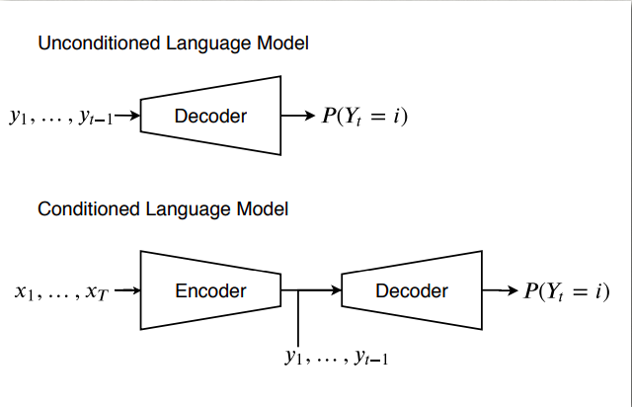
Unconditioned vs. Conditioned LMs
Unconditioned language models have a decoder
Conditioned language models have an encoder in addition to the decoder
The encoder converts the source sequence to hidden states
The decoder takes the sequence of hidden states as well as the embeddings for the string so far and maps it to a probability distribution

Slide 5
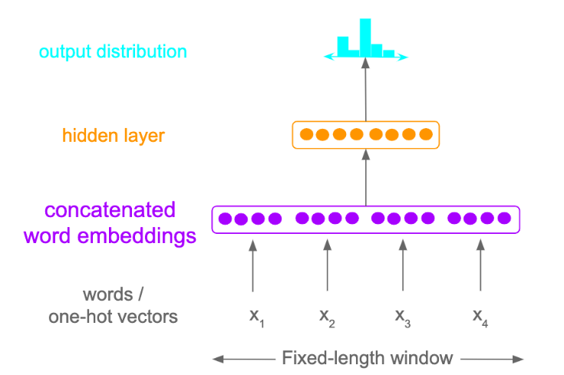
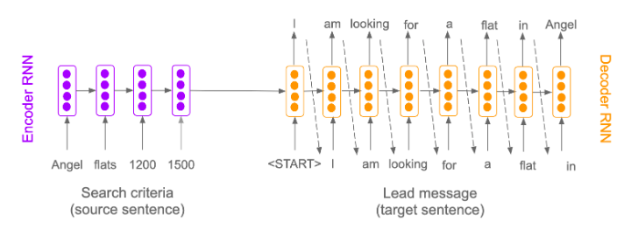
Encoder only
Encoder and decoder

Slide 6
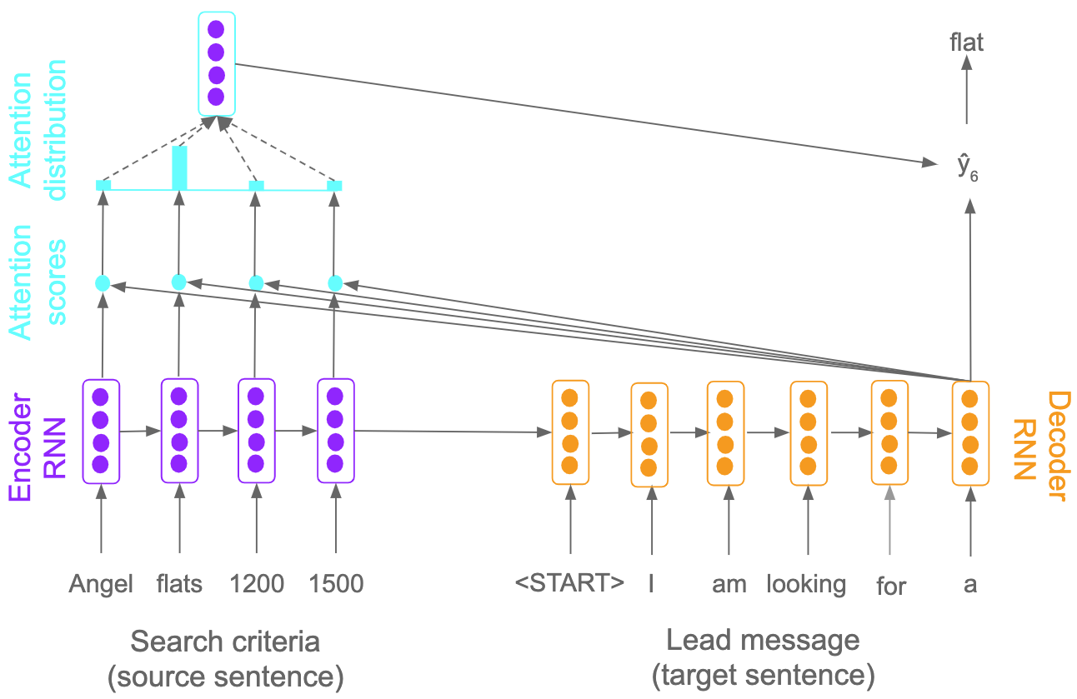
Seq2seq with Attention

Slide 7
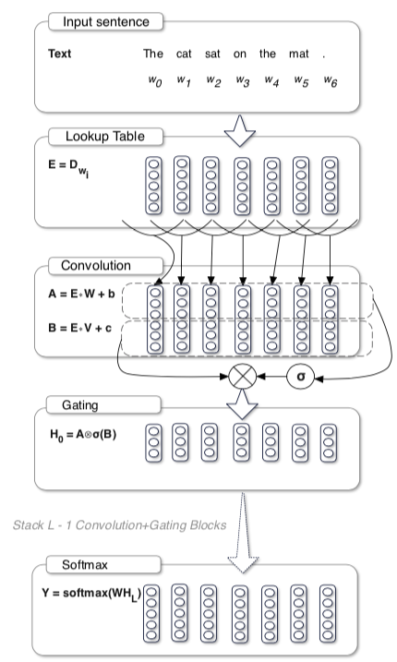
Convolution and Gating
Convolutional language models convolve the embedding matrix with a weight matrix
Gating is a mechanism by which the model attempts to select features that are more relevant to predicting the next word
Final softmax converts probabilities to logits

Slide 8
Hierarchical Story Generation Model
Data set: 300K human-written stories paired with writing prompts from from Reddit's WRITINGPROMPTS sub-reddit. Hierarchical model generates a premise, and then transforms it into a passage of text
Gated multi-scale self-attention mechanism to model long-range context
Two simultaneously trained models are fused to encourage conditioning on the premise
Notes:
5\% data reserved for validation, another 5\% for testing. Length of stories is truncated to 1000 words, and a word frequency threshold on inclusion in the vocabulary is set to 10. <UNK> tokens introduced.

Slide 9
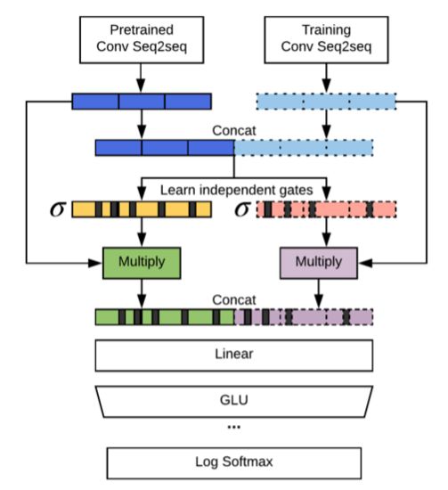
Model Fusion
The pre-trained convolutional seq2seq model is a fixed language model trained on Reddit stories
The second model uses a gated multi-scale self-attention mechanism in a convolutional seq2seq model
The hidden states of the two models are independently gated to decide which information from the two models to retain
The combined hidden state is used to infer probabilities for the next word in the story

Slide 10
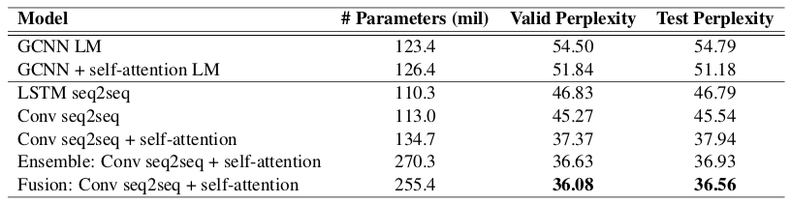
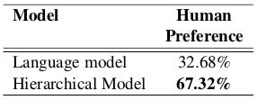
Model Performance

Slide 11
Innovations
Seq2seq is prone to degenerating into a model where the prompt begins to be ignored
Since the training model has access to the hidden states of the pre-trained model, it can focus on learning aspects of the story that are not captured by the pre-trained model
These aspects typically relate to the prompt
The fusion approach used here trains a model on top of a pre-trained seq2seq model, and the second model focusses on the link between the prompt and the story.
Standard recurrent architectures are inefficient in modeling long documents (recall that the average story in the data set contains 734 words); here, a convolutional architecture is employed, which encodes whole stories in parallel
Standard convolutional architectures encode bounded contexts; here a novel gated self-attention mechanism is used to avoid this problem
Novel evaluation metrics are introduced to isolate different aspects of story generation

Slide 12
Example Stories
Prompt: Aliens start abducting humans
Story: It has been two weeks, and the last of my kind has gone. It is only a matter of time until there will be nothing left. I’m not sure what the hell is going on... I can’t think. I can hear a distant scream. I think of a strange, alien sound. I try to speak, but am interrupted by something, something that feels like a drum, I ca not tell. I mean I’m just a little bit older than an average human. But I can, and I can feel the vibrations . I hear the sound of a ship approaching. The ground quakes at the force of the impact, and a loud explosion shatters the silence.
Prompt: The scientists have discovered something terrible
Story: The scientist stood there, a little dazed as he stared. “What is it?” He asked. “This...this...Thing...This is a virus. A chemical that can destroy entire planet and it is a very small, complex, chemical that could destroy any planet.” The scientist replied. His lab assistant looked down at the tablet. “I’ve just discovered it. I can’t believe it. It looks like it’s made of some sort of chemical that’s very dangerous.” “ Well, there’s a virus on the ground. It’s very effective...” “ I can’t believe what it is.” he said, pointing to the scientist . “ We don’t know what this thing is. We haven’t seen anything like it . We can’t even see anything like this. ” Dr. Jones stared at the scientist for a moment. “What do you mean what does it do ?” “It...It ’s a monster.”

Slide 13
Useful Resources
Data set + Code + seq2seq Model: https://github.com/pytorch/fairseq
Presentation at ACL 2018: https://vimeo.com/285801163
Medium Article on LMs: https://towardsdatascience.com/exploring-wild-west-of-natural-language-generation-from-n-gram-and-rnns-to-seq2seq-2e816edd89c6

Slide 14
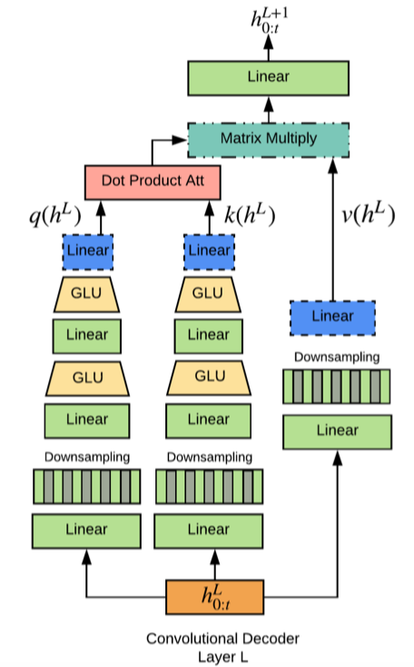
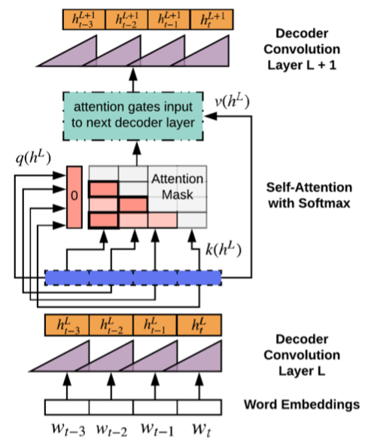
Multi-head Self-attention Mechanism

