Slide 1

STUDENT DATABASE MANAGEMENT SYSTEM
A PRESENTATION BY,
SHIVAM KUMAR: 2000220100206
SHIVAM RAJ SINGH: 2000330100210
COURSE: B. TECH (CSE)
SEC/BATCH: D / D1
GUIDED BY: MRS. GEETANJALI

Slide 2

STUDENT DATABASE MANAGEMET SYSTEM
Login Page

Slide 3
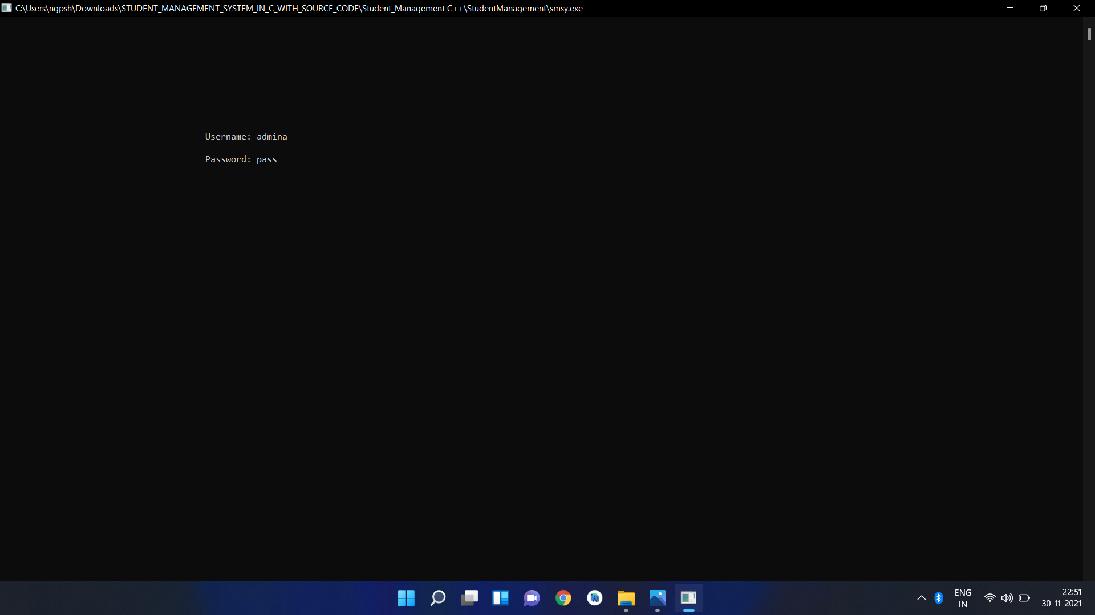

Slide 4
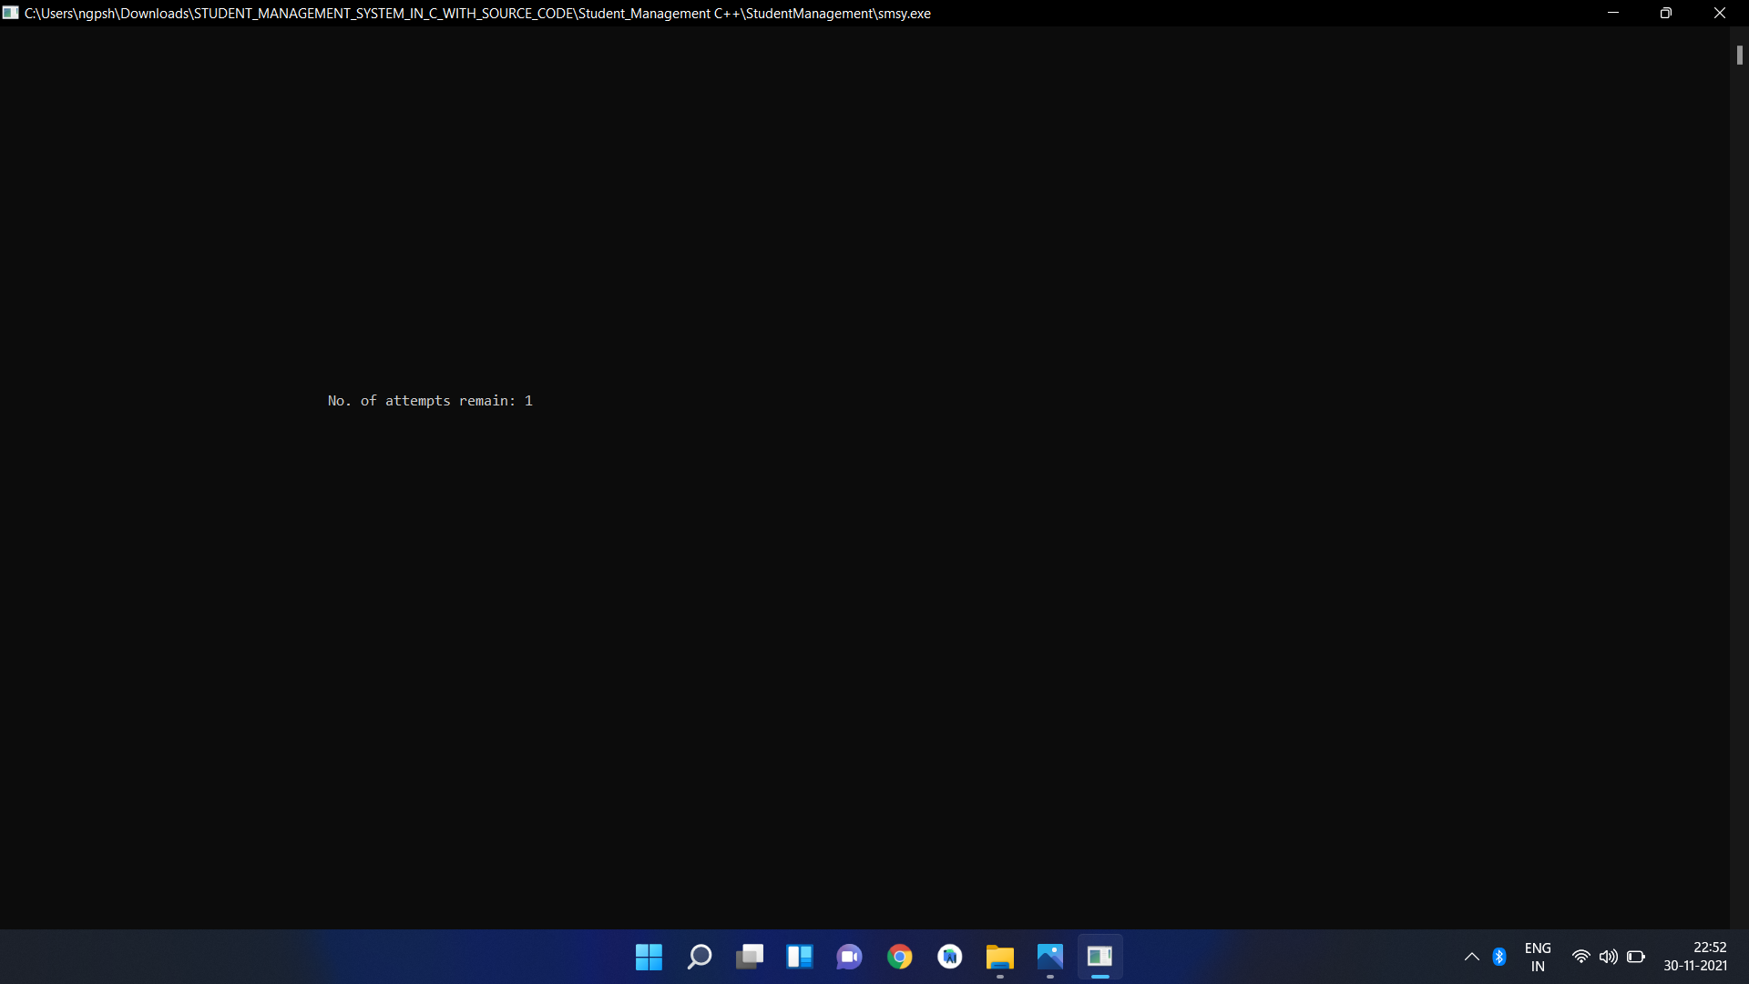

Slide 5
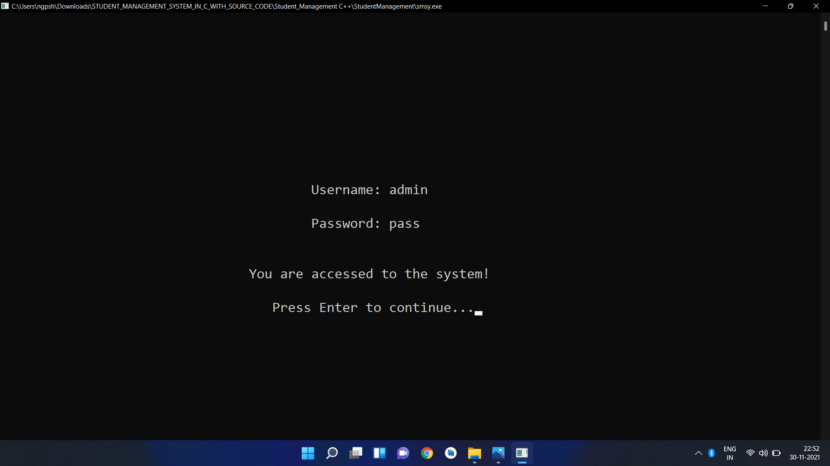

Slide 6
POSSIBLE PROGRAM OUTPUTS

Slide 7
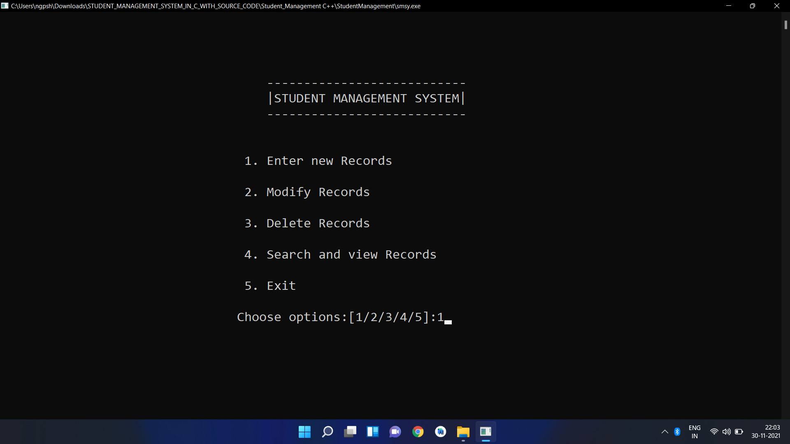

Slide 8
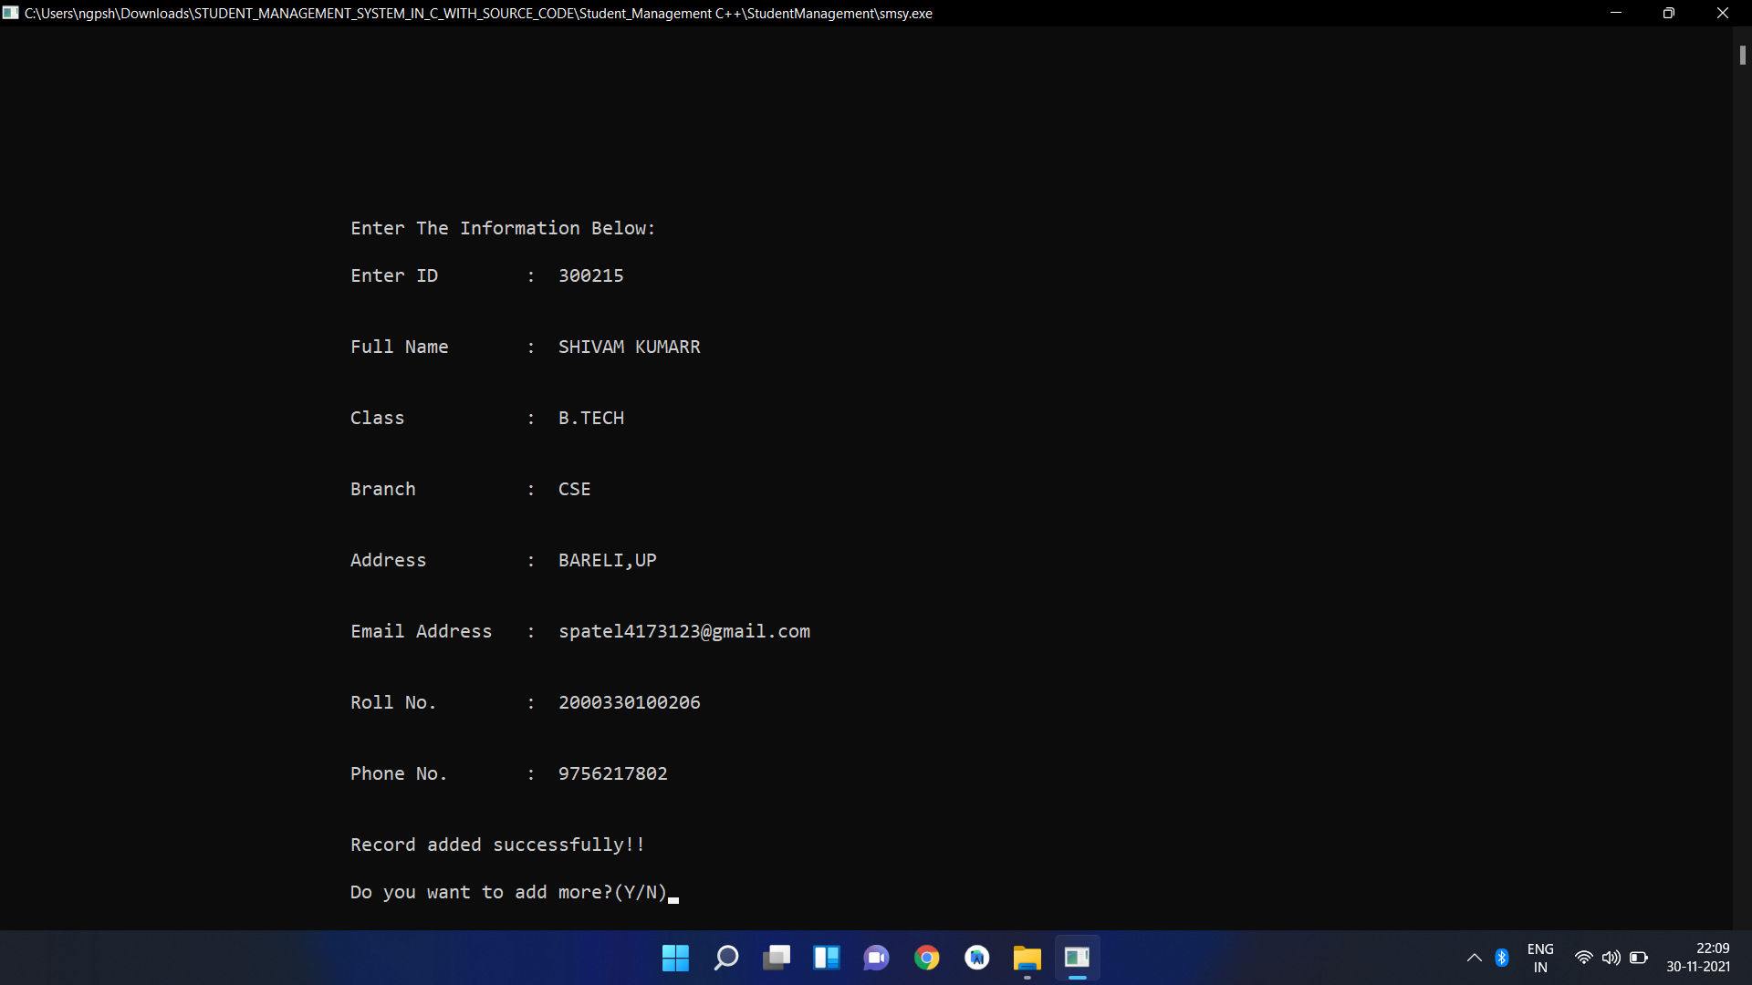

Slide 9
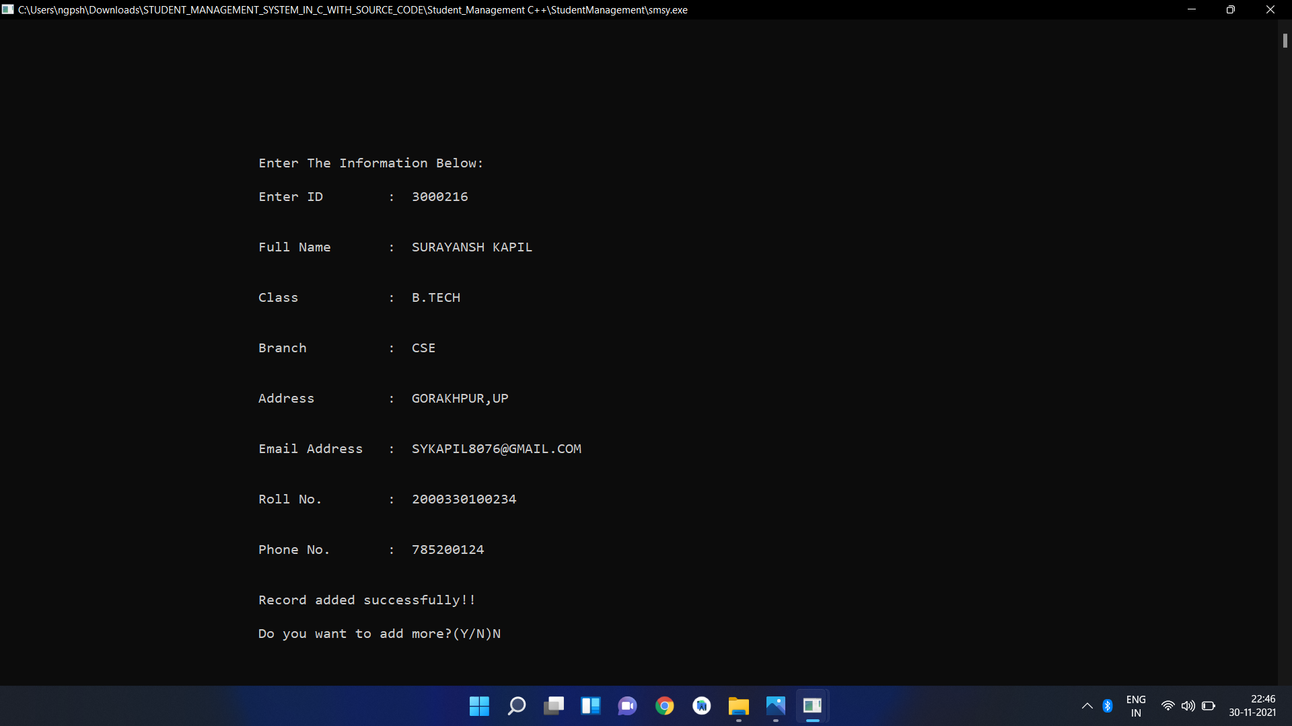

Slide 10


Slide 11
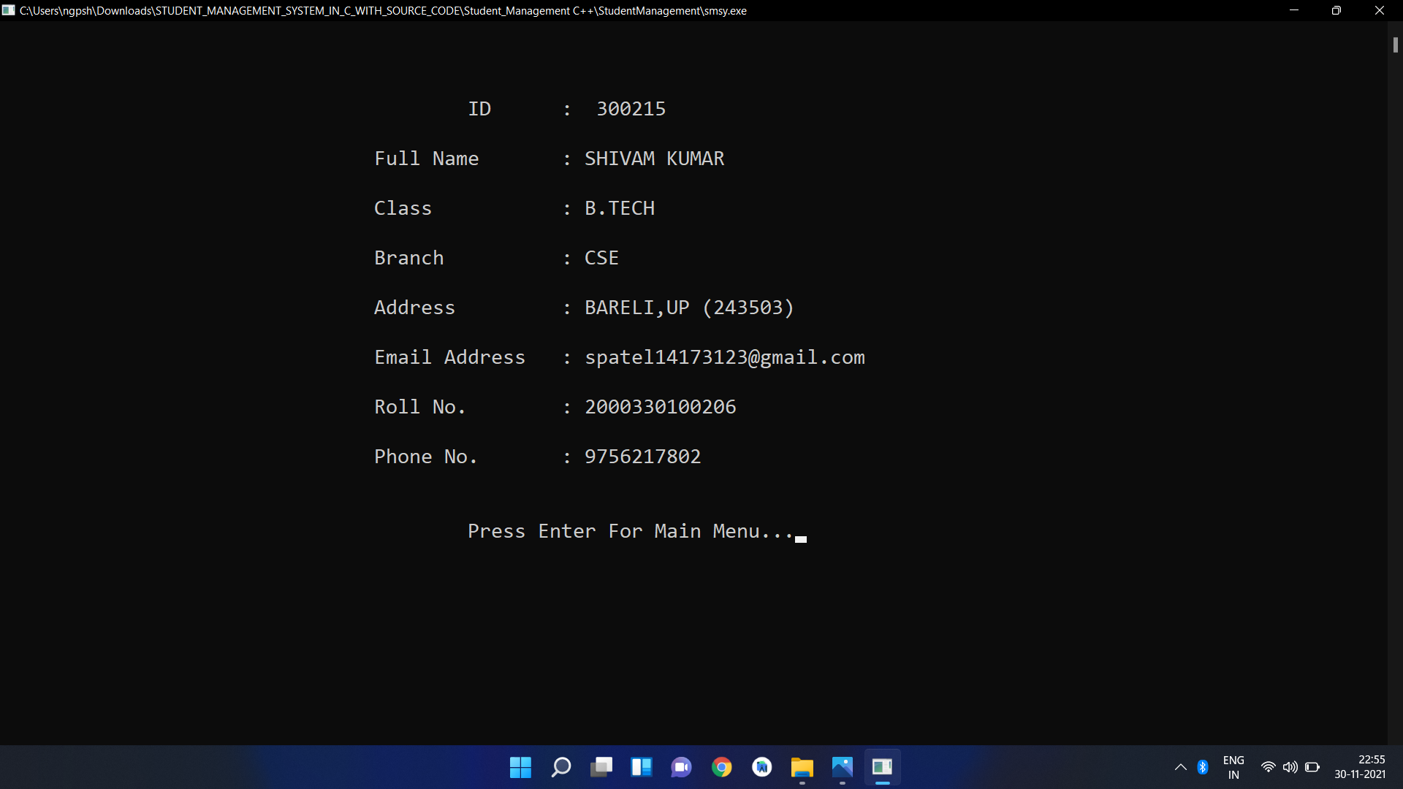

Slide 12


Slide 14
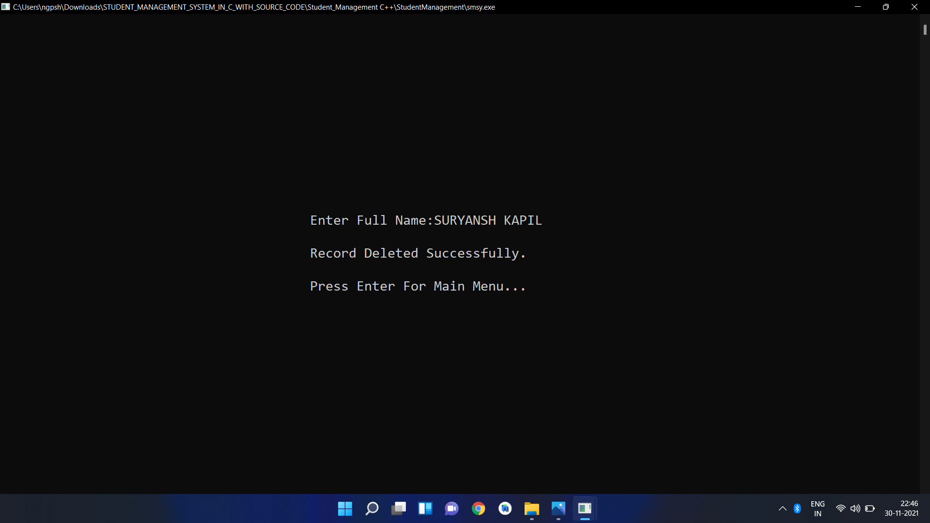

Slide 15
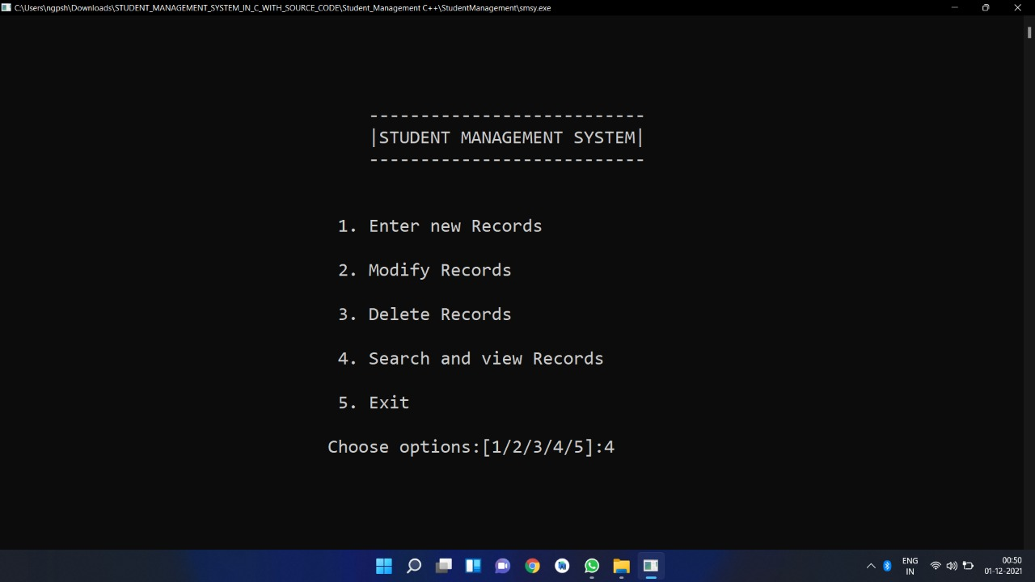

Slide 16
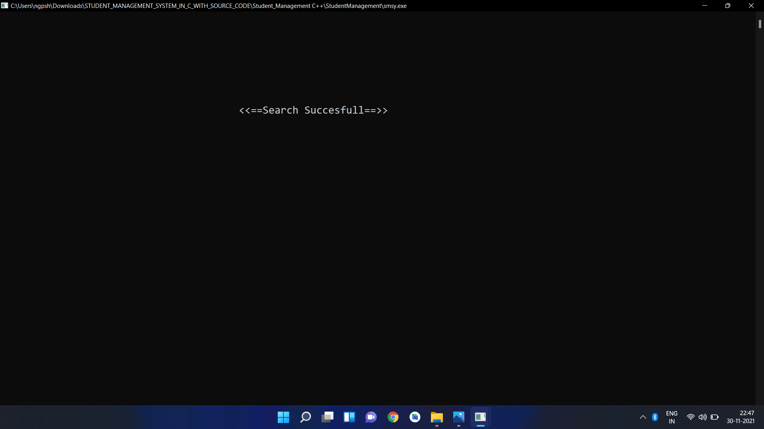

Slide 17
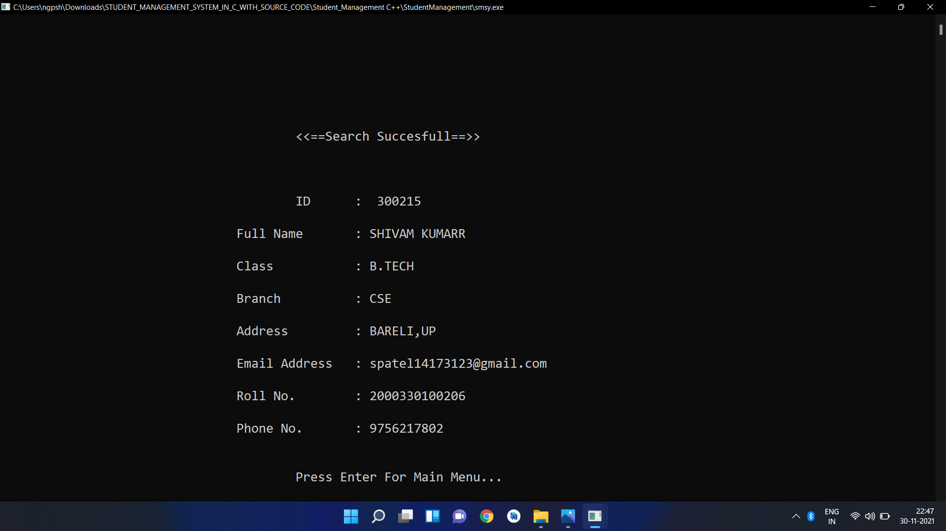

Slide 18
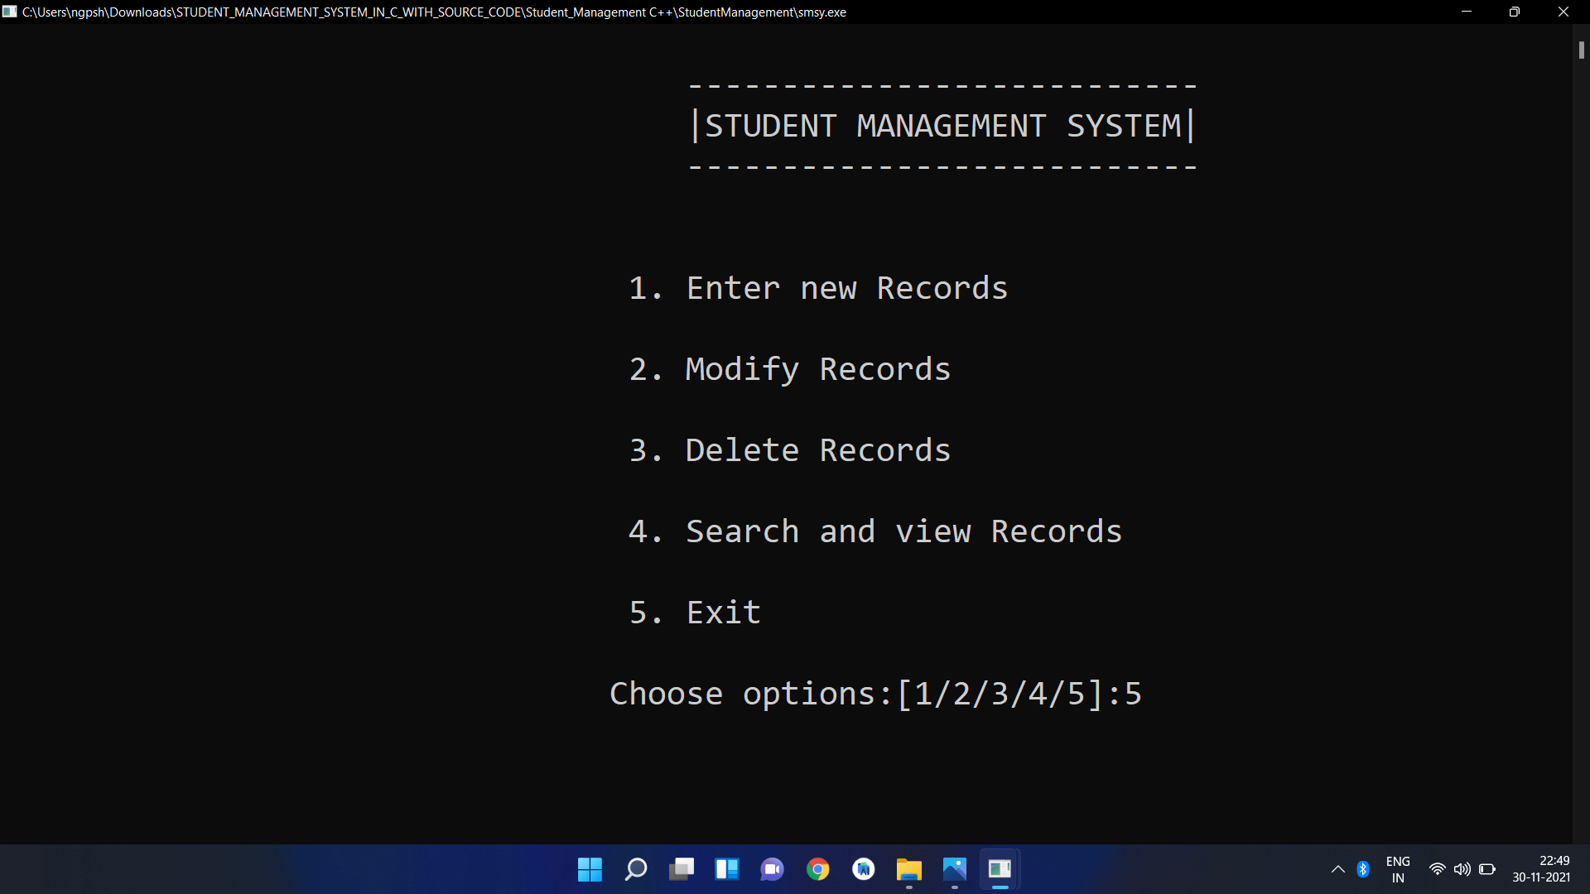

Slide 19
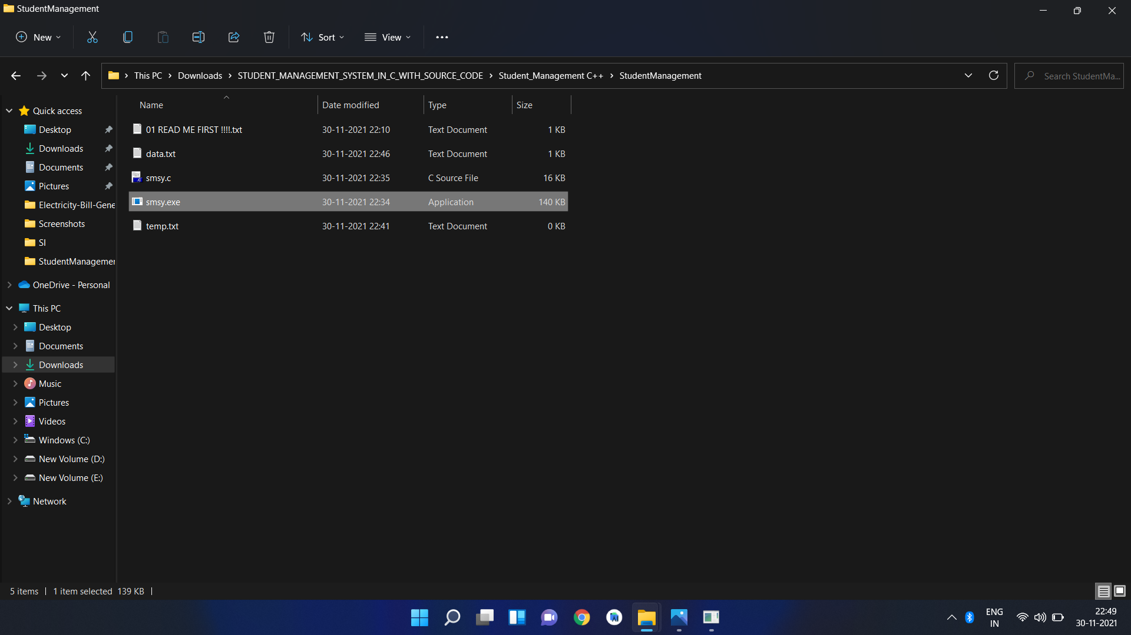

Slide 20


Thank You

