Slide 1
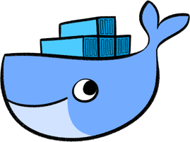
Docker
GETTING STARTED WITH DOCKER
By:
Abhishek Onkar
Ajay Athreya
Rohit Akhairakma

Slide 2
Contents
IT History and Why Docker?
Introduction to Docker
Docker Containers and Images
Docker Architecture and Docker Engine
Docker Hub
Docker CLI
Docker Hands On Demo

Slide 3
History of Docker
Originally a proprietary system started by Solomon Hykes, Docker was shifted to open source in early 2013.
Its popularity grew steadily and exploded in 2014. By 2015, more than 300 million container downloads had occurred.
Today, there are over 3.5 million applications placed in containers and over 3.7 billion containerized applications have been downloaded. Almost all IT and cloud companies have adopted Docker.

Slide 4
Introduction To Docker
Docker is a platform that allows developers to develop, ship and deploy applications using Container Virtualization Technology.
It carves up a running linux system into small containers, each of which has its own code and dependencies.

Slide 5
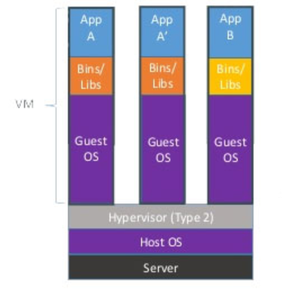
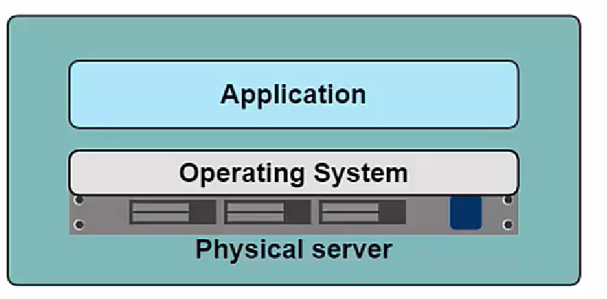
History

Slide 6
HYPERVISOR BASED VM
PRO’s
Con’s
Better resource pooling- One machine, many VMs
Easy scalability – new instances of VM can be created easily
VM can be in cloud
Each VM still requires CPU allocation,Storage and RAM
The more VMs we run, the more resources we need
Guest OS leads to wasted resources
No guarantee of Application Portability

Slide 7
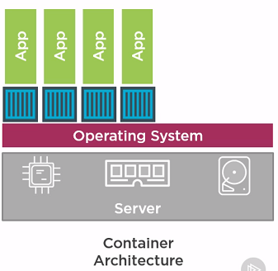
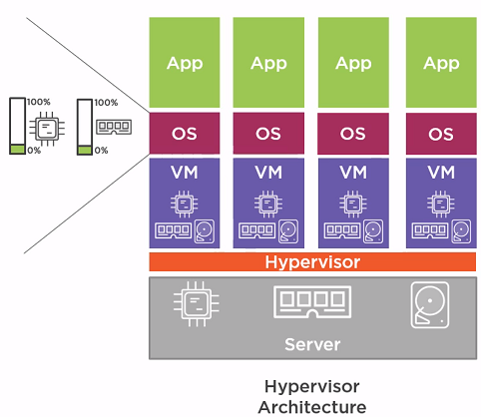
Docker Container

Slide 8
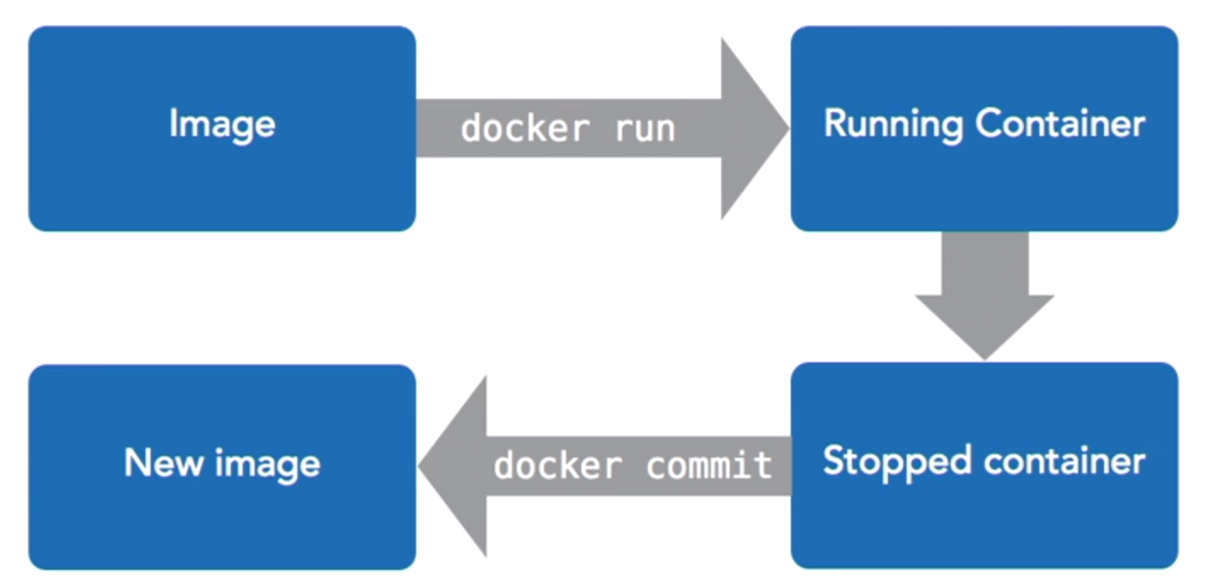
CONTAINERS AND IMAGES

Slide 9
Containers vs VM
Containers do not require Guest OS
More lightweight
More Containers/Machine can be run compared to VMs/Machine
Require less CPU, RAM and storage space

Slide 10
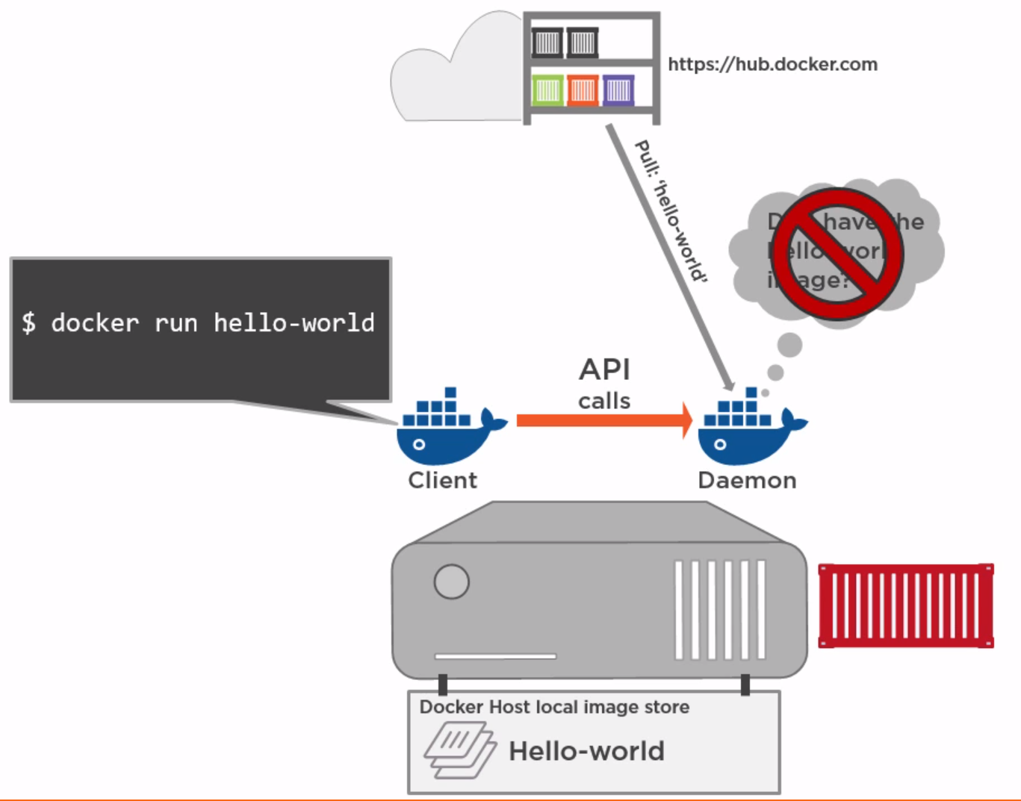
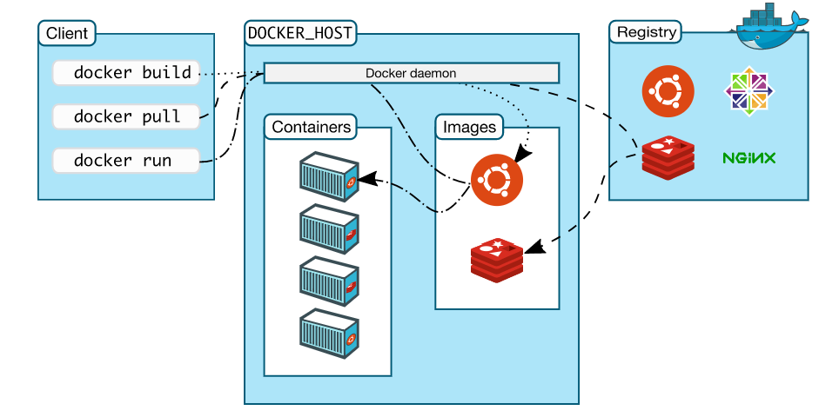
Docker Architecture

Slide 11
Q&A

