Slide 1

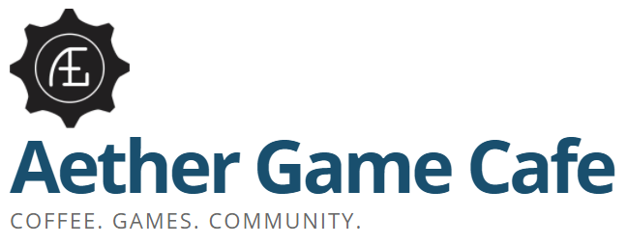
BIA 654: Experimental Design Professor: Chihoon Lee
Jayakumar, Jaya Prasad Karunanithi, Sunoj
Patibandla, Saketh Schoenbrun, Ephraim

Slide 2
Google Online Marketing Challenge (GOMC)
The Google Online Marketing Challenge is a unique opportunity for students to experience and create online marketing campaigns using Google AdWords. Over 110,000 students and professors from almost 100 countries have participated in the past 9 years.
With a $250 AdWords advertising budget provided by Google, students develop and run an online advertising campaign for a business or non-profit organization over a three week period.
The teams that develop and communicate the most successful campaigns win awesome prizes, including trips to Google offices. Students also have the opportunity to participate in the optional AdWords Certification category by studying and passing the necessary exams to become an AdWords Certified individual in the Google Partners platform.
Client and Market Analysis
Aether Game Cafe (AGC) is a blend of traditional coffee shop and board games playcenter located in Hoboken, New Jersey.
It attracts several gaming enthusiasts, it hosts several weekly events that unite various spheres of the gaming community.
AGC’s unique selling point is the wide variety of games they offer and the ambience they provide for a community get-together.
AGC relies only on ‘Word of Mouth’ for its marketing which indicates the presence of a good scope for widening the game cafe’s customer base.

Slide 3
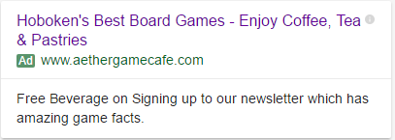
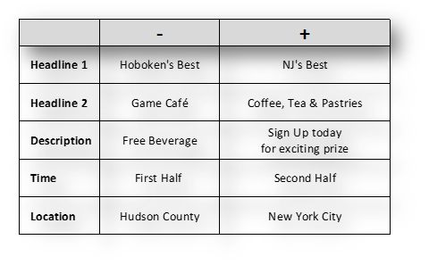
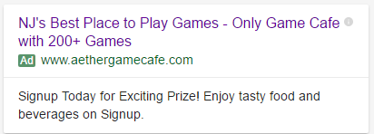
Factors & Sample Ads

Slide 4

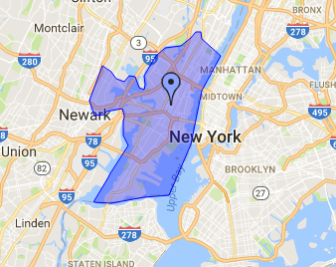
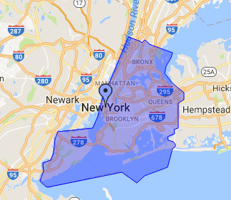
Blocks

Slide 5
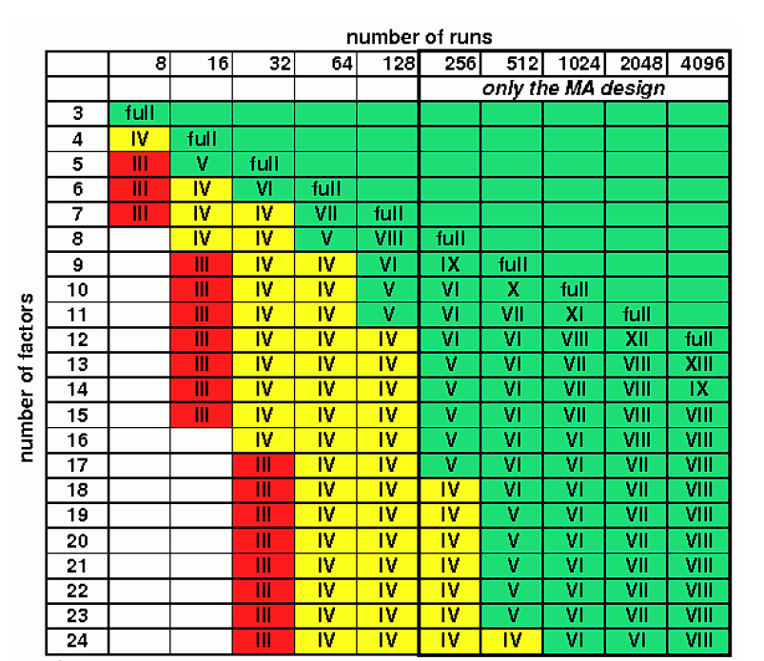
2⁵⁻² Design:
4 Factors and 1 Block
32-run design = Full Factorial
8-run design = Resolution III: Main effects are confounded with two way interactions
So why only 8 runs?
Time = Money
Sparsity of effects
Confound with blocking factor

Slide 6
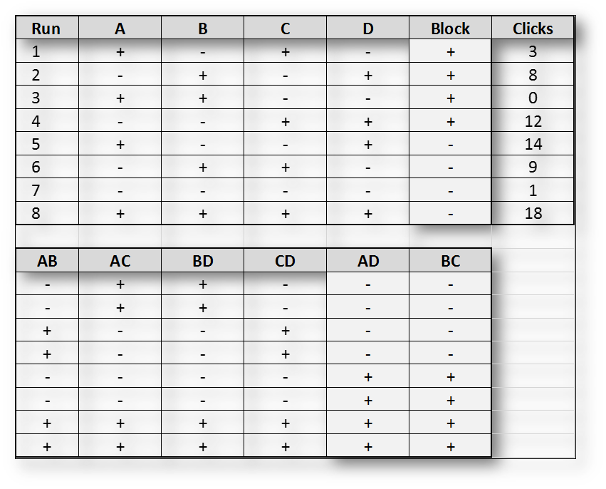
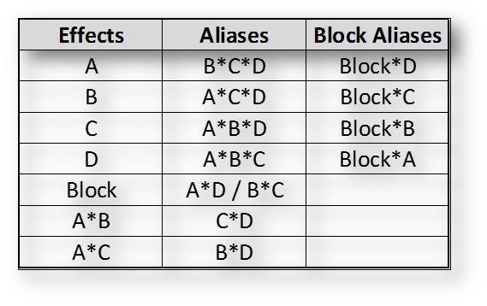

Slide 7
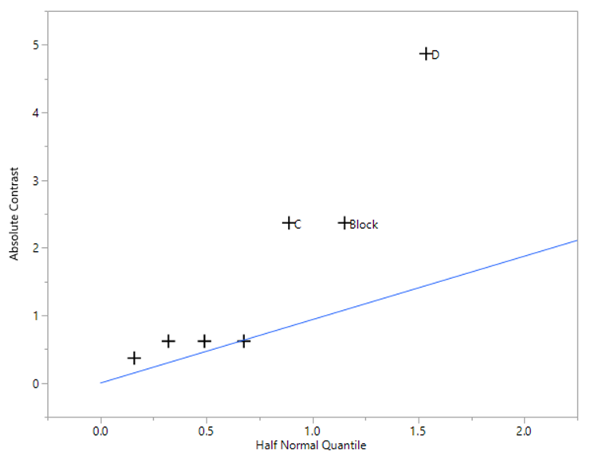
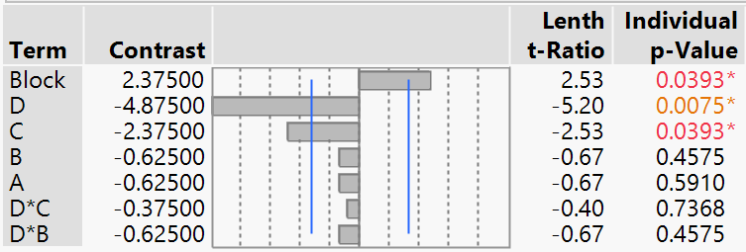
Evaluation of Results
The factors D and C, and the block is significant.
D - Time (First Half / Second half)
C - Description (Free Beverage / Free Prize)
Block - Location (Hudson County / New York City)

Slide 8
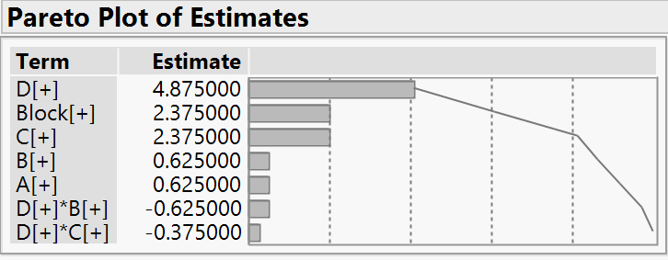
Significant drop off after C (Description)

Slide 9
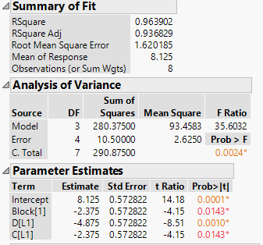
Model
Model Equation:
Number of clicks = 8.125 - 2.375*Block[1] - 4.875*D[L1] - 2.375*C[L1]

Slide 10
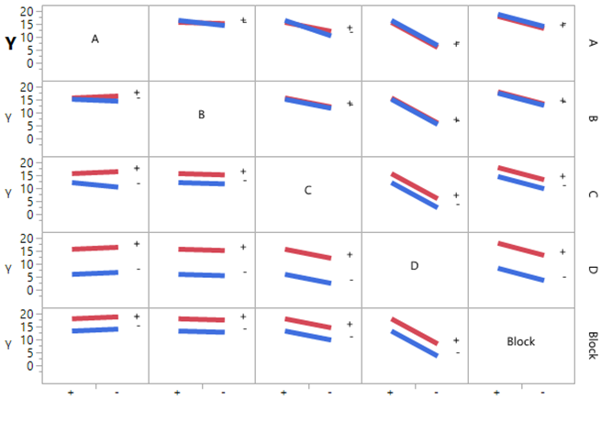
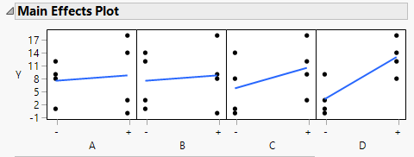

Slide 11
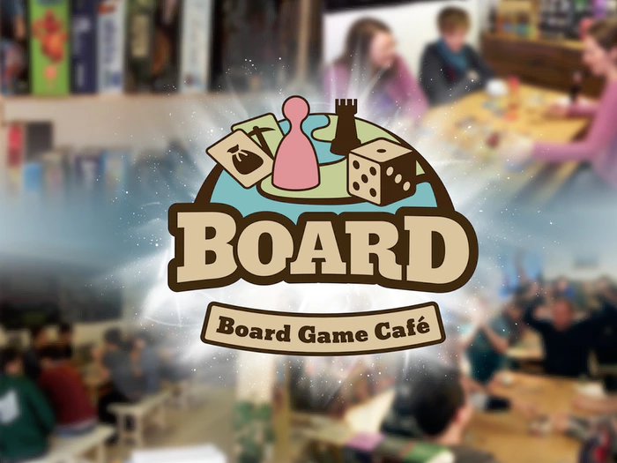
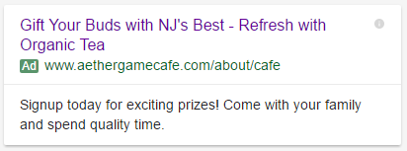
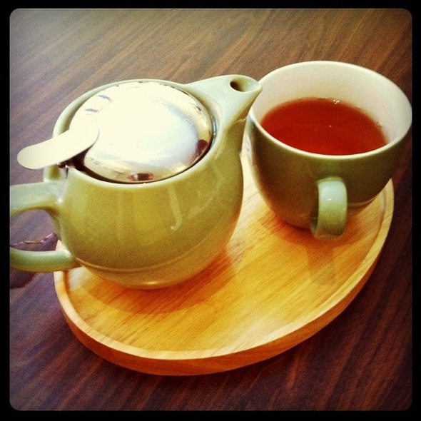
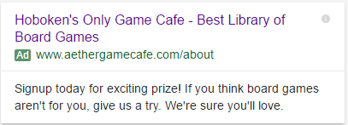
Results out of Experiment

Slide 12

