Slide 1


RC Interpolation vs. RC Smoothing
Code Location: https://github.com/betaflight/betaflight/blob/master/src/main/fc/fc_rc.c

Slide 2
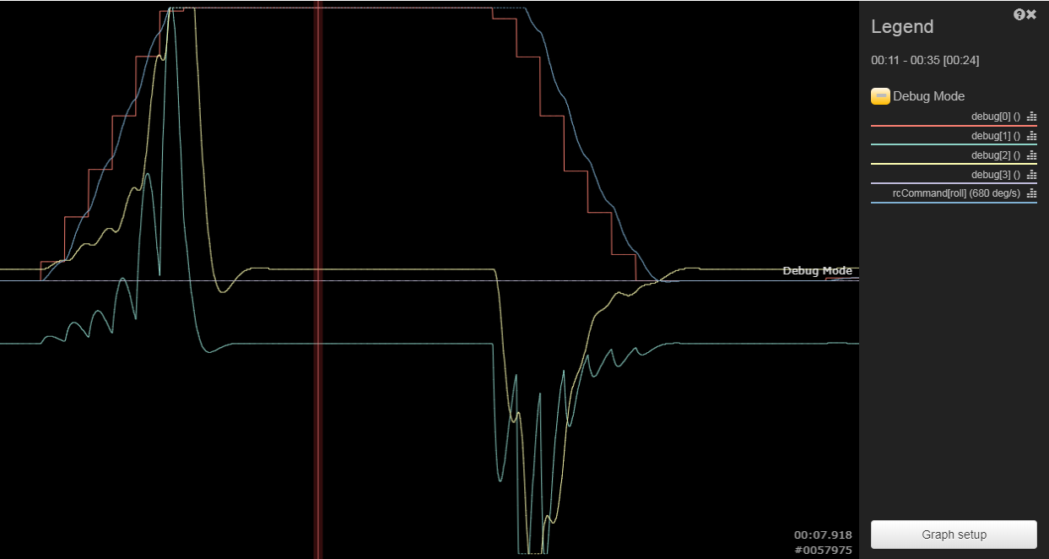
Debug_Mode = RC_Interpolation
debug(0) = raw un-smoothed rc channel data
debug(1) = current RX frame rate
Debug_Mode = RC_Smoothing
debug(0) = raw un-smoothed rc channel data
debug(1) = raw un-smoothed setpoint derivative
debug(2) = filtered setpoint derivative before applied to setpoint weight
debug(3) = auto-calculated filter cutoff frequency base after sampling the rx frame rate
Debug_Mode = RC_Smoothing_Rate
debug(0) = log each RX frame interval
debug(1) = log the training step count
debug(2) = the current calculated average
debug(3) = indicates whether guard time is active

Slide 3
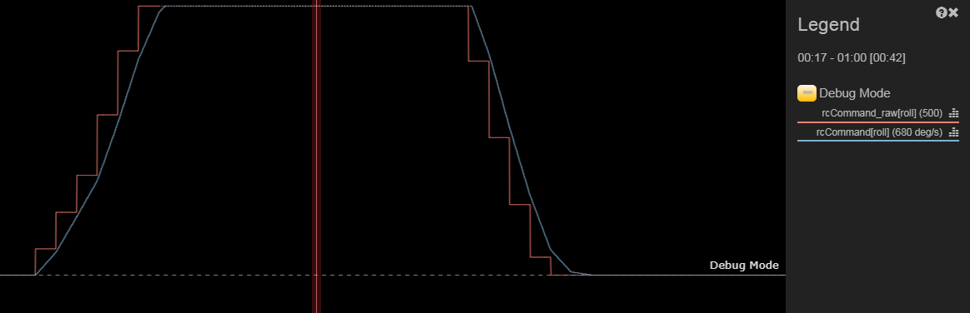
Interpolation
Advantages:
Simple
No Pumping Effects
Disadvantages:
Delayed 1 frame rate
Handles dropped frames poorly
Abrupt Changes in Slope
Input Delayed = to Frame Rate+
Abrupt Change in Slope = Problematic

Slide 4
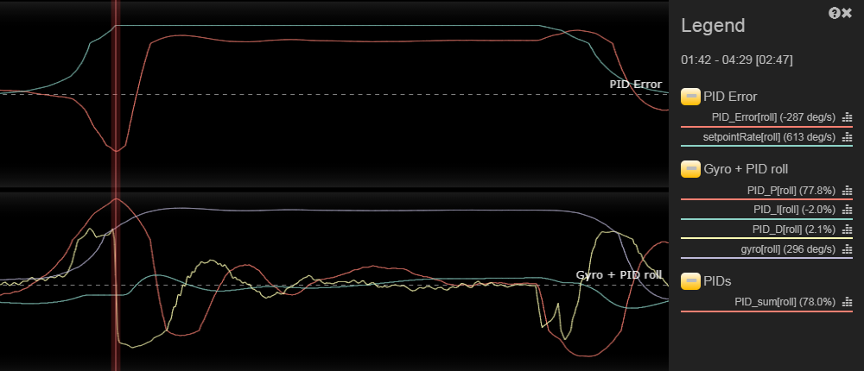
Interpolation
Abrupt Changes in Slope
D-term Jerk
D-term Jerk

Slide 5
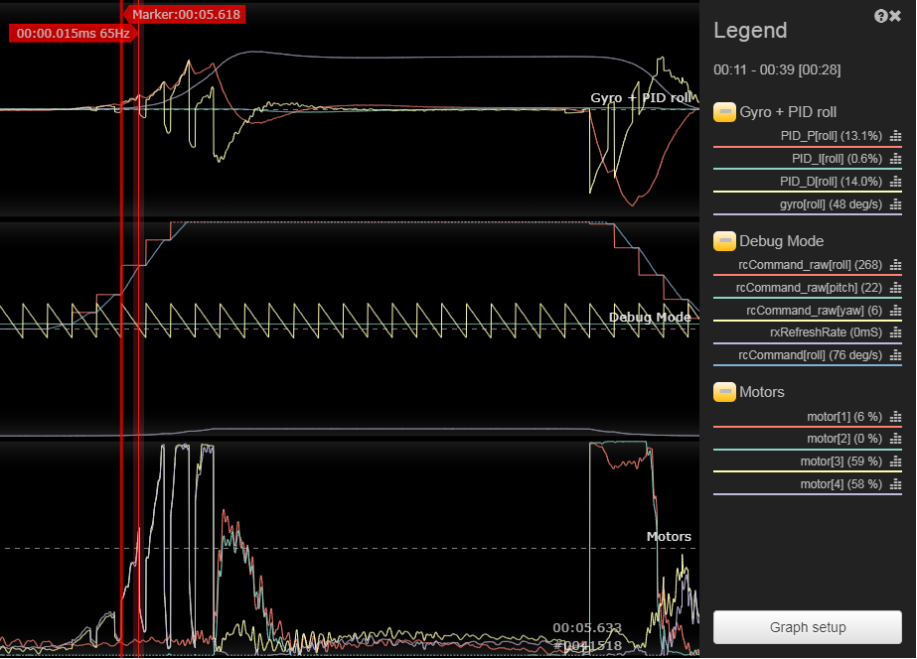
Interpolation set to Manual = 15ms for a 22ms frame rate

Slide 6
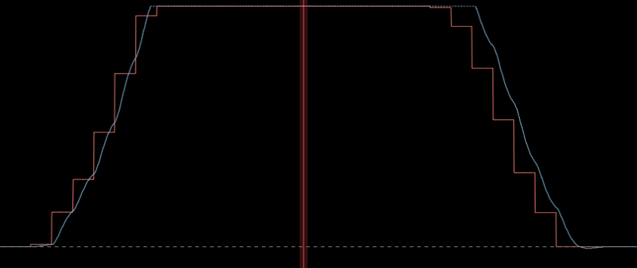
RC Smoothing
Advantages:
Less delay (ascending leg)
Smoother Edges (no juts)
Less affected by loop-time jitter
Handles packet loss better.
Disadvantages:
Reseeding Leg has more Lag
Pull Request: https://github.com/betaflight/betaflight/pull/6017
Less Leading Lag
More Trailing Lag

Slide 7
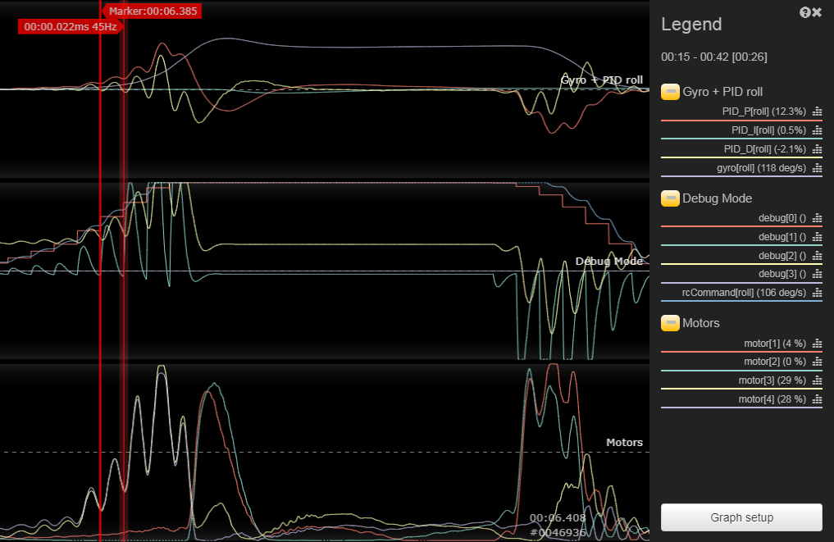
RC Smoothing Calcs
Hz = 1/ ([ms of latency] /1000)
E.g: 1 / (22ms / 1000) = 45.5hz
[Frame rate in Hz] / 2 x 90% = cut-offs
E.g.: 45.5 / 2 x 0.9 = 20hz
Command “rc_smoothing_info”
to get RX rate to FC

Slide 8
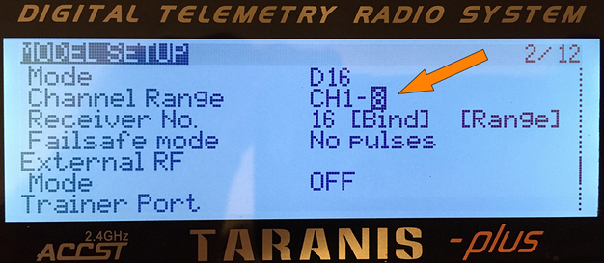
Special RX / TX Conditions
SBus or FPort users
set their radio link to D16 mode and no more than 8 channels
Spektrum (DX6i, DXe, DX6e)
RX at 11ms (91hz), but TX sends at 22ms (45hz)
read this document for setting up RC Smoothing Filter correctly (manually)
Crossfire
150hz (6.7ms) to 50hz (20ms) to switching
https://github.com/betaflight/betaflight/issues/6239
Debug_mode = RC_SMOOTHING_RATE

Slide 9
Other Pull Requests
Details on Crossfire 50hz to 150hz Challanage:
https://github.com/betaflight/betaflight/issues/6103 (discusses issue in Interpolation as well)
https://github.com/betaflight/betaflight/pull/6194 (adding full support of CRSF)
https://github.com/betaflight/betaflight/issues/6239 (RC5 improvements)
Proposed RC_Interpolation Advanced by Plasmatree
https://github.com/betaflight/betaflight/issues/6112

