Slide 1
Updates

Slide 2
3 Features Explored
Edge Information (f₁)
How much edge information reduced by compression algorithm
Temporal Redundancy among Video frames (f₂)
Temporal Redundancy = 1 - (P-frame size of (i+1)^{th} frame ) / (I-frame size of (i+1)^{th} frame )
Spatial Redundancy in each frame (f₃)
Spatial Locality = 1 - (I-frame size/raw frame size)

Slide 3
Possible Classifier Selection
Unsupervised
K-means Clustering, EM clustering
Supervised
Bayesian Classifier
Logistic Regression
Decision Trees
Semi-Supervised
RL approach → Ranking Model

Slide 4
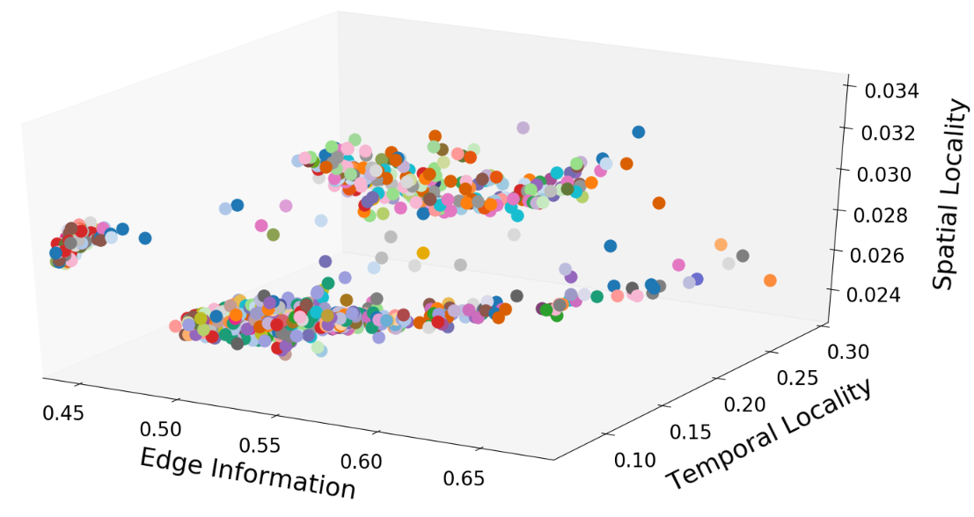
Clustering is a Good Option?
To check whether clustering can be a good classifier in this context,
We plotted 3D plots of those feature vectors of 4 video segments
Here we have 72 different best configurations over 874 frames
Notes:
Same configurations are plotted with same color

Slide 5
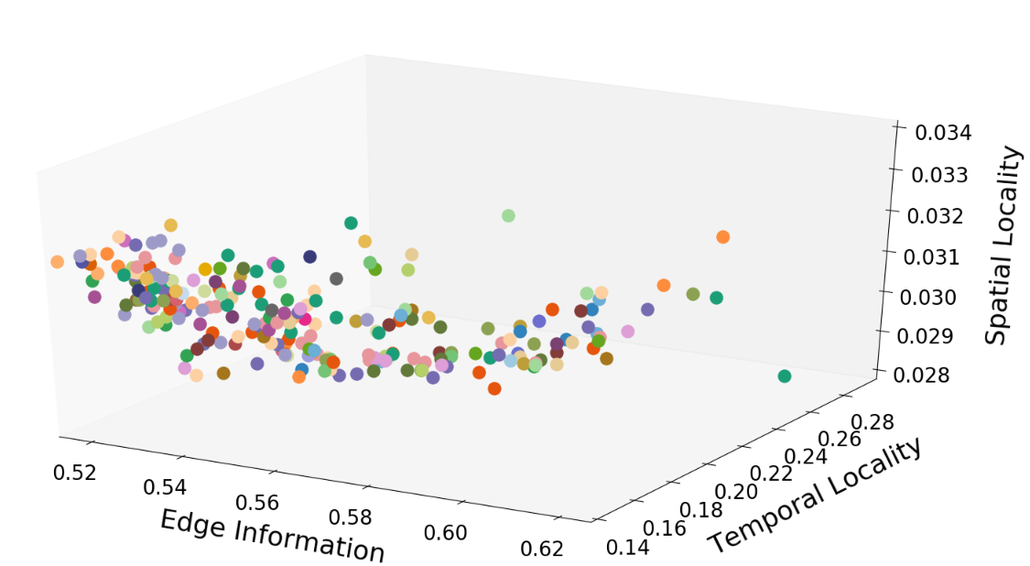
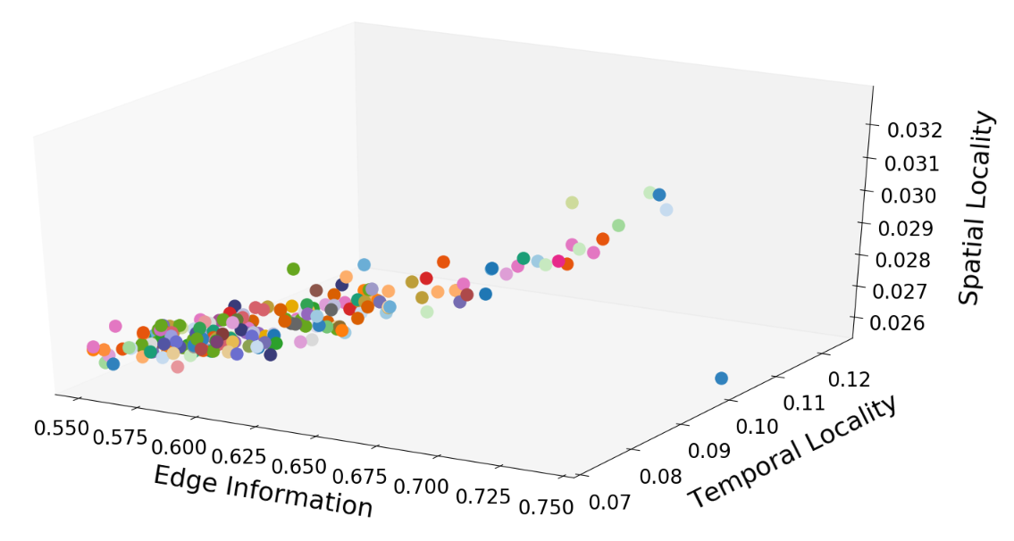
For A Single Video Segment
For single video as well as diverse videos, the same best configuration points are sparsely distributed
Hence with the features considered, clustering (unsupervised learning) is not a good option

Slide 6
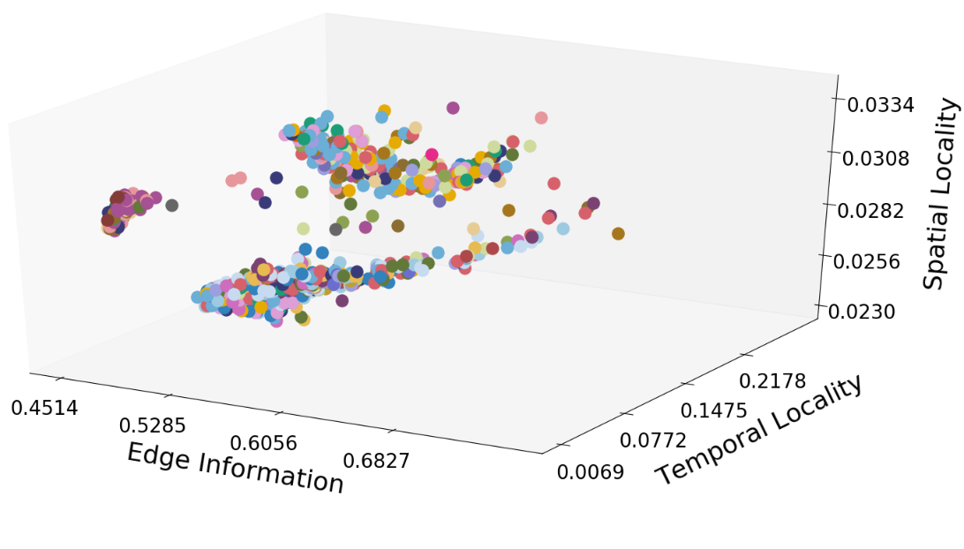
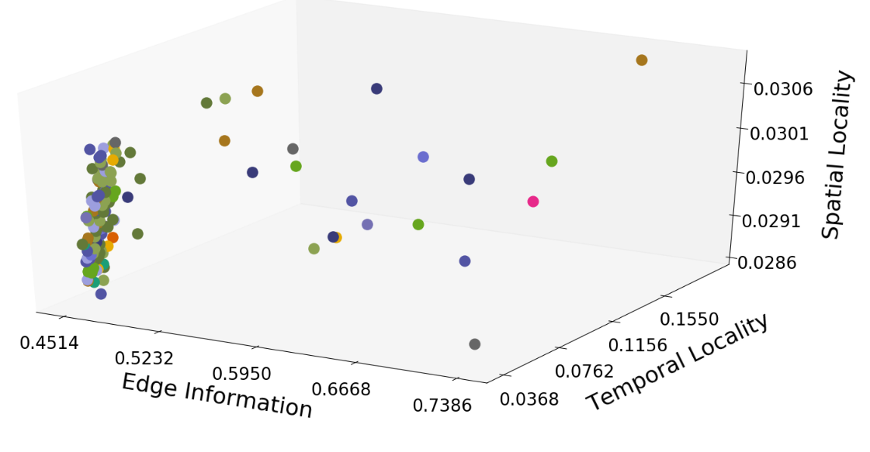
Reduce the Configuration Space
# of Unique Best configs = 32
Frames considered = 874
# of Unique Best configs = 14
Frames considered = 150
Reducing the configuration space by reducing the available bandwidth proves that
Clustering is not a right option for this scenario

Slide 7
Supervised Learning
We used three different regressors
Logistic Regressor (LR)
Decision Tree (DT)
Bayesian Classifier (BC)
We have checked the performance of this classifier on
Four videos individually
Four Videos altogether
2/3 frames used for training
1/3 frames used for testing

Slide 8
Performance of Supervised Learning
 | Video₁ |  |  | Video₂ |  |  | Video₃ |  |  | Video₄ |  |  | All videos combined
Train set | 166 |  |  | 178 |  |  | 142 |  |  | 95 |  |  | 584
Test set | 83 |  |  | 88 |  |  | 72 |  |  | 47 |  |  | 290
 | BC | DT | LR | BC | DT | LR | BC | DT | LR | BC | DT | LR | BC | DT | LR
Top-5 | 14 | 19 | 22 | 18 | 15 | 51 | 6 | 12 | 22 | 17 | 2 | 15 | 75 | 49 | 56
Top-10 | 24 | 30 | 37 | 32 | 27 | 62 | 15 | 26 | 32 | 22 | 3 | 22 | 111 | 85 | 76
Top-20 | 50 | 50 | 53 | 54 | 50 | 73 | 21 | 37 | 47 | 32 | 6 | 37 | 181 | 141 | 141
Acc drop | 0.27 | 0.24 | 0.23 | 0.22 | 0.19 | 0.10 | 0.06 | 0.049 | 0.042 | 0.08 | 0.12 | 0.05 | 0.2 | 0.19 | 0.22

Slide 9
Key Points
Multi-Class Logistic Regression every time predicts a single best configuration for 5 scenarios in the table
Prediction across each 5 scenarios are different
For individual video training and testing, a single best possible configuration predicted by LR can give less accuracy drop or less error
Considering diverse video sets,
LR gives the highest accuracy drop
DT provides less accuracy drop

Slide 10
Performance of Classifiers on Reduced Configuration Space
 | Video₁ |  |  | Video₂ |  |  | Video₃ |  |  | Video₄ |  |  | All videos combined
Train set | 166 |  |  | 178 |  |  | 142 |  |  | 95 |  |  | 584
Test set | 83 |  |  | 88 |  |  | 72 |  |  | 47 |  |  | 290
 | BC | DT | LR | BC | DT | LR | BC | DT | LR | BC | DT | LR | BC | DT | LR
Top-5 | 11 | 25 | 47 | 52 | 30 | 61 | 21 | 28 | 28 | 26 | 18 | 26 | 126 | 74 | 99
Top-10 | 47 | 61 | 71 | 76 | 64 | 79 | 43 | 47 | 47 | 43 | 33 | 43 | 232 | 170 | 170
Top-20 | 83 | 83 | 83 | 88 | 88 | 88 | 72 | 72 | 72 | 47 | 47 | 47 | 290 | 273 | 243
Acc drop | 0.74 | 0.64 | 0.65 | 0.11 | 0.14 | 0.09 | 0.06 | 0.074 | 0.073 | 0.09 | 0.10 | 0.09 | 0.20 | 0.25 | 0.2874
Notes:
Here Bayesian Classifier is giving best performance overall

Slide 11
How Much Benefit Oracle Provides
Let’s look into how much improvement in accuracy we can get
If we use the oracle prediction over choosing one from all possible allowable configurations for all the video frames under the bandwidth consideration
 | Video 1 | Video 2 | Video 3 | Video 4
Allowable configs | 68 | 78 | 83 | 59
Min improvement | 0.068 | 0.056 | 0.034 | 0.04
Max improvement | 0.882 | 0.942 | 0.90 | 0.835
Mean improvement | 0.414 | 0.27 | 0.143 | 0.24
Std deviation | 0.244 | 0.21 | 0.18 | 0.226
Maximum and Average improvement is pretty high
Minimum improvement (< 7%) leads to that one best configuration can be possible for a video segment

Slide 12
Considering Possible Best Configuration Space
Reduce the configuration space to the set of best possible configurations
 | Video 1 | Video 2 | Video 3 | Video 4
Unique Best Configs | 42 | 42 | 55 | 35
Max improvement | 0.692 | 0.466 | 0.74 | 0.58
Mean improvement | 0.29 | 0.182 | 0.095 | 0.13
Std deviation | 0.17 | 0.09 | 0.1 | 0.14
Maximum and Average accuracy degradation reduced from previous experiment where all possible configurations are considered

Slide 13
Future Steps
Need to extend the test set and video diversity
Due to lack of high-resolution drone captured images, we will try to explore more high-resolution surveillance camera videos
Will try other features likewise
Saturation, Brightness, Contrast, sharpness
Need to try other classifiers also (but less imp)
Softmax Regression
xgboost

Slide 14
How to Check Whether Features are Good?
First run the K-means clustering on the feature vectors
Find the Cluster affinity through Adjusted Rand Score Metric
For perfect affinity score = 1.0
Once cluster affinity greater than a threshold
Hence, similar configuration points are close by in space
Then run the supervised learning using those feature vectors

Slide 15
Why RL is not used Currently?
We need to design our own policy network and need to find suitable features
Feature Vectors
Policy Network
Set of Actions
Applying on Environment
<f₁, f₂, f₃, …..>
Select Best Config
Select Penalty or Reward

Slide 16
 | Video 1 | Video 2 | Video 3 | Video 4
Allowable configs | 68 | 78 | 83 | 59
Min improvement | 0.068 | 0.056 | 0.034 | 0.04
Max improvement | 0.882 | 0.942 | 0.90 | 0.835
Mean improvement | 0.414 | 0.27 | 0.143 | 0.24
Std deviation | 0.244 | 0.21 | 0.18 | 0.226
 | Video 1 | Video 2 | Video 3 | Video 4
Unique Best Configs | 42 | 42 | 55 | 35
Min improvement
Max improvement | 0.692 | 0.466 | 0.74 | 0.58
Mean improvement | 0.29 | 0.182 | 0.095 | 0.13
Std deviation | 0.17 | 0.09 | 0.1 | 0.14

Slide 17
 | All Drone Videos |  |  |  |  | Surveillance Videos |  |  |  | All Videos Combined
Train Set | 568 |  |  |  |  | 504 |  |  |  | 1072
Test Set | 290 |  |  |  |  | 258 |  |  |  | 496
Feature_set1 <edge, spatial, temporal> |  | LR | DT | BC | SVM | LR | DT | BC | SVM | LR | DT | BC | SVM
 | Top5 | 56 | 49 | 75 | 56 | 46 | 63 | 64 | 47 | 112 | 111 | 124 | 82
 | Top10 | 76 | 85 | 111 | 77 | 81 | 98 | 92 | 83 | 187 | 184 | 170 | 155
 | Perf | 0.22 | 0.186 | 0.2 | 0.22 | 0.23 | 0.34 | 0.3 | 0.225 | 0.17 | 0.26 | 0.37 | 0.14
Feature_set2 <contrast, color, brightness> | Top5 | 55 | 44 | 69 | 66 | 106 | 45 | 95 | 72 | 140 | 83 | 107 | 162
 | Top10 | 85 | 59 | 109 | 87 | 165 | 74 | 134 | 117 | 225 | 119 | 135 | 244
 | perf | 0.16 | 0.38 | 0.14 | 0.225 | 0.24 | 0.387 | 0.28 | 0.309 | 0.21 | 0.314 | 0.312 | 0.2
Feature_set3 <orb, sift, # of matches> | Top5 | 73 | 49 | 60 | 66 | 91 | 60 | 86 | 89 | 130 | 98 | 117 | 139
 | Top10 | 85 | 77 | 92 | 94 | 144 | 96 | 127 | 135 | 195 | 182 | 176 | 223
 | perf | 0.188 | 0.207 | 0.11 | 0.146 | 0.269 | 0.368 | 0.298 | 0.28 | 0.255 | 0.27 | 0.22 | 0.215
Notes:
496<52, 59, 124, 160, 247>

Slide 18
How much Sparse GroundTruth Clustering is?
 | 4 Drone Videos |  | 2 sur camera videos |  | All videos combined
Total points | 874 |  | 770 |  | 1644
# of Unique Best Configs | 72 |  | 66 |  | 82
 | mean | Standard deviation | mean | Standard deviation | mean | Standard deviation
Feature_set1 | 0.028 | 0.013 | 0.02 | 0.018 | 0.031 | 0.014
Feature_set2 | 6.935 | 4.13 | 1.49 | 1.26 | 6.23 | 3.31
Feature_set3 | 7.79 | 5.03 | 14.48 | 9.18 | 17.07 | 9.51

Slide 19
Measure Sparsity Reducing the Config Space
 | 4 Drone Videos |  | 2 sur camera videos |  | All videos combined
Total points | 874 |  | 770 |  | 1644
# of Unique Best Configs | 32 |  | 27 |  | 32
 | mean | Standard deviation | mean | Standard deviation | mean | Standard deviation
Feature_set1 | 0.031 | 0.0133 | 0.028 | 0.02 | 0.034 | 0.0135
Feature_set2 | 5.258 | 3.71 | 1.427 | 0.95 | 6.74 | 2.68
Feature_set3 | 7.974 | 4.73 | 16.184 | 8.56 | 18.61 | 8.6

Slide 20
 | All Drone Videos |  |  |  | Surveillance Videos |  |  | All Videos Combined
Train Set
Test Set
Feature_set1 |  | SVM | XGB | SM | SVM | XGB | SM | SVM | XGB | SM
 | Top5 |  | 12 |  |  | 11 |  |  | 25
 | Top10 |  | 25 |  |  | 19 |  |  | 51
 | Perf |  | 0.272 |  |  | 0.488 |  |  | 0.36
Feature_set2 | Top5 |  | 32 |  |  | 2 |  |  | 36
 | Top10 |  | 50 |  |  | 6 |  |  | 66
 | perf |  | 0.26 |  |  | 0.50 |  |  | 0.387
Feature_set3 | Top5 |  | 16 |  |  | 8 |  |  | 30
 | Top10 |  | 27 |  |  | 15 |  |  | 45
 | perf |  | 0.237 |  |  | 0.51 |  |  | 0.379

