Slide 1
Performance Configuration
Qiang Xu

Slide 2
Outline
Empirical study [ASPLOS’18]
Literature review (9 papers)
Discussion

Slide 3
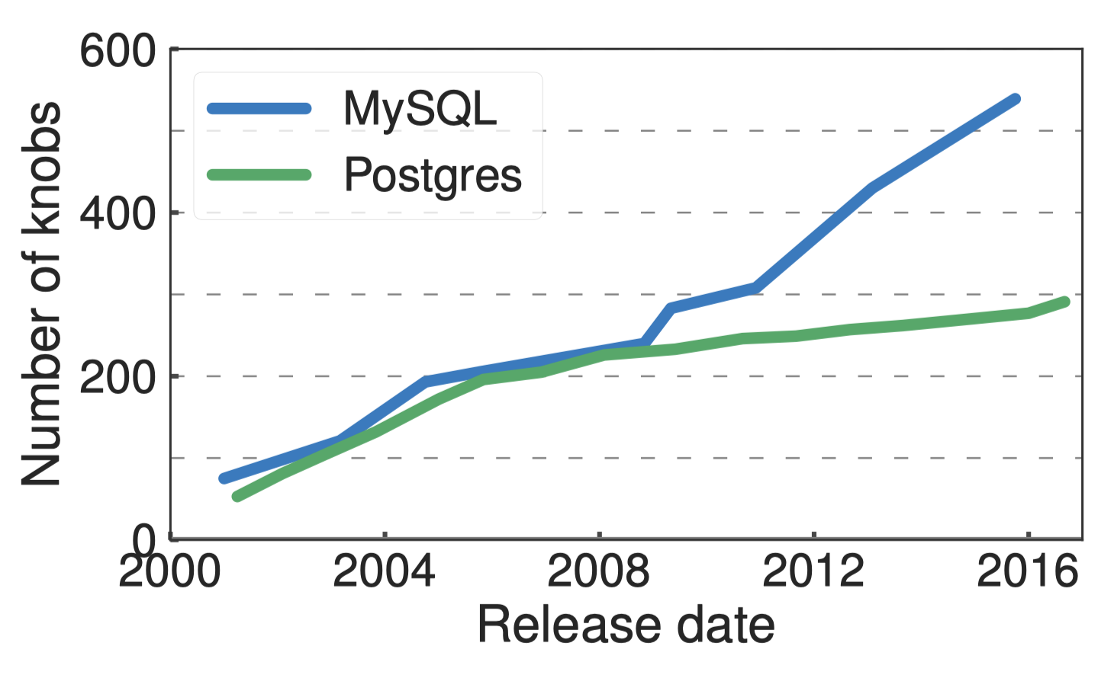
Increasing Number of Knobs
~50 of them affects performance

Slide 4
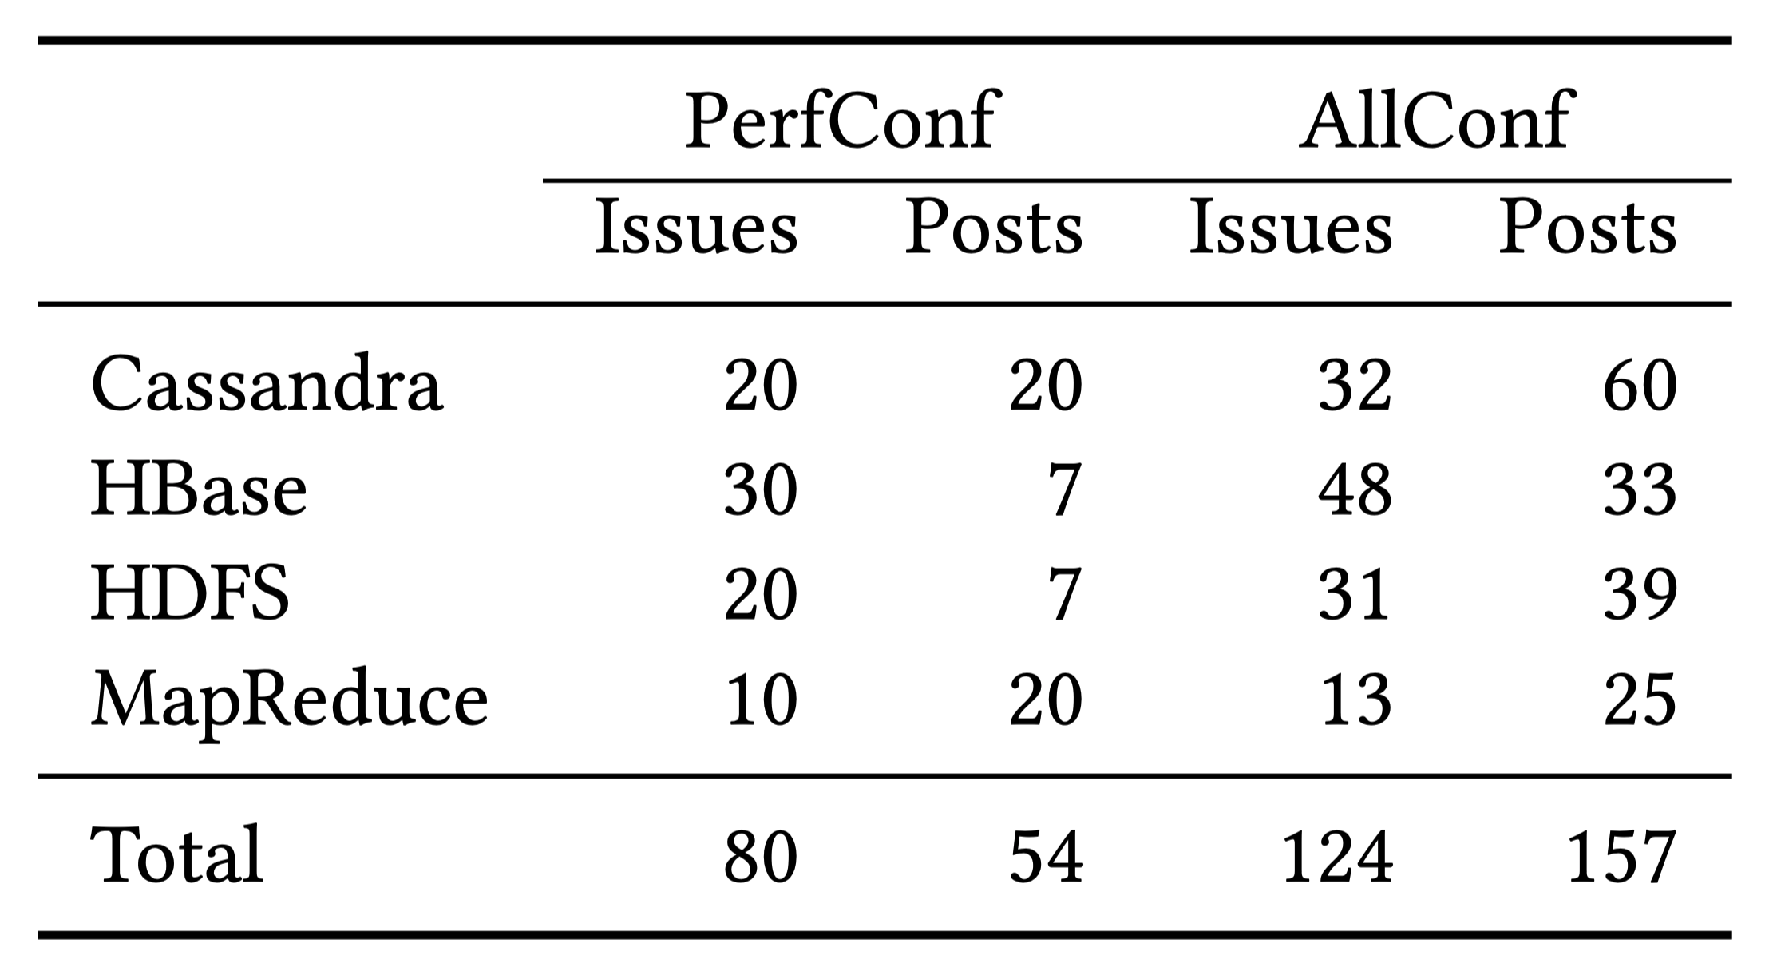
Empirical Study
Subject
Cassandra (CA), HBase (HB), HDFS (HD), Hadoop MapReduce (MR)
Methodology
Search issue trackers and StackOverflow with keyword “config”, then manually select relevant ones till certain amount

Slide 5
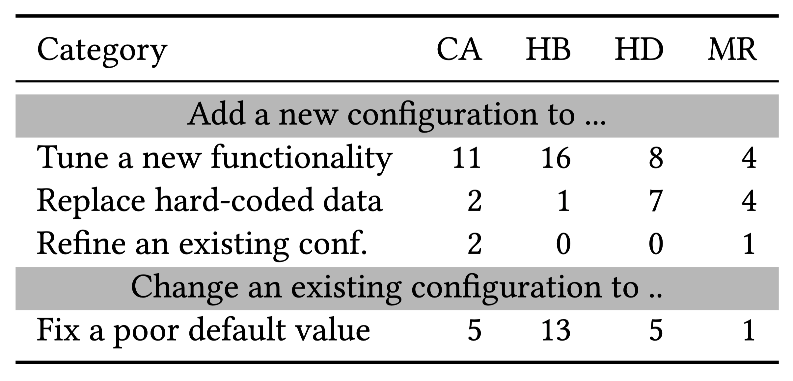
PerfConf Issues
14/80 issues ask developers to make a hard-coded parameter configurable

Slide 6
PerfConf Posts
30% posts ask for help to improve performance
30% posts are related to OOM
Half of the posts don’t know which parameter to configure

Slide 7
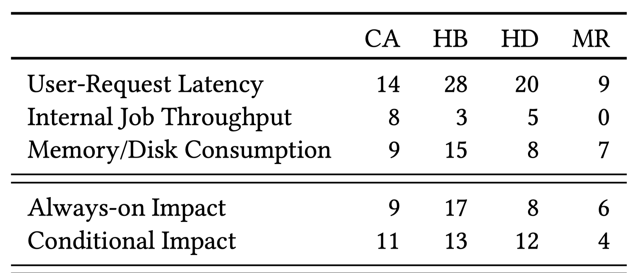
Impact of PerfConf
One metric could be affected by multiple parameters
Perf/perf tradeoffs and perf/func tradeoffs exist
Many parameters only affect particular events or modules

Slide 8
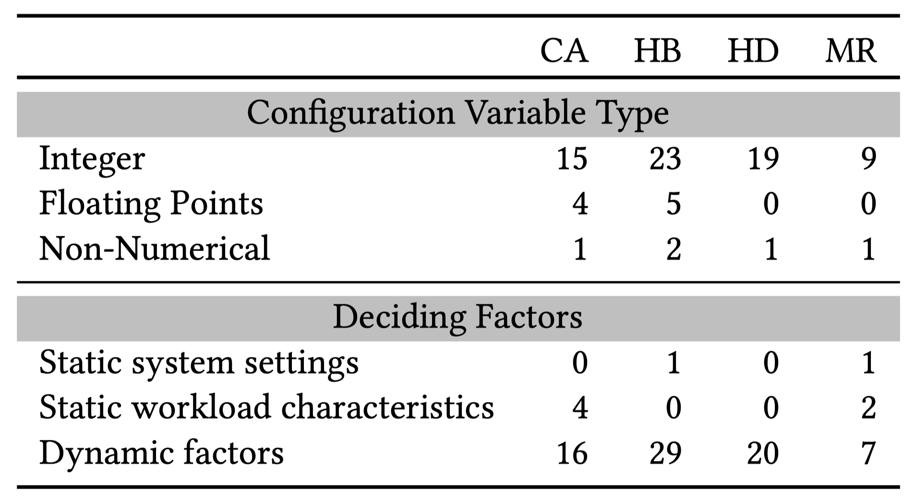
How to Set PerfConf
> 80% are integers, 10% are floats, 5 are boolean
Proper value of 90% parameters depends on dynamic workload or resource consumption
Most influential parameters could be different depending on workload and available environment [ATC’18]

Slide 9
Literature Review
Automatic configuration tuning (7 papers)
Performance bugs under certain configuration (2 papers)

Slide 10
Automatic Configuration Tuning
Black-box tuning
Database tuning
External tools
Internal tools
Tuning for other software categories
Older papers
Offline
Tune for a certain workload and environment
Online
Reconfigure dynamically

Slide 11
Black-box Tuning – Offline
BestConfig [SoCC’17]
Divide-and-diverge sampling + recursive-bound-and-search
[ATC’18] tested 4 classic heuristic searching and RL algorithms
Simulated annealing, genetic algorithms, deep Q-networks, bayesian
All search-based methods does not scale and may not give good configuration
[ATC’18] takes hours to optimize the hand selected 8 knobs
[ATC’18] cannot find a near optimal setting for 40% of the time
BestConfig usually gives far from optimal configuration [SIGMOD’19]

Slide 12
Database Tuning – Offline
OtterTune [SIGMOD’17]
Find the most similar known workload to the target workload, then search using Gaussian Process (GP) regression, with that configuration as bootstrap
Workloads are represented using internal metrics of the DBMS
E.g. innodb_rows_read, innodb_data_read
Lasso is performed to select the most important knobs
Requires a large amount of high-quality samples [SIGMOD’19]
Low-quality samples can only give low quality bootstraps
Hard to get so many samples for a certain environment and DB version

Slide 13
Database Tuning – Offline (Cont)
CDBTune [SIGMOD’19]
Uses DRL: internal metrics → configuration
Only needs a few bootstrap samples
Compared to OtterTune: more expressive model than GP
Compared to search based: more guidance (internal metrics)
QTune [PVLDB’19]
Uses DRL: featurized SQL queries → configuration
Seems like this workload characterization is more accurate

Slide 14
Reasons behind Performance Improvements
BestConfig [SoCC’17]
→ better bootstrap →
OtterTune [SIGMOD’17]
→ more expressive model →
CDBTune [SIGMOD’19]
→ more accurate workload characterization →
QTune [PVLDB’19]
BestConfig is published later than OtterTune, but has worse performance

Slide 15
Black-box Tuning – Online
SmartConf [ASPLOS’18]
Train a perf model offline, then adjust online to meet predefined constraints and give satisfactory performance
It respects (with high probability) constraints under workload shift
E.g. memory usage, disk usage, tail latency
The perf model is a linear model
Cannot handle bumpy perf surface
Only gives satisfactory performance

Slide 16
Database Tuning – Online
Sophia [ATC’19]
Orchestrates reconfig of a cluster
Assumes DBMSs need to be restarted for reconfig, which affects data availability and degrades the overall performance
Performs a cost-benefit-analysis based on workload prediction, estimated improvement, etc.
Servers perform the reconfig in some order to maintain data availability level

Slide 17
Overall Trends
Searching → learning
Offline → online
More domain specific knowledge
Respect constraints

Slide 18
Searching vs Learning
Learning is inferior to searching [SoCC’17, ATC’18]
Black-box tuning
Model: configuration → performance
A too general model for a specific workload
Learning is superior to searching [SIGMOD’17, SIGMOD’19, PVLDB’19]
Database tuning
Model: workload → configuration
Workload feature extraction
[SIGMOD’17, SIGMOD’19] uses internal metrics as workload features
[PVLDB’19] additionally uses features extracted from SQL quires

Slide 19
Learning-based Arbitrary Program Tuning?
Searching-based methods are not sufficient
Problem: how to characterize workload?
Option 1
Most software having many knobs also have many internal metrics
HTTP servers, DBMSs, FSs, analytics frameworks
Option 2
Discover program execution statistics that characterizes a workload yet is independent to configuration parameters
E.g. #times a certain function or loop executes

Slide 20
Where to Apply ConfigProf?
Auto config is a better direction compared to just identifying important config parameters
Especially when tuning a cluster
Use ConfigProf as a preprocessing step to reduce search space?
OtterTune [SIGMOD’17] did this using Lasso
DNN implicitly captures the importance of each parameter [SIGMOD’19]

Slide 21
Perf Bugs under Certain Config
Empirical study [ESEM’16]
Most software are tested with default configuration
Yet 59% performance bugs only manifest under certain configuration, or caused by misconfiguration

Slide 22
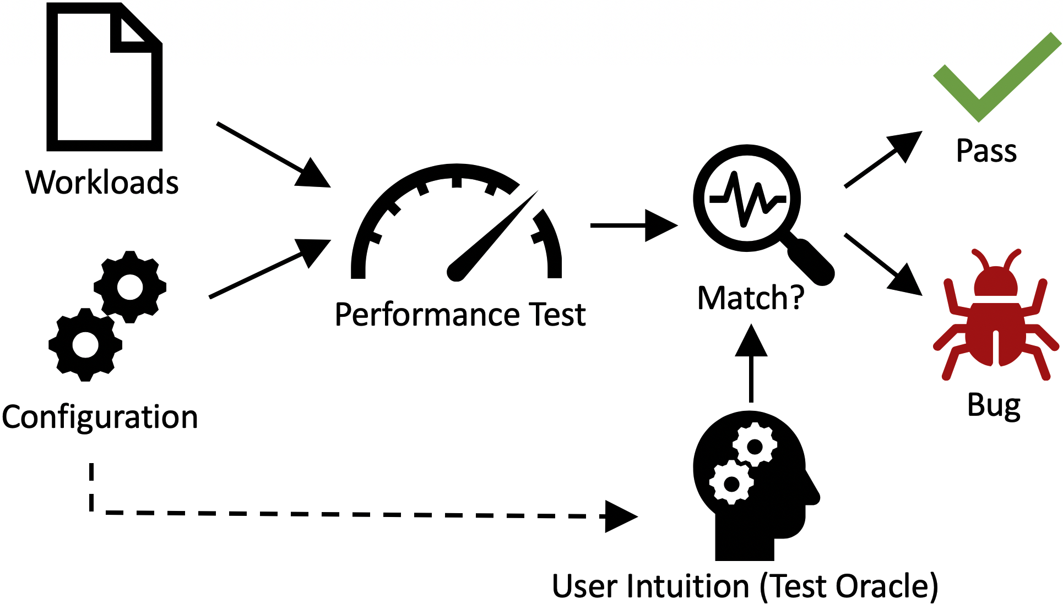
Perf Bugs under Certain Config (Cont)
CP-Detector [FSE’19 poster]
Proposed an oracle for config perf bug testing
Many perf bugs make the related parameter counterintuitive
Turning on a functionality leads to too bad performance
Allocating more resources results in worse performance
False negative? False positive?

