Slide 1
(a)
(d)
(b)
(c)

Slide 2
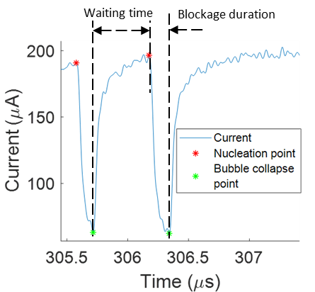
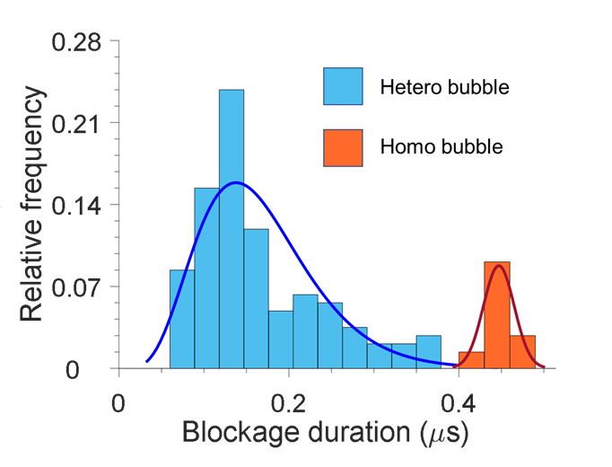
(a)
(b)
(c)

Slide 3
20 voltage pulses
1 voltage pulse (blue) and the bubbles (orange) formed within it.

Slide 5
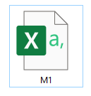
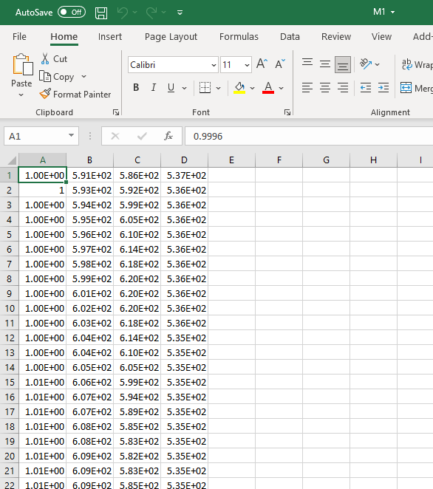
Save the filtered current signals for each pulse separately in csv files: M1, M2, M3,….
A: Time in µs
B: Filtered current (µA) -125 MHz
C: Filtered current (µA) -37.5 MHz
D: Filtered current (µA) -12.5 MHz

Slide 7
(a)
(b)
Dippt
Where disttt>tolerance
disttt
curvept2
Tolerance = Distance from Cutpt1 + factor
curvept1
Distance from Cutpt1

Slide 8
disttt
Dippt
Where disttt>tolerance

