Slide 1

National Values and
Happiness:
A Regression Analysis
Notes:
Welcome to my project - National Values and Happiness: A Regression Analysis

Slide 2

Brief Introduction
Why Code:You?
National Values and Happiness Project Overview
Final Thoughts
Notes:
Introduction:
Jeanne Spaulding
Recently moved to Cincinnati, OH from Northern KY region
Currently Data Management Specialist @ Cincinnati Children’s Hospital pursuing transition into a more analytical role within data science
Master’s degree in Integrative Studies focused on research methodologies and statistics
Through my education and work experiences, adept in the data lifecycle and deriving insights from complex datasets within academic and clinical research
Missing key programming piece in my skillset central to data science
Enter Code:You. I chose Code:You for…
Extensive resources provided
Learning support from experienced Mentors
Hands-on coding experience from projects and interactives

Slide 3
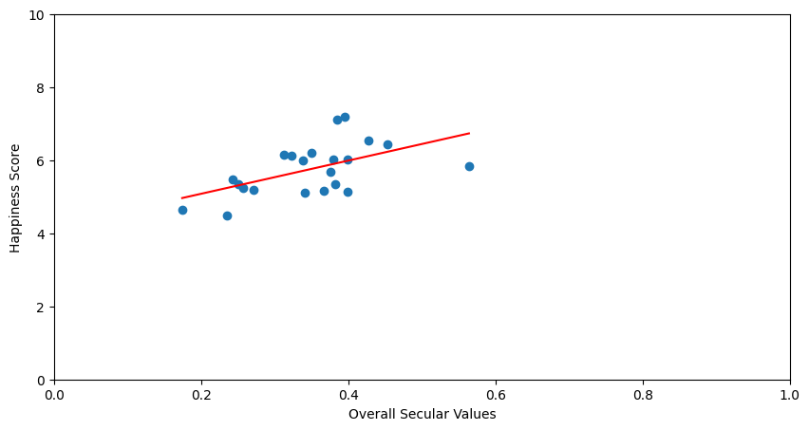
World Values Survey (www.worldvaluessurvey.org)
World Happiness Report (www.worldhappiness.report)
WVS: Societal beliefs, values, and cultural norms
WHR: Happiness score by country
Multiple Linear Regression
- Find patterns among the values
- Determine any potential relationships

Slide 4

Analysis #1
Analysis #2
Analysis #3

Slide 5
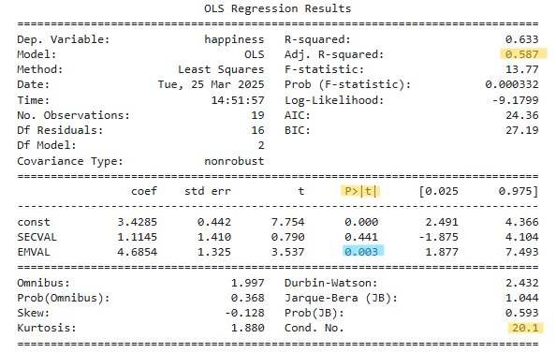




Analysis #2
58.7% of the change in happiness score explained by national values domains
Significant indicator item present
Low condition number suggesting minimal relationship among items
Findings: Independence Values domain positive indicator in happiness score.
Limitation: Sample size
Further Analyses: Replication with larger sample size; Explore individual minor domains affect on happiness score
Notes:
Second Analysis:
With minor domain items removed; 2 domain items remain – Overall National Values & Independence Values
Nearly 59% of the change in happiness score explained by these national values domain items
Independence values significant for a relationship with happiness score
Positive relationship; when Independence values score goes up – happiness score will go up
Limitation:
Sample size
WVS covers ~100 countries the course of several years
WHR surveys ~140 per year
Analyzed single year
All but 1 of the WVS countries joined, but still resulted in small sample size
Recommendations for Further Analyses:
Replicate analyses with larger sample size, possibly utilizing multiple years
Explore individual minor domains affect on happiness score

Slide 6

  Greatest Challenges:
    Visualizations
    Sample Size
What I learned about myself:
  Imposter Syndrome is Real!!
  Confidence
  Growth
Notes:
Challenges:
scatterplot (surprisingly)
Convoluted and messy, clarity better than complexity
built function to easily create individual scatterplots
sample size on analyses limiting application of findings
What I learned about myself:
Imposter syndrome is real!!
Confidence in coding increased
Grown as a data professional in knowledge and capabilities

Slide 7

Thank you!
Jeanne Spaulding
859-250-0298
spauldingj2@outlook.com
https://www.linkedin.com/in/jeanne-r-spaulding-mais
https://github.com/spauldingj2/NationalValues_Happiness
Notes:
Please feel free to reach out. I invite you to:
Call, text, email
Connect on LinkedIn
Follow me on GitHub

