Slide 1
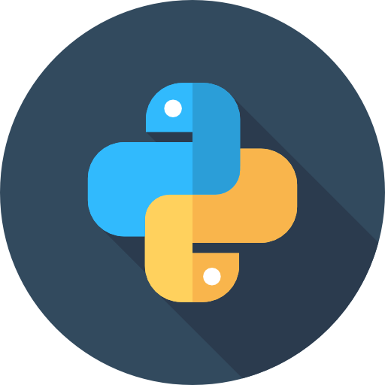
Greetings to
Our Classmates & Respected Sir

Slide 2
Greetings to
Our Classmates & Respected Sir
The Forgetful Web Browser Ghajini Using Python

Slide 3
The Forgetful Web Browser Ghajini Using Python

Slide 4


The Ghajini Browser
“A Forgetful Browser For Your Forgetful Mind.”
Take Back Your Privacy In Your Own Hand
Use this Secure, Open-Source & Forgetful Browser
And Never Again Worry About Forgetting To Logout When You Leave.

Slide 5

Introduction
1
Prerequirments
PyQt5 is not a built-in python module. To use it in programs it must be installed manually via ‘pip’ (a package manager for Python packages, or modules) from the ‘CMD’ or ‘Terminal’
Command:
pip install PyQt5 PyQtWebEngine
What is a web browser?
A web browser is an application for accessing websites. When a user requests a web page from a particular website, the browser retrieves its files from a web server and then displays the page on the user's screen. Browsers are used on a range of devices, including desktops, laptops, tablets, and smartphones.
Why PyQt5 to build a browser?
PyQt5, a Python library for creating graphical user interfaces (GUIs).

Slide 6
Prerequirments
PyQt5 is not a built-in python module. To use it in programs it must be installed manually via ‘pip’ (a package manager for Python packages, or modules) from the ‘CMD’ or ‘Terminal’
Command:
pip install PyQt5 PyQtWebEngine

Slide 7
The PyQt5 module
Prerequirments
PyQt5 is not a built-in python module. To use it in programs it must be installed manually via ‘pip’ (a package manager for Python packages, or modules) from the ‘CMD’ or ‘Terminal’
Command:
pip install PyQt5 PyQtWebEngine
Qt is a popular cross platform framework used to build GUI application
PyQt5 provides a set of python bindings for the Qt framework, as it is simple and flexible in python
It provides a varierty of GUI components such as windows, dialogs, text boxes, buttons etc.
It includes support for signal and slots, which is a powerful mechanism for handeling events and connecting components.
This above features makes it a great choice for building GUI applications using python.

Slide 8
Necessary methods & modules
QMainWindow
Provides the basic window for GUI applications and allows rendering informations to it.
QAction
It assigns the functions of the buttons or events, when clicked or occures
QtCore
It provides necessary methods to work with URLs.
QWidget
It is a module for creating GUI elements.
QToolBar
Provides a basic toolbar to contain other elements ie. Buttons, Address Bar, and Status window in a meaningful manner
QLineEdit
Allows changing containts of addressbar or search bar, sends a signal that ‘The address bar is updated’
QUrl
It modifies the URL of the browser

Slide 9
Web Interface Components
QWebEngineView
provides a widget that is used to view and edit web documents
QWebEnginePage
provides an object to view and edit web documents
QtWebEngineWidgets
Provides UI elements ( buttons, address bar, navigation bar etc. ) for the browser
QWebEngineProfile
provides a web engine profile shared by multiple pages.

Slide 10
The ‘Subprocess’ module
This module is used to execute a command to the operating system as a parallel process (subprocess / thread).
The Popen method is called to execute the following command as a parallel process:
python -m http.server 5000
It starts the python http server on localhost:5000
It is used to load the landing page of the browser

Slide 11
Defining the `Window` class
It is a subclass of `QMainWindow`, which represents the main application window.
The constructor method `__init__` is defined to initialize the window and its components.
An instance of `QWebEngineProfile` is created and set as the default profile for the browser.
The browser widget is created using `QWebEngineView` and a `QWebEnginePage` with the specified profile.
The URL of the home page of the browser is set to ‘localhost:5000/homepage’. It can be changed to any other webpage also.
The browser widget is set as the central widget of the main window, which means it will occupy the main content area.

Slide 12
Defining the `Window` class
The window is displayed in full-screen mode.
A navigation bar is created using `QToolBar` and added to the window.
Buttons for previous, next, refresh, home, and clear actions are created using `QAction` and added to the navigation bar.
A search bar is created using `QLineEdit` and added to the navigation bar.
Signal connections are set up for the buttons and search bar to handle user interactions.
Methods are defined to handle actions such as clearing cookies, going back to the home page, loading a URL, and updating the URL displayed in the search bar.

Slide 13
The Program Code 1 : Importing Necessary Modules & Initialize Window Class
import subprocess
import qdarkstyle
from PyQt5.QtWidgets import *
from PyQt5.QtWebEngineWidgets import *
from PyQt5.QtCore import *
from PyQt5.QtGui import *
#main window class (to create a window)-sub class of QMainWindow class
class Window(QMainWindow):
def __init__(self):
super(Window,self).__init__()
self.profile = QWebEngineProfile.defaultProfile()
self.clear_cookies()
self.browser = QWebEngineView(self)
self.browser.setPage(QWebEnginePage(self.profile, self.browser))
self.browser.setUrl(QUrl('http://localhost:5000/frontpage/'))
self.setCentralWidget(self.browser)
self.showMaximized()

Slide 14
The Program Code 2 : Creating the Navigation Bar & adding Buttons with there actions to it.
navbar = QToolBar()
self.addToolBar(navbar)
prevBtn = QAction('Prev',self)
prevBtn.triggered.connect(self.browser.back)
navbar.addAction(prevBtn)
goBtn = QAction('Go',self)
goBtn.triggered.connect(self.loadUrl)
navbar.addAction(goBtn)
nextBtn = QAction('Next',self)
nextBtn.triggered.connect(self.browser.forward)
navbar.addAction(nextBtn)
refreshBtn = QAction('Refresh',self)
refreshBtn.triggered.connect(self.browser.reload)
navbar.addAction(refreshBtn)
homeBtn = QAction('Home',self)
homeBtn.triggered.connect(self.home)
navbar.addAction(homeBtn)
clearBtn = QAction('Forget',self)
clearBtn.triggered.connect(self.clear_cookies)
navbar.addAction(clearBtn)

Slide 15
The Program Code 3: Creating the Address bar & defining the methods
self.searchBar = QLineEdit()
#when someone presses return(enter) call loadUrl method
self.searchBar.returnPressed.connect(self.loadUrl)
#adding created seach bar to navbar
navbar.addWidget(self.searchBar)
#if url in the searchBar is changed then call updateUrl method
self.browser.urlChanged.connect(self.updateUrl)
def clear_cookies(self):
# Clear all cookies for the default profile
self.profile.cookieStore().deleteAllCookies()
#method to navigate back to home page
def home(self):
self.browser.setUrl(QUrl('http://localhost:5000/frontpage/’))
#method to load the required url
def loadUrl(self):
#fetching entered url from searchBar
url = self.searchBar.text()
#loading url
self.browser.setUrl(QUrl(url))
#method to update the url
def updateUrl(self, url):
#changing the content(text) of searchBar
self.searchBar.setText(url.toString())

Slide 16
The Program Code 4 :
Starting the python server
Setting the Application Name
Initializing The Application
Creating The Window
Setting the icon for the Window
Executing The Application
subprocess.Popen('python -m http.server 5000’) # Run the python http sever to load landing page
QApplication.setApplicationName('Ghajini Browser’) # Set the title of the window of the browser
MyApp = QApplication([]) # initialize and create a object of the Application
window = Window() # initialize and create a object of the Application Window
window.setWindowIcon(QIcon('icon.png’)) # set the icon of the browser
MyApp.exec_() # Execute The app

Slide 17
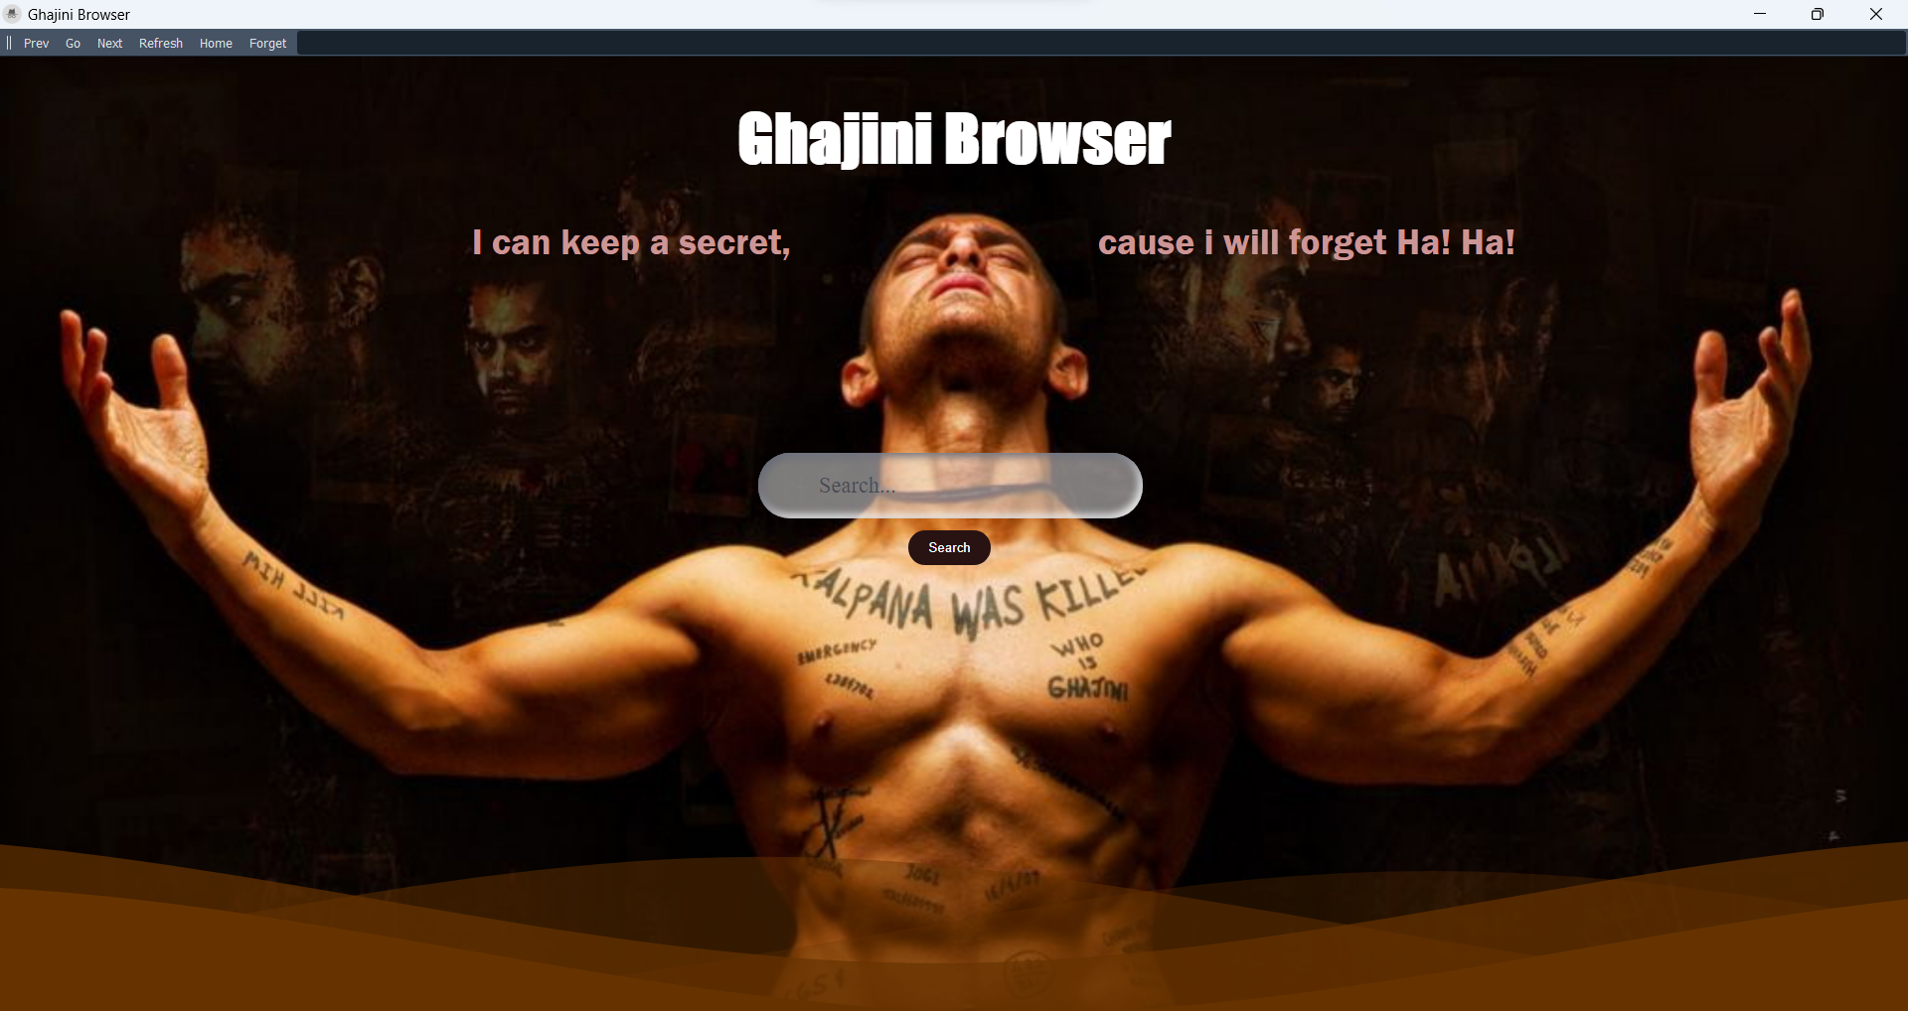
OutPut:

Slide 18
OutPut:

Slide 20
Thanks!
Open For Discussions😊
Any questions ?
References:
https://www.geeksforgeeks.org/python-introduction-to-pyqt5/
https://www.tutorialspoint.com/pyqt5/index.htm
https://wiki.python.org/moin/PyQt

