Slide 1
Detecting Phishing Websites Using Machine Learning.
By
Shinelle Hutchinson
sdh053@shsu.edu
Zhaohe Zhang
zxz003@shsu.edu

Slide 2
Back Ground :What is Phishing?
Phishing is a cybercrime in which a target or targets are contacted by email, telephone or text message by someone posing as a legitimate institution to lure individuals into providing sensitive data such as personally identifiable information, banking and credit card details, and passwords [1].
This information can then be used to access important accounts which can lead to identity theft and financial loss.

Slide 3
Objective
Our paper focuses on web-based phishing detection and aims to identify some of the most relevant features that can accurately identify phishing URLs, using the Random Forests classifier.

Slide 4
Methodology
In order to detect phishing websites with high precision and recall, we carefully select specific features that represent each URL. These features are used in training and testing inputs. We divide this input into four different arrays: training input, training output, testing input and testing output. We then use the training input array to train our Random Forest classifier. Once the classifier is trained to accept the specific features and make the appropriate decision, we used the testing input to test the classifier.
This process is summarized in Fig. 1. The performance of the classifier is then evaluated based on accuracy, precision, recall and F-score.

Slide 5
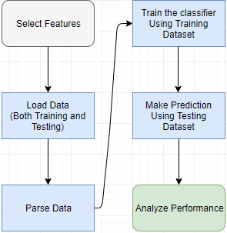
Fig. 1 Phishing Detection using URL Features.

Slide 6
Methodology : Dataset
UCI dataset with 11,055 URLs of which 6,157 are phishing and 4,898 are legitimate sites.
Each row represented one URL, according to 30 features which could determine whether or not it is used for phishing.
Each row ended with a result that specifies the true nature of the URL, -1 if it is phishing or 1 if it is a legitimate site.

Slide 7
Methodology : Feature Selection
From the 30 features, we identified five subsets:
Set A: Web-presence related features. We chose these four features to determine if it is practical to determine the nature of a URL simply by looking at its presence on the internet, and not by any structural features of the URL itself. Contained 4 features.
Set B: Features with only two (2) possible outcomes {-1,1}. This makes the data more binary and eliminates the possibility of uncertain URLs. Contained 21 features.
Set C: Features with three (3) possible outcomes {-1,0,1}. Contained 8 features.
Set D: Combination of Sets B and C. This set contains all 30 features.
Set E: The most important features (those rated 0.01 and up) according to Random Forest’s feature_importances_ attribute. Contained 16 features.

Slide 8
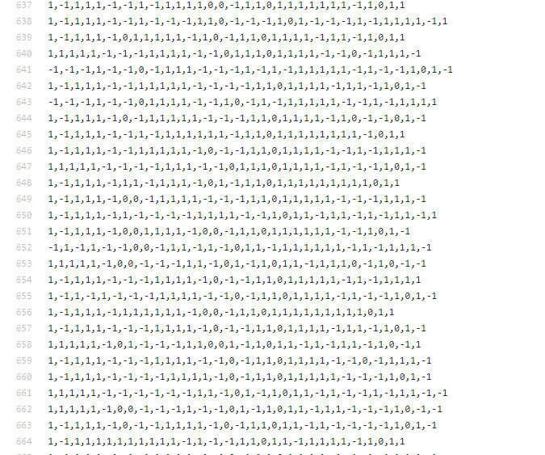
The Dataset Structure
Part of dataset

Slide 9
Methodology : Environment
Python 2.7;
Numpy – Load data;
Sklearn – RF classifier; ROC curve; calculate Accuracy, precision, recall and f-score;
Pandas_confusion – confusion matrix
Pyplot – Plot ROC curve.

Slide 10

Evaluation Methods - Precision
Precision measures the number of instances that have been correctly classified and is a measure of the classifier’s exactness. Precision answers the question, “Of all the URLs labeled as phishing, how many are actually phishing?”

Slide 11

Evaluation Methods - Recall
Recall measures the number of positive instances that the classifier correctly identified from the set of all positive instances. Recall is a measure of the classifier’s completeness. Recall answers the question, “Of all the URLs that are truly phishing, how many did we identify as phishing?”

Slide 12

Evaluation Methods – F1 Score
F1 score, is the weighted average of precision and recall scores.

Slide 13


Evaluation Methods – ROC and AUC
The Receiver Operating Characteristic (ROC) curve is ideal for representing binary classifications like this one. The curve is plotted with the False Positive Rate (FPR) on the x-axis and the True Positive Rate (TPR) on the y-axis. The Area Under the ROC Curve (AUC) shows how well the classifier is able to discriminate between phishing and legitimate URLs.

Slide 14
Classifier Performance
 | Precision | Recall | F1 Score | Accuracy | FPR | TPR | AUC
Set A | 0.4283 | 0.5119 | 0.4664 | 0.4881 | 0.488 | 0.4669 | 0.4908
Set B | 0.7148 | 0.783 | 0.7474 | 0.7687 | 0.2169 | 0.7575 | 0.7703
Set C | 0.9213 | 0.9154 | 0.9183 | 0.9289 | 0.0845 | 0.9393 | 0.9273
Set D | 0.9559 | 0.9414 | 0.9486 | 0.9554 | 0.0585 | 0.9663 | 0.9538
Set E | 0.9711 | 0.9479 | 0.9593 | 0.9649 | 0.052 | 0.9781 | 0.963

Slide 15
Set Performance

Slide 16
Feature Count Against Metric Scores

Slide 17
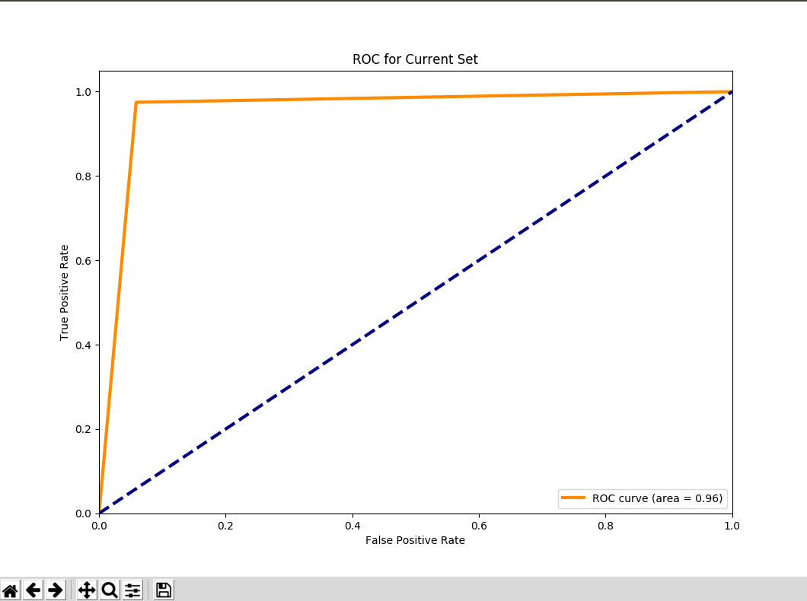
ROC curve and AUC for Set E

Slide 18
Demonstration

Slide 19
Features in Set E
having_IP_Address, URL_Length, Prefix_Suffix, having_Sub_Domain, SSLfinal_State, Domain_registeration_length, HTTPS_token, Request_URL ,URL_of_Anchor, Links_in_tags, SFH, age_of_domain ,DNSRecord, web_traffic, Page_Rank, Google_Index, Links_pointing_to_page

Slide 20
Conclusion
From performance graph we can see set A had the worst performance compared to other sets; the reasons behind the low performance are:1. The feature set size is small. 2. All these features have relatively low importance compare to others.
Also we can see the set E have much better performance compare to other sets. While compared to set D, not only did we eliminate over half of the total features, but we were also able to achieve better results.
In the future, we can increasing our scope of testing feature sets, as well as using forward selection to get more reliable and accurate results.

Slide 21
References
[1] "Phishing | What Is Phishing?", Phishing.org, 2018. [Online]. Available: http://www.phishing.org/what-is-phishing. [Accessed: 19- Mar- 2018].

