Slide 1
Evaluating Phishing Attack Detection Techniques
Presentation of Related Works
By
Shinelle Hutchinson
sdh053@shsu.edu
Zhaohe Zhang
zxz003@shsu.edu

Slide 2
What is Phishing?
Phishing is a cybercrime in which a target or targets are contacted by email, telephone or text message by someone posing as a legitimate institution to lure individuals into providing sensitive data such as personally identifiable information, banking and credit card details, and passwords [5].
This information can then be used to access important accounts which can lead to identity theft and financial loss.

Slide 3
The Problem: Phishing Attacks
Objective
Because there is no known way to altogether prevent phishing attacks, our focus is to detect phishing.
Phishing attacks can occur via three mediums: e-mail based phishing, website based phishing and malware based phishing.
4 Methods used to detect phishing:
Public Key Certificates
Heuristics
Automation of Human Behavior
Data mining (html e-mail content)

Slide 4
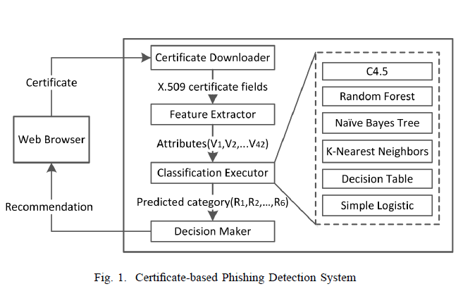
Real-Time Detection Of Phishing Websites Using Public Key Certificates [1]
Based on the belief that information embedded in public key certificates is far more useful than traditional client-side verification.
This method is also able to examine those cases where phishers have sabotaged a legitimate host, leveraging their control to host malicious content.

Slide 5
Pros [1]
This model is an improved alternative to traditional detection approaches, like blacklisting, as it can be run by end users in real time.
This model also does not require frequent updates from a central server, thereby eliminating any vulnerabilities users may face if they were using blacklists.
Experimental results indicate that this method of anti-phishing can identify phishing websites that use the HTTP protocol as well as HTTPS and classify sites as either phishing or non-phishing.
Cons [1]
Only one source, PhishTank, was used to illicit the verified phishing sites used in the dataset.
This model is susceptible to sophisticated learning attacks such as evasion and poisoning.
Need to train data before classification can occur.

Slide 6
System Evaluation Methods
Precision: the percentage of instances classified into a category that have been correctly classified.
Precision = (TP) / (TP + FP)
Recall: Measures how many instances have been missed, rather than how many have been incorrectly added, for a given category.
Recall = (TP)/ (TP + FN)

Slide 7
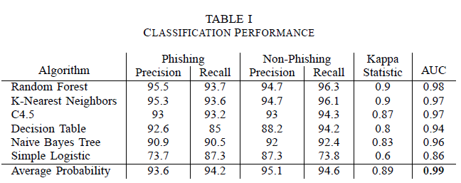
Results [1]

Slide 8
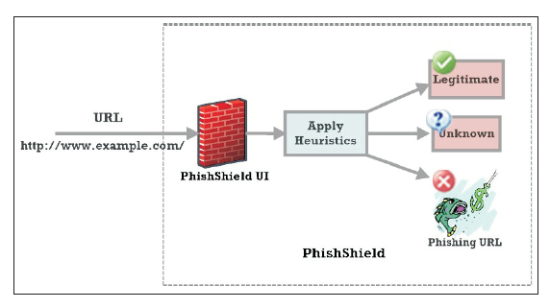
PhishShield: A Desktop Application to Detect Phishing Webpages through Heuristic Approach [2]
PhishShield takes a URL as input and outputs the classification of the URL as either phishing or legitimate website.
Uses heuristics to determine the URL classification. These include: Footer links with NULL values, Zero links in the body of the HTML, Copyright Content, Title Content and Website Identity.
PhishShield prides itself on being able to detect zero-day phishing attacks.
Fig. 2 Architecture of PhishShield [2].

Slide 9
Pros [2]
PhishShield is able to detect phishing sites that employ Image Based Phishing Attacks, and it is able to do this with acceptable execution time.
Utilizes a heuristic approach which results in fewer false positives or false negatives.
Simple application design which is easy for users to make use of, as they simply have to copy the suspected URL into PhishShield and click “Check the URL”.
Cons [2]
Focus was only put on examining the logon page of webpages to make a decision on whether or not the URL is legitimate or in fact, phishing.
PhishShield is unable to detect phishing when all the filters are bypassed. This occurs when some phishing sites fail to use targeted legitimate content to display webpages.
PhishShield fails when its parser component, JSoup, fails.

Slide 10

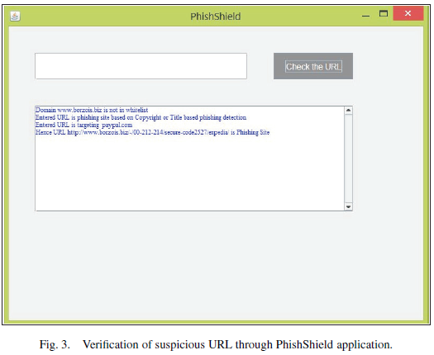
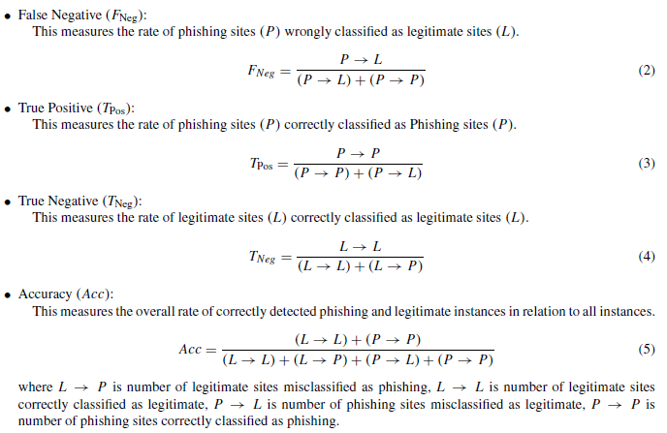
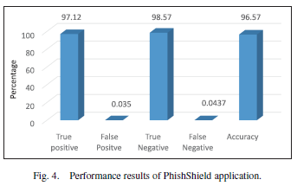
Results [2]

Slide 11
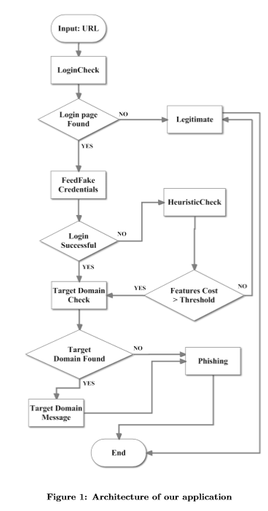
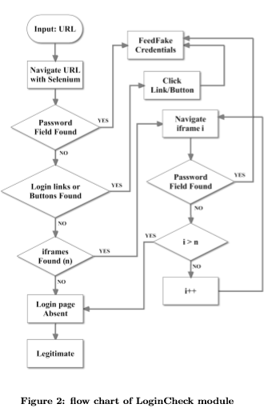
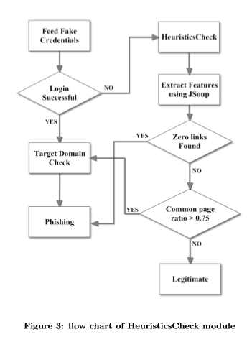
Automation of Human Behavior [3]
This technique is based on user behavior when they exposed in fake website;
Application (Feedphish) will feed the fake credentials to the login page and check the website’s response;
If login failed, application will continue serval heuristic test;
Upon pass all the test, website will be classified as a legitimate website;

Slide 12
Pros and Cons [3]
Direct and fast;
Can be automated;
Does not depend on search engines, WHOIS or page rank;
No need for training data, black list or history;
Able to detect the phishing site based on compromised domains;
Able to detect the phishing sites which use captcha verification in login page; Able to detect phishing websites contains embedding HTML text;
Application (Feedphish) will feed the fake credentials to the login page and check the website’s response;
Only useable on the phishing website; needs login credential;
Failed to handle the anchor text replaced with icon or images;
Not useable on Single Sign-On (SSO) websites (Failed to handle the login procedure via javascript);
Assume that attacker does not verify the input login credential;

Slide 13
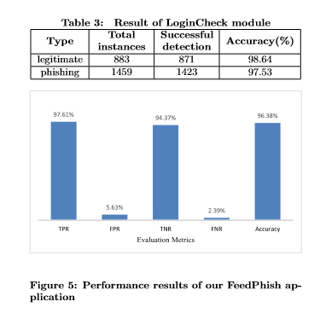
Results [3]
TPR = TP / (TP + FN)
FPR = FP / (FP + TN)
TNR = TN / (TN + FP)
FNR = 1 - TPR
True Positive: Correct Classified.
False Positive: Missing Classified.
True Negative: Correct Classified.
False Negative: Incorrect Classified.

Slide 14
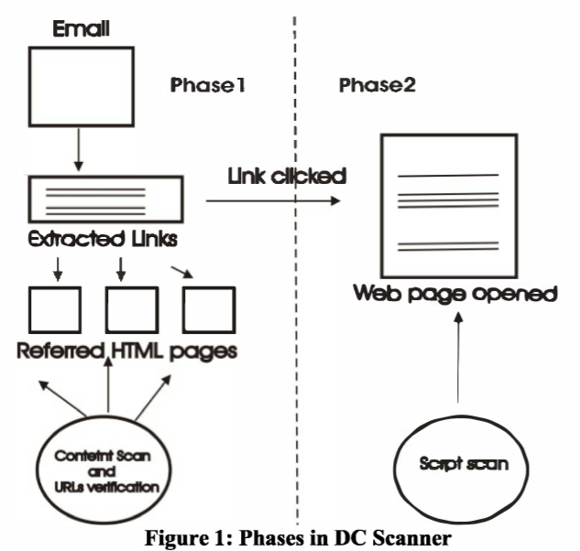
Domain and Content Scanner [4]
Domain and Content Scanner will detect the email-based phishing attack by mining html contents and verify the source;
In phase 2, DC scanner will analyze the web page script to conclude the probability of phishing attacks;

Slide 15
Pros and cons [4]
Use datamining strategy to mining the malicious URLs in email and html code;
Verify the domain and domain related authority details;
Verify the code associated webpage;
Require web pages must base on the certain design rules in order to efficient and accurately identify the malicious webpages;
Unable to detect malware-based phishing attack;

Slide 16
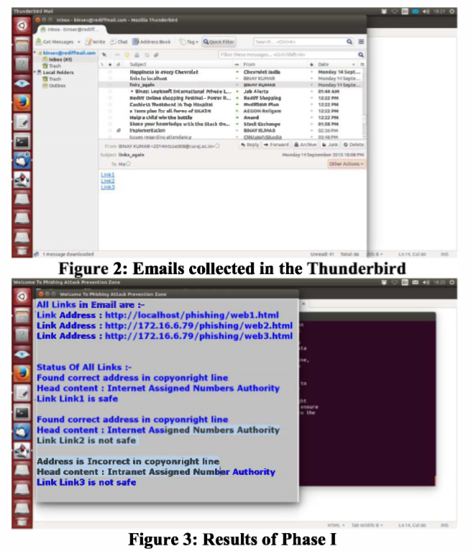
Results [4]
DC scanner will open a email in thunderbird and scan all URLs in email for potential phishing sites;
In phase 2, the scanner will search the html script in the webpage and confirm the result; (Picture missing)

Slide 17
Conclusion
There are various proposed ways to detect phishing, some of which return more False Positives or False Negatives than others.
Different methods target different phishing techniques, in our research we are focusing on Link Manipulation and Spam.
By analyzing their pros and cons, we get better insight on how we can improve on these existing models.

Slide 18
References
[1] Z. Dong, A. Kapadia, J. Blythe, and L. J. Camp, “Beyond The Lock Icon: Real-Time Detection Of Phishing Websites Using Public Key Certificates,” in Electronic Crime Research (eCrime), 2015 APWG Symposium on. IEEE, 2015.
[2] R. Rao and S. Ali, "PhishShield: A Desktop Application to Detect Phishing Webpages through Heuristic Approach", Procedia Computer Science, vol. 54, pp. 147-156, 2015.
[3] Rao, R. S., & Pais, A. R. (2017). Detecting Phishing Websites using Automation of Human Behavior. Proceedings of the 3rd ACM Workshop on Cyber-Physical System Security - CPSS 17. doi:10.1145/3055186.3055188
[4] Kumar, B., Kumar, P., Mundra, A., & Kabra, S. (2015). DC scanner: Detecting phishing attack. 2015 Third International Conference on Image Information Processing (ICIIP). doi:10.1109/iciip.2015.7414779
[5] "Phishing | What Is Phishing?", Phishing.org, 2018. [Online]. Available: http://www.phishing.org/what-is-phishing. [Accessed: 19- Mar- 2018].

