Slide 1

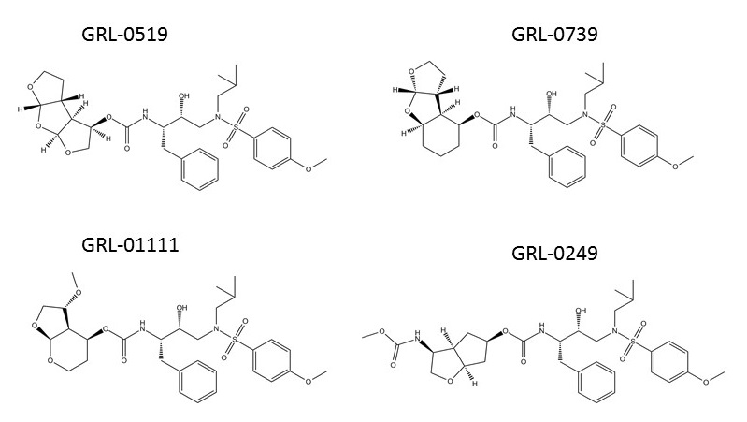
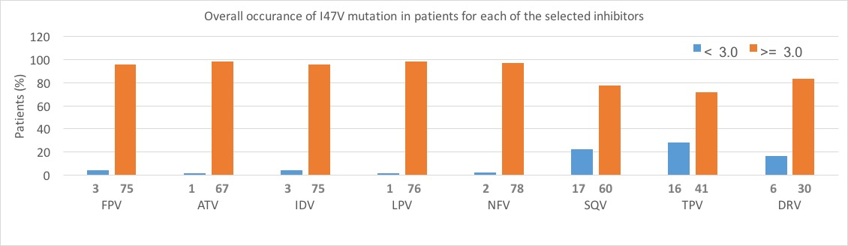
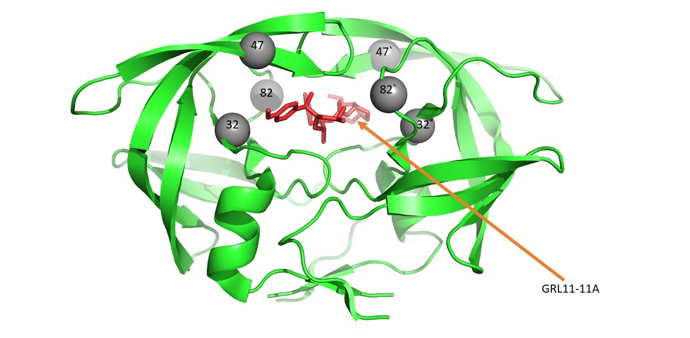
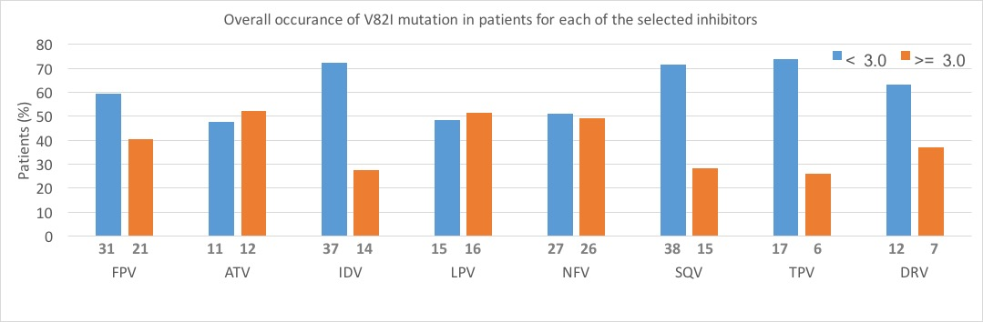
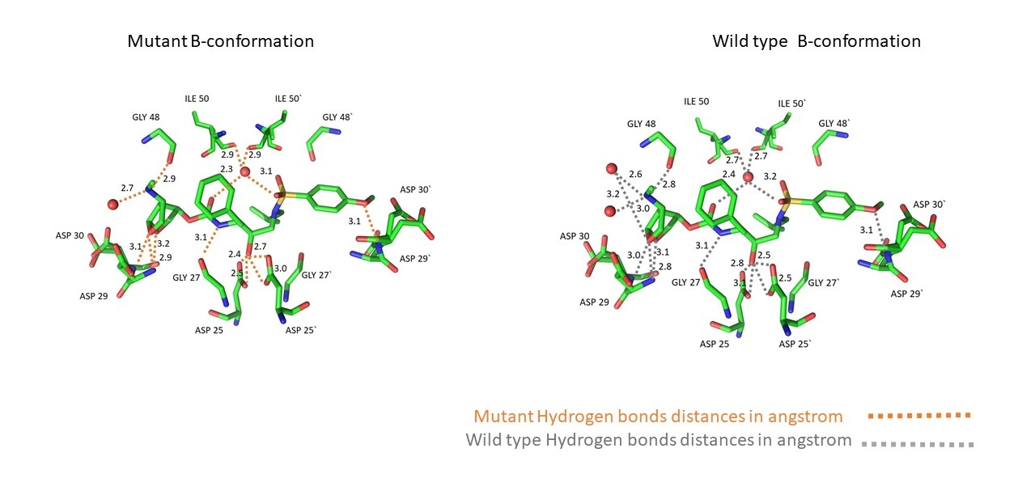
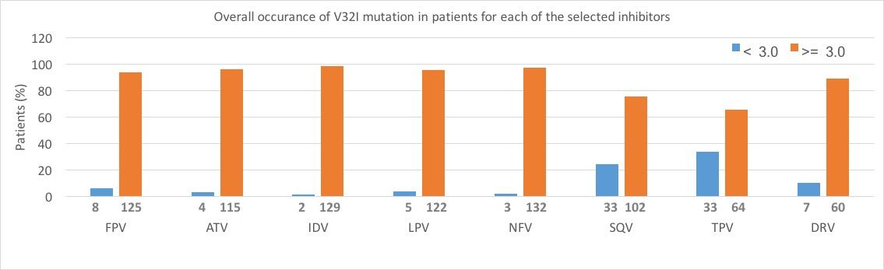
Studies of four investigational protease inhibitors with HIV-1 protease bearing drug resistant substitutions of V32I, I47V and V82I
Shrikant Pawar^{1,2}, Yuan-Fang Wang¹, Johnson Agniswamy¹, Arun K. Ghosh⁴, Robert W. Harrison^{1,2} and Irene T. Weber^{1,3}*
¹Department of Biology, Georgia State University, Atlanta, GA 30303, USA
²Department of Computer Science, Georgia State University, Atlanta, GA 30303, USA
³Department of Chemistry, Georgia State University, Atlanta, GA 30303, USA
⁴Department of Chemistry, Purdue University, West Lafayette, IN 47907, USA
Abstract
HIV-1 protease (PR) has developed resistance mutations to all 9 FDA-approved clinical protease inhibitors (PIs). This study examines the effects of four investigational PR inhibitors against HIV-1 PR with drug resistant mutations of V32I, I47V and V82I (PRTri). From the total number of V32I, I47V and V82I single mutation patients, approximately, 60-90, 70-90 and 30-50% patients are found to be resistant to inhibitors FPV, ATV, IDV, LPV, NFV, SQV, TPV and DRV. The antiviral inhibitors, GRL-0249, GRL-0519, GRL-0739 and GRL-1111, introduce diverse chemical modifications on the darunavir (DRV) scaffold, and form new interactions with wild type PR. These inhibitors were expected to show increased interactions and improved inhibition towards the PRTri mutant relative to current PIs, however, the measured inhibition constants range from 5-10-fold higher than that for amprenavir. The structure of PRTri mutant in complex with GRL01111 was determined and compared with the corresponding wild type PR complex to analyze its interactions with inhibitors.
Occurrence of sequence with I47V mutation and resistance fold for each of the clinical inhibitors.
Structures of all the investigational inhibitors used in this study
Results
 | PR_{Tri}/GRL-01111
Space group | P2₁2₁2
Unit cell dimensions: (Å)
a | 58.57
b | 86.52
c | 45.32
Resolution range (Final Shell )(Å) | 50-1.50 (1.55-1.50)
Unique reflections | 37188 (2865)
R_{merge} (%) overall (final shell) | 5.9 (49.2)
I/σ(I) overall (final shell) | 26.6 (3.1)
Completeness (%) overall (final shell) | 96.8 (76.4)
Redundancy (final shell) | 6.7 (4.1)
R (%) | 13.6
R_{free} (%) | 17.3
No. of solvent atoms (total occupancies) | 155 (107.6)
 | 137 HOH + 1 GOL + 3 DMS
RMS deviation from ideality
Bonds (Å) | 0.019
Angle distance (degree) | 2.11
Average B-factors (Å²)
Wilson B-factor | 17.7
Main-chain atoms | 17.2
Side-chain atoms | 23.9
Whole chain atoms | 20.5
Inhibitor | 16.0
Solvent | 28.9
RMS deviation to DRV (2IEN) | 0.20
Occurrence of sequence with V82I mutation and resistance fold for each of the clinical inhibitors.
Structure of protease and location of three mutations
Materials and Methods
Frequency of occurrence of the three mutations alone or in combination: We collected the genotype/phenotype data for 1808 isolates and checked the occurrence of V32I, I47V, and V82I mutations in PR, individually and in combinations of two or three from Stanford HIV database.
Ki values for investigational inhibitors: The Ki value of 1.23 nM was determined for PRTri mutant protease with APV. This inhibition constant is comparable with the Ki value of 2.5 nM determined previously using a different peptide substrate in an HPLC assay.
Comparison of hydrogen bonds in mutant and wild type protease B -conformation.
Table 1: Crystallographic Data Collection and Refinement Statistics.
Discussion
Structurally, PRTri and HIV-2 PR share very similar side chain conformations for Ile32, Val47, and Ile82 reflecting the importance of local effects for recognition.
Our crystallographic analysis of the inhibitor GRL01111 with PRTri reveals some important changes with van der waal interactions and two hydrogen bonds.
Three interactions in range 3.5-3.9 Å were gained with LEU10 and ARG8 with the mutation V182I. In PR20/SQV, the P1 group of SQV-2 inserts between Arg8 and L10F and prevents the movement of Arg8, Arg8 is involved with the dimer stability of HIV-1 PR.
To understand if these conformational changes in Arg8 cause dimer instability in PRTri, a urea denaturation assay was performed. Although a significant difference in UC50 was not seen amongst PRTri and wild type protease, PRTri seems to have a little less dimer stability.
 | APV | GRL-0519 | GRL-1111 | GRL-0739 | GRL-0249
PR Tri | 1.2 ± 0.9 | 27.1 ± 1.2 | 22.2 ± 3.9 | 27.9 ± 6.1 | 11.8 ± 0.8
PR | 0.15 | 0.006 | 0.002 | 0.010 | 0.002
UC50 value for PRTri mutant protease to check dimer stability: The UC50 value of 0.97 nM (standard deviation 0.05) was determined for PRTri mutant protease.
Table 2: Ki values for different inhibitors and PRTri mutant compared to wild type HIV-1 PR. Ki values (nM) were determined from enzyme kinetic assays
Crystallographic analysis of PRTri complex with GRL-01111: The crystal structure of PRTri with GRL-01111 was solved at 1.50 Å resolution in P21212 space group, and refined to R/Rfree values of 13.6/17.3 %.
Conclusions
This new structure show how drug resistant mutations of V32I, I47V, and V82I can alter the interactions with the P2 and P2′ groups of inhibitors. This analysis suggests a strategy for improved inhibitors of HIV-2 and drug resistant HIV-1 by introducing P2 or P2′ groups with enhanced interactions in the S2 and S2′ subsites.
Occurrence of sequence with V32I mutation and resistance fold for each of the clinical inhibitors.

