Slide 1
Bioinformatics.

Slide 2
GENOMICS and PROTEOMICS
Genomics is the study of an organism's genome and the use of the genes.
It deals with the systematic use of genome information, associated with other data, to provide answers in biology, medicine, and industry.
Proteomics is the large-scale study of proteins, particularly their structures and functions.
Proteomics is much more complicated than genomics. Most importantly, while the genome is a rather constant entity, the proteome differs from cell to cell and is constantly changing through its biochemical interactions with the genome and the environment. One organism will have radically different protein expression in different parts of its body, in different stages of its life cycle and in different environmental conditions.

Slide 3
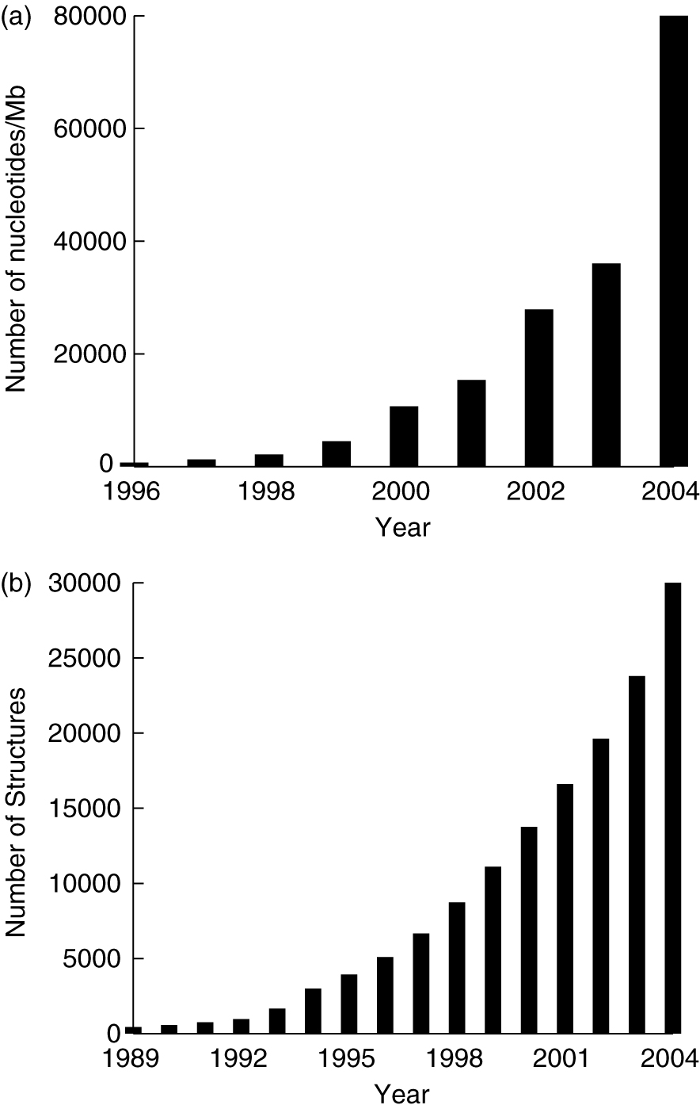
Development
of
Genomics/
Proteomics
Databases

Slide 4
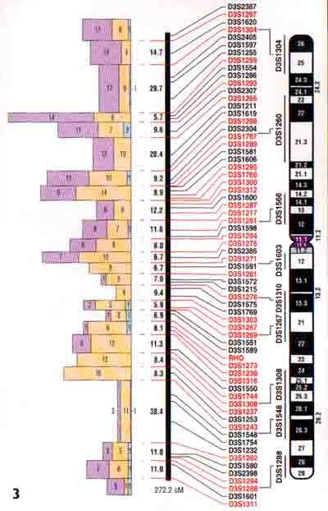
modern map-makers have mapped the entire human genome
we know the entire 3.3 billion bps of the human genome !!!
… but what does it mean ???

Slide 5
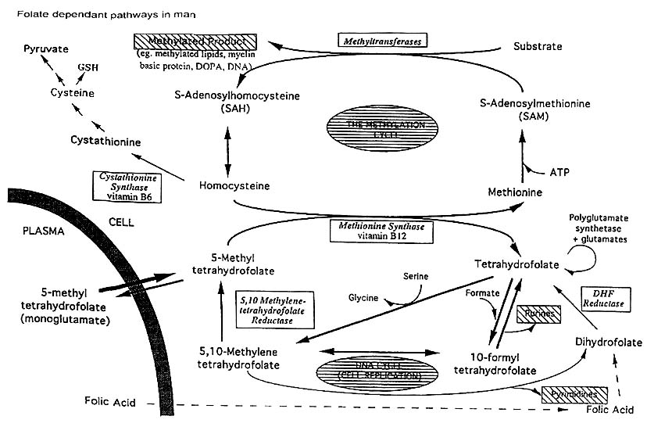
Metabolic activity in GENETIC PATHWAYS

Slide 6
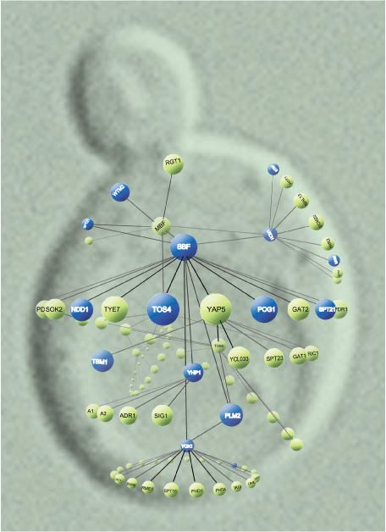
How can we
measure
metabolic
processes
and
gene activity ???

Slide 7
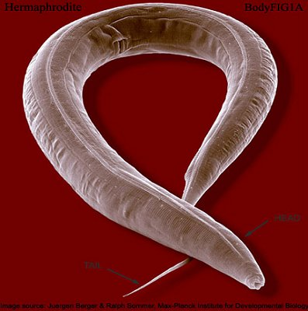
EXAMPLE:
Caenorhabditis elegans

Slide 8
Until recently we lacked tools to measure gene activity
1989 saw the introduction of the microarray technique by Stephen Fodor
But only in 1992 this technique became generally available – but still very costly

Slide 9
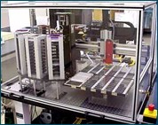
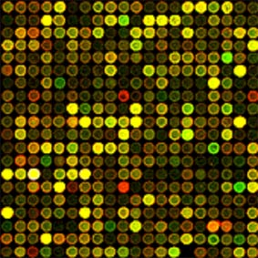
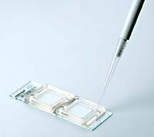

Ontwikkelde microarray
Microarray-ontwikkelaar
Until recently we lacked tools to measure gene activity
1989 saw the introduction of the microarray technique by Stephen Fodor
But only in 1992 this technique became generally available – but still very costly
Microarray
Stephen Fodor

Slide 10
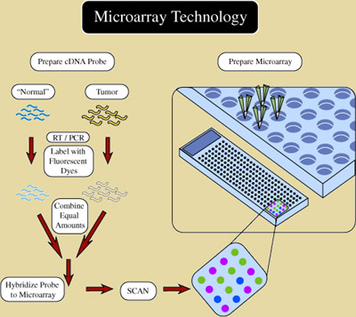

Slide 11
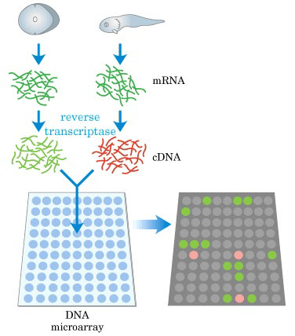

Slide 12
Using the microarray technology we can now make time series of the activity of our 22.000 genes – so-called
genome wide expression profiles

