Slide 1
FUNDAMENTALS OF PROGRAMMING
Lecture 2: BallWorld

Slide 2
1ST PROGRAM
A first Java program (outline)
  import java.lang.*;
  public class Test {
  public static void main(String [] args)
  {
  System.out.println("Hello");
  }
  }

Slide 3
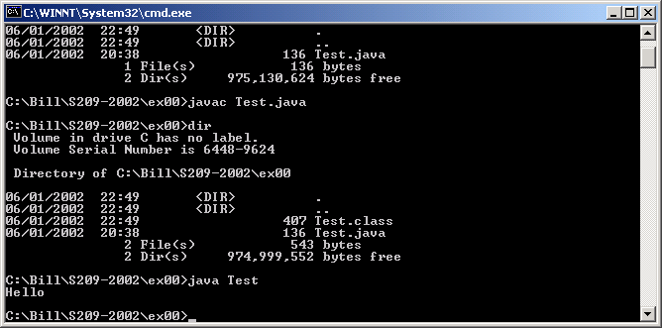
RUNNING
Java is interpreted
  The Java interpreter must be installed
The Java ‘compiler’ is called ‘javac’
The Java interpreter is called ‘java’

Slide 4
PROGRAM STRUCTURE
Declarations
  Primitive types
    int 32 bit signed integer
    byte 8 bit signed integer
    short 16 bit signed integer
    long 64 bit signed integer
    float 32 bits
    double 64 bits
    char 16 bits (Unicode)
    boolean
No typedef
No struct, have class
No (explicit) pointers (references instead)

Slide 5
STRING
String is a built-in type (note the capital S)
Many functions
‘+’ for concatenation
‘toString’ methods for conversion
Conversions often automatic
int x = 123;
float y = 23.66f;
System.out.print
("Hello " + x + " and " + y);

Slide 6
ARRAYS
Arrays are always dynamic (a.length)
int [] a;
int a[]; // alternative
a = new int[10]; // allocate
int i;
for (i = 0; i < 10; i++)
a[i] = ……;
for (i = 9; i >= 0; i--)
System.out.println(
"a[" + i + "] = " + a[i]);
a = null; // no deallocate

Slide 7
ARRAYS
Multi-dimensional arrays
int [] [] a;
int a[][]; // alternative
a = new int[10][20];
a[1][7] = ...;
  a = new int [10] [];
  a[0] = new int[10];
  a[1] = new int[11];

Slide 8
Statements are the same as C/C++
  if, switch (case, break), for, while
  Assignment
Expressions also similar to C/C++
  type cast using (char)10 style notation
Routines as for C/C++
  return
Exception handling used more often
  throw, try and catch – see later

