Slide 1

OpenNow Introduction to Computing
Module 3: Computer Hardware and Components

Slide 2
Introduction to Computer Hardware and Components
Hardware – the tangible parts of a computer or digital device; typically includes support for processing, storage, input, and output
Hardware is the foundation on which digital technologies and services are built
Understanding hardware allows you to
Develop a better understand of what computing devices are capable of and how to benefit from those capabilities
Be a wise consumer by purchasing computers and digital devices that best suit your needs
Be empowered to use electronic devices
New developments in hardware technologies impact the way you live and work and present their own ethical challenges

Slide 3
Lesson 3.1
The Development of Computers

Slide 4
The Development of Computers: Introduction
In this module, you will learn about
Computer history
Moore’s Law
Processing
Central processing unit
Motherboard
Storage
System Storage
Magnetic storage
Optical storage
Solid-state storage
Cloud storage
Input/Output
Input device
General-Purpose input device
Special-purpose input device
Output Device
Display
Printer
3-D printer
Audio and special media output
Expansion

Slide 5
The Development of Computers: Computing History
The history of the electronic computer dates from around 1940.
Progression for processing goes from vacuum tubes to diodes and transistors to the integrated circuits used today.
The computer is responsible for ushering us into the digital age.
Understanding its evolution assists us in understanding its impact on humanity.
ENIAC considered the first fully electronic general-purpose computer.
Video: Colossus: Breaking the Code

Slide 6
The Development of Computers: Moore’s Law
Moore’s Law states that the number of transistors on a chip will double about every two years.
Using Moore’s Law, scientists can gauge how fast processors might be in coming years.
Some experts, including Moore, believe that Moore’s Law will exhaust itself as transistors become too small to be created out of silicon.
Many other materials and processing techniques are being studied in order to continue, if not speed up, the progress of technological innovations.

Slide 7
Lesson 3.2
Processors

Slide 8
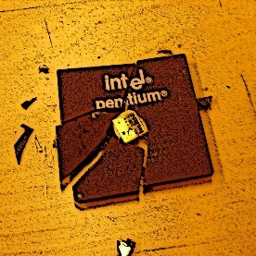
Processors: Introduction
Processing – carries out the instructions provided by software, using specially designed circuitry and a well-defined routine to transform data into use outputs
Processing is the core of computing
Processors are designed to excel in a specific type of activity, such as computer graphics, personal computing or artificial intelligence
Photo: smashed cpu
Source: fab:ian/CC 2.0

Slide 9
Processors: Central Processing Unit (1/2)
Central processing unit – a group of circuits that perform the processing in a computer, typically in one integrated circuit called a microprocessor.
CPU enables computer engineers to consolidate transistors from several chips and circuit boards to a single chip called a microprocessor.
The CPU is a microprocessor that governs all actions that a computer of any type carries out.
CPU components include
Control unit
Arithmetic/logic unit (ALU)
Registers
Cache
Clock speed

Slide 10
Processors: Central Processing Unit (2/2)
Microprocessors contain multiple CPUs or cores, including
Dual core (two processors)
Quad core (four processors)
Multiprocessing, also called parallel processing, uses more than one processing unit to increase productivity and performance

Slide 11
Processors: Motherboard
The motherboard – primary circuit board of a computer to which all components are connected, including the CPU
The motherboard connects all of a computer’s components and enables them to communicate
Both general-purpose and special-purpose computers utilize motherboards.
A typical personal computer motherboard includes
Socket for microprocessor
RAM
ROM
Expansion slots
Buses

Slide 12
Lesson 3.3
Storage Devices

Slide 13

Storage Devices: Introduction
Storage – the ability to maintain data within a computer system temporarily or permanently
Storage technologies allow us to carry billions of bytes of data in our pockets to access anytime, anywhere
Storage devices and technologies vary in terms of
Access speed
Capacity
Portability
Price
Photo: Storage
Source: Marcin Wichary/CC 2.0

Slide 14
Storage Devices: System Storage
System storage – storage used by a computer system in its normal operations, which includes RAM, ROM, and video memory
System memory and the processor work together
System memory provides the instructions required to start the computer
Different types of system memory, including
ROM (read-only memory), includes firmware
RAM (random access memory)
Video memory, also called RAM or VRAM

Slide 15
Storage Devices: Magnetic Storage
Magnetic storage – storage technology that uses magnetic properties of iron oxide particles rather than electrical charges to store bits and bytes more permanently than RAM
Magnetically stored data
Lasts for years
Provides inexpensive, high-capacity storage
Is the main storage medium in low-end desktops
Video: How Do Hard Drives Work?

Slide 16
Storage Devices: Optical Storage
Optical storage – stores bits by using an optical laser to burn pits into the surface of a highly reflective disc
Optical storage media
Includes CDs, DVDs, and Blu-ray discs
Is very portable
Is diminishing because of the use cloud storage
External drive can be purchased to support optical storage media if computer does not have a drive

Slide 17
Storage Devices: Solid-State Storage
Solid-state storage – stores data permanently and does not require any moving mechanical parts or electricity
As cost for solid-state storage continues to decrease, it will be used to replace magnetic storage
Examples of solid-state storage devices include
Flash memory cards
USB flash drives
Solid-state drives
Used as the storage medium for
Tablets
Smartphones
Digital media players

Slide 18
Storage Devices: Cloud Storage
Cloud storage – stores data on Internet servers for access from any Internet-enabled device
Cloud storage offers many benefits including
Ability to store files and media in a single location
Ability to access data from any location or device
Ability to more easily share and collaborate files
One drawback, if you lose your Internet connection, you lose access to your files.

Slide 19
Lesson 3.4
I/O Devices

Slide 20
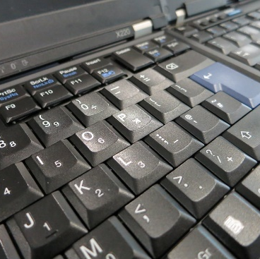
I/O Devices: Introduction
Input/Output, also called I/O, — the manner in which
Data is received into a computer system (input)
Information and the results of processing are provided to the user
I/O devices have the most direct impact on the user experience
Photo: Non-shiny new X220 keyboard.
Source: Kai Hendry,/CC 2.0

Slide 21
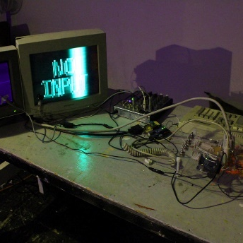
I/O Devices: Input Device
Input device – assists in capturing and entering data into a computer system
Getting data into a computer system rapidly and accurately is the purpose of input devices
The more specialized the application, the more specialized the input device
Self-checkout systems include many input devices such as touch screens, keypads, bar code scanners, sensors, and scales
Photo: No input - Arcanebolt
Source: by Rosa Menkman/CC 2.0

Slide 22
I/O Devices: General-Purpose Input Device
General-purpose input device – an input device designed to be used for a wide variety of computing activities
Common pointing devices include
Keyboards
Pointing devices
Touch screens
Multitouch devices
Microphones
Applications, like speech recognition and voice recognition programs

Slide 23
I/O Devices: Special-Purpose Input Device
Special-Purpose Input Device – designed to provide input for one specific type of activity
Special-purpose input devices include
Medical devices to collect biomedical information
A wide variety of game controllers
Digital cameras
Scanners
Optical readers
Point-of-Sale devices
Card swipers
Near-field communications devices

Slide 24
I/O Devices: Output Device
Output devices – allows a user to observe the results of computer processing with one or more senses
Output devices can create
Visual output (on a display or printed page)
Auditory output (through speakers or a headphone)
Tactile or olfactory output
Output from one system can be used as input for another system, such as using a smartphone as a remote control for your TV

Slide 25
I/O Devices: Display
Display – provides visual computer output for observation on a monitor or screen
Display output
Is the most common form of visual display
Comes in an assortment of displays and technologies, providing appropriate quality for specific environments and applications
Size is measured diagonally, corner to corner
Quality is measured in pixels
Video card controls the video output for computers

Slide 26
I/O Devices: Printer
Printer – an output device dedicated to providing computer output printed on paper
Hard copy is paper output from a printer
Printer speed is measured as pages per minute
Many different types of printers, which provide varying quality of paper-based output
Specialty printers are used for special output such as 3D printers for three-dimensional output

Slide 27
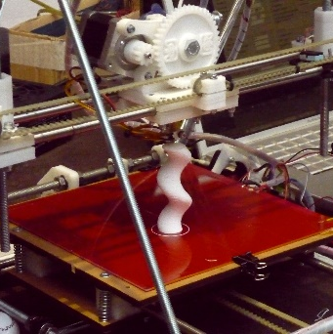
I/O Devices: 3D Printer
3D printer – builds 3D objects by adding one layer of material at a time from the bottom up until the object is complete
3D printing is powering the “maker” revolution
3D printing is also called additive manufacturing
Different 3D printing techniques include
Fused deposition modeling (FDM)
Granular materials binding
Lamination
Stereolithography
Photo: 3D Printer
Source: Mirko Tobias Schäfer/CC 2.0

Slide 28
I/O Devices: Audio and Special Media Output
Audio and special media output – devices designed to provide output to all the senses
Audio and special media output includes
Speakers
Headphones
Screen readers
Haptic output (output you can feel)
Digital scent technology
Virtual reality headsets
Video: Could This Hologram Headset Replace Your Office?

Slide 29
I/O Devices: Expansion
Expansion – a computer’s capacity to interface with a variety of external devices, such as I/O devices, network devices, and storage devices, by connecting through ports, slots, and wireless technologies
Expansion is the ability to increase the capabilities of a computer system by connecting external devices, known as peripherals
The universal serial port, or USB, was invented to standardize computer interfaces around one type of connection
Some peripherals require a specialized expansion board or expansion card
Some devices can connect wirelessly using Bluetooth

