Slide 1

OpenNow Introduction to Computing
Module 4: Software Development and Applications

Slide 2
Introduction to Software Development and Applications
Software – the electronic instructions that govern a computer’s actions in order to provide a computing service
In this module, you will learn about
Software Development
Computer Programming
Programming Languages
Application Programming Interface (API)
System Software
Operating System (OS)
User Interface (UI)
File Management
Microsoft Windows and Phone
Apple Mac OS and iOS
Google Chrome and Android
Linux
Virtual Machine Software
Server Operating Systems
Embedded Operating Systems
Utility Software
Application Software (Apps)
Office Suites
Information Apps
Communication Apps
Creativity Apps
Personal Information Apps
Entertainment Apps
Professional Apps
Managing Software
Acquiring Software
Software Licensing
Installing Software
Maintaining Software
Uninstalling Software

Slide 3
Lesson 4.1
Software Development

Slide 4
Software Development: Introduction
Software Development – the systematic process of transforming a software idea into functional software
Process guided by a process called the software development cycle
SDLC has five stages and is called the waterfall model
Requirements
Design
Implementation
Verification
Maintenance
Video: What is Agile Development?

Slide 5
Software Development: Computer Programming
Computer Programming – the process of creating software through the use of logic, algorithms, and programming languages. Also called coding
First, computer programs were done manually by setting switches and circuits in the computer
Next, computer programs were created on punch cards as a series of holes
Then, computer programs were typed as a series of commands
Now, software programs and toolkits used to create computer programs
Programs developed by coders, computer programmers, software engineers

Slide 6
Software Development: Programming Languages
Programming Languages – a set of symbols, commands, and rules (syntax) used to write program code
Programming languages
Automate the tedious process of coding
Create source code, which is converted to low-level machine instructions
Each language has its own syntax and rules
Many different types, including
C
C++, Java, Python
Javascript, Jquery, AJAX
PHP, Ruby, Perl
SQL, MySQL
C#, VB, .NET
Objective-C

Slide 7
Software Development: Application Programming Interface
Application programming interface (API) – set of programming tools specifically designed for developing apps for a specific platform
APIs allow third-party programmers to develop software for specific systems or devices
APIs can be used with software development kits (SKDs)
APIs may be public or licensed
SKDs make software development less complicated

Slide 8
Lesson 4.2
Software and Applications

Slide 9
Software and Applications: Introduction
System Software – any software that coordinates the activities of the hardware and assists the computer in functioning safely, effectively, and efficiently
System software includes
Operating system software
Utilities, like security software
File management software
DVD burning software
Operating system software is essential for all types of computers
Software platform – the hardware configuration of a computer system and its operating system

Slide 10
Software and Applications: Operating System (OS)
Operating System (OS) – set of computer programs that runs or controls the computer hardware and acts as a user interface
Operating systems
Play a central role in the functioning of any computer system
Run on most digital devices
Perform certain similar tasks, including
Controlling hardware
Managing RAM
Managing the processor(s)
Controlling input and output devices
Storying and managing files
Providing the user interface

Slide 11
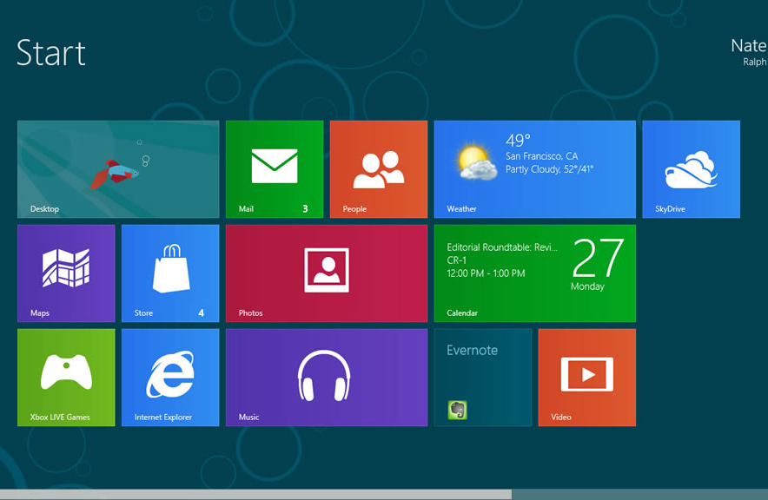
Software and Applications: User Interface
User Interface (UI) – allows one or more people to have access to and command of a computer system or computer software
Defines the computing experience for the user
Two types of UIs
Command-based user interface
Graphical user interface (GUI)
GUIs
Default UI today
Intuitive
Can allow multitasking
Photo: Windows 10 Screenshot
Source: Microsoft Corporation/Fair Use

Slide 12
Software and Applications: File Management
File management – the physical and logical storage system and practices provided for managing data on a computer.
Converts a logical request for data into a physical location
Logical view is the way the user things of data as stored
EX: c:/Users/Johnson/Documents/Homework/report.doc
Physical view is the actual location as determined by the OS file system
Each OS has its own file-naming conventions
Maintaining an organized file system makes it easy to find files and information

Slide 13
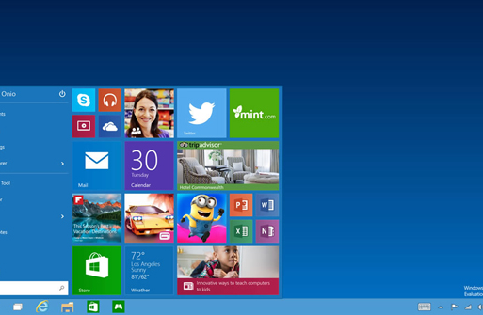
Software and Applications: Microsoft Windows and Windows Phone
Microsoft Windows platform – Microsoft Windows OS for PCs and tablets and Windows Phone for smartphones
Microsoft Windows runs 90 percent of PCs
Dominant OS in the business environment
Windows 10 configures automatically to PC or tablet for better UI
Photo: Microsoft Windows 10
Source: Microsoft Corporation/Fair Use

Slide 14
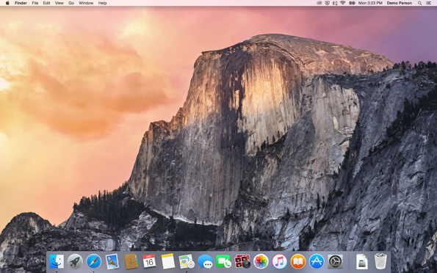
Software and Applications: Apple Mac OS and iOS
Apple Mac OS, iOS, and Watch OS – native OS for Apple Macs, the iPad, and iPhone
Offer outstanding graphics capabilities
Popular with professionals working in art, photography, motion pictures, animation, and music
Built on the UNIX OS
Photo: Apple Mac OS
Source: Apple Inc/Fair Use

Slide 15
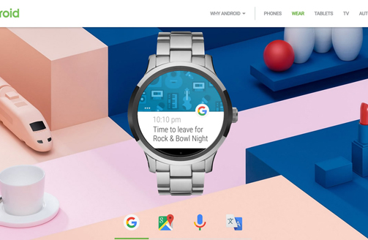
Software and Applications: Google Chrome and Android
Google Chrome and Android are Google’s operating system that extend over phones, tablets, laptops, desktops, watches and other wearable devices, TV, and autos
Chrome
Used on computers and laptops
Wants to move from installed apps to the web by offering web-based apps, like Google Docs, Sheets, Slides, Gmail, and more
Android
Most popular mobile OS
Uses free and open-source Linux architecture
Photo: Android OS
Source: Google/Fair Use

Slide 16
Software and Applications: Linux
Linux – free, open-source operating system for PCs, servers, and other types of computers
Developed by Linus Torvalds in 1991
Popular with
Technically-inclined users
Users looking for free and open-source software
Some businesses
Can be customized to meet specific needs
Many versions, called distributions or distros, available; Ubuntu one popular distros
Video: What is Linux?

Slide 17
Software and Applications: Virtual Machine Software
Virtual machine software, also called virtualization software – allows one operating system to run on top of another by creating a virtual machine on which the guest system can run
Used when you need to run more than one OS on a computer, such as
Programmers who need to develop software for multiple platforms
Professionals who need to access programs only available for a certain OS
Home users who like having multiple operating systems to meet diverse needs
Used on servers to make more efficient use of server resources

Slide 18
Software and Applications: Server Operating Systems
Server operating systems – control large networked systems and servers
Can manage multiple processors, sometimes hundreds or thousands
Companies that manufacture the OS, also provide the hardware
Examples include
Windows Server
Linux
Oracle Solaris

Slide 19
Software and Applications: Embedded Operating Systems
Embedded operating systems, also called embedded systems – hardwired into a computer component, such as ROM or flash memory, to control a special-purpose computer
Designed to perform a limited number of specialized tasks, which
Increases reliability
Increases performance
Decreases size
Decreases cost
Real-time operating system (RTOS) has time constraints placed on its functionality

Slide 20
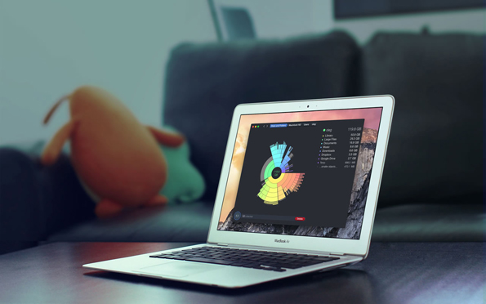
Software and Applications: Utility Software
Utility software – any system software besides that OS that assists in maintaining, managing, and protecting computer system resources
Utility programs come
Come preinstalled with the OS
Can be purchased separately
Some examples include
Defragmentation apps
Backup apps
Security apps
Windows cleaners
Diagnostics apps
File management apps
File compression apps
Photo: DaisyDisk App
Source: daisydiskapp.com/Fair Use

Slide 21
Software and Applications: Apps – Desktop, Mobile, and Web
Apps, or application software,-- programs on PCs, mobile devices, and wearables that are written to perform tasks or solve problems for people, groups, and organizations
Apps make us more productive
Categories include
Productivity and office suites
Information apps
Communication apps
Creativity apps
Personal Information apps
Entertainment apps
Professional apps

Slide 22
Software and Applications: Office Suites
Office suites – software collections that include a word processor, a spreadsheet app, presentation software, and sometimes database and other use software; also called a software suit
Office suites most common type of software and include
Word processing app for recording ideas
Spreadsheets app for making calculations
Presentation app for creating graphic depictions
Other apps, such as a database app, calendar app, desktop publishing app, depending on the version

Slide 23
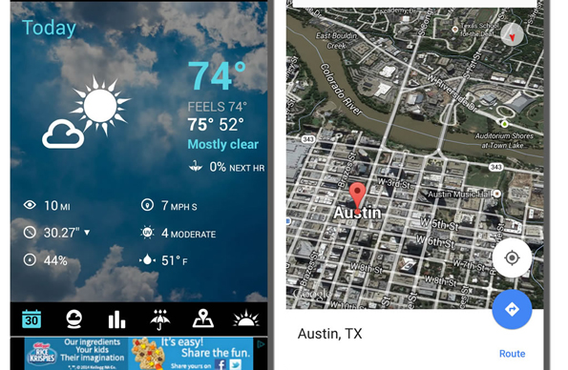
Software and Applications: Information Apps
Information apps – provide useful information on a variety of topics
Deliver valued information on demand
Examples include apps for
Weather
Maps
Personal assistants
Health and medical
Photo: Weather app
Source: Google/Fair Use

Slide 24
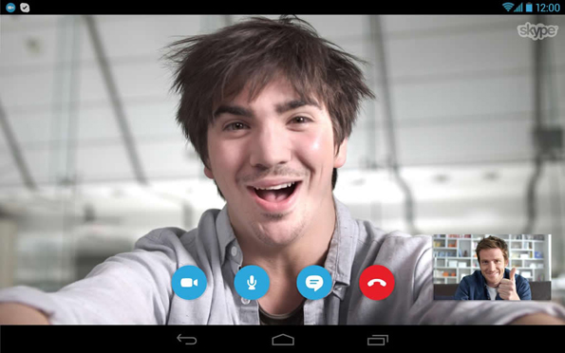
Software and Applications: Communication Apps
Communication apps – support communication between people and groups through text, voice, and video
Examples include
Voice over Internet Protocol (VoIP)
WhatsApp
Skype
Goggle Hangouts
Apple Facetime
Facebook
Twitter
Photo: Skype
Source: Softpedia/Fair Use

Slide 25
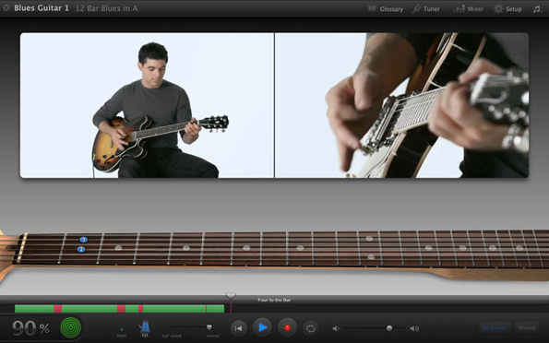
Software and Applications: Creativity Apps
Creativity apps – software that assists people in creating items of value like art, music, video, and even software used to create software
Can be used to create a variety of objects, including
Songs
Artwork
Music
Software algorithms
Photo: GarageBand app
Source: Apple Inc./Fair Use

Slide 26
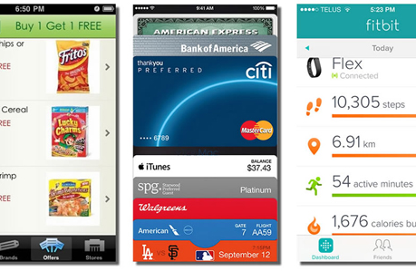
Software and Applications: Personal Information Apps
Personal information apps – assist people in managing their personal lives, including their calendars, to-do lists, health, and money
Personal information apps
Keep us organized
Help us stay healthy
Are often free
Personal information apps include
Calendars apps
Fitness apps
Contacts apps
To-Do List apps
Photo: Publix, Apple Pay, Fitbit
Source: Publix Markets, Apple Inc., Fitbit/Fair Use

Slide 27
Software and Applications: Entertainment Apps
Entertainment apps – apps that are used for enjoyable leisure time activities, including listening to music; watching TV, videos, and movies, reading books and magazines; and playing games
Examples include
Gaming
Microsoft Xbox, Google TV and Chromecast
Music
iTunes, Amazon Music, Spotify, Pandora
Ebooks and emagazines
Amazon Kindle, Apple Bookshelf, Amazon Audible

Slide 28
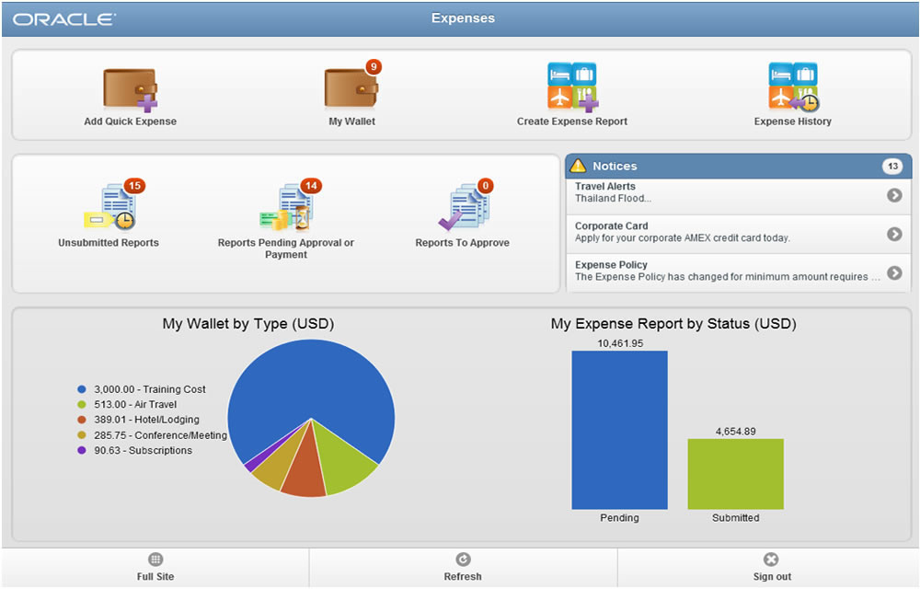
Software and Applications: Professional Apps
Professional apps – general-purpose, custom apps required for use at work
Designed for specific tasks, including
Project management
Graphics design
Customer management
Data manipulation
Photo: Oracle Expenses
Source: Oracle Corporation/Fair Use

Slide 29
Lesson 4.3
The Life Cycle of Software

Slide 30
The Life Cycle of Software: Introduction
Managing software – software used to acquire, install, maintain, and remove software and apps from computers and mobile devices
Computers and mobile devices are only as useful as the software that runs on them.
Users should research software that will be most useful to their lifestyle, interests, and activities.
Selecting and managing software is one of the most important responsibilities of a computer user.
In this unit, you will learn about
Acquiring Software
Software licensing
Installing software
Maintaining software
Uninstalling software

Slide 31
The Life Cycle of Software: Acquiring Software
Acquiring software – refers to the method by which software can be purchased or accessed, including
Packaged software, installed on computer
Downloaded software
Cloud apps
Custom designed software
Users often install software on their computer and use the same/similar apps on the web
Cloud apps can be accessed from any Internet-enabled device

Slide 32
The Life Cycle of Software: Software Licensing
Software licensing – defines the permissions, rights, and restrictions assigned to the person who purchases a copy of software
Copyright defines the exclusive rights legally granted to the owner
Software license addresses questions such as how many users can access the software and on how many computers the software can be installed
Types of licenses include
Single-user license
Multiuser license
Concurrent site license
Site license
Creative Commons license
Video: What is Open Source explained in LEGO

Slide 33
The Life Cycle of Software: Installing Software
Installing software – process by which software is added to a computer so that it is available for use
Installing allows computers to be customized to user’s needs
Stages of installing software on a PC include
Run the installation
Interact with the installation wizard
Agree to license
Select the install location
Choose standard or custom
Register and/or activate the software

Slide 34
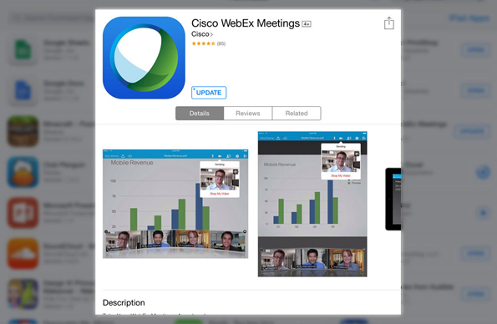
The Life Cycle of Software: Maintaining Software
Maintaining software – involves applying software updates to correct software bugs, improve the software, or add new features
Maintain software to
Keep app up-to-date
Improve performance
Keep computer secure
Fix bugs
Patch security holes
Improve functionality
Add features
Photo: Cisco WebEx Meetings
Source: Cisco WebEx/Fair Use

Slide 35
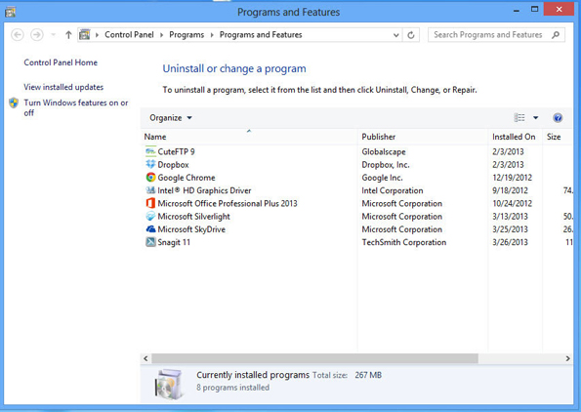
The Life Cycle of Software: Uninstalling Software
Uninstalling software – the process of completely removing software from a computer
Uninstall software to
Free up disk space
Streamline the system
Use an uninstall program to
Follow proper procedures
Ensure all parts of the program are uninstalled
Photo: Programs and Features
Source: Microsoft Corporation/Fair Use

