Slide 1

OpenNow Introduction to Computing
Module 7: Telecommunications Fundamentals

Slide 2
Introduction to Telecommunications Fundamentals
Telecommunications – refers to the electronic transmission and reception of signals for voice and data communications
Nearly all our communication and information is accessed through telecommunication systems
In this module, you will learn about
Telecommunications
Telecommunications Signals
Telecommunications Media
Radio Spectrum
Telecommunications Device
Telecommunications Software
Telecommunications Networks
Cellular Networks
Cellular Carrier
Cellular Plans
Cellular Phone
Wireless Networking
Wi-Fi
Bluetooth
Radio Frequency Identification
Global Positioning System

Slide 3
Lesson 7.1
Telecommunications

Slide 4

Telecommunications: Introduction
Infrastructure – refers to the hardware, software, and protocols that support telecommunications
Important to understand the infrastructure (hardware, software, and protocols) that support useful technology so you can select services that meet your needs
Telecommunications require
Sender
Receiver
Signal
Medium
Photo: caged sky”
Source: mh.xbhd.org/CC 2.0

Slide 5
Telecommunications: Telecommunications Signals
Telecommunications signals – analog or digital electronic transmissions for the purpose of communication
Signals can vary in speed and strength
Analog signal fluctuates continuously and creates a curved waveform
Digital signal has only two states and is represented by 1s (high) and 0s (low)
Frequency is the speed at which a digital signal can change from high to low
Signal frequency is measured in hertz (Hz)
Bandwidth is the data transmission speed
Video: How WiFi and Cell Phones Work

Slide 6
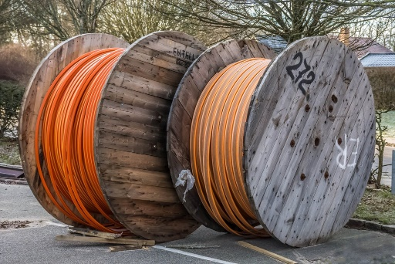
Telecommunications: Telecommunications Media
Telecommunications media – anything that carries a signal and creates an interface between a sending device and a receiving device
Various types of media
Each media has its own characteristics, including
Transmission capacity
Speed
Convenience
Security
Use the media appropriate for the task
Photo: “CABLE REELS”
Source: kunst.ftf/CC 2.0

Slide 7
Telecommunications: Radio Spectrum
Radio spectrum – part of the electromagnetic spectrum, refers to all frequencies available for radio waves from about 10 KHz to 300 GHz and their assigned users
Uses assigned by the Federal Communications Commission (FCC)
Devices operate at different frequencies so as not to cause interference with each other
Includes
AM and FM radio
Television
Wireless phones
Wireless computer networks
Global positioning systems
Ham and CB radios
Police and emergency
Satellite communications

Slide 8
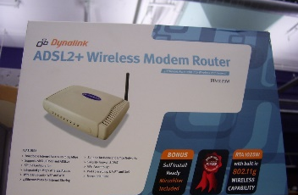
Telecommunications: Telecommunications Device
Telecommunications devices – include the variety of computer hardware designed to support telecommunications activities for individuals and businesses
Telecommunication devices range in size and purpose
Networking devices include
Modems
Network adapters
Access points
Others
Photo: "Waiting for Telstra“
Source: Lachlan Hardy/CC 2.0

Slide 9
Telecommunications: Telecommunications Software
Telecommunications software – software based on telecommunications protocols used to control, monitor, and troubleshoot data traveling over a telecommunications network.
Hardware needs software to tell it what to do
Networking software
Monitors the load or amount of traffic
Provides error checking and message formatting
Provides data information security and privacy
Servers that manage networks use network operating system (NOS) software

Slide 10
Telecommunications: Telecommunications Networks
Telecommunications software – software based on telecommunications protocols used to control, monitor, and troubleshoot data traveling over a telecommunications network.
Hardware needs software to tell it what to do
Networking software
Monitors the load or amount of traffic
Provides error checking and message formatting
Provides data information security and privacy
Servers that manage networks use network operating system (NOS) software
LANs
MANs
VPNs
WANs

Slide 11
Lesson 7.2
Cellular Networks

Slide 12
Cellular Networks: Introduction
Cellular networks – wide area network in which a geographic area is divided into cells, with a transceiver, antenna (tower), and station at the center of each cell, to support wireless mobile communications
Composed of many different technologies and devices
Uses a honeycomb design to cover provide overlapping coverage to devices with limited signal range
Uses the cell phone’s location to determine which cell tower to connect to
LTE is fourth-generation wireless broadband technology and is marketed as the fastest and most reliable
Video: A 5G World Is on the Horizon, But How Will It Work?

Slide 13
Cellular Networks: Cellular Carrier
Cellular carrier – a company that builds and maintains a cellular network and provides cell phone service to the public
Many provide service worldwide
Can be costly and inconvenient to Global Systems for Mobile Communications (GSM) is most popular international standard
Main networking standards in the U.S. are GSM and CDMA
Popular U.S. carriers include
Verizon (CDMA)
AT&T (GSM)
T-Mobile (GSM)
Sprint (CDMA)

Slide 14
Cellular Networks: Cellular Plans
Cellular plans – defines the terms of service provided by a cellular carrier to which a cellular user subscribes
Most carriers offer a variety of plans to meet users needs and include talk, text, and data (which may have limits)
Things to consider before subscribing to a plan
What phone do you use
How much data do you plan to download per month
What service do your family and friends use
How many text messages do you plan to send per month
Are you interested in a package deal that includes TV, home Internet, home phone, and cellular

Slide 15
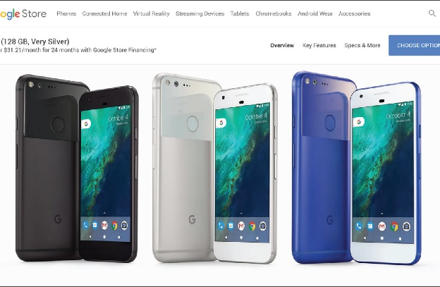
Cellular Networks: Cellular Phone
Mobile phone – the handset used by the subscriber to communicate on a cellular network
Smartphones include a “soft” keyboard, predictive text, support voice input, and connect to the Internet
Wide variety of phones available, select based on
Display size
Network type
Processor type
Features
Storage
Photo: Google-branded Pixel phone manufactured by HTC
Source: Google Inc/CC 2.0

Slide 16
Lesson 7.3
Wireless Networking

Slide 17

Wireless Networking: Introduction
Wireless data communications – refers to telecommunications that take place over the air to provide data and Internet access
Allows users to connect to access information and data from many locations
Many different types of wireless technologies including
Wi-Fi
Bluetooth
RFID
GPS
Photo: “Laptop and working lunch. An outside table with a silver laptop, coffee and a sandwich on it.”
Source: Rob Pearce/CC 2.0

Slide 18
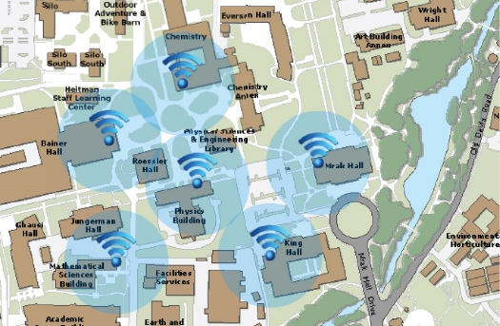
Wireless Networking: Wi-Fi
Wi-Fi (short for wireless fidelity) – a wireless technology that uses access points to connect users to networks within a range of 250-1,000 feet (75-300 meters)
Provides wireless Internet access in households, businesses, and public spaces
Benefits
Provides Internet access at high speed
Downside
Relatively short range
Supports limited number of users
Photo: WiFi Coverage map
Source: University of California, Davis/CC 2.0

Slide 19
Wireless Networking: Bluetooth
Bluetooth – enables a wide assortment of digital devices to communicate directly with each other over sort distances
Useful for passing data over a short distance by pairing the devices
Pairings can be created automatically or manually
Developed by the Bluetooth Special Interest Group (BSIG)
Used to
Connect mobile phones to speakers, headphones, earbuds
Connect mobile phones to vehicles
Share files between computers and mobile devices
Connect keyboards and mice to computers and tablets
Connect smartwatches to mobile phones
For other specialized needs

Slide 20
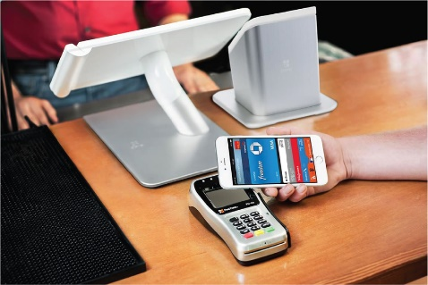
Wireless Networking: Radio Frequency Identification
RFID (radio frequency identification) – uses tiny transponders in devices or tags that can be attached to merchandise or other objects and read wirelessly using an RFID reader
RFID is
Used to identify and track products
Embedded in credit cards, cell phones, and other devices to enable wireless transactions at checkout counters and vending machines for contactless payments
Some critics are concerned about privacy
Photo: RFID Sales Transaction
Source: Apple Inc/Fair Use

Slide 21
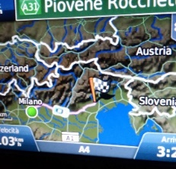
Wireless Networking: Global Positioning System
GPS (global positioning system) – uses satellites to pinpoint the location of objects on earth
Provides useful navigation assistance
Uses a receiver and a network of 24 satellites
Can pinpoint the exact location of the receiver
Geotagging is the process of adding geographic metadata to digital media and messages
Some critics are concerned about privacy
Video: How Satellites Track Your Exact Location
Photo: “Driving Back”
Source: orsorama/CC 2.0

