Slide 1

OpenNow Introduction to Computing
Module 8: Internet Fundamentals

Slide 2
Introduction to Internet Fundamentals
Internet – the world’s largest public computer network, provides a vast array of services to individuals, businesses, and organizations
In this module, you will learn about
Internet Software and Protocols
Internet History
TCP/IP
Domain Name System
Voice over IP
Internet Hardware and Media
Internet Backbone
Network Architecture
Internet Service Provider
The Internet of Things (IoT)

Slide 3
Lesson 8.1
Internet Software and Protocols

Slide 4
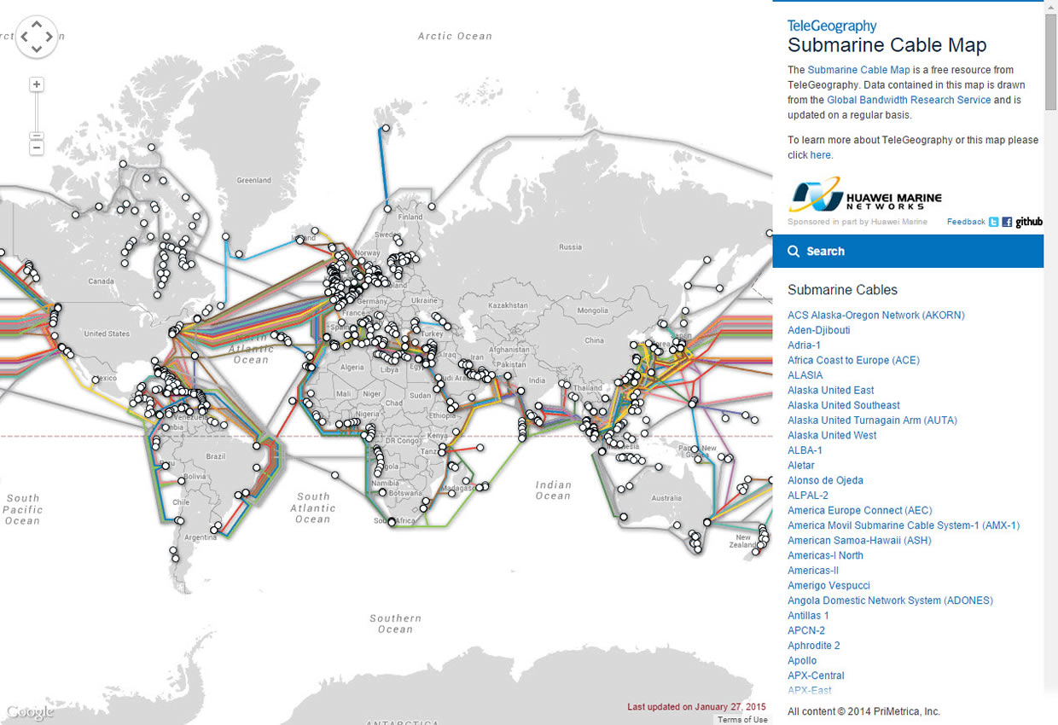
Internet Software and Protocols: Introduction
Internet technologies – work together to provide information and services over the Internet, including a variety of protocols, hardware, and software
Important to understand the underlying technologies of the Internet in order to make informed decisions
A computer network is a collection of computing devices connected together to share resources
The Internet is a global network
Photo: TeleGeography Submarine Cable Map
Source: Google INEG/Fair Use

Slide 5
Internet Software and Protocols: Internet History
Internet history – relatively short, dating back to only around 1970
The Internet has had as great an impact as any invention
Its story is still unfolding
It started with 13 connected computers, today nearly one billion computers are connected
The Internet has improved both communication and productivity
The world wide web was introduced in the early 1990s.
Tim Berners-Lee provided a graphical user interface for the web that launched the digital information revolution

Slide 6
Internet Software and Protocols: TCP/IP
TCP/IP (transmission control protocol/Internet protocol) – the protocols on which the Internet is based
The family of protocols that defines how information travels over the Internet
Works behind the scenes to allow many different types of networks and devices to join together in an immense global network
Data is transmitted in a packet
TCP/IP defines the format and addressing scheme used for the packets
TCP guarantees delivery
IP guarantees a unique address

Slide 7
Internet Software and Protocols: Domain Name System
DNS (domain name server) – maintains a database of all domain names and IP addresses used on the Internet
Acts like a phonebook, supplying information to Internet nodes and routers working to get data packets to their destination
Keeps track of the billions of addresses, names, and servers on the Internet
IP addresses are assigned associated names called domain names
IP address 173.194.219.99 is assigned the domain name www.google.com
The Internet uses the DNS to translate IP addresses into domain names
13 root servers make up the foundation of the DNS
Video: DNS Explained

Slide 8
Internet Software and Protocols: Voice over IP
VoIP (Voice over Internet Protocol) – refers to technologies that support voice communications using the Internet protocol over data networks
Combines voice and data networks into one digital network
Saves on installation and maintenance costs of two separate networks
Cellular service providers are supporting VoIP so customers can switch from a voice network to a data network
Photo: “Incoming call test works”
Source: Kai Hendry/CC 2.0

Slide 9
Lesson 8.2
Internet Hardware and Media

Slide 10
Internet Hardware and Media: Internet Backbone
Internet backbone – refers to the main Internet pathways and connections, made up of many national and international communication networks that are owned by major telecom companies, called network service providers (NSPs)
Consists of mostly fiber-optic cables that span the globe overland and under sea
Also includes routers, switching stations, communications towers, and satellites
Photo: “network”
Source: GEGENWAeRTs/CC 2.0

Slide 11
Internet Hardware and Media: Network Architecture
Network architecture – defines the manner in which devices connect and communicate with each other over a network
Different types of network architecture, including
Client/server: client computers or programs make requests from servers, such as a user using Chrome to request a webpage from a server
Peer-to-Peer: does not use a central server but facilitates communication directly between clients with user computers acting as both clients and servers
Blockchain uses peer-to-peer architecture, which provides anonymity for the buyer and seller and cuts out the middleman
Photo: “Salle de serveurs”
Source: Frédéric BISSON/CC 2.0

Slide 12
Internet Hardware and Media: Internet Service Provider
ISP (Internet service provider) – a company that provides individuals and organizations with access to the Internet
Act as liaisons between Internet users and the Internet companies that own the Internet backbone
Control the flow of data packets over the Internet
Charge a monthly fee to subscribers
Different ISPs offer different connection types, including
Cable modem
Cellular data connection
Digital subscriber line (DSL)
Fiber
Dial-up
Digital satellite service (DSS)
Broadband over power line (BPL)

Slide 13
Internet Hardware and Media: The Internet of Things (IoT)
IoT (Internet of Things) – refers to the ability of physical objects to communicate over the Internet using embedded computing devices
Uses sensors and monitors
Begin with technologies such as RFID
Smart objects are physical objects that contain embedded computing devices, such as sensors to relay information about their environment
Critics are concerned about privacy and bandwidth
Video: How the Internet of Things Will Change the World
Photo: “Introducing Nike+ Training”
Source: Nike/Fair Use

