Slide 1

OpenNow Introduction to Computing
Module 2: Ethical Considerations for Computer Users

Slide 2
Introduction to Computer Ethics
Ethics – a branch of philosophy that deal with issues of morality, that is, consideration of which human actions and reactions are morally right and wrong
All computer uses face ethical choices, whether at home or in the workplace
In this module, you will learn about
Personal Computer Ethics
Professional Computer Ethics
Governmental Computer Ethics
Accessible Computing
Green Computing
Digital Divide

Slide 3
Lesson 2.1
Computer Ethics

Slide 4
Computer Ethics: Personal Computer Ethics
Personal computer ethics – the responsible use of computers by individuals outside of professional environments
Computer uses face many ethical choices
Some software and online services make it possible to engage in unethical and even illegal activities online
Computer users must consider their actions carefully
Computer users must be sure their actions match their ethics
Personal computer ethics requires an examination of one’s conscience and the weighing of benefits against costs in terms of personal, social, and legal considerations
Video: Cybersecurity & Privacy Ethics

Slide 5
Computer Ethics: Professional Computer Ethics
Professional computer ethics – the ethical issues faced by professionals in their use of computer systems as part of their jobs
Professional computer ethics include responsibility to
Customers
Coworkers
Employers
Employees
Anyone with whom you interact and who are impacted in some way by your computer use on the job
Many organizations and businesses establish their own code of professional ethics to foster ethical behavior

Slide 6
Lesson 2.2
Government Rules and Regulations

Slide 7
Government Rules and Regulations: Governmental Computer Ethics
Governmental computer ethics – a government’s responsibility to create laws to protect citizens from unethical computer use and provide citizens with equal access to computers and information technologies as well as their benefits
Governments shoulder the computer-related ethical responsibilities of entire countries and cultures
These responsibilities generally fall into two categories
Protection – laws to protect
Empowerment – equal access to technology for all
Video: Explaining Net Neutrality Is Easier On A Giant Roller Coaster

Slide 8
Government Rules and Regulations: Accessible Computing
Accessible computing – the provision of equal access to computers and information technology for individuals with disabilities
There is a growing body of laws in many countries that addresses accessibility of information and communications technologies (ICT), including the Internet and web
Laws differ from country to country
Numerous software and hardware tools are available to make ICT available to a broader audience

Slide 9
Lesson 2.3
Social and Environmental Impacts

Slide 10
Social and Environmental Impacts: Green Computing (1/2)
Green Computing – the efforts of individuals, businesses, and governments to utilize environmentally conscious practices in manufacturing and use of digital technologies
Individuals, organizations, and governments are making efforts to
reduce their carbon footprint- the amount of greenhouse gases they produce
manufacture and use computing resources in an environmentally conscientious manner
Green computing initiatives fall into one of two categories
Energy efficiency
Ecology

Slide 11
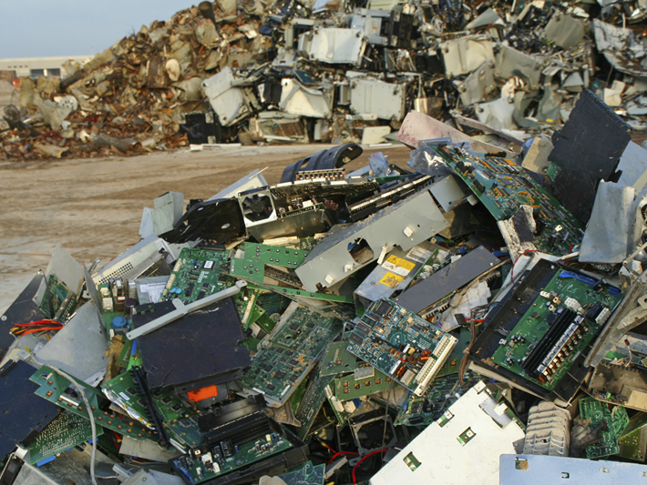
Social and Environmental Impacts: Green Computing (2/2)
E-waste – discarded electronic devices and components
Conflict materials – natural resources that are extracted in conflict zones and sold to perpetuate the fighting
Photo: Mountains of e-waste blight the landscape in some developing countries.
Source: iStockphoto.com/Lya_Cattel

Slide 12
Social and Environmental Impacts: Digital Divide
Digital divide – the social and economic gap between those how have access to computers and the Internet and those who do not
There are digital divides based on
Gender
Ethnicity
Race
Age
Income
Disability
Location, such as geographic isolation
Political or social repression
Video: Introducing Project Loon

