Slide 1
Georgia Research Consultancy (GRC)
Pawar Shrikant, Ph.D.
Assistant Professor, Claflin University
Research Affiliate, Yale University
Co-founder, ChestAi
https://www.claflin-computation.com/
Google scholar: https://scholar.google.com/citations?user=SvcIPSsAAAAJ&hl=en

Slide 2
Bioinformatics/Computational Biology
Sequence Analysis
Structural Biology
Network/Systems Biology
Databases, Software Development & Simulations
NGS: Machine Learning Application [1]
NGS: Supervised Clustering Application [1]
NGS: Receiver Operating Characteristic (ROC) [2]
X-ray Crystallography on HIV-1 Protease [5]
Indispensable Proteins in P. mirabilis [7]
Cancer Drug Targets [6]
RodentSQL [8],
Electronic Lab Notebook [9]
Simulation study: DEVS-JAVA Model [10]
Microarray Analysis
[3, 4]
Computer Vision [11]

Slide 3
Sequence Analysis: Microarray
KIFCI, a novel putative prognostic biomarker for ovarian adenocarcinomas.
3. KIFCI, a novel putative prognostic biomarker for ovarian adenocarcinomas: delineating protein interaction networks and signaling circuitries, Shrikant Pawar, Shashikiran Donthamsetty, Vaishali Pannu, Padmashree Rida, Angela Ogden, Nathan Bowen, Remus Osan, Guilherme Cantuaria, and Ritu Aneja, BMC: Journal of Ovarian Research
4. A centrosome clustering protein, KIFC1, predicts aggressive disease course in serous ovarian adenocarcinomas, Karuna Mittal, Da Hoon Choi, Sergey Klimov, Shrikant Pawar, Ramneet Kaur, Anirban K. Mitra, Meenakshi V. Gupta, Ralph Sams, Guilherme Cantuaria, Padmashree C. G. Rida, Ritu Aneja, BMC: Journal of Ovarian Research

Slide 4
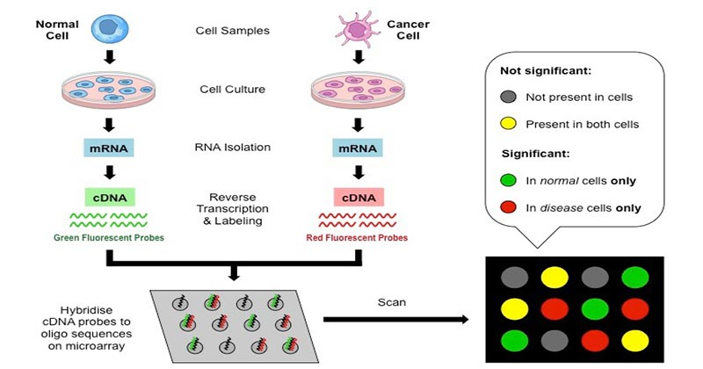
Microarray technology

Slide 5

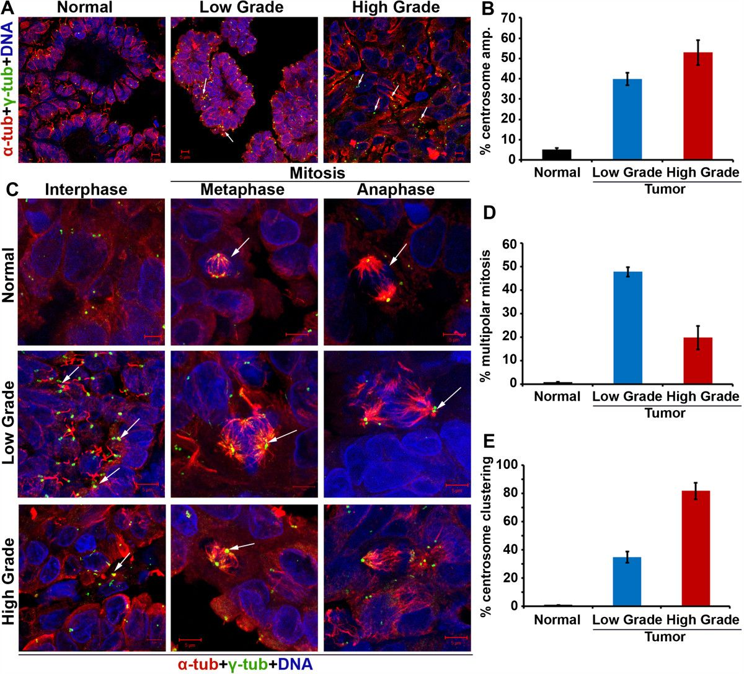
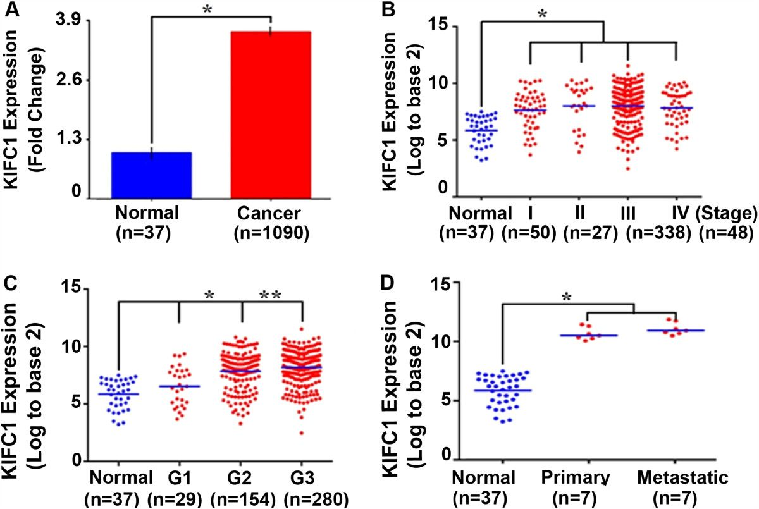
Centrosome amplification in ovarian cancer and high KIFC1 expression in ovarian cancer and normal tissue.

Slide 6
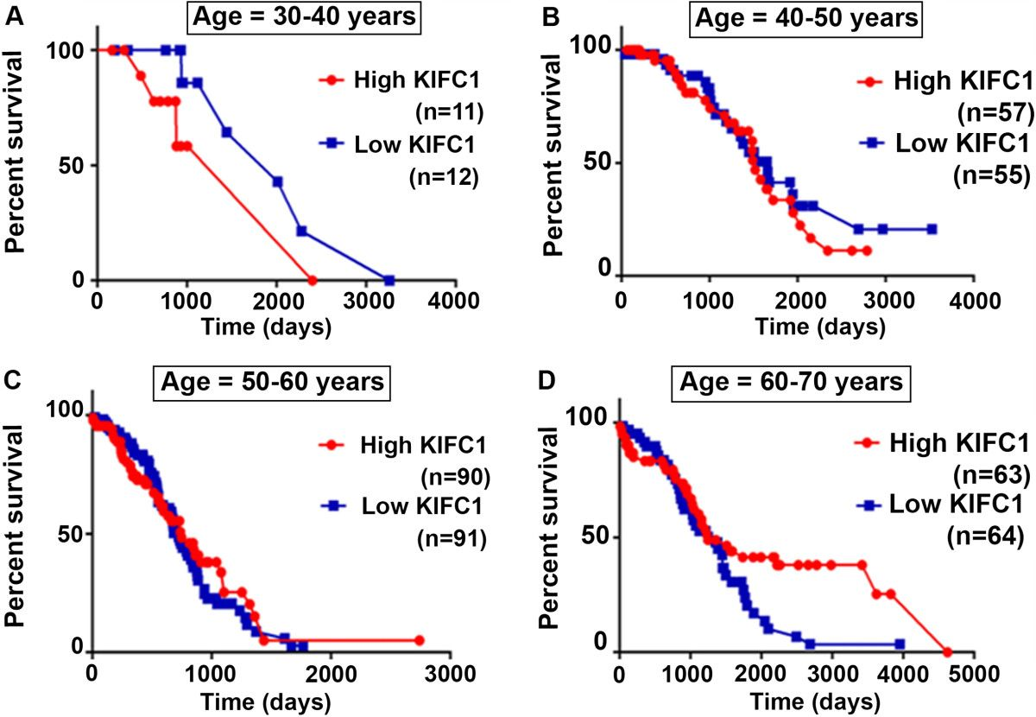
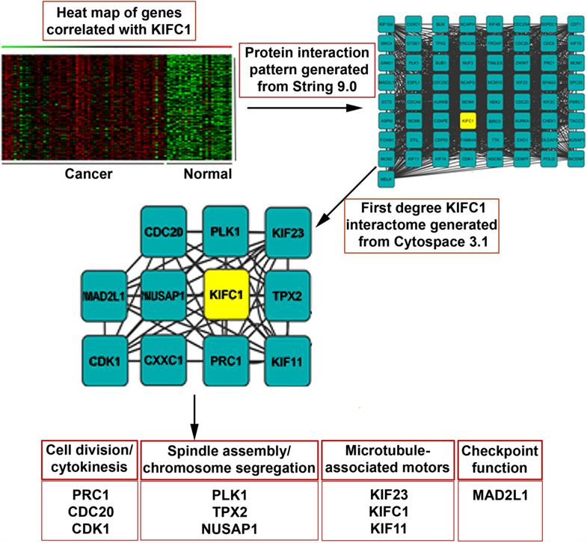
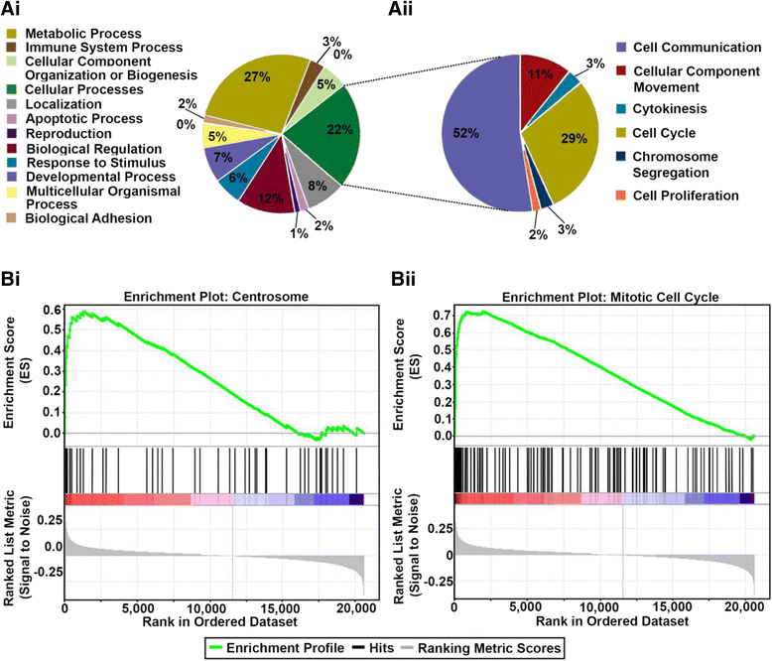
Increased KIFC1 expression is associated with poorer overall survival in age-specific ovarian cancer patients and pathways associated with first degree neighbors of KIFC1 protein
KM Survival Analysis
Protein Interactions
GSEA Analysis

Slide 7
Conducting a research
Develop a specific research question
Draft the search strategy: Keywords, inclusion, exclusion criteria’s, limits
Register your research: Example Prospero: International prospective register for systematic reviews
Systematic search for data, check the data and articles sources (PubMed, EMBASE, Google scholar, etc.)

Slide 8
How to visualize results?
Forest Plots are typically used to display epidemiological data and are often used in subject area reviews to summarize previously published findings. The forest plot is not necessarily a meta-analytic technique but may be used to display the results of a meta-analysis or as a tool to indicate where a more formal meta-analytic evaluation may be useful.

Slide 9
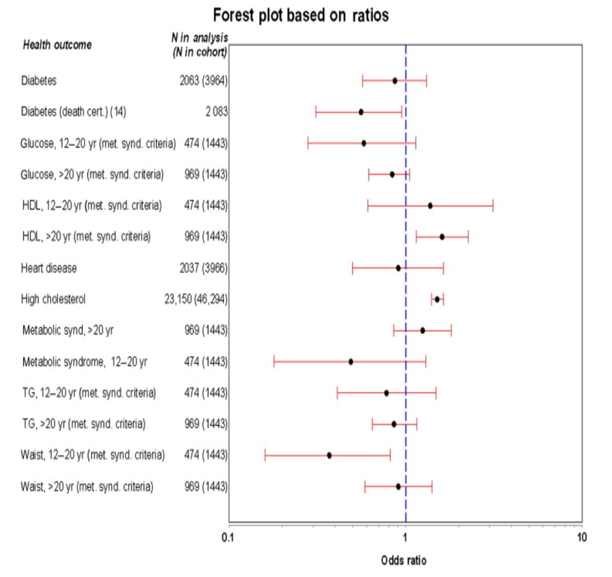
Forest Plot R Library “forestploter” focuses entirely on forest plots, which are treated as a table. https://cran.r-project.org/web/packages/forestplot/vignettes/forestplot.html
Graphical Depictions of Toxicological Data G.M. Woodall, in Encyclopedia of Toxicology (Third Edition), 2014

