Slide 1


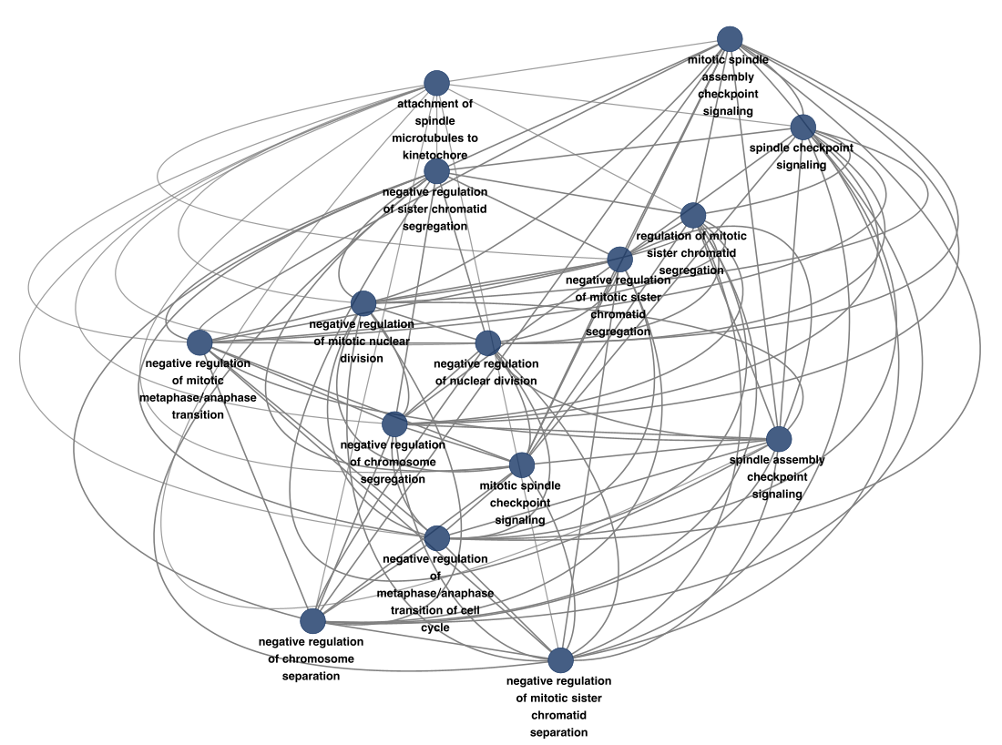
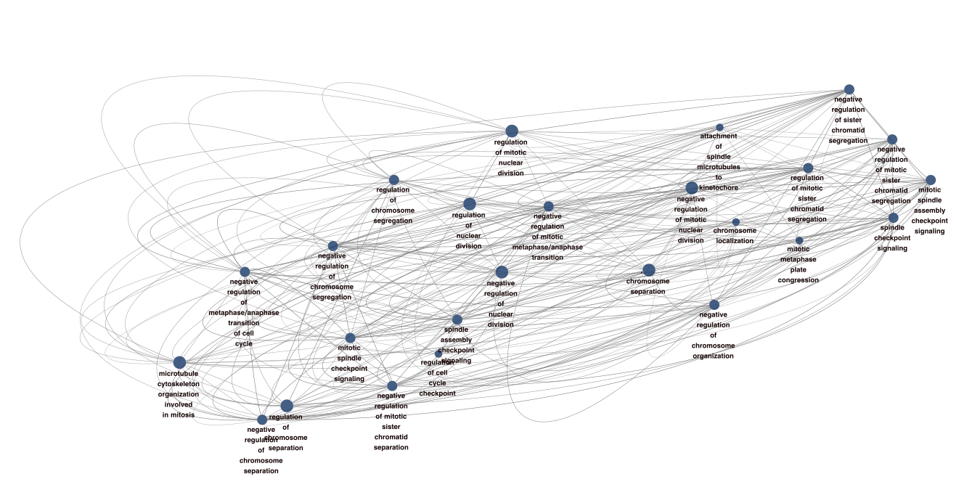
Identifying Diagnostic & Prognostic Biomarker Signatures in Lung Cancer Yash Singh, Abhay Raheja, Mohit Sai – Karuna Mittal, Shrikant Pawar Georgia Institute of Technology, Forsyth Central High School, Paul Duke STEM High School, Georgia Research Consulting, Claflin University
Introduction
Results
Lung cancer is the second most common cancer worldwide.
Although the management of lung cancer has improved over the past decade, early detection is one of the crucial facets of outcomes of successful treatment and improved survival.
In the landscape of the pathways underlying the pathogenesis and progression of Lung cancer are those that disrupt the regular regulation of cell cycle as its precise regulation is crucial to maintain normal cell homeostasis.
The goal of this study is to evaluate the profiles of genes/pathways that play a pivotal role in the dysregulation of the cell cycle in lung cancer pathogenesis.
Methods and Materials
 | Male | Female | Dead | Alive | Female /Dead | Female/Alive | Male/ Dead | Male/ Alive
SCLC | 18 | 1 | 17 | 2 | 1 | 0 | 16 | 2
NSCLC | 59 | 23 | 50 | 32 | 10 | 13 | 40 | 19
Figure 3. Left: Pathway interactome in SCLC. Right: Protein interactome in NSCLC
Conclusions and Next Steps
Known Genes involved in lung cancer: SCEL, SLC6A4, ASCL1, NOL4
Genes involved in cell cycle: HEPACAM2, TUBB2B
Genes involved in other cancer types: GNG4, CLDN18
Future Scope of the Study
Replicate the study with improved patient sample size
Find the metadata to conduct a survival analysis
Understand the role of genes involved in other cancer types and if they are related to SCLC and NSCLC
In vitro and in vivo validation of significant genes
Conclusion
Collectively findings from our study provide novel insights into cell cycle associated genes and pathways that can aid in developing a biosignature, allowing for earlier detection of lung cancer at more treatable stages.
Gene set enrichment analysis indicated that the top 50 up and down-regulated genes were associated with multiple cell-cycle processes including mitotic spindle assembly checkpoint, metaphase/anaphase transition, transcription regulatory, tissue morphogenesis, chromosome segregation, immune infiltration and nuclear division.
Importantly, the genes associated with most of the dysregulated cell cycle processes are part of the kinetochore complex components (NUF2 and SPC25) and protein kinases (TTK).
Table 1. Patient Population characteristics
Microarray
Pre-Processing
Differentially Expressed Genes
GEO
SCLC Patients: 19
NSCLC Patients: 82
Normal Samples: 80
Normalization
Fold-change
Up- and Down- Regulated
Downstream Analysis
Acknowledgements & Literature Cited
Gene Pathways
Protein Interactomes
We acknowledge the microarray datasets provided from the following studies that were used in this analysis.
Cai L, Liu H, Huang F, Fujimoto J et al. Cell-autonomous immune gene expression is repressed in pulmonary neuroendocrine cells and small cell lung cancer. Commun Biol 2021 Mar 9;4(1):314. PMID: 33750914
Sato T, Kaneda A, Tsuji S, Isagawa T et al. PRC2 overexpression and PRC2-target gene repression relating to poorer prognosis in small cell lung cancer. Sci Rep 2013;3:1911. PMID: 23714854
He L, Yuan H, Liang J, Hong J et al. Expression of hepatic stellate cell activation-related genes in HBV-, HCV-, and nonalcoholic fatty liver disease-associated fibrosis. PLoS One 2020;15(5):e0233702. PMID: 32442221
Figure 1. Analysis Pipeline
Figure 2. Up: Top DEG in SCLC. Down: Top DEG in NSCLC

