Slide 1
Probability and Mathematical Statistics I
GitHub Register and Follow

Slide 2
Descriptive and Inferential Statistics
Descriptive statistics summarize the characteristics of a data set. Inferential statistics allow you to test a hypothesis or assess whether your data is generalizable to the broader population.

Slide 3
What is standard deviation?
The standard deviation is the average amount of variability in your data set. It tells you, on average, how far each score lies from the mean.
In normal distributions, a high standard deviation means that values are generally far from the mean, while a low standard deviation indicates that values are clustered close to the mean.

Slide 4
How do I find the median?
To find the median, first order your data. Then calculate the middle position based on n, the number of values in your data set.
If n is an odd number, the median lies at the position (n + 1) / 2.
If n is an even number, the median is the mean of the values at positions n / 2 and (n / 2) + 1.

Slide 5
How do I find the mode?
To find the mode:
If your data is numerical or quantitative, order the values from low to high.
If it is categorical, sort the values by group, in any order.
Then you simply need to identify the most frequently occurring value.

Slide 6
Can there be more than one mode?
A data set can often have no mode, one mode or more than one mode – it all depends on how many different values repeat most frequently.
Your data can be:
without any mode
unimodal, with one mode,
bimodal, with two modes,
trimodal, with three modes, or
multimodal, with four or more modes.

Slide 7
When should I use the interquartile range?
The interquartile range is the best measure of variability for skewed distributions or data sets with outliers. Because it’s based on values that come from the middle half of the distribution, it’s unlikely to be influenced by outliers.
The two most common methods for calculating interquartile range are the exclusive and inclusive methods.
The exclusive method excludes the median when identifying Q1 and Q3, while the inclusive method includes the median as a value in the data set in identifying the quartiles.

Slide 8
What’s the difference between the range and interquartile range?
While the range gives you the spread of the whole data set, the interquartile range gives you the spread of the middle half of a data set.

Slide 9
What is variance used for in statistics?
Statistical tests such as variance tests or the analysis of variance (ANOVA) use sample variance to assess group differences of populations. They use the variances of the samples to assess whether the populations they come from significantly differ from each other.

Slide 10
What’s the difference between standard deviation and variance?
Variance is the average squared deviations from the mean, while standard deviation is the square root of this number. Both measures reflect variability in a distribution, but their units differ:
Standard deviation is expressed in the same units as the original values (e.g., minutes or meters).
Variance is expressed in much larger units (e.g., meters squared).

Slide 11
What is the empirical rule?
The empirical rule, or the 68-95-99.7 rule, tells you where most of the values lie in a normal distribution:
Around 68% of values are within 1 standard deviation of the mean.
Around 95% of values are within 2 standard deviations of the mean.
Around 99.7% of values are within 3 standard deviations of the mean.
The empirical rule is a quick way to get an overview of your data and check for any outliers or extreme values that don’t follow this pattern.

Slide 12
What is a normal distribution?
In a normal distribution, data is symmetrically distributed with no skew. Most values cluster around a central region, with values tapering off as they go further away from the center.
The measures of central tendency (mean, mode and median) are exactly the same in a normal distribution.

Slide 13
When should I use the median?
The median is the most informative measure of central tendency for skewed distributions or distributions with outliers. For example, the median is often used as a measure of central tendency for income distributions, which are generally highly skewed.
Because the median only uses one or two values, it’s unaffected by extreme outliers or non-symmetric distributions of scores. In contrast, the mean and mode can vary in skewed distributions.

Slide 14
What is the range in statistics?
In statistics, the range is the spread of your data from the lowest to the highest value in the distribution. It is the simplest measure of variability.

Slide 15
What’s the difference between central tendency and variability?
While central tendency tells you where most of your data points lie, variability summarizes how far apart your points from each other.
Data sets can have the same central tendency but different levels of variability or vice versa. Together, they give you a complete picture of your data.

Slide 16
What are the 4 main measures of variability?
Variability is most commonly measured with the following descriptive statistics:
Range: the difference between the highest and lowest values
Interquartile range: the range of the middle half of a distribution
Standard deviation: average distance from the mean
Variance: average of squared distances from the mean

Slide 17
What is variability?
Variability tells you how far apart points lie from each other and from the center of a distribution or a data set.
Variability is also referred to as spread, scatter or dispersion.

Slide 18
What is a critical value?
A critical value is the value of the test statistic which defines the upper and lower bounds of a confidence interval, or which defines the threshold of statistical significance in a statistical test. It describes how far from the mean of the distribution you have to go to cover a certain amount of the total variation in the data (i.e. 90%, 95%, 99%).
If you are constructing a 95% confidence interval and are using a threshold of statistical significance of p = 0.05, then your critical value will be identical in both cases.

Slide 19
Distributions

Slide 20
What is the difference between the t-distribution and the standard normal distribution?
The t-distribution gives more probability to observations in the tails of the distribution than the standard normal distribution (a.k.a. the z-distribution).
In this way, the t-distribution is more conservative than the standard normal distribution: to reach the same level of confidence or statistical significance, you will need to include a wider range of the data.

Slide 21
What is a t-score?
A t-score (a.k.a. a t-value) is equivalent to the number of standard deviations away from the mean of the t-distribution.
The t-score is the test statistic used in t-tests and regression tests. It can also be used to describe how far from the mean an observation is when the data follow a t-distribution.

Slide 22
What is a t-distribution?
The t-distribution is a way of describing a set of observations where most observations fall close to the mean, and the rest of the observations make up the tails on either side. It is a type of normal distribution used for smaller sample sizes, where the variance in the data is unknown.
The t-distribution forms a bell curve when plotted on a graph. It can be described mathematically using the mean and the standard deviation.

Slide 23
The t-distribution is a type of normal distribution that is used for smaller sample sizes. Normally-distributed data form a bell shape when plotted on a graph, with more observations near the mean and fewer observations in the tails.
The t-distribution is used when data are approximately normally distributed, which means the data follow a bell shape but the population variance is unknown. The variance in a t-distribution is estimated based on the degrees of freedom of the data set (total number of observations minus 1).
It is a more conservative form of the standard normal distribution, also known as the z-distribution. This means that it gives a lower probability to the center and a higher probability to the tails than the standard normal distribution.

Slide 24
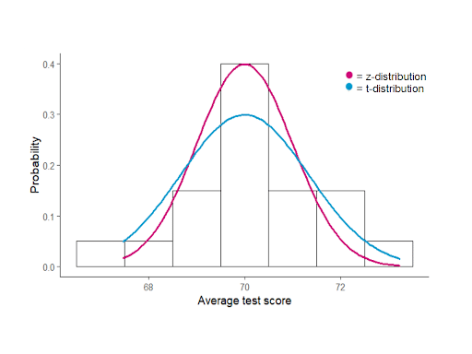
What is a t-distribution and z-distribution?

Slide 25
What is a standard normal distribution?
The standard normal distribution, also called the z-distribution, is a special normal distribution where the mean is 0 and the standard deviation is 1.
Any normal distribution can be converted into the standard normal distribution by turning the individual values into z-scores. In a z-distribution, z-scores tell you how many standard deviations away from the mean each value lies.

Slide 26
What does correlation coefficient tell you?
Correlation coefficients always range between -1 and 1.
The sign of the coefficient tells you the direction of the relationship: a positive value means the variables change together in the same direction, while a negative value means they change together in opposite directions.
The absolute value of a number is equal to the number without its sign. The absolute value of a correlation coefficient tells you the magnitude of the correlation: the greater the absolute value, the stronger the correlation.

Slide 27
What are the assumptions of the Pearson correlation coefficient?
These are the assumptions your data must meet if you want to use Pearson’s r:
Both variables are on an interval or ratio level of measurement
Data from both variables follow normal distributions
Your data have no outliers
Your data is from a random or representative sample
You expect a linear relationship between the two variables

Slide 28
What is a correlation coefficient?
A correlation coefficient is a single number that describes the strength and direction of the relationship between your variables.
Different types of correlation coefficients might be appropriate for your data based on their levels of measurement and distributions. The Pearson product-moment correlation coefficient (Pearson’s r) is commonly used to assess a linear relationship between two quantitative variables.

Slide 29
Correlation in R
if(!require(devtools)) install.packages("devtools") devtools::install_github("kassambara/ggpubr")
library("ggpubr")
my_data <- mtcars
head(my_data, 6)
ggscatter(my_data, x = "mpg", y = "wt", add = "reg.line", conf.int = TRUE, cor.coef = TRUE, cor.method = "pearson", xlab = "Miles/(US) gallon", ylab = "Weight (1000 lbs)")
res <- cor.test(my_data$wt, my_data$mpg, method = "pearson")
res
res2 <-cor.test(my_data$wt, my_data$mpg, method = "spearman")
res2

Slide 30
What are null and alternative hypotheses?EXAM2
In statistical hypothesis testing, the null hypothesis of a test always predicts no effect or no relationship between variables, while the alternative hypothesis states your research prediction of an effect or relationship.

Slide 31
What are ordinal and nominal variables?
In statistics, ordinal and nominal variables are both considered categorical variables.
Even though ordinal data can sometimes be numerical, not all mathematical operations can be performed on them.

Slide 32
What’s the difference between a point estimate and an interval estimate?
Using descriptive and inferential statistics, you can make two types of estimates about the population: point estimates and interval estimates.
A point estimate is a single value estimate of a parameter. For instance, a sample mean is a point estimate of a population mean.
An interval estimate gives you a range of values where the parameter is expected to lie. A confidence interval is the most common type of interval estimate.
Both types of estimates are important for gathering a clear idea of where a parameter is likely to lie.

Slide 33
What’s the difference between standard error and standard deviation?
Standard error and standard deviation are both measures of variability. The standard deviation reflects variability within a sample, while the standard error estimates the variability across samples of a population.

Slide 34
What is standard error?
The standard error of the mean, or simply standard error, indicates how different the population mean is likely to be from a sample mean. It tells you how much the sample mean would vary if you were to repeat a study using new samples from within a single population.

Slide 35
Means:
You can find the mean, or average, of a data set in two simple steps:
Find the sum of the values by adding them all up.
Divide the sum by the number of values in the data set.
This method is the same whether you are dealing with sample or population data or positive or negative numbers.
The arithmetic mean is the most commonly used mean. It’s often simply called the mean or the average. But there are some other types of means you can calculate depending on your research purposes:
Weighted mean: some values contribute more to the mean than others.
Geometric mean: values are multiplied rather than summed up.
Harmonic mean: reciprocals of values are used instead of the values themselves.

Slide 36
What’s the difference between univariate, bivariate and multivariate descriptive statistics?
Univariate statistics summarize only one variable at a time.
Bivariate statistics compare two variables.
Multivariate statistics compare more than two variables.

Slide 37
What is a factorial ANOVA?
A factorial ANOVA is any ANOVA that uses more than one categorical independent variable. A two-way ANOVA is a type of factorial ANOVA.
Some examples of factorial ANOVAs include:
Testing the combined effects of vaccination (vaccinated or not vaccinated) and health status (healthy or pre-existing condition) on the rate of flu infection in a population.
Testing the effects of marital status (married, single, divorced, widowed), job status (employed, self-employed, unemployed, retired), and family history (no family history, some family history) on the incidence of depression in a population.
Testing the effects of feed type (type A, B, or C) and barn crowding (not crowded, somewhat crowded, very crowded) on the final weight of chickens in a commercial farming operation.

Slide 38
How is statistical significance calculated in an ANOVA?
In ANOVA, the null hypothesis is that there is no difference among group means. If any group differs significantly from the overall group mean, then the ANOVA will report a statistically significant result.
Significant differences among group means are calculated using the F statistic, which is the ratio of the mean sum of squares (the variance explained by the independent variable) to the mean square error (the variance left over).
If the F statistic is higher than the critical value (the value of F that corresponds with your alpha value, usually 0.05), then the difference among groups is deemed statistically significant.

Slide 39
What is the difference between a one-way and a two-way ANOVA?
The only difference between one-way and two-way ANOVA is the number of independent variables. A one-way ANOVA has one independent variable, while a two-way ANOVA has two.
One-way ANOVA: Testing the relationship between shoe brand (Nike, Adidas, Saucony, Hoka) and race finish times in a marathon.
Two-way ANOVA: Testing the relationship between shoe brand (Nike, Adidas, Saucony, Hoka), runner age group (junior, senior, master’s), and race finishing times in a marathon.
All ANOVAs are designed to test for differences among three or more groups. If you are only testing for a difference between two groups, use a t-test instead.

Slide 40
Hypothesis in one-way ANOVA test:
H0: The means between groups are identical
H3: At least, the mean of one group is different

Slide 41
Example One way ANOVA Test
You will use the poison dataset to implement the one-way ANOVA test. The dataset contains 48 rows and 3 variables:
Time: Survival time of the animal
poison: Type of poison used: factor level: 1,2 and 3
treat: Type of treatment used: factor level: 1,2 and 3
Before you start to compute the ANOVA test, you need to prepare the data as follow:
Step 1: Import the data
Step 2: Remove unnecessary variable
Step 3: Convert the variable poison as ordered level
library(dplyr) PATH <- "https://raw.githubusercontent.com/guru99-edu/R-Programming/master/poisons.csv" df <- read.csv(PATH) %>% select(-X) %>% mutate(poison = factor(poison, ordered = TRUE)) glimpse(df)

Slide 42
Our objective is to test the following assumption:
H0: There is no difference in survival time average between group
H3: The survival time average is different for at least one group.
In other words, you want to know if there is a statistical difference between the mean of the survival time according to the type of poison given to the Guinea pig.
You will proceed as follow:
Step 1: Check the format of the variable poison
Step 2: Print the summary statistic: count, mean and standard deviation
Step 3: Plot a box plot
Step 4: Compute the one-way ANOVA test
Step 5: Run a pairwise t-test

Slide 43
Step 1) You can check the level of the poison with the following code. You should see three character values because you convert them in factor with the mutate verb.
levels(df$poison)

Slide 44
Step 2) You compute the mean and standard deviation.
df % > % group_by(poison) % > % summarise( count_poison = n(), mean_time = mean(time, na.rm = TRUE), sd_time = sd(time, na.rm = TRUE) )

Slide 45
Step 3) In step three, you can graphically check if there is a difference between the distribution. Note that you include the jittered dot.
ggplot(df, aes(x = poison, y = time, fill = poison)) + geom_boxplot() + geom_jitter(shape = 15, color = "steelblue", position = position_jitter(0.21)) + theme_classic()

Slide 46
Step 4) You can run the one-way ANOVA test with the command aov. The basic syntax for an ANOVA test is:
anova_one_way <- aov(time~poison, data = df) summary(anova_one_way)

Slide 47
EXAM 2
Pairwise comparison
The one-way ANOVA test does not inform which group has a different mean. Instead, you can perform a Tukey test with the function TukeyHSD().
TukeyHSD(anova_one_way)

Slide 48
What is the difference between a one-sample t-test and a paired t-test?
A one-sample t-test is used to compare a single population to a standard value (for example, to determine whether the average lifespan of a specific town is different from the country average).
A paired t-test is used to compare a single population before and after some experimental intervention or at two different points in time (for example, measuring student performance on a test before and after being taught the material).

Slide 49
What does a t-test measure?
A t-test measures the difference in group means divided by the pooled standard error of the two group means.
In this way, it calculates a number (the t-value) illustrating the magnitude of the difference between the two group means being compared, and estimates the likelihood that this difference exists purely by chance (p-value).
A t-test is a statistical test that compares the means of two samples. It is used in hypothesis testing, with a null hypothesis that the difference in group means is zero and an alternate hypothesis that the difference in group means is different from zero.

Slide 50
Which t-test should I use?
Your choice of t-test depends on whether you are studying one group or two groups, and whether you care about the direction of the difference in group means.
If you are studying one group, use a paired t-test to compare the group mean over time or after an intervention, or use a one-sample t-test to compare the group mean to a standard value. If you are studying two groups, use a two-sample t-test.

Slide 51
What is statistical significance?
Statistical significance is a term used by researchers to state that it is unlikely their observations could have occurred under the null hypothesis of a statistical test. Significance is usually denoted by a p-value, or probability value.
Statistical significance is arbitrary – it depends on the threshold, or alpha value, chosen by the researcher. The most common threshold is p < 0.05, which means that the data is likely to occur less than 5% of the time under the null hypothesis.
When the p-value falls below the chosen alpha value, then we say the result of the test is statistically significant.

Slide 52
What are z-scores and t-scores?
The z-score and t-score (aka z-value and t-value) show how many standard deviations away from the mean of the distribution you are, assuming your data follow a z-distribution or a t-distribution.
These scores are used in statistical tests to show how far from the mean of the predicted distribution your statistical estimate is. If your test produces a z-score of 2.5, this means that your estimate is 2.5 standard deviations from the predicted mean.
The predicted mean and distribution of your estimate are generated by the null hypothesis of the statistical test you are using. The more standard deviations away from the predicted mean your estimate is, the less likely it is that the estimate could have occurred under the null hypothesis.

Slide 53
What are the main assumptions of statistical tests?
Statistical tests commonly assume that:
the data are normally distributed
the groups that are being compared have similar variance
the data are independent
If your data does not meet these assumptions you might still be able to use a nonparametric statistical test, which have fewer requirements but also make weaker inferences.

Slide 54
Calculating Paired T Test with R
x = rnorm(10)
y = rnorm(10)
pts = seq(-4.5,4.5,length=100)
plot(pts,dt(pts,df=9),col='red',type='l')
lines(density(x), col='green')
lines(density(y), col='blue')
ttest = t.test(x,y)

Slide 55
Probability Distributions
Probability distributions are functions that describe the likelihood of obtaining the possible values that a random variable can assume. In other words, the values of the variable vary based on the underlying probability distribution.
Suppose you draw a random sample and measure the heights of the subjects. As you measure heights, you create a distribution of heights. This type of distribution is useful when you need to know which outcomes are most likely, the spread of potential values, and the likelihood of different results.

Slide 56
General Properties of Probability Distributions
Probability distributions indicate the likelihood of an event or outcome. Statisticians use the following notation to describe probabilities:
p(x) = the likelihood that random variable takes a specific value of x.

Slide 57
The sum of all probabilities for all possible values must equal 1. Furthermore, the probability for a particular value or range of values must be between 0 and 1.
Probability distributions describe the dispersion of the values of a random variable. Consequently, the kind of variable determines the type of probability distribution. For a single random variable, statisticians divide distributions into the following two types:
Discrete probability distributions for discrete variables
Probability density functions for continuous variables

Slide 58
Discrete Probability Distributions
Discrete probability functions are also known as probability mass functions and can assume a discrete number of values. For example, coin tosses and counts of events are discrete functions. These are discrete distributions because there are no in-between values. For example, you can have only heads or tails in a coin toss. Similarly, if you’re counting the number of books that a library checks out per hour, you can count 21 or 22 books, but nothing in between.

Slide 59
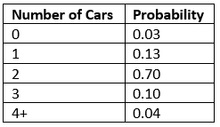
For example, the likelihood of rolling a specific number on a die is 1/6. The total probability for all six values equals one. When you roll a die, you inevitably obtain one of the possible values.
If the discrete distribution has a finite number of values, you can display all the values with their corresponding probabilities in a table. For example, according to a study, the likelihood for the number of cars in a California household is the following:

Slide 60
Types of Discrete Distributions
There are a variety of discrete probability distributions that you can use to model different types of data. The correct discrete distribution depends on the properties of your data. For example, use the:
Binomial distribution to model binary data, such as coin tosses.
Poisson distribution to model count data, such as the count of library book checkouts per hour.
Uniform distribution to model multiple events with the same probability, such as rolling a die.

Slide 61
A probability distribution describes how the values of a random variable is distributed. For example, the collection of all possible outcomes of a sequence of coin tossing is known to follow the binomial distribution.

Slide 62
Binomial Distribution
The binomial distribution is a discrete probability distribution. It describes the outcome of n independent trials in an experiment. Each trial is assumed to have only two outcomes, either success or failure.

Slide 63
Problem
Suppose there are twelve multiple choice questions in an English class quiz. Each question has five possible answers, and only one of them is correct. Find the probability of having four or less correct answers if a student attempts to answer every question at random.
Solution
Since only one out of five possible answers is correct, the probability of answering a question correctly by random is 1/5=0.2. We can find the probability of having exactly 4 correct answers by random attempts as follows.
> dbinom(4, size=12, prob=0.2)

Slide 64
Alternatively, we can use the cumulative probability function for binomial distribution pbinom.
> pbinom(4, size=12, prob=0.2)

Slide 65
Poisson Distribution
The Poisson distribution is the probability distribution of independent event occurrences in an interval.
Expresses the probability of a given number of events occurring in a fixed interval of time or space if these events occur with a known constant mean rate and independently of the time since the last event.

Slide 66
Problem
If there are twelve cars crossing a bridge per minute on average, find the probability of having seventeen or more cars crossing the bridge in a particular minute.
Solution
The probability of having sixteen or less cars crossing the bridge in a particular minute is given by the function ppois.
> ppois(16, lambda=12) # lower tail

Slide 67
Hence the probability of having seventeen or more cars crossing the bridge in a minute is in the upper tail of the probability density function.
> ppois(16, lambda=12, lower=FALSE) # upper tail
Answer
If there are twelve cars crossing a bridge per minute on average, the probability of having seventeen or more cars crossing the bridge in a particular minute is 10.1%.

Slide 68
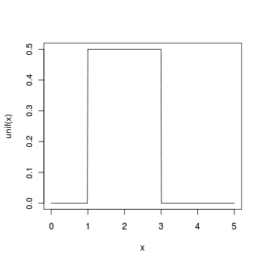
Continuous Uniform Distribution
The continuous uniform distribution is the probability distribution of random number selection from the continuous interval between a and b.

Slide 69
Problem
Select ten random numbers between one and three.
Solution
We apply the generation function runif of the uniform distribution to generate ten random numbers between one and three.
> runif(10, min=1, max=3)

Slide 70
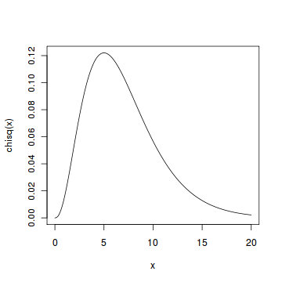
Chi-squared Distribution
If X1,X2,…,Xm are m independent random variables having the standard normal distribution.
In probability theory and statistics, the chi-squared distribution with k degrees of freedom is the distribution of a sum of the squares of k independent standard normal random variables.

Slide 71
Problem
Find the 95th percentile of the Chi-Squared distribution with 7 degrees of freedom.
Solution
We apply the quantile function qchisq of the Chi-Squared distribution against the decimal values 0.95.
> qchisq(.95, df=7) # 7 degrees of freedom
Answer
The 95th percentile of the Chi-Squared distribution with 7 degrees of freedom is 14.067.

Slide 72
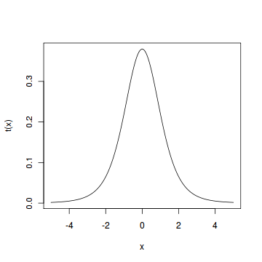
Student t Distribution
Assume that a random variable Z has the standard normal distribution, and another random variable V has the Chi-Squared distribution with m degrees of freedom.

Slide 73
Problem
Find the 2.5th and 97.5th percentiles of the Student t distribution with 5 degrees of freedom.
Solution
We apply the quantile function qt of the Student t distribution against the decimal values 0.025 and 0.975.
> qt(c(.025, .975), df=5) # 5 degrees of freedom
Answer
The 2.5th and 97.5th percentiles of the Student t distribution with 5 degrees of freedom are -2.5706 and 2.5706 respectively.

Slide 74
F Distribution
If V 1 and V 2 are two independent random variables having the Chi-Squared distribution with m1 and m2 degrees of freedom.
Problem
Find the 95th percentile of the F distribution with (5, 2) degrees of freedom.
Solution
We apply the quantile function qf of the F distribution against the decimal value 0.95.
> qf(.95, df1=5, df2=2)
Answer
The 95th percentile of the F distribution with (5, 2) degrees of freedom is 19.296.

Slide 75
Continuous Probability Distributions
Continuous probability functions are also known as probability density functions. You know that you have a continuous distribution if the variable can assume an infinite number of values between any two values. Continuous variables are often measurements on a scale, such as height, weight, and temperature.
Unlike discrete probability distributions where each particular value has a non-zero likelihood, specific values in continuous distributions have a zero probability. For example, the likelihood of measuring a temperature that is exactly 32 degrees is zero.

Slide 76
Characteristics of Continuous Probability Distributions
Just as there are different types of discrete distributions for different kinds of discrete data, there are different probability distributions for continuous data. Each probability distribution has parameters that define its shape. Most distributions have between 1-3 parameters. Specifying these parameters establishes the shape of the distribution and all of its probabilities entirely.
The most well-known continuous distribution is the normal distribution, which is also known as the Gaussian distribution or the “bell curve.” This symmetric distribution fits a wide variety of phenomena, such as human height and IQ scores. It has two parameters—the mean and the standard deviation. The Weibull distribution and the lognormal distribution are other common continuous distributions. Both of these distributions can fit skewed data.

Slide 77
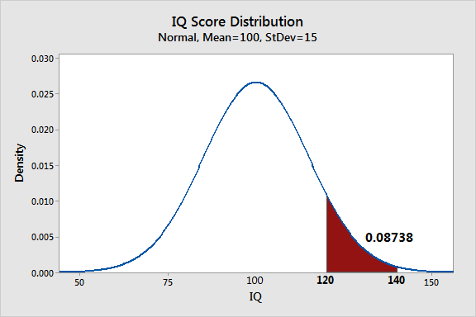
Continuous Probability Distributions

Slide 78
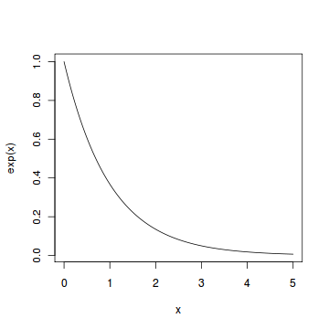
Exponential Distribution
The exponential distribution describes the arrival time of a randomly recurring independent event sequence.

Slide 79
Problem
Suppose the mean checkout time of a supermarket cashier is three minutes. Find the probability of a customer checkout being completed by the cashier in less than two minutes.
Solution
The checkout processing rate is equals to one divided by the mean checkout completion time. Hence the processing rate is 1/3 checkouts per minute. We then apply the function pexp of the exponential distribution with rate=1/3.
> pexp(2, rate=1/3)
Answer
The probability of finishing a checkout in under two minutes by the cashier is 48.7%

Slide 80
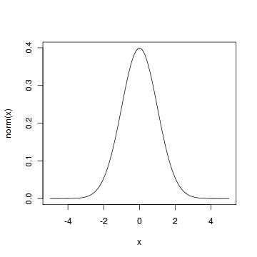
Normal Distribution
The normal distribution is defined by the probability density function, where μ is the population mean and σ2 is the variance.

Slide 81
Problem
Assume that the test scores of a college entrance exam fits a normal distribution. Furthermore, the mean test score is 72, and the standard deviation is 15.2. What is the percentage of students scoring 84 or more in the exam?
Solution
We apply the function pnorm of the normal distribution with mean 72 and standard deviation 15.2. Since we are looking for the percentage of students scoring higher than 84, we are interested in the upper tail of the normal distribution.
> pnorm(84, mean=72, sd=15.2, lower.tail=FALSE)
Answer
The percentage of students scoring 84 or more in the college entrance exam is 21.5%.

Slide 82
Chi Square Test
Chi-Square test in R is a statistical method which used to determine if two categorical variables have a significant correlation between them. The two variables are selected from the same population.

Slide 83
Example
Suppose we have 105 patients under study and 50 of them were treated with the drug. Moreover, the remaining 55 patients were kept under control samples. Thus, the health condition of all patients was checked after a week.
With the following table, we can assess if their condition has improved or not. By observing this table, one can you tell if the drug had a positive effect on the patient?

Slide 84
Assumptions
Moreover, like all statistical tests, we assume this test as a null hypothesis and an alternate hypothesis.
The main thing is, we reject the null hypothesis if the p-value that comes out in the result is less than a predetermined significance level, which is 0.05 usually, then we reject the null hypothesis.
H0: The two variables are independent. H1: The two variables relate to each other.

Slide 85
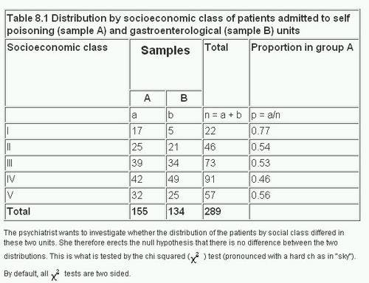
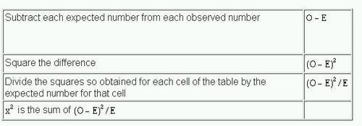

Slide 86
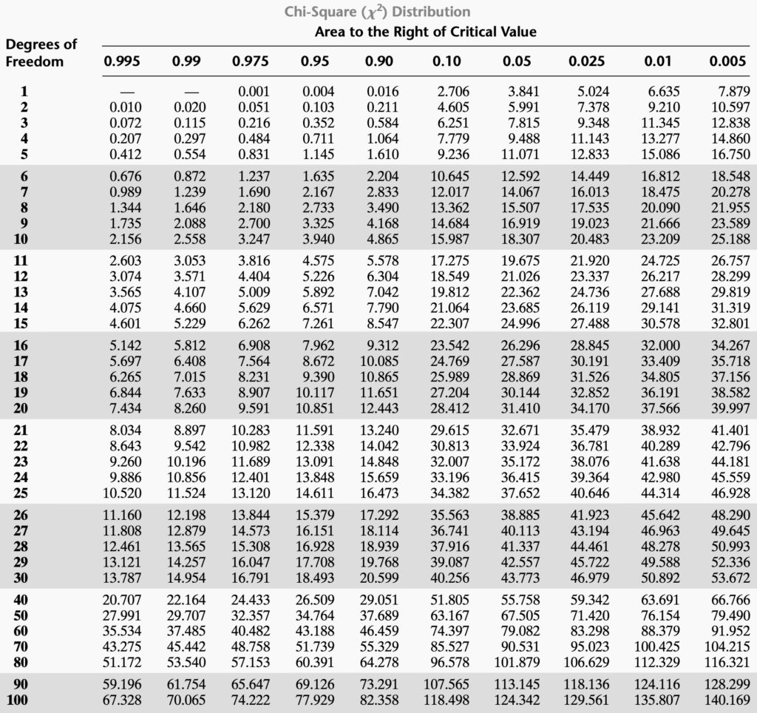
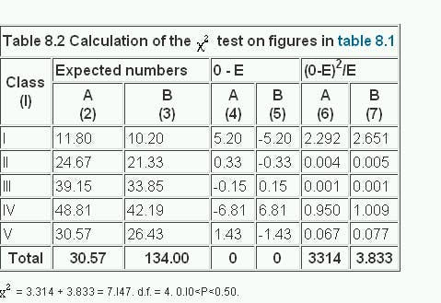
https://www.socscistatistics.com/pvalues/chidistribution.aspx

Slide 87
R Function
> data_frame <- read.csv("https://goo.gl/j6lRXD")
> table(data_frame$treatment, data_frame$improvement)
improved not-improved
not-treated 26 29
treated 35 15
> chisq.test(data_frame$treatment, data_frame$improvement, correct=FALSE)
Pearson's Chi-squared test
data: data_frame$treatment and data_frame$improvement
X-squared = 5.5569, df = 1, p-value =
0.01841

Slide 88
We have a chi-squared value of 5.5569. Since we get a p-Value less than the significance level of 0.05, we reject the null hypothesis

