Slide 1


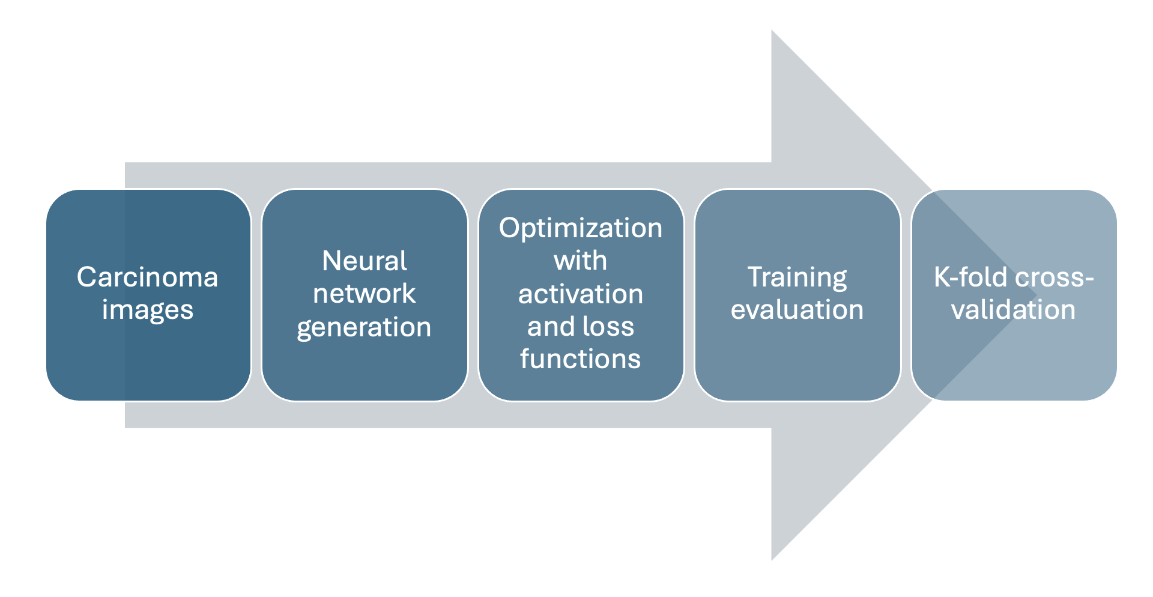
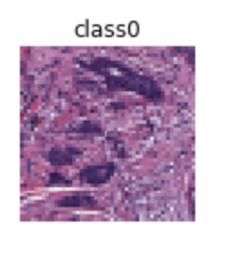
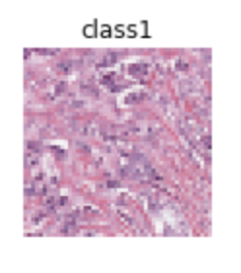





Adapting High-Performance Computing (HPC) tools in image classification using Convolutional Neural Networks (CNN)
Pawar Shrikant, Department of Computer Science & Biology, School of Natural Sciences Claflin University, Orangeburg, South Carolina
SGX3 award # 2231406
Revised Course Description
Sample HPC/Gateways Exercise
Gateway Community Mentor Syllabus Suggestions
BTEC680: This course is designed to help students grasp statistical concepts and techniques, and to present real-life opportunities for applying them to their specific disciplines. Students will learn how to implement machine learning techniques on biomedical imaging data. Students will learn importance and implementation of HPC resources in big data training.
Feature selection and data visualization.
Preprocessing and standardization.
Classification (training and test splits, cross validation) and model evaluation.
Resources / Science Gateways
Datasets
HPC can optimize the Convolutional Neural Network (CNN) algorithm. Multi-core processors, GPUs, and parallel computing frameworks like OpenMPI and CUDA can speed up CNN model training. The approach improves performance and training time and is superior to alternative strategies. HPC technologies can refine the CNN method, resulting in faster and more accurate training of large-scale CNN models.
Image Classification using Convolutional Neural Networks (CNN): https://www.kaggle.com/code/arbazkhan971/
image-classification-using-cnn-94-accuracy
This open-source data has 4000+ images of invasive ductal carcinoma (IDC) histopathological images which can be utilized for CNN training.
Exercise pipeline:
Implementation Schedule
Data wrangling, visualization, Theory overview: Machine Learning QDA, LDA, ROC, Decision Trees, Feature Engineering, Classification and Model Evaluation, Regression: Basics and Prediction, Evaluation and Interpretation, Clustering.
HPC overview.
Datasets overview and EDA.
Implementation of neural networks on training set.
Evaluation metrics.
Resource Needs/List
Use Cases
Carcinoma
Nodes with GPU cores.
Each node with 20-50GB memory to store imaging datasets.
Approximately 15-20 Students are expected to enroll per semester, each student will need individual allocation.
Tutorial on accessing and using GPU nodes.
CUDA tutorial for HPC.
CNN is a specialized neural network for processing data that has an input shape like a 2D matrix like images. CNN's are typically used for image detection and classification. In this example we learn how to implement CNN on general images, which then can be replicated for Computer Aided Diagnosis (CAD) on radioimaging datasets like X-rays, computed tomography (CT) scans, etc.
No Carcinoma
Authors
Pawar Shrikant,
Computer Science,
Claflin University, South Carolina, USA.
HPC/Gateways Mentor
Charlie Dey,
Texas Advanced Computing Center (TACC), USA.
Your feedback is welcome!
MORE INFORMATION → https://hackhpc.github.io/facultyhack-gateways23 __

