Slide 1
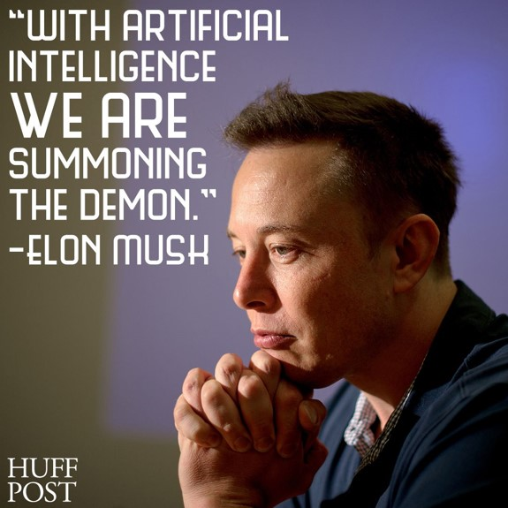
Artificial Intelligence (AI) & its applications. -Shrikant Pawar

Slide 2
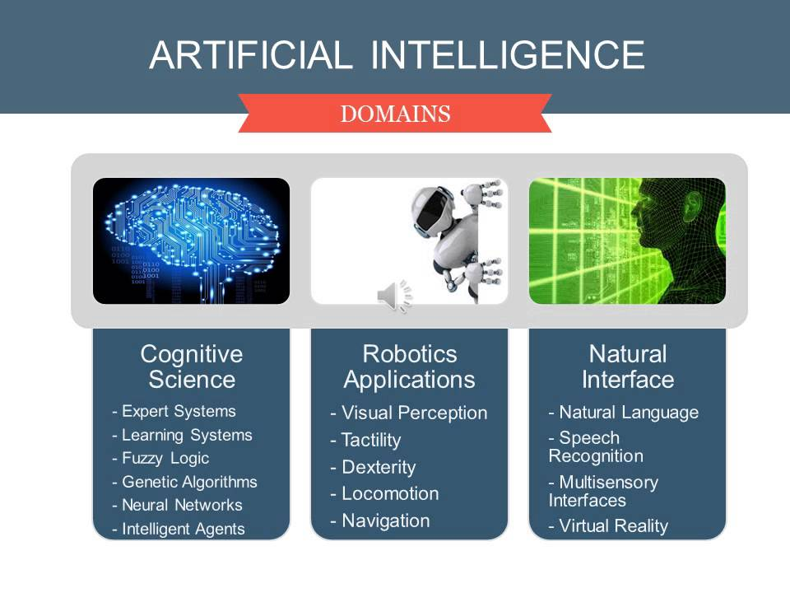
Overview:
INTUITIONISTIC FUZZY SETS (IFS)
FUZZY SETS THEORY
NEURO-FUZZY SETS THEORY

Slide 3

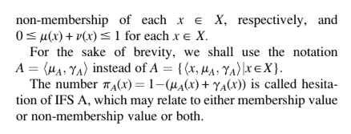
Degree of membership and non-membership

Slide 4
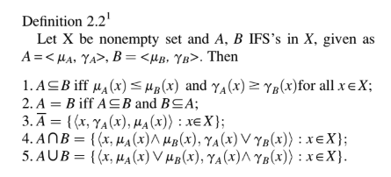
Unions and Intersections

Slide 5
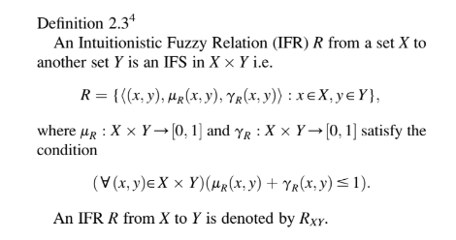
Intuitionistic Fuzzy Relation (IFR)

Slide 6
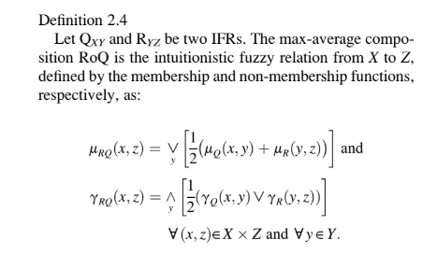
Max-average composition

Slide 7
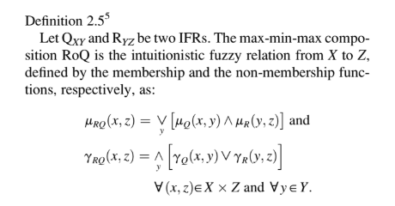
Max-min composition

Slide 8
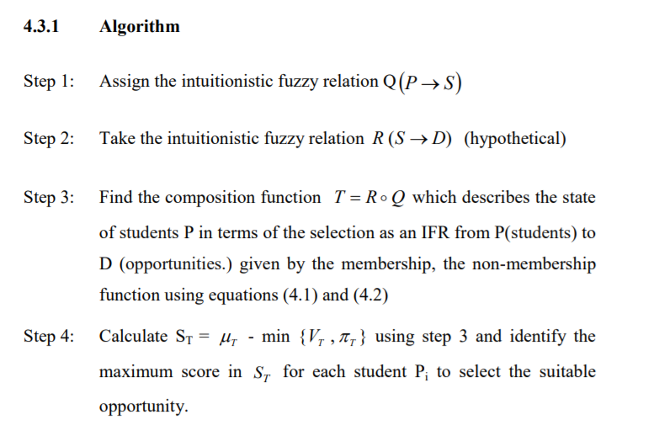
Algorithm

Slide 9
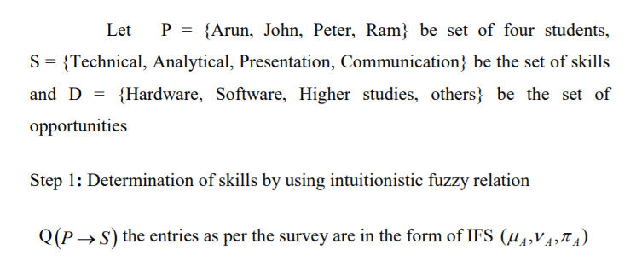
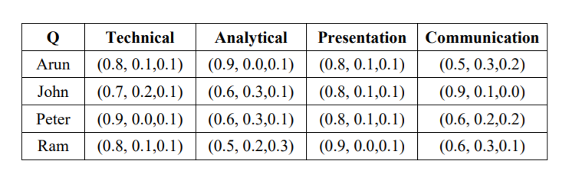
Example 1

Slide 10
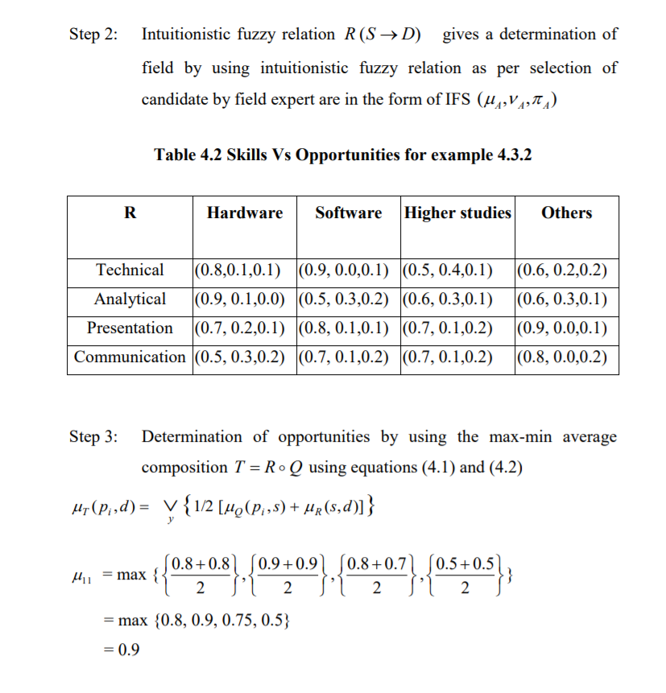
Continued:

Slide 11
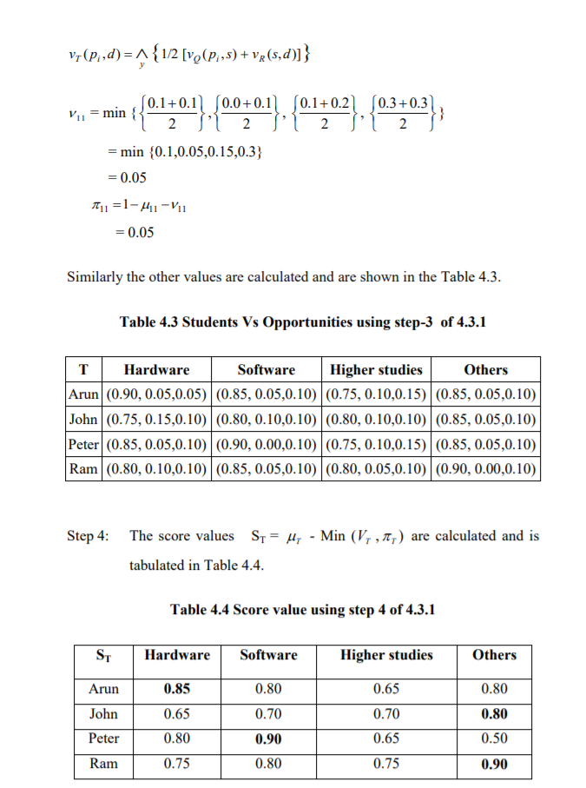
Continued:

Slide 12
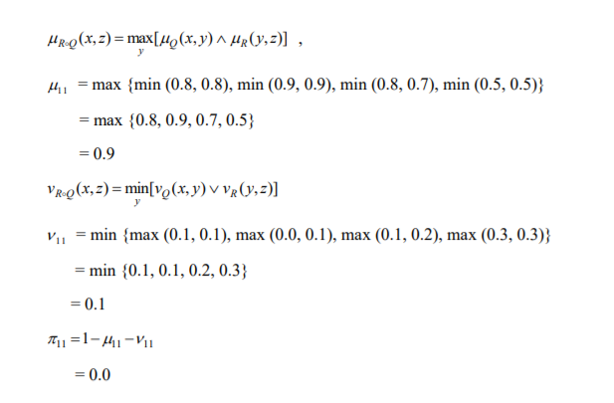
Continued:

Slide 13
FUZZY SETS THEORY:

Slide 14
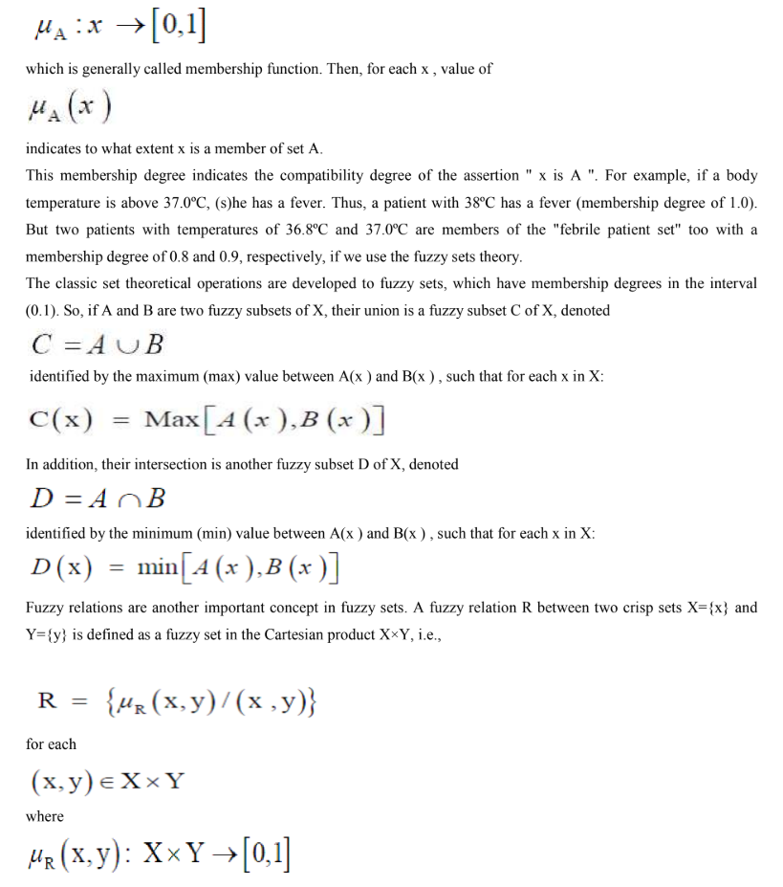
Algorithm

Slide 15
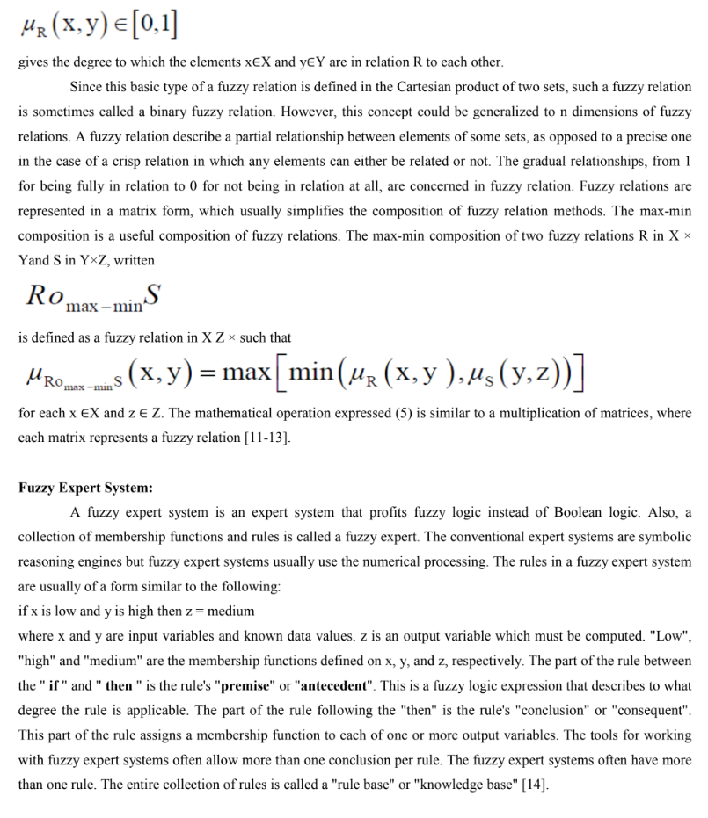
Continued

Slide 16
NEURO-FUZZY SETS THEORY:

Slide 17
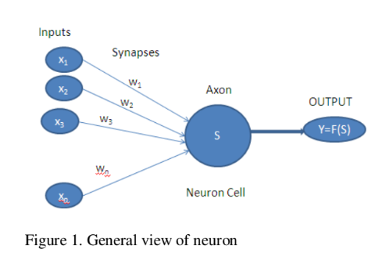

Neuron?

Slide 18
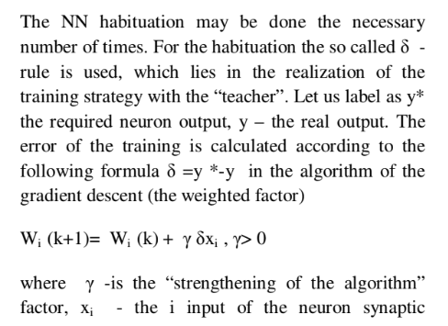
NN habituation:

Slide 19
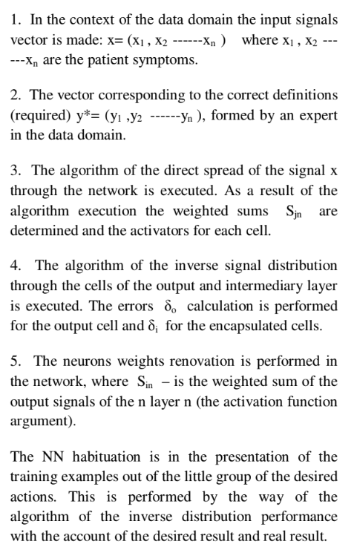
Algorithm

Slide 20
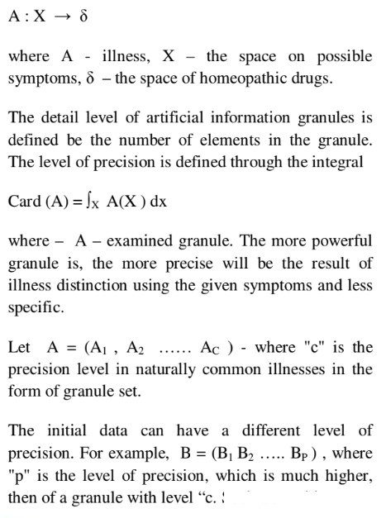
NN application

Slide 21
Contact
Shrikant Pawar
001-404-431-0213, spawar2@student.gsu.edu
M.S (Comp. Sci.); M.S, Ph.D. (Bioinformatics)
Georgia State University, Department of Computer Science & Biology,
503 Petit Science Center, Atlanta, GA 30302.
Android & web application projects: https://github.com/spawar2 Personal profile webpage: http://shrikantpawar.000webhostapp.com/ Company webpage: http://www.ebird.in
University profile webpage: http://sites.gsu.edu/spawar2/
LinkedIn page: https://www.linkedin.com/in/shrikant-pawar-5bb37a16

Slide 22
Questions?
Resources: https://github.com/topics/artificial-intelligence
AI Packages:
R Bioconductor: https://www.bioconductor.org/packages/release/bioc/html/rqt.html
Python:https://www.tutorialspoint.com/artificial_intelligence_with_python/index.html

