Slide 1
Probability Distributions
Probability distributions are functions that describe the likelihood of obtaining the possible values that a random variable can assume. In other words, the values of the variable vary based on the underlying probability distribution.
Suppose you draw a random sample and measure the heights of the subjects. As you measure heights, you create a distribution of heights. This type of distribution is useful when you need to know which outcomes are most likely, the spread of potential values, and the likelihood of different results.

Slide 2
General Properties of Probability Distributions
Probability distributions indicate the likelihood of an event or outcome. Statisticians use the following notation to describe probabilities:
p(x) = the likelihood that random variable takes a specific value of x.

Slide 3
The sum of all probabilities for all possible values must equal 1. Furthermore, the probability for a particular value or range of values must be between 0 and 1.
Probability distributions describe the dispersion of the values of a random variable. Consequently, the kind of variable determines the type of probability distribution. For a single random variable, statisticians divide distributions into the following two types:
Discrete probability distributions for discrete variables
Probability density functions for continuous variables

Slide 4
Discrete Probability Distributions
Discrete probability functions are also known as probability mass functions and can assume a discrete number of values. For example, coin tosses and counts of events are discrete functions. These are discrete distributions because there are no in-between values. For example, you can have only heads or tails in a coin toss. Similarly, if you’re counting the number of books that a library checks out per hour, you can count 21 or 22 books, but nothing in between.

Slide 5
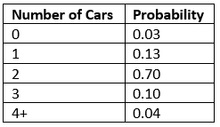
For example, the likelihood of rolling a specific number on a die is 1/6. The total probability for all six values equals one. When you roll a die, you inevitably obtain one of the possible values.
If the discrete distribution has a finite number of values, you can display all the values with their corresponding probabilities in a table. For example, according to a study, the likelihood for the number of cars in a California household is the following:

Slide 6
Types of Discrete Distributions
There are a variety of discrete probability distributions that you can use to model different types of data. The correct discrete distribution depends on the properties of your data. For example, use the:
Binomial distribution to model binary data, such as coin tosses.
Poisson distribution to model count data, such as the count of library book checkouts per hour.
Uniform distribution to model multiple events with the same probability, such as rolling a die.

Slide 7
A probability distribution describes how the values of a random variable is distributed. For example, the collection of all possible outcomes of a sequence of coin tossing is known to follow the binomial distribution.

Slide 8
Binomial Distribution
The binomial distribution is a discrete probability distribution. It describes the outcome of n independent trials in an experiment. Each trial is assumed to have only two outcomes, either success or failure.

Slide 9
Problem
Suppose there are twelve multiple choice questions in an English class quiz. Each question has five possible answers, and only one of them is correct. Find the probability of having four or less correct answers if a student attempts to answer every question at random.
Solution
Since only one out of five possible answers is correct, the probability of answering a question correctly by random is 1/5=0.2. We can find the probability of having exactly 4 correct answers by random attempts as follows.
> dbinom(4, size=12, prob=0.2)

Slide 10
Alternatively, we can use the cumulative probability function for binomial distribution pbinom.
> pbinom(4, size=12, prob=0.2)

Slide 11
Poisson Distribution
The Poisson distribution is the probability distribution of independent event occurrences in an interval.
Expresses the probability of a given number of events occurring in a fixed interval of time or space if these events occur with a known constant mean rate and independently of the time since the last event.

Slide 12
Problem
If there are twelve cars crossing a bridge per minute on average, find the probability of having seventeen or more cars crossing the bridge in a particular minute.
Solution
The probability of having sixteen or less cars crossing the bridge in a particular minute is given by the function ppois.
> ppois(16, lambda=12) # lower tail

Slide 13
Hence the probability of having seventeen or more cars crossing the bridge in a minute is in the upper tail of the probability density function.
> ppois(16, lambda=12, lower=FALSE) # upper tail
Answer
If there are twelve cars crossing a bridge per minute on average, the probability of having seventeen or more cars crossing the bridge in a particular minute is 10.1%.

Slide 14
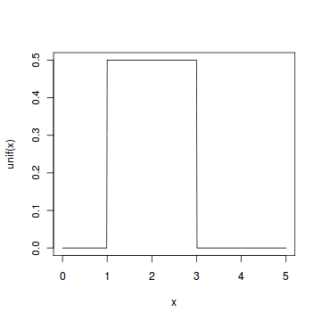
Continuous Uniform Distribution
The continuous uniform distribution is the probability distribution of random number selection from the continuous interval between a and b.

Slide 15
Problem
Select ten random numbers between one and three.
Solution
We apply the generation function runif of the uniform distribution to generate ten random numbers between one and three.
> runif(10, min=1, max=3)

Slide 16
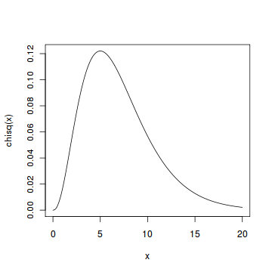
Chi-squared Distribution
If X1,X2,…,Xm are m independent random variables having the standard normal distribution.
In probability theory and statistics, the chi-squared distribution with k degrees of freedom is the distribution of a sum of the squares of k independent standard normal random variables.

Slide 17
Problem
Find the 95th percentile of the Chi-Squared distribution with 7 degrees of freedom.
Solution
We apply the quantile function qchisq of the Chi-Squared distribution against the decimal values 0.95.
> qchisq(.95, df=7) # 7 degrees of freedom
Answer
The 95th percentile of the Chi-Squared distribution with 7 degrees of freedom is 14.067.

Slide 18
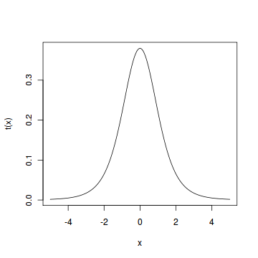
Student t Distribution
Assume that a random variable Z has the standard normal distribution, and another random variable V has the Chi-Squared distribution with m degrees of freedom.

Slide 19
Problem
Find the 2.5th and 97.5th percentiles of the Student t distribution with 5 degrees of freedom.
Solution
We apply the quantile function qt of the Student t distribution against the decimal values 0.025 and 0.975.
> qt(c(.025, .975), df=5) # 5 degrees of freedom
Answer
The 2.5th and 97.5th percentiles of the Student t distribution with 5 degrees of freedom are -2.5706 and 2.5706 respectively.

Slide 20
F Distribution
If V 1 and V 2 are two independent random variables having the Chi-Squared distribution with m1 and m2 degrees of freedom.
Problem
Find the 95th percentile of the F distribution with (5, 2) degrees of freedom.
Solution
We apply the quantile function qf of the F distribution against the decimal value 0.95.
> qf(.95, df1=5, df2=2)
Answer
The 95th percentile of the F distribution with (5, 2) degrees of freedom is 19.296.

Slide 21
Continuous Probability Distributions
Continuous probability functions are also known as probability density functions. You know that you have a continuous distribution if the variable can assume an infinite number of values between any two values. Continuous variables are often measurements on a scale, such as height, weight, and temperature.
Unlike discrete probability distributions where each particular value has a non-zero likelihood, specific values in continuous distributions have a zero probability. For example, the likelihood of measuring a temperature that is exactly 32 degrees is zero.

Slide 22
Characteristics of Continuous Probability Distributions
Just as there are different types of discrete distributions for different kinds of discrete data, there are different probability distributions for continuous data. Each probability distribution has parameters that define its shape. Most distributions have between 1-3 parameters. Specifying these parameters establishes the shape of the distribution and all of its probabilities entirely.
The most well-known continuous distribution is the normal distribution, which is also known as the Gaussian distribution or the “bell curve.” This symmetric distribution fits a wide variety of phenomena, such as human height and IQ scores. It has two parameters—the mean and the standard deviation. The Weibull distribution and the lognormal distribution are other common continuous distributions. Both of these distributions can fit skewed data.

Slide 23
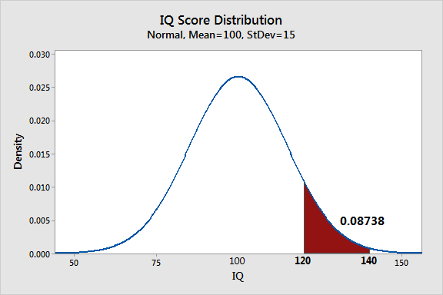
Continuous Probability Distributions

Slide 24
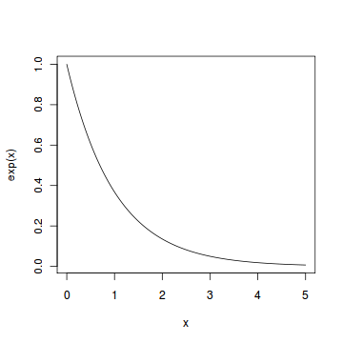
Exponential Distribution
The exponential distribution describes the arrival time of a randomly recurring independent event sequence.

Slide 25
Problem
Suppose the mean checkout time of a supermarket cashier is three minutes. Find the probability of a customer checkout being completed by the cashier in less than two minutes.
Solution
The checkout processing rate is equals to one divided by the mean checkout completion time. Hence the processing rate is 1/3 checkouts per minute. We then apply the function pexp of the exponential distribution with rate=1/3.
> pexp(2, rate=1/3)
Answer
The probability of finishing a checkout in under two minutes by the cashier is 48.7%

Slide 26
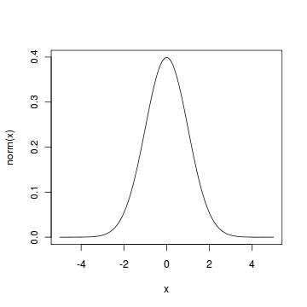
Normal Distribution
The normal distribution is defined by the probability density function, where μ is the population mean and σ2 is the variance.

Slide 27
Problem
Assume that the test scores of a college entrance exam fits a normal distribution. Furthermore, the mean test score is 72, and the standard deviation is 15.2. What is the percentage of students scoring 84 or more in the exam?
Solution
We apply the function pnorm of the normal distribution with mean 72 and standard deviation 15.2. Since we are looking for the percentage of students scoring higher than 84, we are interested in the upper tail of the normal distribution.
> pnorm(84, mean=72, sd=15.2, lower.tail=FALSE)
Answer
The percentage of students scoring 84 or more in the college entrance exam is 21.5%.

Slide 28
Chi Square Test
Chi-Square test in R is a statistical method which used to determine if two categorical variables have a significant correlation between them. The two variables are selected from the same population.

Slide 29
Example
Suppose we have 105 patients under study and 50 of them were treated with the drug. Moreover, the remaining 55 patients were kept under control samples. Thus, the health condition of all patients was checked after a week.
With the following table, we can assess if their condition has improved or not. By observing this table, one can you tell if the drug had a positive effect on the patient?

Slide 30
Assumptions
Moreover, like all statistical tests, we assume this test as a null hypothesis and an alternate hypothesis.
The main thing is, we reject the null hypothesis if the p-value that comes out in the result is less than a predetermined significance level, which is 0.05 usually, then we reject the null hypothesis.
H0: The two variables are independent. H1: The two variables relate to each other.

Slide 31
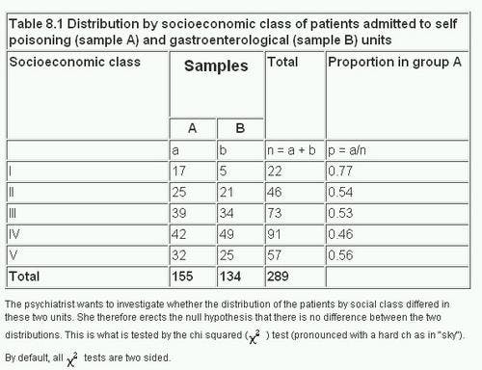
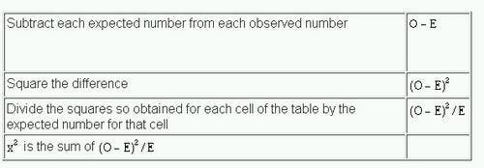

Slide 32
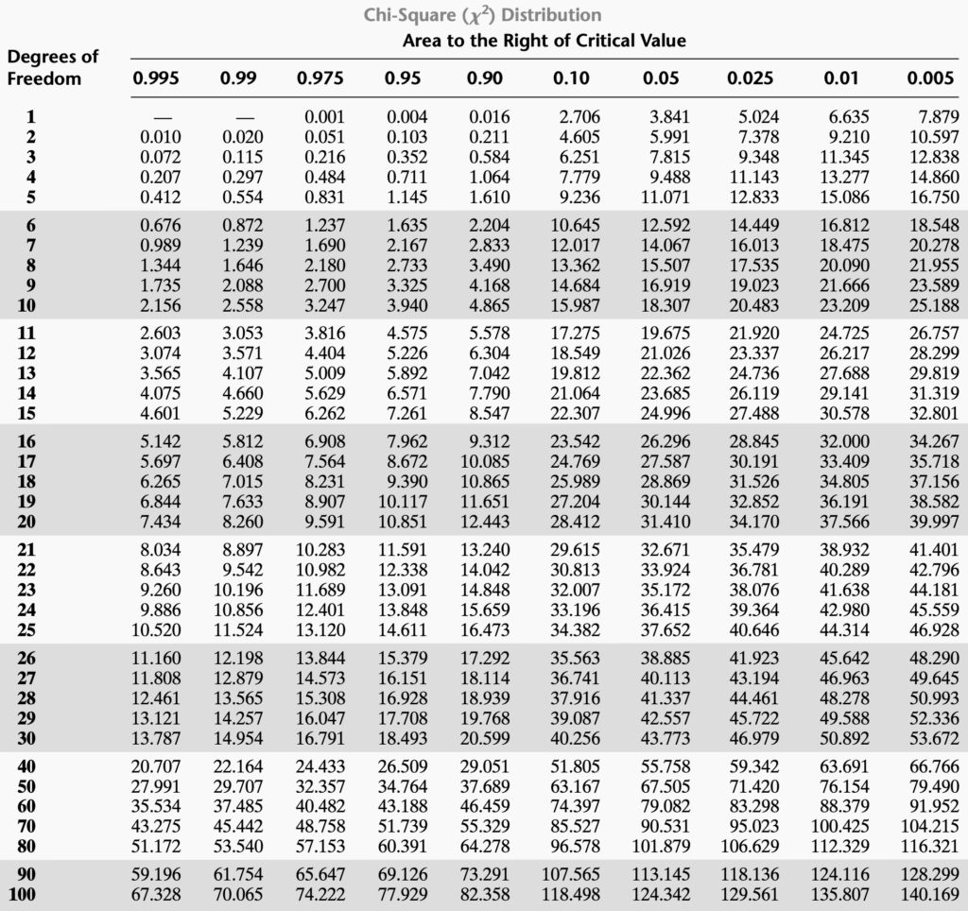
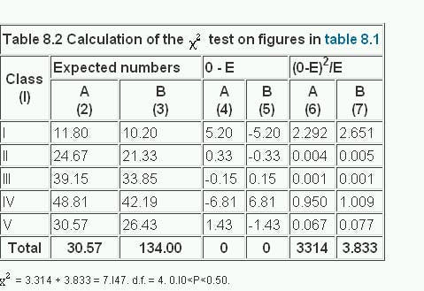
https://www.socscistatistics.com/pvalues/chidistribution.aspx

Slide 33
R Function
> data_frame <- read.csv("https://goo.gl/j6lRXD")
> table(data_frame$treatment, data_frame$improvement)
improved not-improved
not-treated 26 29
treated 35 15
> chisq.test(data_frame$treatment, data_frame$improvement, correct=FALSE)
Pearson's Chi-squared test
data: data_frame$treatment and data_frame$improvement
X-squared = 5.5569, df = 1, p-value =
0.01841

Slide 34
We have a chi-squared value of 5.5569. Since we get a p-Value less than the significance level of 0.05, we reject the null hypothesis

