Slide 1
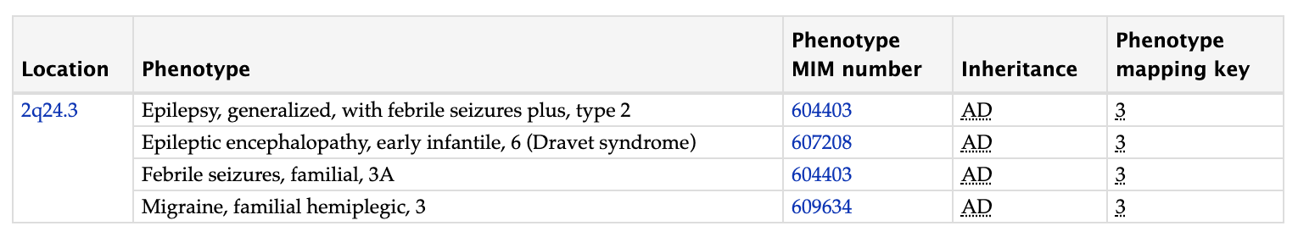
Patient 32742, ~5kb deletion in SCN1A, partial exon deletion (chr2:166887931-166893029)
Mutation in the SCN1A gene can cause a spectrum of early-onset epileptic encephalopathies, with the most common designation being Dravet syndrome (Carranza Rojo et al., 2011).
Dravet syndrome, also known as severe myoclonic epilepsy of infancy (SMEI), involve fever-associated seizures with mutations in the SCN1A gene.
Patient is having tremor, ataxia, dysarthria, ataxia, choreiform movements of the face and upgoing toes. Exome sequencing analysis identified no pathogenic variant.
OMIM Entry: 182389

Slide 2
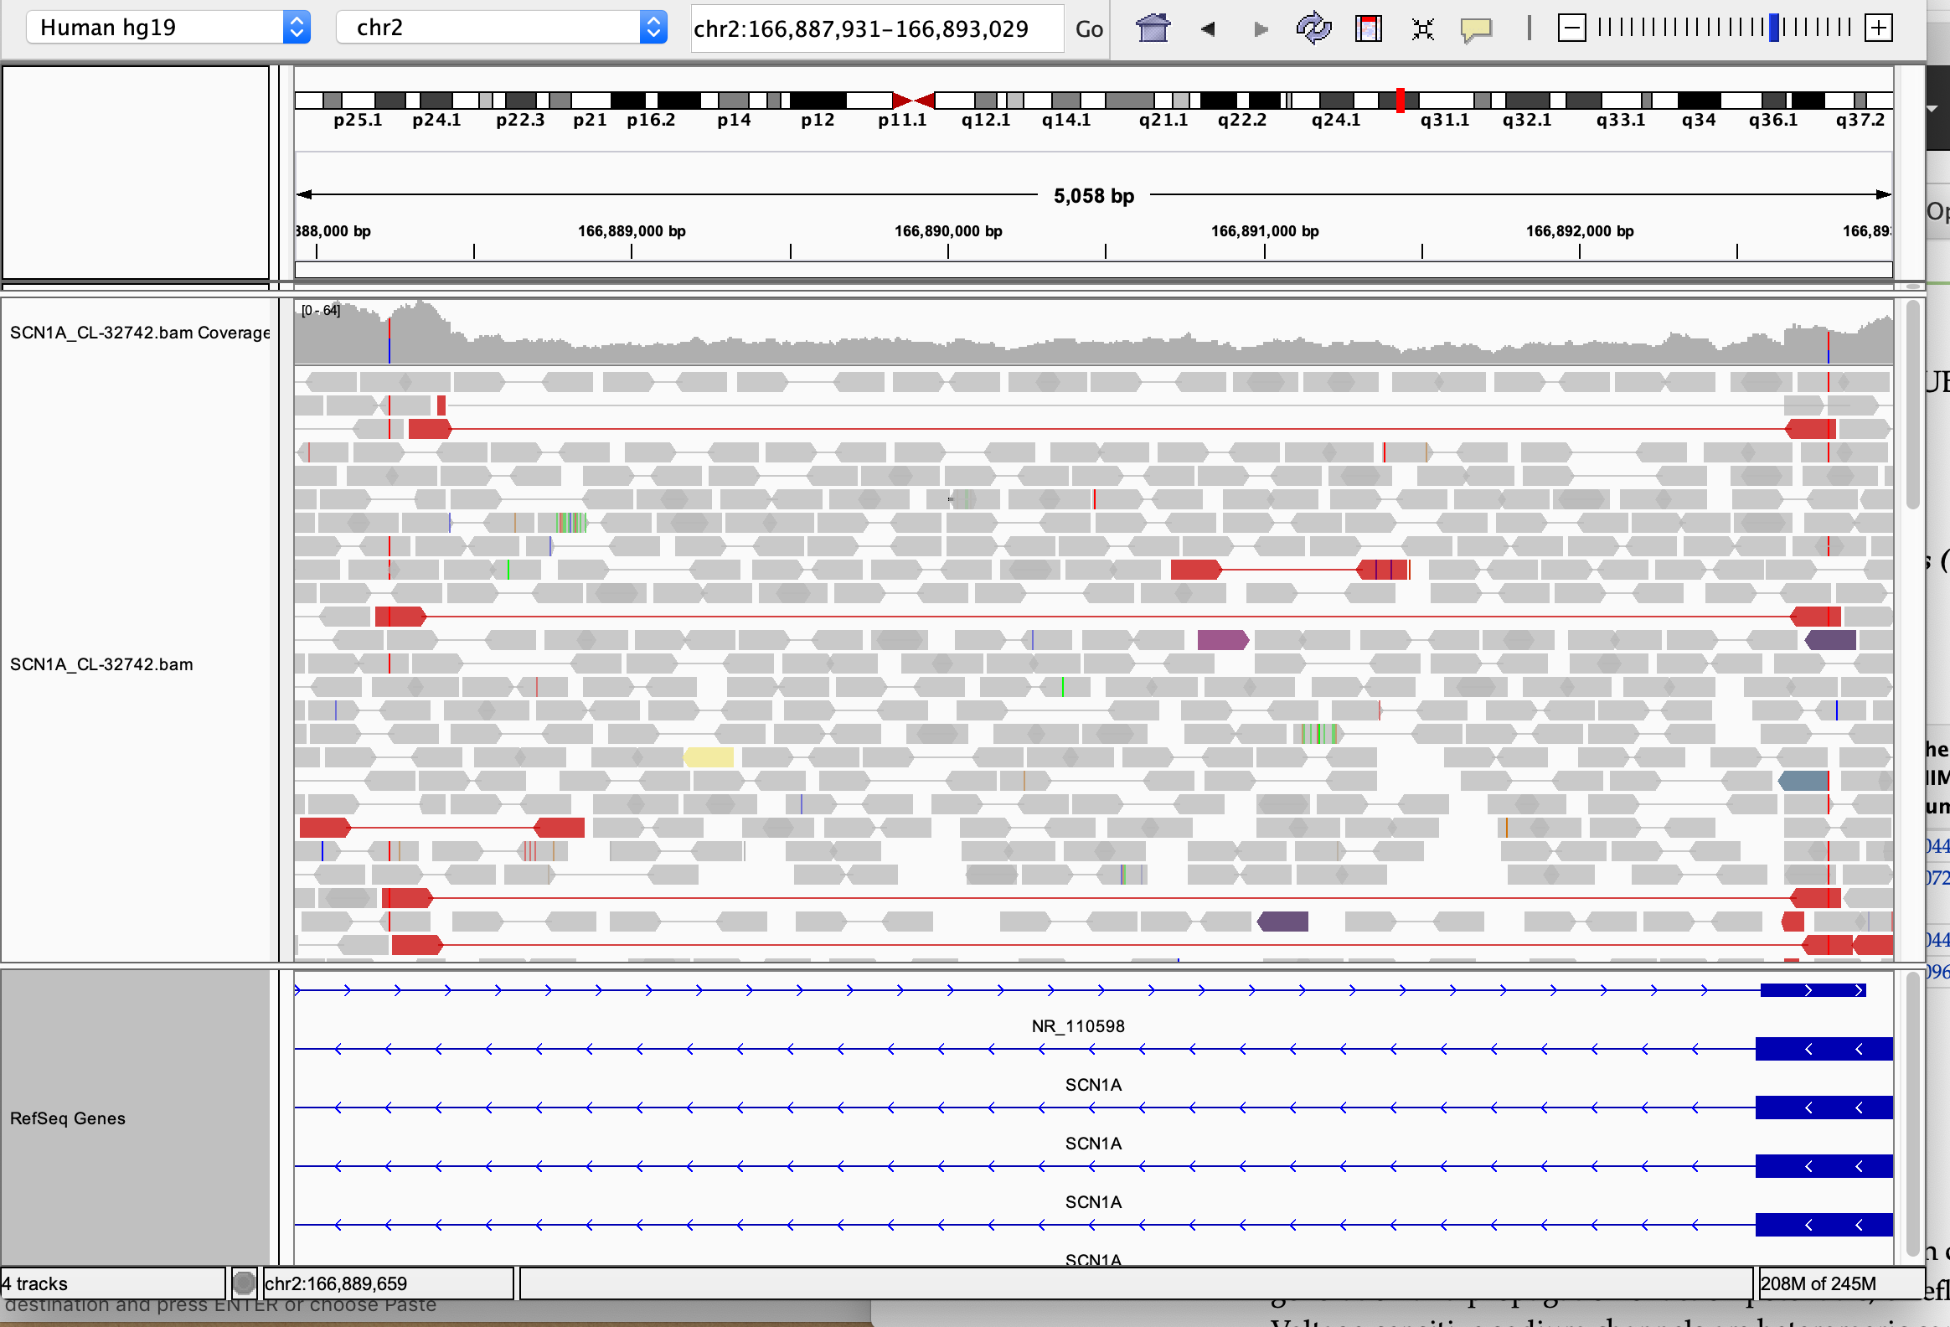
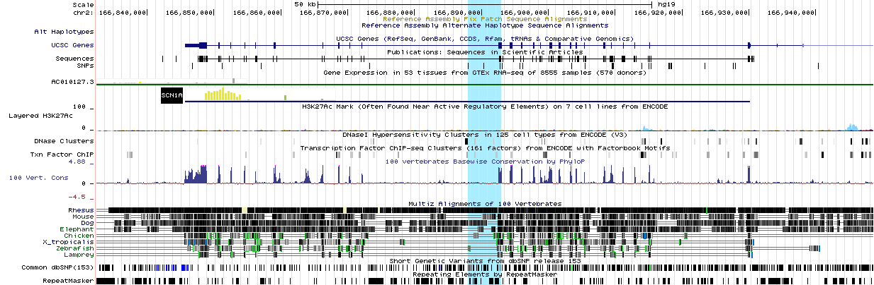
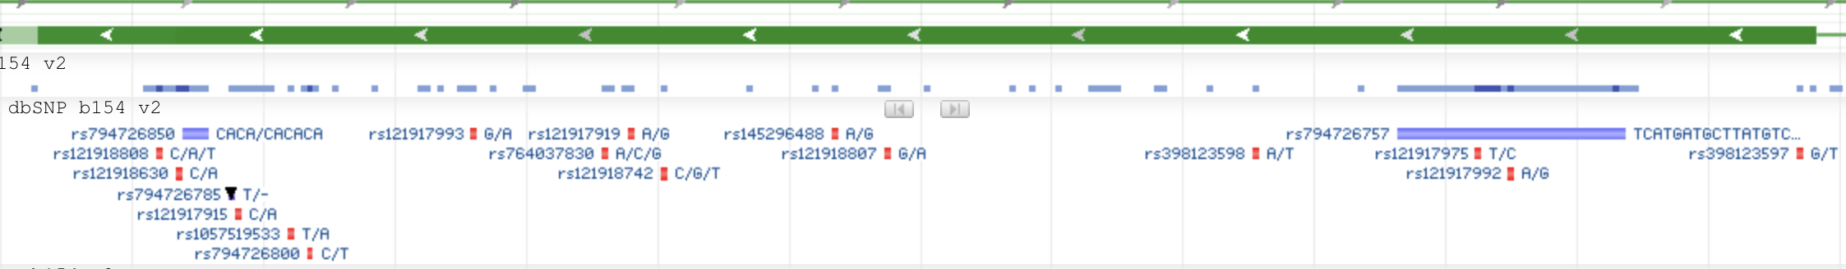
SCN1A gene has 29 transcripts, each with several different variants. SCN1A: partial exon deletion

Slide 3
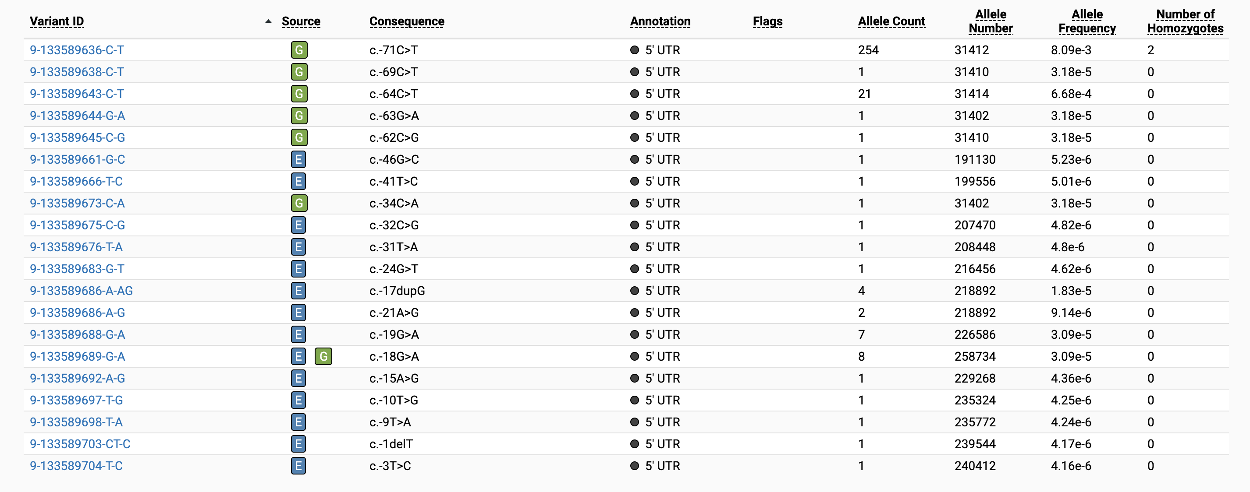
gnomAD has 10922 variants for SCN1A gene but the observed deletion is not present in database
Nineteen point mutations, 12 of which were novel were identified, confirming the clinical diagnosis of the patients.
Patients with a mutation (either truncating or missense) on linker regions had significantly later disease onset than patients
with mutations in homology regions. SCN1A gene sequencing in 46 Turkish epilepsy patients disclosed 12 novel mutations, Seizure
39, 2016, 34-43.

Slide 4
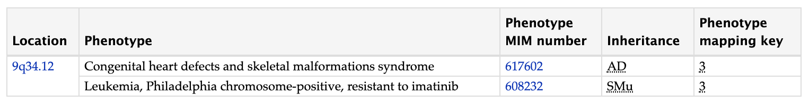
Patient 23379, ~1kb deletion ABL1, middle of intron 7 (chr9:133,752,100-133,753,279)
The ABL1 protooncogene encodes a cytoplasmic and nuclear protein tyrosine kinase that has been implicated in processes of cell differentiation, cell division, cell adhesion, and stress response.
Alterations of ABL1 by chromosomal rearrangement or viral transduction lead to malignant transformation, as in chronic myeloid leukemia (Barila and Superti-Furga, 1998)
Patient is having bilateral shaking episodes beginning at about 3 months of age, with seizure-like activity.
OMIM Entry: 189980

Slide 5
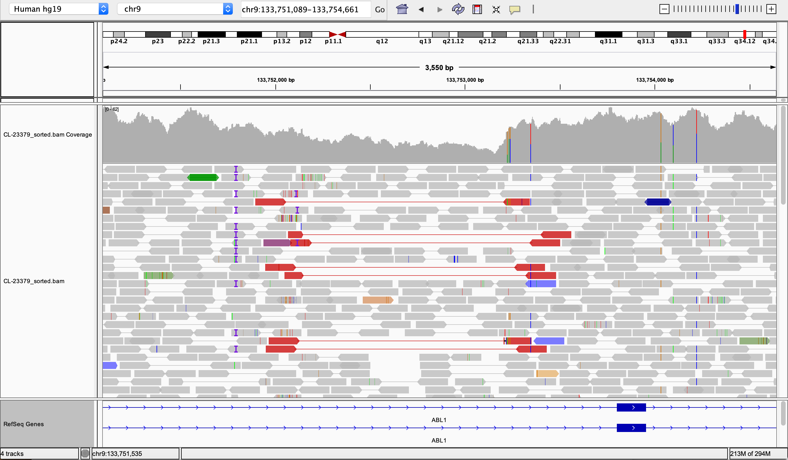
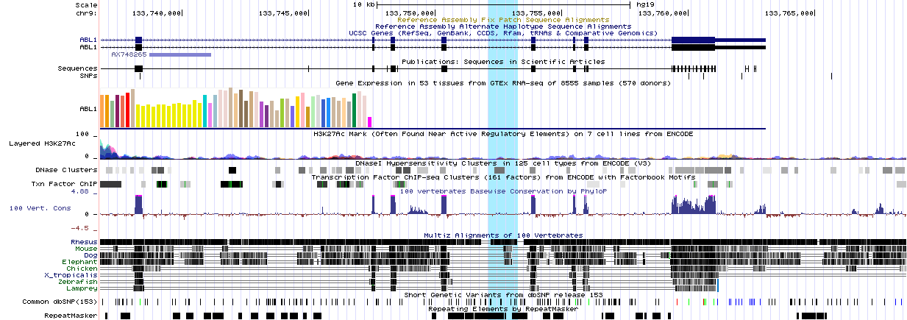
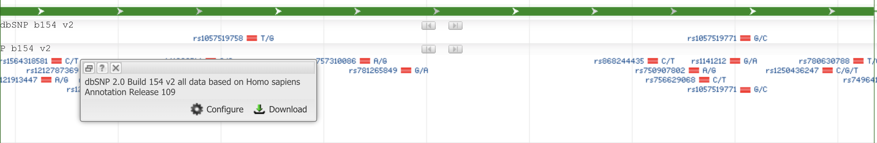
ABL1 gene has 11 transcripts, each with several different variants, ABL1: middle of intron 7 del
Notes:
Congenital heart defects and skeletal malformations syndrome (CHDSKM) is characterized by atrial and ventricular septal defects, with aortic root dilation in adulthood. Skeletal defects are variable and include pectus excavatum, scoliosis, and finger contractures, and some patient exhibit joint laxity. Failure to thrive is observed during infancy and early childhood (Wang et al., 2017).
Other variants:
ARID1A:NM_006015:exon3:c.C1546T:p.P516S,ARID1A:NM_139135:exon3:c.C1546T:p.P516S
ARID1A:NM_006015:exon15:c.G3768A:p.M1256I,ARID1A:NM_139135:exon15:c.G3768A:p.M1256I
PRKD1:NM_001330069:exon4:c.G563T:p.C188F,PRKD1:NM_001348390:exon4:c.G275T:p.C92F,PRKD1:NM_002742:exon4:c.G563T:p.C188F
IRF2BPL:NM_024496:exon1:c.G2141C:p.C714S
PTCHD1:NM_173495:exon1:c.G53T:p.G18V

Slide 6
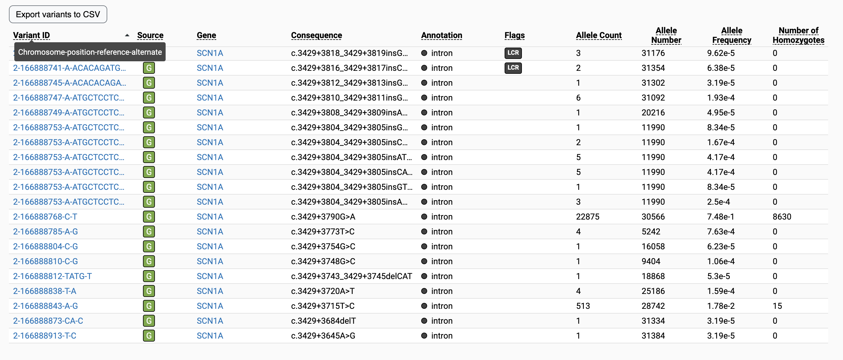
gnomAD has 1423 variants for ABL1 gene but the observed deletion is not present in database
Several types of mutations of the Abl gene can be found in chronic myeloid leukemia patients resistant to STI571, and they can
pre-exist to the onset of treatment. Blood (2002) 100 (3): 1014–1018.
Novel mutations in the kinase domain of BCR-ABL gene causing imatinib resistance in chronic myeloid leukemia patients.
Sci Rep. 2019; 9: 2412.

Slide 7
Conclusions
Both the deletions (partial exon and intronic) for genes SCN1A and ABL1 seems novel as no databases have reported these.
Both deletions can be low frequency mutations for known gene with known phenotype.
Both deletions are observed in only one sample, which can be study limitation.

