Slide 1
Calling structural variants (SV) with different coverage depts Shrikant Pawar 09/25/19

Slide 2
Datasets:
Ecoli EHEC O157 strains carry a large virulence plasmid, pO157. Plasmids are circular genetic elements that many bacteria carry in addition to their chromosomes.
This particular plasmid encodes a number of proteins which are known or suspected to be involved in the ability to cause severe disease in infected humans.
The raw data used here is Illumina MiSeq dataset. The sequenced organism is an enterohaemorrhagic E. coli (EHEC) of the serotype O157, a potentially fatal gastrointestinal pathogen.

Slide 3
Workflow
BWA Indexing of reference genome
BWA mapping of raw reads on reference genome
SAM to BAM conversion
SAM Sort for sorting BAM file
Variant calling with bcftools and Sniffles
Random read removal for
Downtitration of coverage

Slide 4
Coverage calculation (Lander-Waterman Equation)
Coverage =
(Total number of reads x Average length of reads)/Genome length

Slide 5
Different coverages from random reads removal
Total Reads | Average Read Length | Coverage (X)
4242787 | 151.574 | 138.6
2121055 | 151.572 | 69.8
1060085 | 45.982 | 10.59
530135 | 45.673 | 5.26

Slide 6
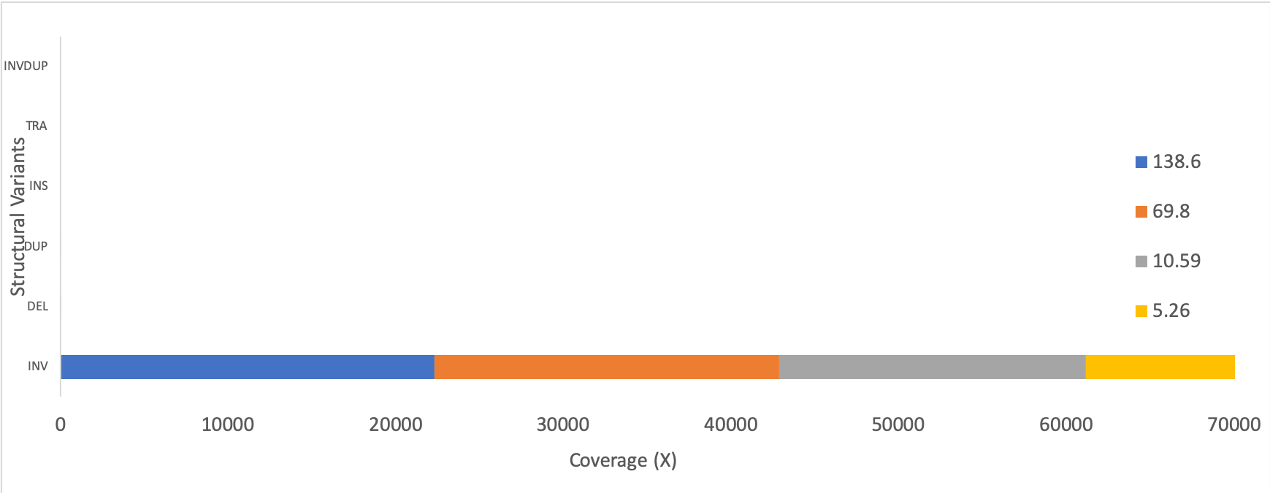
Number of SV's decrease as coverage drops (Sniffles)

Slide 7
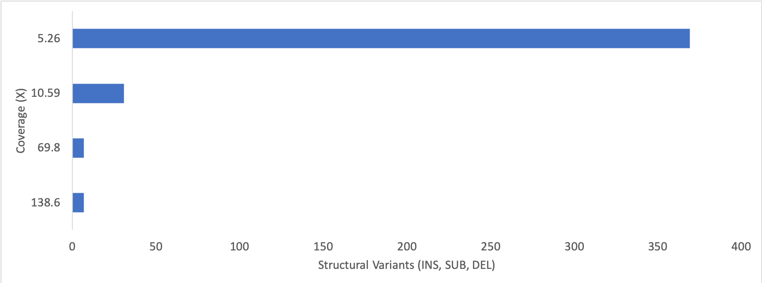
Number of SV's (SUB, INS, DEL) increase as coverage drops (BCF tools)

Slide 8
Conclusion
Sniffles and BCF tools results contradict SV calling with decreasing coverages. Sniffles SV measured changes in terms of INV, DEL, and DUP, while BCF tools outcome changes were seen with SUB, DEL and INS.
The differences may not be significant, linear downgrade titration is needed to understand real changes.

