Slide 1
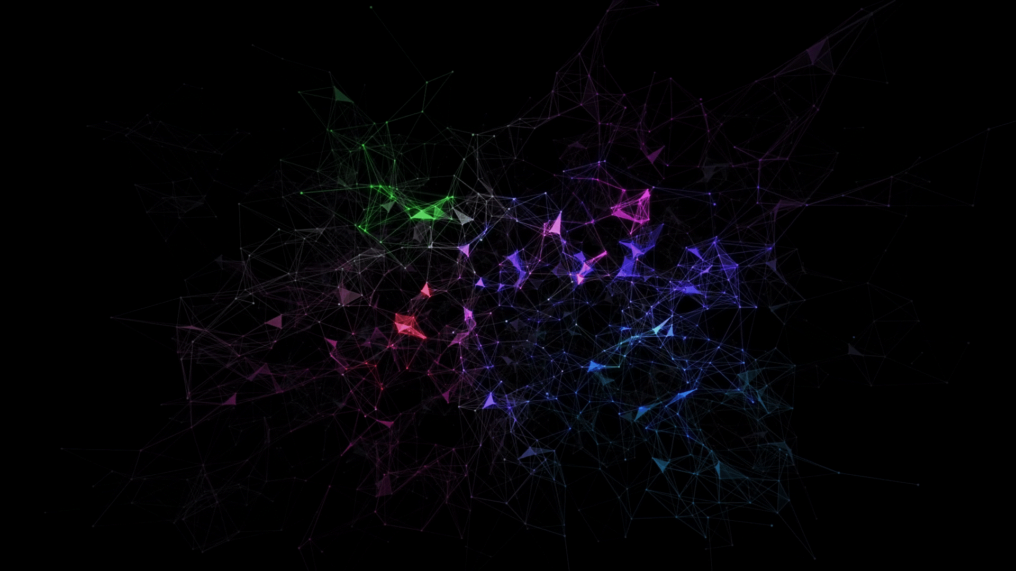
Automating Hemorrhage Detection: A CNN Approach
By: Amrinder Singh
Mentor: Dr. Shrikant Pawar
Claflin University
Department of Computer Science and Mathematics, School of Natural Sciences and Mathematics

Slide 2
Index
Introduction
Methods
Results
Discussion
Conclusion
References
Acknowledgements

Slide 3
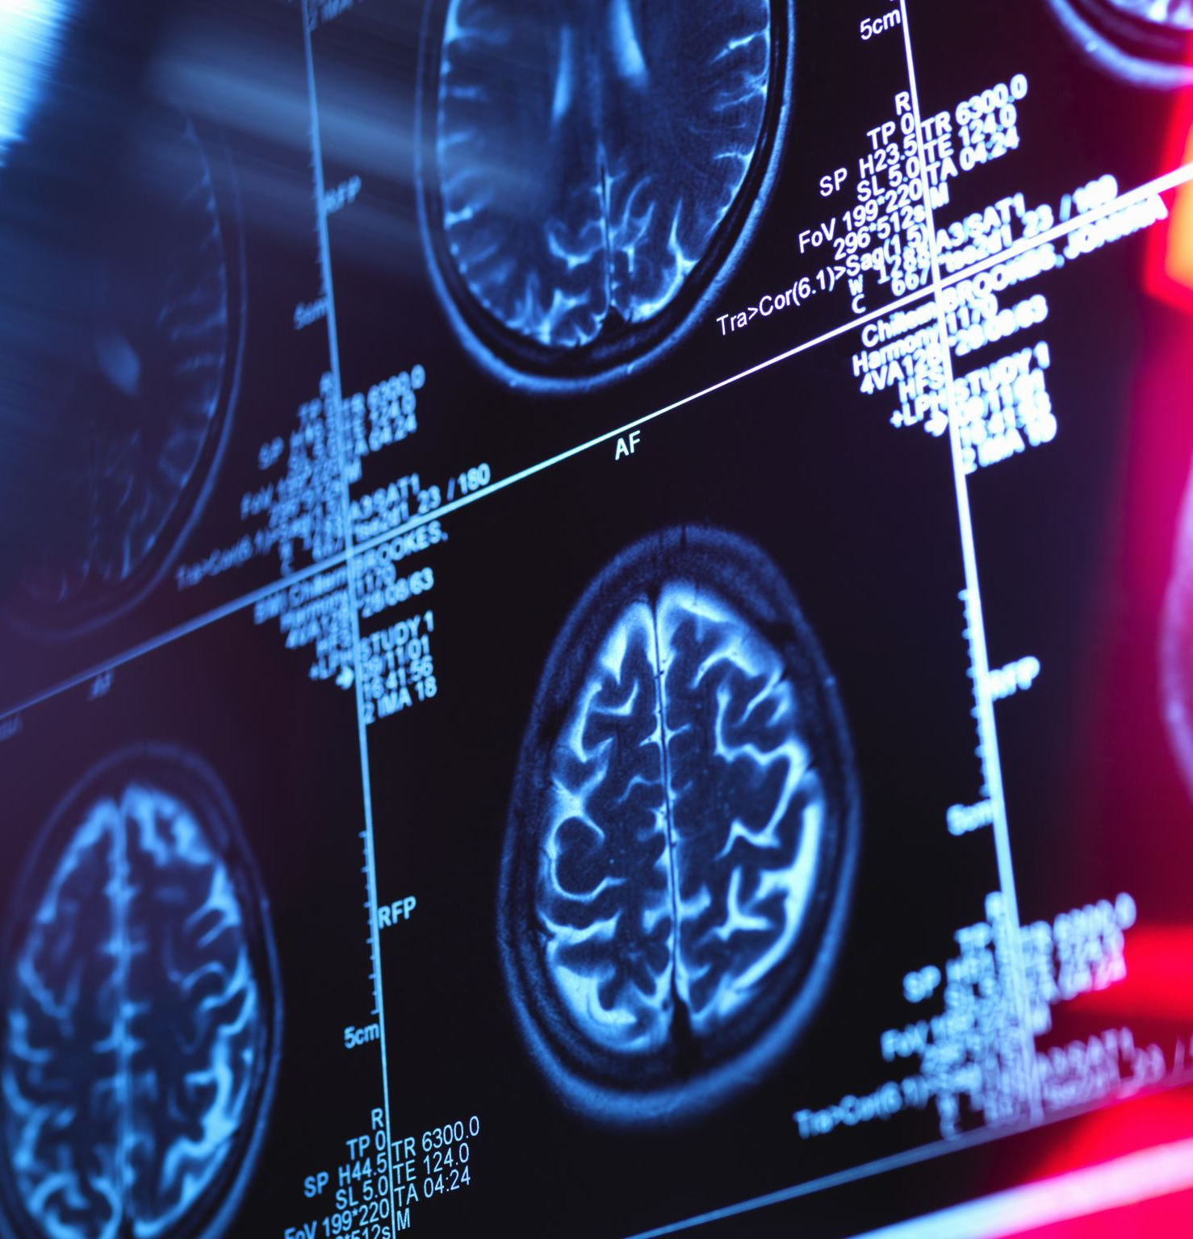
Brain Hemorrhage
A brain hemorrhage, also known as an intracranial hemorrhage, occurs when a blood vessel in the brain bursts, causing bleeding within the brain tissue.
Triggers can include high blood pressure, head injuries, or aneurysms.
The bleeding increases pressure in the skull, damaging brain cells.
Symptoms often include severe headache, weakness, and confusion.
According to the American Heart Association (AHA), brain hemorrhages contribute to about half of all stroke-related deaths. Strokes are the second leading global cause of death, resulting in 5.5 million deaths yearly, with brain hemorrhages causing about 2.75 million of these deaths.

Slide 4
Available Treatments
Minimally Invasive Surgery: Small incisions and specialized tools are used to treat brain hemorrhages, reducing damage and recovery time.
Interventional Radiology: Advanced imaging guides catheters to the site of bleeding, allowing treatments like coil embolization without open surgery.
Traditional Surgery (e.g., Craniotomy): Open surgical procedures involve accessing the brain through a skull incision to remove the blood clot or repair damaged blood vessels directly.

Slide 5
Problem Statement
Diagnosis requires an urgent procedure. When a patient shows acute neurological symptoms such as severe headache or loss of consciousness, highly trained specialists review medical images of the patient’s cranium to look for the presence, location and type of hemorrhage. The process is complicated and often time-consuming, hindering timely patient care and potentially impacting outcomes.

Slide 6
Project Overview
We are tackling this challenge by developing an advanced AI model to automatically detect and classify acute intracranial hemorrhages from CT scans. Using a convolutional neural network (CNN) trained on a large, annotated dataset of medical images, our model learns to identify various hemorrhage subtypes based on their unique imaging characteristics. This state-of-the-art deep learning approach aims for high accuracy and robustness, significantly expediting the diagnostic process.

Slide 7
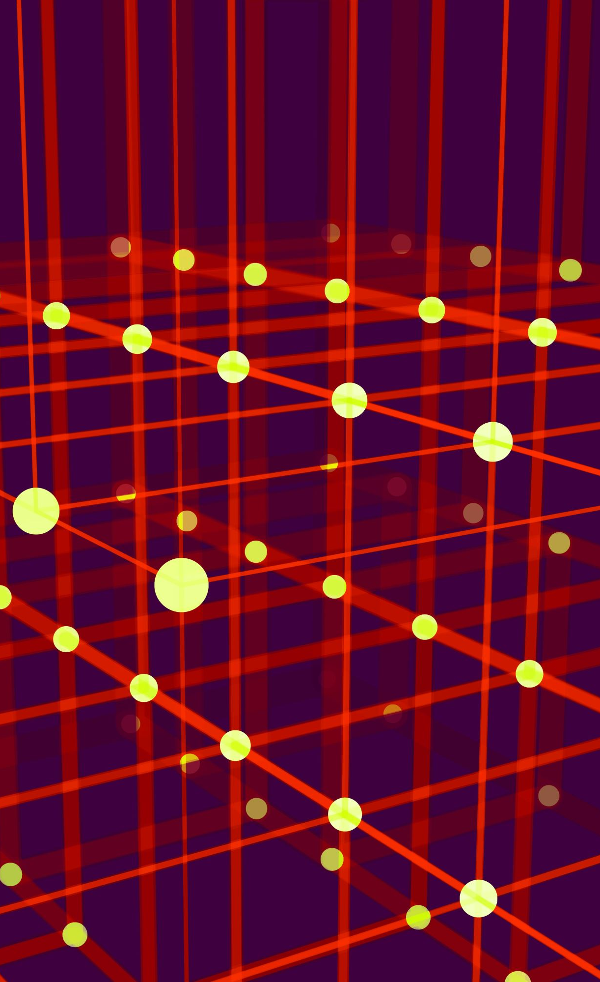
Convolutional Neural Network
A Convolutional Neural Network (CNN) is a deep learning algorithm designed for processing images.
It consists of multiple layers, starting with ones that detect simple patterns like edges and textures.
As the layers deepen, they combine these patterns to recognize complex features such as shapes and objects.
Convolution layers learn to extract relevant features from the image data.
Pooling layers then reduce the spatial dimensions of these features, enhancing efficiency.
Finally, fully connected layers interpret the features to make predictions or classifications.

Slide 8
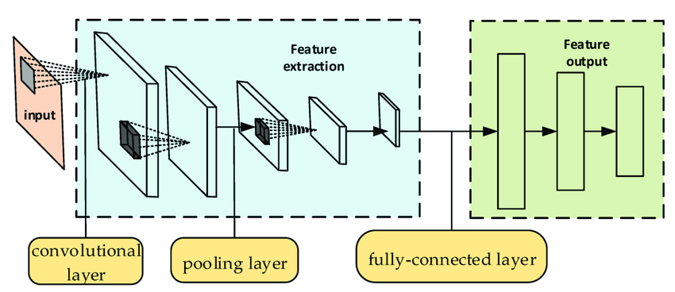
Adopted from: https://www.researchgate.net/figure/Schematic-diagram-of-the-CNN-structure_fig2_361386340

Slide 9
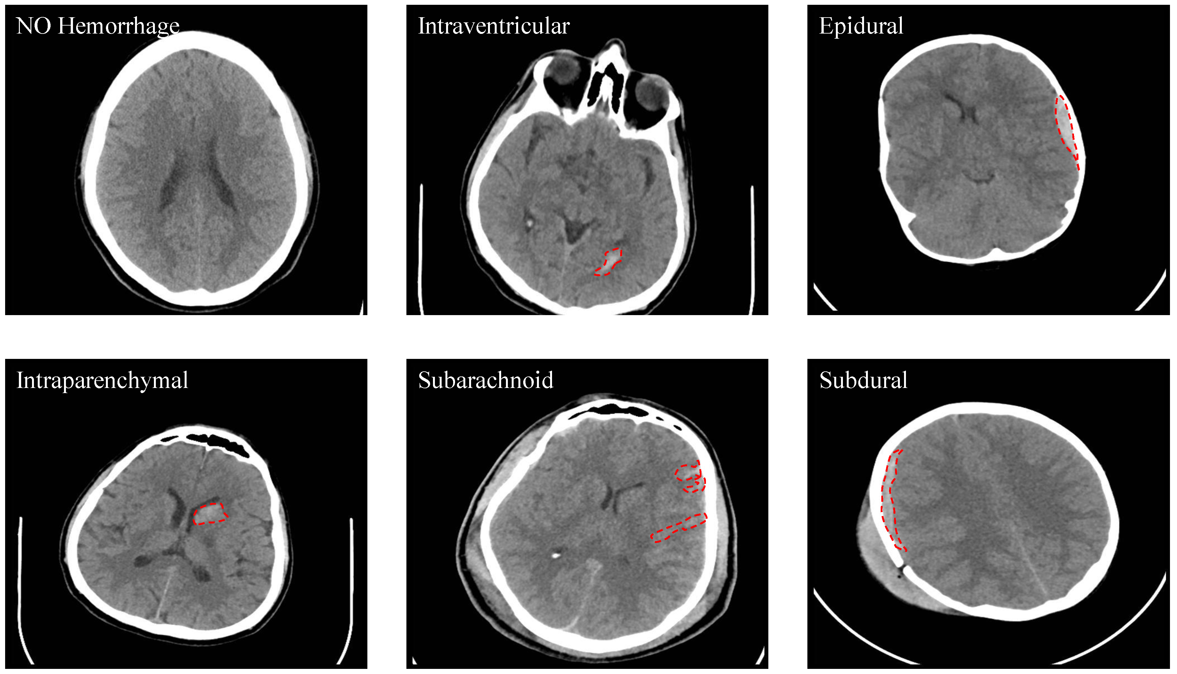

Slide 10
CNN Architectures
DenseNet: It connects every layer to all other layers, allowing each layer to use information from all previous layers. This improves gradient flow and feature reuse, making deep networks easier to train and more efficient. DenseNet achieves good performance with fewer parameters.
ResNet (Residual Networks): It uses shortcut connections to skip layers, helping to solve the vanishing gradient problem. These shortcuts make it easier to train very deep networks by simplifying the learning process. ResNet has set high standards in image recognition performance.
Inception (GoogLeNet/Inception Networks): Inception modules apply different sized filters (1x1, 3x3, 5x5) at the same layer to capture various features. It uses 1x1 convolutions to reduce computational cost while maintaining efficiency. Inception networks combine depth and width to perform well in image classification tasks.

Slide 11
Understanding Results
Loss: Measures the error between predicted and actual values during training. A lower loss indicates more accurate predictions.
Training Accuracy: Represents the percentage of correct predictions using the training dataset. Higher accuracy means the model is learning effectively from the data.
Validation Accuracy: Reflects the percentage of correct predictions on a validation dataset, assessing the model’s ability to generalize its learning to new data. A high accuracy indicates strong real-world application.

Slide 12
CNN Architectures Results
Architecture | Loss | Training Accuracy | Validation accuracy
DenseNet | 0.70 | 0.76 | 0.99
ResNet | 0.68 | 0.70 | 0.91
Inception | 0.80 | 0.78 | 0.98

Slide 13
CNN Architectures Graph

Slide 14
Optimizers
Optimizers are algorithms that adjust the weights and biases in machine learning and deep learning models to minimize the loss function, ensuring the model’s output aligns with expected results.
Popular optimizers, such as SGD, Adam, and RMSprop, each utilize different strategies and algorithms to adjust weights during training.
Optimizers leverage the gradient of the loss function to determine the weight updates, with methods like Adam adjusting the learning rate adaptively to optimize the training process.

Slide 15
Optimizers Results
AdamW is the best Optimizer for the model with the highest of the accuracies.
Optimizer | Loss | Training Accuracy | Validation Accuracy
SGD | 0.88 | 0.42 | 0.66
RMSprop | 0.60 | 0.72 | 0.90
Adam | 0.69 | 0.78 | 0.98
AdamW | 0.59 | 0.99 | 1.0
Adagrad | 0.46 | 0.38 | 0.90
Adadelta | 0.72 | 0.54 | 0.68
AdamX | 1.47 | 0.49 | 0.22
Nadam | 0.45 | 0.71 | 0.74
Ftrl | 1.43 | 0.57 | 0.83
NovaGrad | 1.37 | 0.50 | 0.83

Slide 16
Optimizers Results

Slide 17
Future Scope
Integrate the model into healthcare systems to help diagnose intracranial hemorrhages accurately. This will lead to faster and more reliable diagnoses, improving patient outcomes.
Use the model in medical research and education to study intracranial hemorrhages and train healthcare professionals. This fosters innovation and enhances understanding of AI in medicine.

Slide 18
Conclusion
During the summer research internship developed a model to detection intracranial hemorrhage focusing on accuracy and efficiency.
Tested various architectures and optimizers, applying the best model to RSNA Hemorrhage dataset, showing high accuracy in identifying hemorrhage types.
Used RESNET architecture with AdamW optimizer, achieving Loss of 0.59, Training Accuracy of 0.99, and Validation Accuracy of 1.0.
Future Work: Optimize with alternative architectures, fine-tune hyperparameters, and integrate data augmentation to enhance generalization and efficiency.
Code Base: AmrinderGlLL/Summer-internship-2024: Summer Research work (github.com)

Slide 19
Acknowledgement
This project was generously supported by Claflin University, and I am deeply grateful to the Department of Computer Science for their collaboration and support. My sincere thanks go to my mentor, Dr. Shrikant Pawar, for his expert guidance and insights throughout the research process. I also extend my thanks to Miss Shuler for her support and assistance throughout the program. Also, I like thanks to my fellow research interns, Bimal Itani and Ian Adams, for their assistance and valuable suggestions. Additionally, I appreciate all individuals who contributed to this research with their expertise and support.

Slide 20
References
Long-Term Survival, Causes of Death, and Trends in 5-Year Mortality After Intracerebral Hemorrhage: The Tromsø Study | Stroke (ahajournals.org).
https://www.kaggle.com/c/rsna-intracranial-hemorrhage-detection/data
https://towardsdatascience.com/architecture-comparison-of-alexnet-vggnet-resnet-inception-densenet-beb8b116866d
https://analyticsarora.com/complete-glossary-of-keras-optimizers-and-when-to-use-them-with-code/
https://www.researchgate.net/figure/Schematic-diagram-of-the-CNN-structure_fig2_361386340

Slide 21
Thank You
Questions

