Slide 1



BRAIN STROKE PREDICTION
Ian Adams
Computer Science | 2024
Claflin University

Slide 2
Nam
Name: Ian Adams
Classification: Rising Junior
Major: Computer Science
Mentor: Dr. Pawar

Slide 3
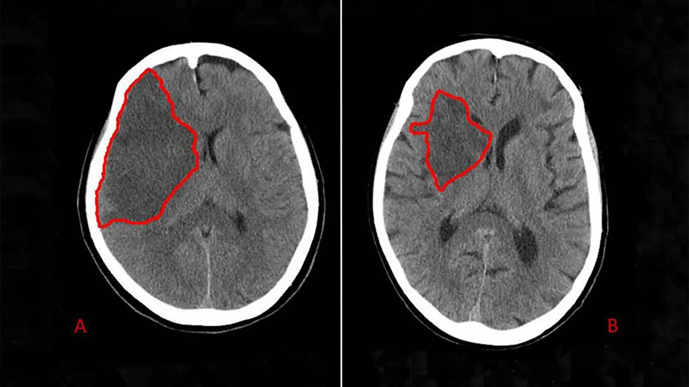
INTRODUCTION
What is a stroke?
A stroke is a cerebrovascular incident that occurs when the blood supply to part of the brain is interrupted or reduced, preventing brain tissue from getting enough oxygen and nutrients causing brain cells to die within minutes.

Slide 4
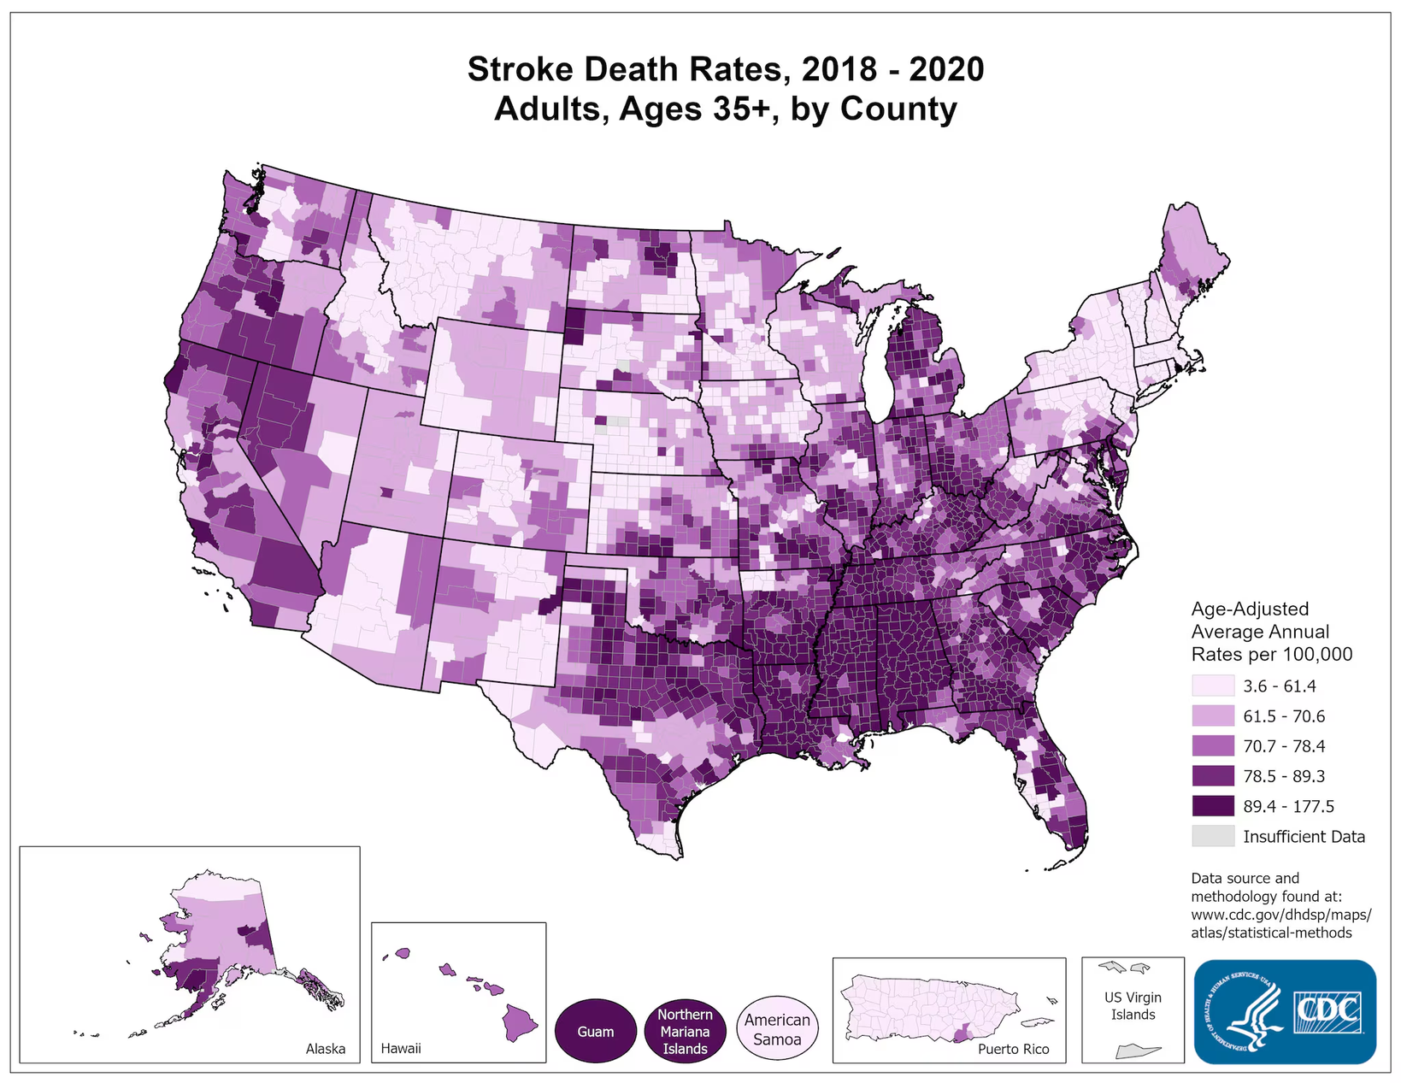
According to the World Health Organization, strokes are the second leading cause of death globally, just behind ischemic heart disease. Strokes account for approximately 11% of all deaths worldwide, underscoring the critical importance of awareness, prevention, and timely treatment of this medical condition. They not only contribute significantly to mortality rates but also lead to severe disability

Slide 5
Treatment
A stroke requires immediate emergency care, usually in a hospital's specialized stroke unit. Treatment varies based on factors such as the type of stroke (ischemic or hemorrhagic), the time elapsed since symptom onset, and any underlying medical conditions.

Slide 6
To treat an ischemic stroke, restoring blood flow quickly is vital. This can be done through:
Emergency IV Medicine: Administering tPA (e.g., alteplase or tenecteplase) within 4.5 hours of symptom onset, ideally within the first three hours.
Emergency Endovascular Procedures:
- Intra-arterial tPA: Directly delivering tPA to the brain via a catheter.
- Mechanical Thrombectomy: Using a stent retriever to remove large clots.
Newer imaging technologies (CT/MRI perfusion) help identify patients who can benefit from these treatments beyond standard time limits.

Slide 7
Emergency treatment for hemorrhagic stroke focuses on controlling bleeding and reducing brain pressure. Key measures include:
Emergency Measures: Counteracting blood thinners, lowering brain pressure, reducing blood pressure, preventing blood vessel spasms, and controlling seizures.
Surgery:
- Surgical Clipping: Clamping an aneurysm to prevent bursting or re-bleeding.
- Coiling: Inserting coils to block blood flow in an aneurysm.
- AVM Removal: Surgically removing arteriovenous malformations.
- Stereotactic Radiosurgery: Using focused radiation to repair blood vessel malformations.

Slide 8

PROBLEM STATEMENT
Our goal is to determine if the patient is at risk of having a stroke using the CT/MRI scan of a patient’s brain. This information is crucial because it allows for early intervention, which can significantly improve outcomes. Early detection can lead to prompt treatment, potentially preventing the stroke or minimizing its severity, thereby reducing the risk of long-term disability and improving the patient's quality of life.

Slide 9
OUR SOLUTION
Our solution involves training an AI model using Convolutional Neural Networks (CNN) to predict the risk of brain stroke in patients from their CT/MRI scans.
CNNs are particularly effective in image analysis due to their ability to automatically learn and detect patterns and features within visual data.
By leveraging a large dataset of brain scans, our model will be trained to recognize the subtle indicators of stroke risk.
This approach aims to provide accurate and early predictions, enabling timely medical interventions that can prevent strokes or minimize their severity, ultimately reducing healthcare costs and improving long-term health outcomes for patients.

Slide 10
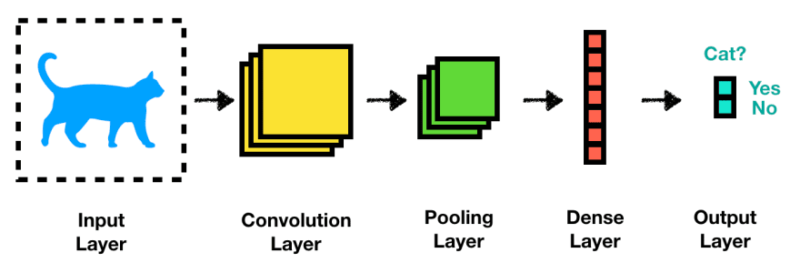
METHODS
These layers are followed by activation functions that reduce the spatial dimensions of the data. Fully connected layers at the end integrate features to make predictions, enabling CNNs to excel in tasks like image classification, object detection, and facial recognition. CNNs have greatly advanced the performance of visual data analysis.
A Convolutional Neural Network (CNN) is a type of neural network designed for processing image and grid-like data. It uses convolutional layers to apply filters to input data, capturing local patterns such as edges and textures.
visual - https://towardsdatascience.com/convolutional-neural-network-a-step-by-step-guide-a8b4c88d6943

Slide 11
OPTIMIZERS
An optimizer is an algorithm or method used to adjust the weights and biases of a model to minimize the loss function.
The loss function measures the difference between the predicted outputs of the model and the actual target values. By minimizing this difference, the optimizer helps the model learn from the data and improve its performance.
Optimizers play a crucial role in the training process of neural networks and other machine learning models. They determine how the model's parameters are updated based on the gradients computed during backpropagation.

Slide 12
Training Accuracy:
The proportion of correctly predicted instances out of the total instances in the training dataset.
Indicates how well the model is learning the patterns in the training data.
High training accuracy generally suggests that the model is fitting the training data well, but it does not guarantee good performance on unseen data.
Validation Accuracy:
The proportion of correctly predicted instances out of the total instances in the validation dataset.
Measures how well the model generalizes to new, unseen data during the training process.
Consistently high validation accuracy indicates good generalization, while a significant gap between training and validation accuracy may suggest overfitting.

Slide 13
Loss:
A measure of how well the model's predictions match the actual target values in the training dataset. It's a numerical value that the optimizer tries to minimize.
Provides a way to monitor the model’s performance and guide the optimization process.
Lower training loss indicates that the model is better at fitting the training data. Common loss functions include mean squared error (MSE) for regression and cross-entropy for classification.
Validation Loss:
A measure of how well the model's predictions match the actual target values in the validation dataset.
Evaluates the model's performance on new, unseen data during training.
Lower validation loss suggests better generalization. If validation loss is significantly higher than training loss, it may indicate overfitting.

Slide 14
RESULTS
Optimizer | Accuracy | Loss | Validation Accuracy | Validation Loss
Nadam | 0.5832 | 0.6794 | 0.7025 | 0.6330
Adadelta | 0.7939 | 0.4887 | 0.7643 | 0.5399
Ftrl | 0.5901 | 0.6867 | 0.7025 | 0.6774
Adamax | 0.9941 | 0.0185 | 0.9497 | 0.1279
Adagrad | 0.8811 | 0.2819 | 0.8009 | 0.4007
Adam | 0.5843 | 0.6792 | 0.7025 | 0.6370
Rmsprop | 0.5921 | 0.6769 | 0.7025 | 0.6320
SGB | 0.7953 | 0.4422 | 0.7391 | 0.6931

Slide 15
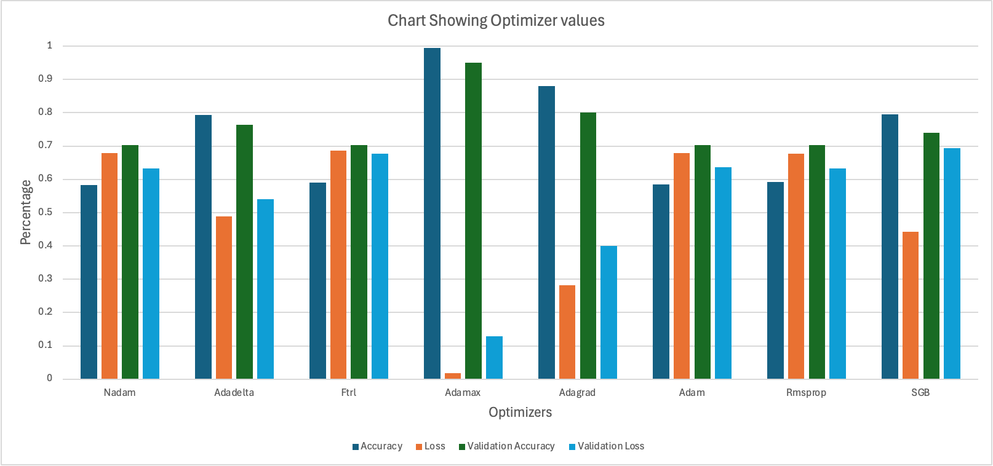
RESULTS

Slide 16
CONCLUSION
During the summer research internship, I developed a model to detect intracranial hemorrhage with a focus on both accuracy and efficiency.
Key Activities:
Tested various neural network optimizers.
Applied the optimal model to the Brain Stroke dataset.
Achieved high accuracy in identifying a stroke.
Model Details:
Utilized the VGG16 architecture paired with the AdamX optimizer.
Results included a loss of 0.0185, a training accuracy of 99%, and a validation accuracy of 95%.
Future Work:
Further optimization with alternative architectures.
Integration of data augmentation techniques to enhance model generalization and efficiency.
Code Repository:
https://github.com/IanAAdams/Summer-internship-2024/blob/main/brain%20stroke%20prediciton

Slide 17
ACKNOWLEDGMENT
I would like to express my deepest gratitude to all those who made this project possible. Claflin University generously supported this research, and I am profoundly thankful to the Department of Computer, School of Natural Sciences and Mathematics for their collaboration and unwavering support.
I extend my heartfelt thanks to my mentor, Dr. Shrikant Pawar, for his expert guidance and invaluable insights throughout the research process. I also deeply appreciate Miss Shuler's continuous support and assistance throughout the program.
I would like to thank my fellow research interns, Bimal Itani, Amrinder Singh, and Jy’Nese Spivey, for their dedicated assistance. Additionally, I am grateful to all individuals who contributed to this research with their expertise and support.

Slide 18
REFERENCES
https://www.kaggle.com/datasets/iashiqul/brain-stroke-prediction-ct-scan-image-dataset
https://towardsdatascience.com/convolutional-neural-network-a-step-by-step-guide-a8b4c88d6943
https://keras.io/api/optimizers/

