Slide 1
OOP Snake
Part 3 – More Collisions and Death!

Slide 2
Game OOP Structure
World Component
Knows where everything is in the game and what is happening
Objects
Snake
Food
In this tutorial we will be looking to develop the world model to handle collisions involving the snake with walls and the snake with itself

Slide 3
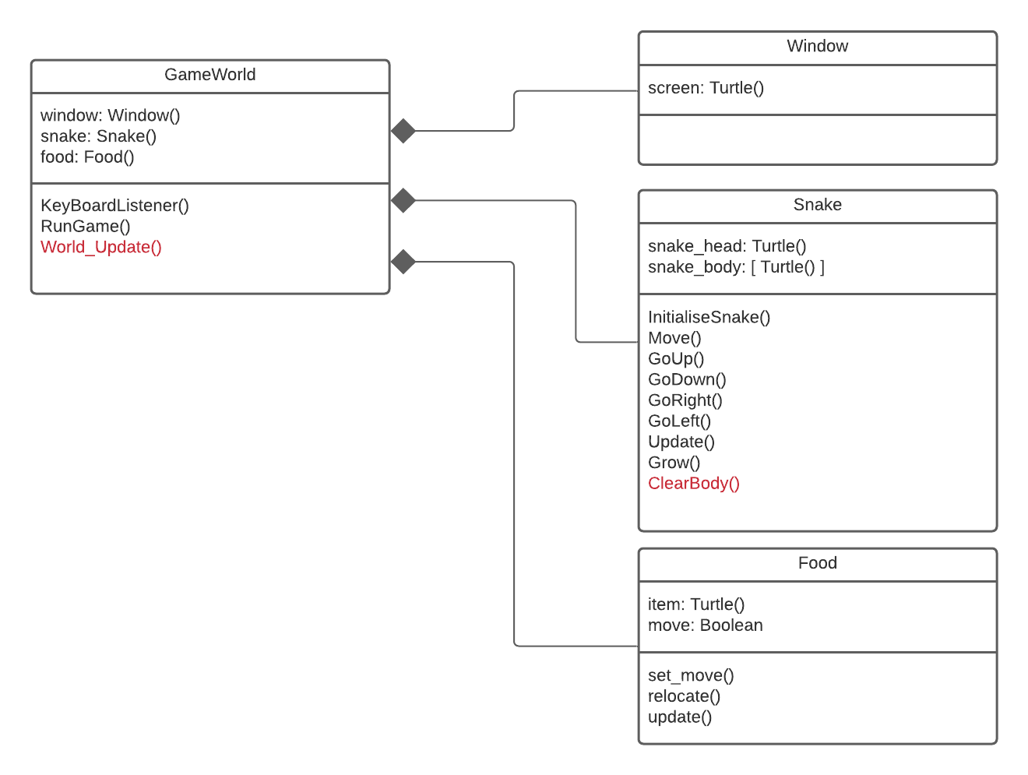
Game OOP Structure
We will be developing the World_Update() method of our GameWorld class and adding a new method to ClearBody() to our snake class to delete the snake body when the snake dies

Slide 4
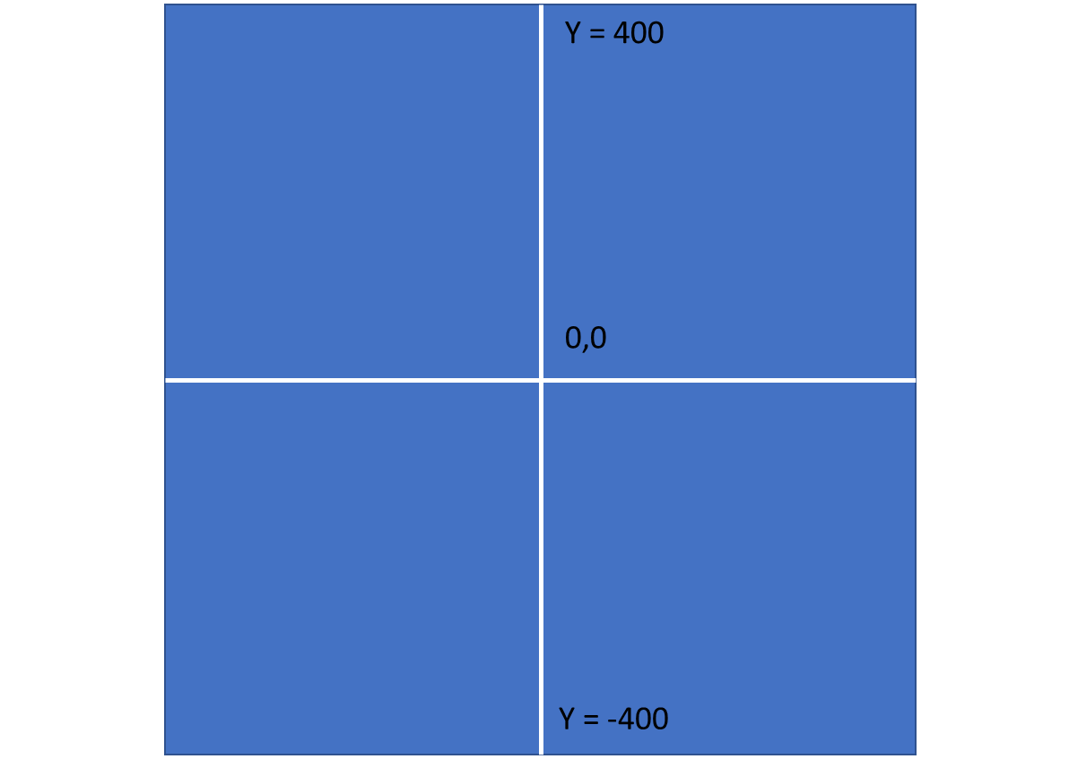
Walls
If you remember from the first tutorial we created a screen that was 800 by 800 pixels.
The origin of the screen (unlike in many other game development software and APIs) is located at the center

Slide 5
Walls
To calculate collisions with TOP, RIGHT, BOTTOM and LEFT walls we want to be able to quickly and easily reference these values.
We also want to allow them to alter if the user changes to screen size.
To do this we will set these values as CONSTANTS.

Slide 6
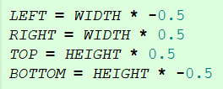
Walls
To find the correct values we simply * by 0.5
Since LEFT and BOTTOM on on the negative axis we simply multiply by – 0.5

Slide 7
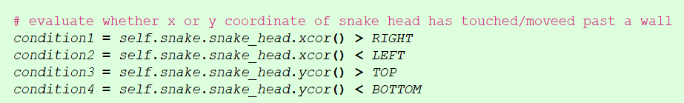
Collision Detection with walls
In our World_Update() method we need to workout whether the snake_head has collided with wall.
We can use the turtle.xcor() and turtle.ycor() methods to get the current x and y co-ordinates of the snake head to compare with the wall.
Each of the conditions will evaluate to a Boolean value TRUE or FALSE

Slide 8
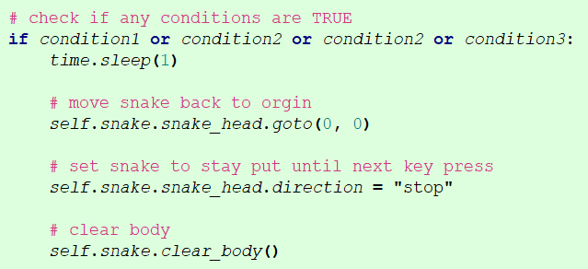
Collision Detection with walls
We then need to use an IF to check whether any of the conditions are TRUE
If they are we sent the snake back to (0, 0) and alter the direction attribute to be “stop” meaning that the snake_head will not move until next key press.
Finally we call a new method .clear_body() of the snake class
There is a slight issue with the food be generated at the origin at the start of the game. You might want to alter this location

Slide 9
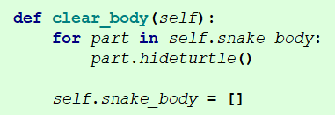
Clearing the Snake Body
The clear body method will loop through each body part of the snake and use the turtle.hideturtle() method.
This will hide the drawings of the snake body (turtle objects) that are on screen. If we don’t do this the carcass of our snake will still be on the screen when the game restarts.
We can then reset the array to be an empty array

Slide 10
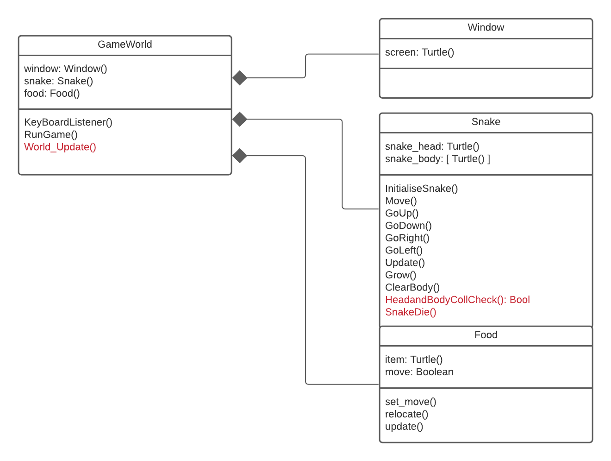
Game OOP Structure
We will be developing the World_Update() method of our GameWorld class and adding a new method to HeadandBodyCollCheck()to our snake class to detect whether the snake head has collided with a body part.
We are also adding the method SnakeDie() to tidy up some of our code to it can be reused.
Notice the return value of this new method

Slide 11
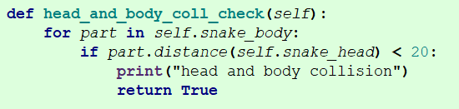
Head and Body Collisions
As we have done before we using the turtle.distance() method to check whether the snake_head (turtle object instance) is in touching distance of each boday part (also instances of a turtle object) using a loop.
If any of the checks are TRUE, we return TRUE to where the method was called

Slide 12
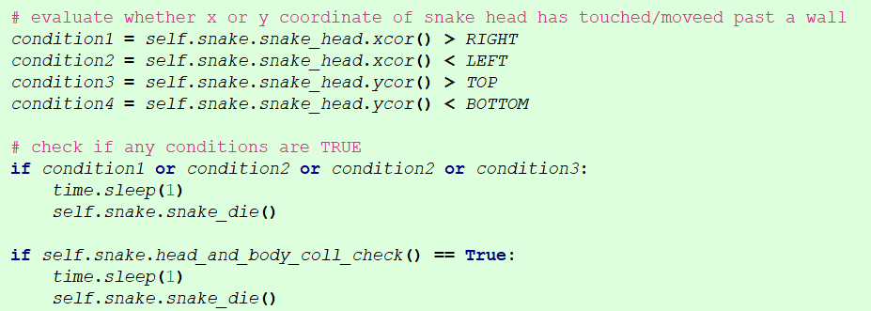
Head and Body Collisions
From within our world_update method we call our new method to check for a collision between the head and body. If TRUE is returned we now call a method named snake_die()
We are also using the same snake_die() method for when a collision occurs with a wall

Slide 13
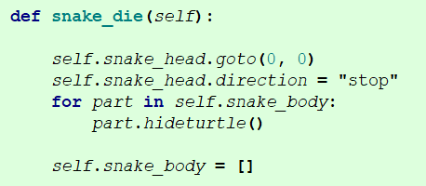
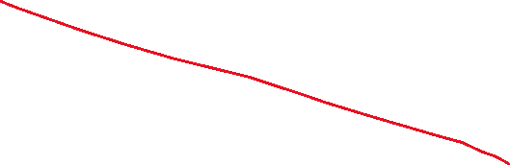

Snake Die()
The snake_die() method simply resets the snake to the origin and sets its direction flag to “stop”. This code was originally in the word_update() method.
It also contains the body code we had earlier in the method clear_body()
This makes the clear_body() method redundant and we can remove it.

Slide 14
Problems
Compare code you have written back to the snippets shown
If you are unsure about where the code should go in terms of files or class, have a look back at the class diagrams.

