Slide 1

SMART INDIA HACKATHON 2026
TITLE PAGE
Problem Statement ID - SIH26034
Problem Statement Title -Software System to check compliance of Packaged Commodities under Legal Metrology(Packaged Commodities) Rules, 2011 by scanning products, images and labels
Theme - Miscellaneous
PS Category - Software
Team ID - NA
Team Name - TEAM MEGATRON

Slide 2














AI-Powered Legal Metrology & Packaged Commodity Compliance System
TEAM
MEGATRON
Transforming Legal Metrology Compliance through Multi model AI Inspection
Proposed Solution :-
Uniqueness :-
The proposed solution uses advanced computer vision and machine learning models to inspect packaged commodities based on visual data, influencing factors such as text, regulatory logos, barcodes and cross modal tamper detection.
A user friendly website allows officers to easily capture product images and view compliance result, it features an offline first approach, ensuring seamless data storage in remote areas and automatic synchronization when internet connectivity returns
The solution combines data driven AI model for accurate legal compliance checks and has a user friendly and scalable web interface for efficient field to desk operations.
1) Computer Vision Based text extraction and Measurement :-
Using ORC and ArUco reference tag to extract and measure font size in real word millimeters not just pixels
2) Deterministic Legal Rule Engine :-
Use Programed blocked rule engine for fixed explainable legal decisions no LLM hallucinations in penalties or compliance result
3) Offline First and Tamper Proof Inspection :-
Captures data off-line without internet, lock images using SHA-256 hashing and automatically syncs data when connectivity returns
OCR
1. Capture
2.Preprocses
3. Multilingual OCR
4. Barcode / QR
5. Regulatory
Logo Detection
6. LLM / NLP
Images / Data
Enhance & Detect
Text Extraction
Decode
Structured
Extraction
Cross-Modal Verification
Rule Engine
Compliance Result
Inspector Review
Infrastructure
and
Development
OCR
Compare OCR Data with
Barcode / Reference
ConfigurableLegal Rules
Evaluation
Pass / Fail / Review
with Confidence Score
Verify Evidence
& Confirm
This system is deployed on NIC’s indigenous cloud servers MegRaj to protect data and ensure secure handling of governments data.
Evidence Storage
Auto Challan / Notice
Notifications
Geospatial Dashboard
Audit & Logs
Images,, Results
(MinIO / AWS S3)
Generate Draft
/ Notice (PDF)
SMS / Email
Alerts
Maps, Heatmaps,
Analytics
All Actions, Versions,
Audit Trail
2

Slide 3



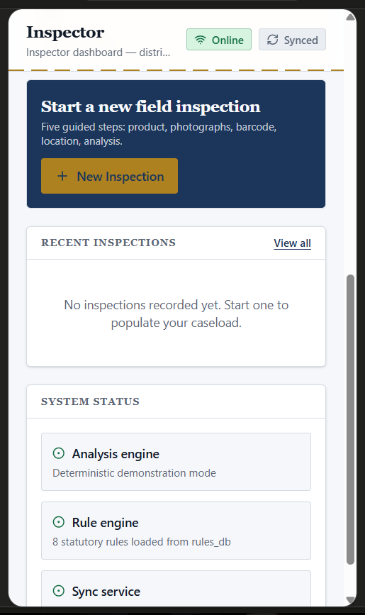




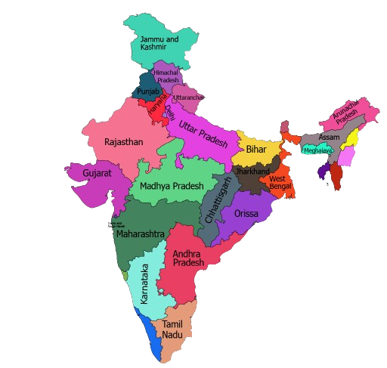

















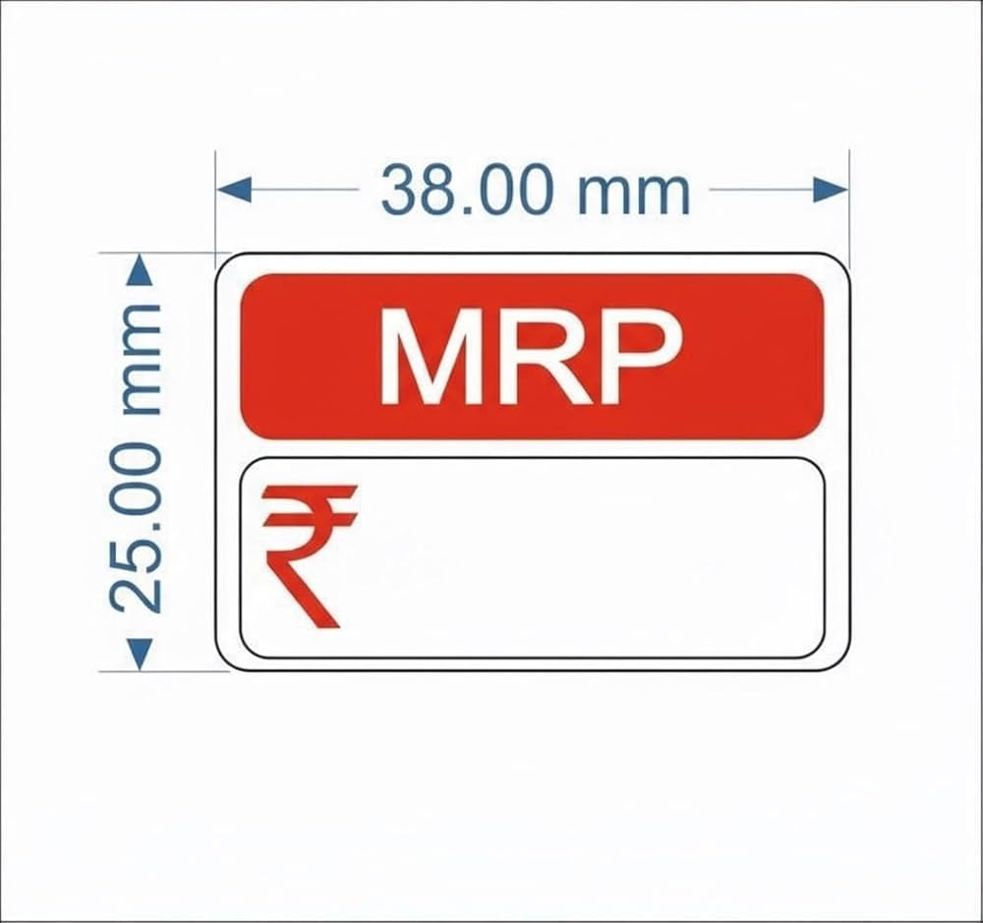
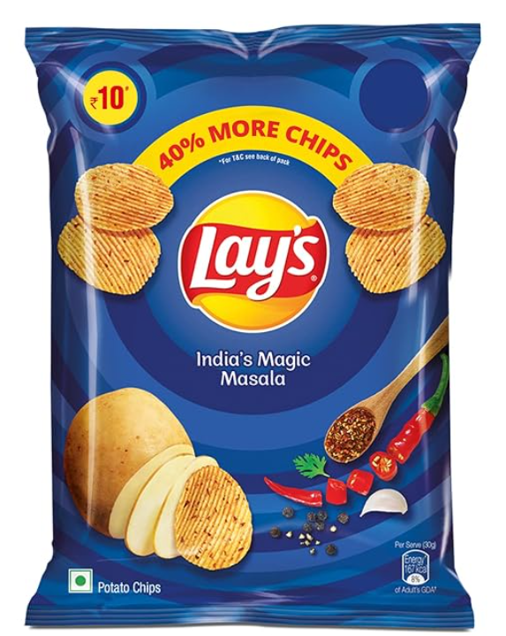
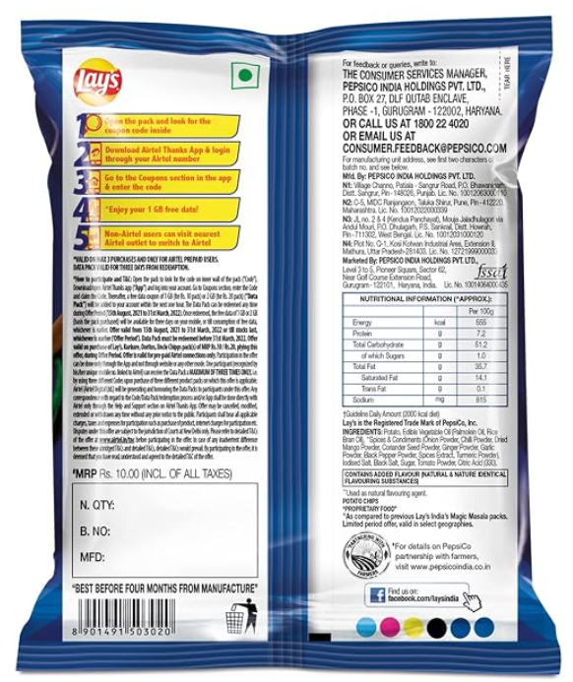




TECHNICAL APPROACH
TEAM
MEGATRON
Rule 19 & Rule 21 : Premises Context
Inspections must be tied to a physical location (Factory under Rule 19, or Retail Shop under Rule 21)
Location Data
Latitude, Longitude
Rule 11, 12 & 13 : Standard Units & Phrasing
Inspector After Submition
5.OUTPUT
PostgreSQL
2.FRONTEND
INSPECTOR LOGIN
INSPECTOR Verificitation Result
Quantity must be in metric units (g, kg, ml, L). Vague terms like "approx" or "minimum" are strictly banned.
Rule 6(1)(a to f) : Mandatory Declarations
1. Related Details
2. Capture Images
3. Submit
Verification
Report Generate
Rule Evaluation
Violations Detected
Evidence
Inspector & Administrator
Approval
Store structured information
Label must show Manufacturer Name/Address, Generic Name, Net Qty, Date, MRP (incl. of all taxes), and Consumer Care details.
React/Next.js
Website behaves like mobile app
Products Inspection
Store Inspection Location Coordinates
Pass:certificate Generate
Inspection map
Overall Data
interconnected
3.BACKEND
Hfont,mm=Hchar,px/PMM
Fail:Legal notice generated along with Chalan
$H_{font,mm}≥H_{statutory,min}=$ PASS
$H_{font,mm}<H_{statutory,min}=$FAIL
leaflet
ADMINISTRATION LOGIN
4.EXTERNAL API SERVICES
API
GATEWAY
Node.js/Express.js
1. HEAT Map
2. Approval System
3. Show KPI’S
Capture Image
Google Map Apl
1. DATA CAPTURE LAYER
License
Verification API
GST
Verification
API
Address /
Location
API
Physical Font Height Calculation
Detect marks/symbols
Product Reference
Data API
Rule 7 (Table-I & II) N : Numeral & Font Height
PMM=Wmarker_px/Wmarker_mm
Redis
Open Source LLM
Capture
GPS + Location Shop Metadata
Regional
Language UI
Metadata
offline Data
Row text convert json
1.Front Image
2.Back Image
3.Close-up
Barcode /QR Scanner
extra details
Store locally
MongoDB
Redis
A dealer cannot alter, smudge, or paste a new sticker over the printed MRP, nor sell above it.
Data Store JSON Format
status
PaddleOCR
OCR Text Extraction
Rule 22:package's net weight falls
frontend
Text must "contrast conspicuously" with the background. The area around the Net Qty must be clear of graphics.
live
Allowed Deficit
=Declared Quantity×(MPE%/100)
Rule 18(2) & 18(5) : Retail Overpricing & Tampering
Pyzbar
Redis
QR code read/detect
Minimum Legal Weight
=Declared Quantity−Allowed Deficit
Websocket
$$C_{W}=\frac{(I_{text}−I_{bg})}{I_{bg}}$$
Ensures text stands out clearly against the package background
Rule 8 & 9 : Legibility & Contrast

Slide 4











FEASIBILITY AND VIABILITY
TEAM
MEGATRON
FEASIBLITY
CHALLENGES
Technical Feasibility
Built using modern open source technologies (Next.js,FastAPI,YOLOv8,
PaddleOCTR,supabase) offline first PWA with seamless sync
AI Hallucination & False Positives
High Server Load / Traffic Spikes
TECHNICAL MITIGATION
Deterministic Rule Engine BRMS
TECHNICAL MITIGATION
Operational Feasibility
Simple workflow for inspectors with mobile app and dashboard, Automated AI and Rule Based validation reduces manual efforts and errors
Separation of AI extraction from hard coded Python legal rules ensures 100% compliant, predictable outcomes.
Redis In Memory Buffering
Leverages Fast API HTTP 202 async task dispatch to securely decouple request intake from intensive processing.
Poor Field Connectivity
Economic Feasibility
Open-source AI tools and cloud ready infrastructure reduce development Offloading heavy image streams to Redis task queues prevents the server from blocking and reduces cloud hosting costs.
Integrating into Existing
Infrastructure &Ensuring
Adoption
TECHNICAL MITIGATION
Offline-First PWA Queue
Utilizes Indexed DB storage with secure client UUIDs and robust auto-sync upon connection restoration.
TECHNICAL MITIGATION
1. Language Barriers
Regulatory Feasibility
Support Legal Metrology Rules, 2011 Act ,FSSAI ,GST and packaging rules
Multi-lingual support (Hindi + Regional
languages via Bhashini), • Local
UI for inspectors
Extract Physical Measurements from image
TECHNICAL MITIGATION
Using reference ArUco Marker
2. System Compatibility
Scalability & Future Readiness
Modular design allows addition of new APIs and models. Can scale from SIH MVP to enterprise use
Optical Metrology (PMM Calibration): OpenCV detects a 20mm ArUco Reference Marker. Calculates Pixels per mm (PMM). Divides text pixel height by PMM to check physical compliance in millimeters
PMM=Wmarker_mm​/Wmarker_px​
Works with existing devices and network conditions Cross platform support (Android/iOS/Web)
OVERALL VIABILITY
Technically sound | Operationally practical | Economically efficient | Legally aligned | Ready to scale
@SIH Idea submission- TEAM MEGATRON
4

Slide 5













IMPACT AND BENEFITS
TEAM
MEGATRON
IMPACT ON TARGET AUDIENCE
Inspectors & Field
Officers
Consumers
Businesses &
Manufacturers
Government
& Regulators
Our solution empowers all key stakeholders in the packaged commodity ecosystem.
Faster & accurate inspections
Safer and genuine products
Fair competition
Efficient compliance monitoring
Offline access in remote areas
Protection from fraud
Reduced counterfeit risk
Data-driven decision making
Easy evidence & report generation
Greater trust and transparency
Better brand reputation
Stronger enforcement
BENEFITS OF THE SOLUTION
SOCIAL BENEFITS
ENVIRONMENTAL BENEFITS
OPERATIONAL BENEFITS
ECONOMIC BENEFITS
Safer Communities, Healthier Lives
Fair Market, Stronger Economy
Sustainable Choices, Greener Future
Smarter Systems, Higher Efficiency
Reduces counterfeit and substandard products in the market
Prevents revenue loss due to tax evasion and under-declaration
Promotes responsible packaging and labeling
Automates manual and repetitive tasks
Supports honest manufacturers and small businesses
Reduces waste from fake/expired products
Saves time with AI-powered analysis
Protects consumer health and safety
Builds trust in packaged commodities
Reduces cost of compliance through digital automation
Supports sustainable and eco-friendly supply chains
Enables offline-first field operations
Boosts investor confidence and trade
✓
Promotes transparency and accountability
✓
More compliance. More growth.
Less waste. A cleaner tomorrow.
Do more. In less time.
Healthy people. Stronger communities.
Empowering inspectors, protecting consumers,
strengthening businesses and building a safer, fairer
and more sustainable India.
Better Compliance
Today for a
Stronger India Tomorrow
THE BIG PICTURE

Slide 6
RESEARCH AND REFERENCES
TEAM
MEGATRON
LM
Legal Metrology & Compliance (India)
OCR
Multilingual OCR for Indian Languages
• Legal Metrology (Packaged Commodities) Rules, 2011
• PaddleOCR-VL: Multilingual OCR with 109 Languages
https://simpliance.in/India/EHS/govt_notification/Central/frequently-asked-questions-relating-to-legal-metrology-packaged-commodities-rules-2011-and-model-approval-requirements-9571
https://arxiv.org/html/2510.14528v1
• 2026 Amendment Rules – AEO & Corporate Accountability
• PaddleOCR PP-OCRv5 Multilingual Models
https://www.indialaw.in/blog/environment/legal-metrology-packaged-commodities-amendment-rules/
https://github.com/PaddlePaddle/PaddleOCR/blob/main/docs/version3.x/algorithm/PP-OCRv5/PP-OCRv5_multi_languages.en.md
CV
Computer Vision for Regulatory Marks & Food Safety
YOLO
Computer Vision – Regulatory Mark Detection
• 5-Class Food Certification Dataset
• YOLO: Unified, Real-Time Object Detection – Original Paper (arXiv)
https://universe.roboflow.com/labelblind/5-class-g6oha
https://arxiv.org/abs/1506.02640
• AI in Food Safety Governance – Review Article
• Ultralytics YOLOv8 – Official Documentation
https://iledu.in/v6i997/
https://docs.ultralytics.com
AI
Structured Extraction (LLM/NLP) & Barcode Decoding
DATA
Food Packaging & Label Datasets
• Llama 2: Open Foundation and Fine-Tuned Chat Models (arXiv)
• General Food Packaging Recognition
https://arxiv.org/abs/2307.09288
https://universe.roboflow.com/computer-vision-workspace/food-packaging-recognition
• Package & Label Detection
• pyzbar – Barcode/QR Decoding Library Docs (PyPI)
https://universe.roboflow.com/packageandbarcode/package-and-label-detection-agjvl
https://pypi.org/project/pyzbar/
• Food Packaging Info (Text & Regions)
https://universe.roboflow.com/kjobinulaval/food-packaging-info
Measuring
Measuring Size of an Object using Computer Vision
• International Journal of Innovative Technology and Exploring Engineering (IJITEE) ISSN: 2278-3075, Volume-8, Issue-6S4, April 2019
@SIH Idea submission- TEAM MEGATRON
6

Slide 7


RESEARCH AND REFERENCES
TEAM
MEGATRON
LM
Legal Metrology & Compliance (India)
Live Demo
https://vyapar-nirikshan-portal.onrender.com
Click
GitHub Repo
• Legal Metrology (Packaged Commodities) Rules, 2011
https://github.com/Tushar-Ganmukhe/SIH-26.git
• 2026 Amendment Rules – AEO & Corporate Accountability
Click
COMPARISON TABLE WITH EXISTING SYSTEMS :-
Sr | Feature | Our System | Existing System (wooqer)
1 | Legal Metrology Enforcement | ✔ | ✘
2 | Automated Label Measurement | ✔ | ✘
3 | Deterministic Rule Engine | ✔ | ✘
4 | Government Verification | ✔ | ✘
5 | Workflow / Corrective Action | ✔ | ✔
6 | Inspection Records | ✔ | ✔
CV
Computer Vision for Regulatory Marks & Food Safety
• 5-Class Food Certification Dataset
Click
• AI in Food Safety Governance – Review Article
Click
• YOLO: Unified, Real-Time Object Detection – Original Paper (arXiv)
Click
Click
• Ultralytics YOLOv8 – Official Documentation
AI
Structured Extraction (LLM/NLP) & Multilingual OCR for Indian Languages
DATA
Food Packaging & Label Datasets
• Llama 2: Open Foundation and Fine-Tuned Chat Models (arXiv)
Click
• pyzbar – Barcode/QR Decoding Library Docs (PyPI)
Click
• General Food Packaging Recognition
Click
• PaddleOCR-VL: Multilingual OCR with 109 Languages
Click
• Package & Label Detection
Click
• PaddleOCR PP-OCRv5 Multilingual Models
Click
• Food Packaging Info (Text & Regions)
Click
Measuring
Measuring Size of an Object using Computer Vision
• International Journal of Innovative Technology and Exploring Engineering (IJITEE) ISSN: 2278-3075, Volume-8, Issue-6S4, April 2019
@SIH Idea submission- TEAM MEGATRON
7

